Slide 1
EOM 190.02
Interactive Lecture
By:
Maintain Personal Equipment & Hygiene in the Field
30 min
Level 1 IG

Slide 2
Table of contents
01
02
03
Explain how to care for personal equipment
Explain knife safety in the field.
Explain how to maintain hygiene in the field

Slide 3
01
Explain how to care for personal equipment

Slide 4
CARE FOR PERSONAL EQUIPMENT
Socks should be changed frequently (at least once a day)
- Wet and dirty socks = blisters
How to wash socks in Field
- Wash in warm water
- Rinse out all the soap
- Ring out water and stretch back into shape
- Set out to dry immediately
All articles of clothing must be kept as clean as possible
- Dirt in clothing can damage skin (infection)
- Dirt may damage clothing insulation value, which is why undergarments should be changed daily.
Boots should be properly maintained by keeping them dry and soft.
Boots should never be placed too close to the fire.

Slide 5
TP1 Confirmation Questions
A1. Dirt can get through some clothing and damage the skin. It may also decrease insulation value of the clothing.
A2. Carefully rinse out all of the soap, squeeze out the water, stretch the socks back into shape, and dry them appropriately.
A3. By keeping them dry and soft and not to place them close to the fire
Q1. Why must undergarments be changed daily?
Q2. What are the steps to take when laundering socks?
Q3. How are boots maintained?

Slide 6
02
Explain knife safety in the field.

Slide 7
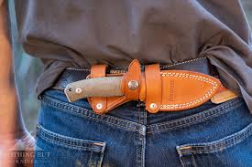
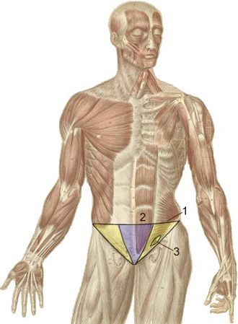
CARE OF KNIVES IN THE FIELD
A knife should:
- Be kept sharp
- Carried in a suitable sheath
- Remain in sheath when not in use
- Position knife near back of the hip when carrying in order to prevent it from being driven into the groin during a fall
- Never point/angle knife at anybody or yourself
- Always make sure knives are put away safely
- When passing blade = Pointed up

Slide 8
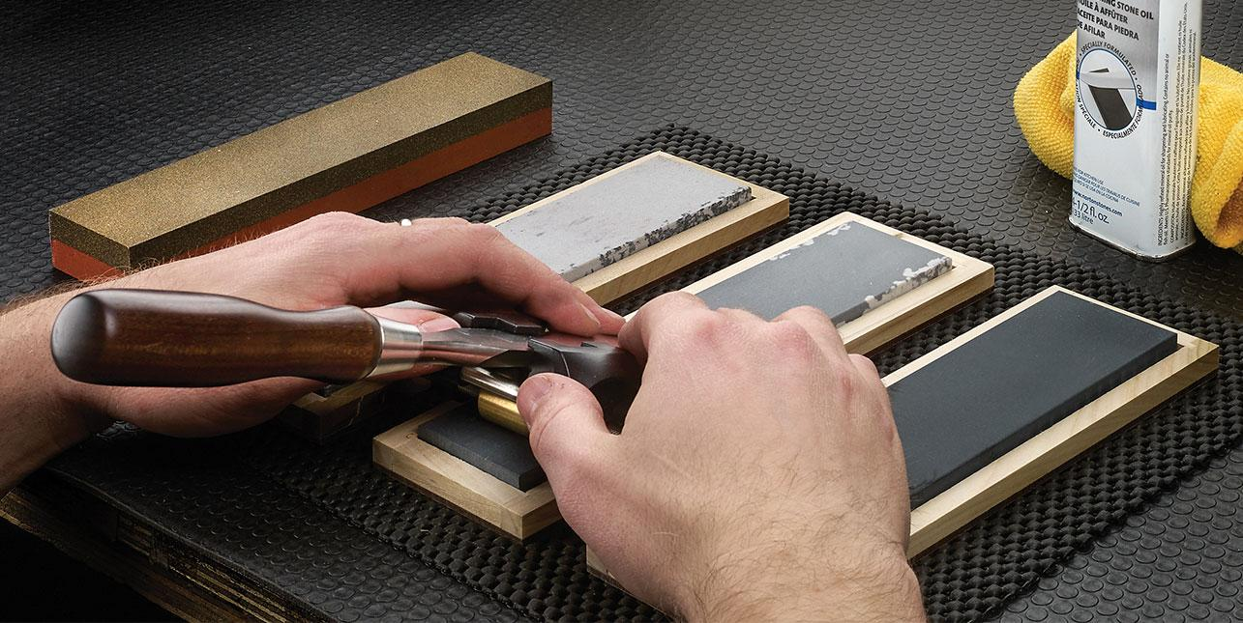
SHARPENING
- Sharpen knife only when dull
- Use quality sharpening stone
- Apply the right type of lubricant
- Only wood ash should be used to remove stains, as it does not scratch the blade.
- When sharpening, make sure to put the blade on the stone and pull it in circular motion, this should be done equal number of times on each side.

Slide 9
TP2 Conformation
A1. A knife should be kept sharp and carried in a suitable sheath.
A2. This positioning prevents the knife from being driven into the groin during a fall.
A3. Up.
Q1. How should a knife be stored and kept?
Q2. Why is the sheath positioned towards the back of the hip when carrying?
Q3. When passing the knife, which way should the blade be facing?

Slide 10
03
Explain how to maintain hygiene in the field.

Slide 11
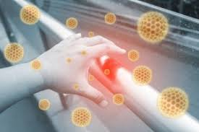
Explain how to maintain hygiene in the field.
- Important to manage waste effectively
- Wet and dry garbage shall be separated
- Grey water = Dish water, water used to clean teeth, clothes, and body
- Grey water should be disposed away from site
- Solid garbage shall be packed out
- Be responsible of all your garbage
- Use soap and water while in field
- Face, armpits, and feet should be washed and dried at least once a day if shower is not available
- Keep hands as clean as possible
- Daily hygiene prevents spread of germs

Slide 12
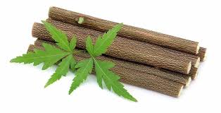
Dental Hygiene
Brush teeth after every meal and before bed
- Table salt or baking soda = toothpaste
- If not possible, chew a green twig until it reaches a paste like texture
- Rinse mouth after every meal

Slide 13
TP3 Conformation
Q1: If a shower is not available, what parts of the body should one ensure to clean?
Q2: What can be used as a substitute for toothpaste?
Q3: What is grey water?
A1: Hands, face, armpits, crotch and feet
A2: Table salt or baking soda
A3: Water that has been used to clean clothes, dishes, teeth, body, etc.

Slide 14
End Of Lesson Conformation
A1. Place the blade on the stone and pull it in a circular motion and repeat this action many times.
Ensure that this motion is completed an equal number of times on both sides.
A2. In another person’s direction or at yourself.
A3. Water that has been used to clean clothes, dishes, teeth, bodies etc.
Q1. What is the proper action to take when sharpening a knife?
Q2. Where should the knife blade not be pointed?
Q3. What is grey water?

Slide 15
CONCLUSION

