Slide 1

EOC240.03 IDENTIFY PARTS OF A ROCKET
By:

Slide 2
REMINDER CADET SUMMER TRAINING OPPORTUNITIES
Aviation Technology and Aerospace
Intro to Drill and Ceremonial
Intro to Fitness and Sports
Intro to Marksmanship
Intro to Military Band
Intro to Pipe Band
Intro to Survival
Each about 1-2 weeks

Slide 3

Teaching Points
TP1 Explain the Parts of a Rocket
TP2 Name the Parts of a Rocket
Notes:
It is important for cadets to know the parts of a rocket so that they can understand how they are constructed. Identifying the parts of a rocket may develop an interest in the components that make up a rocket, which may lead to future aerospace opportunities in the Air Cadet Program.

Slide 4
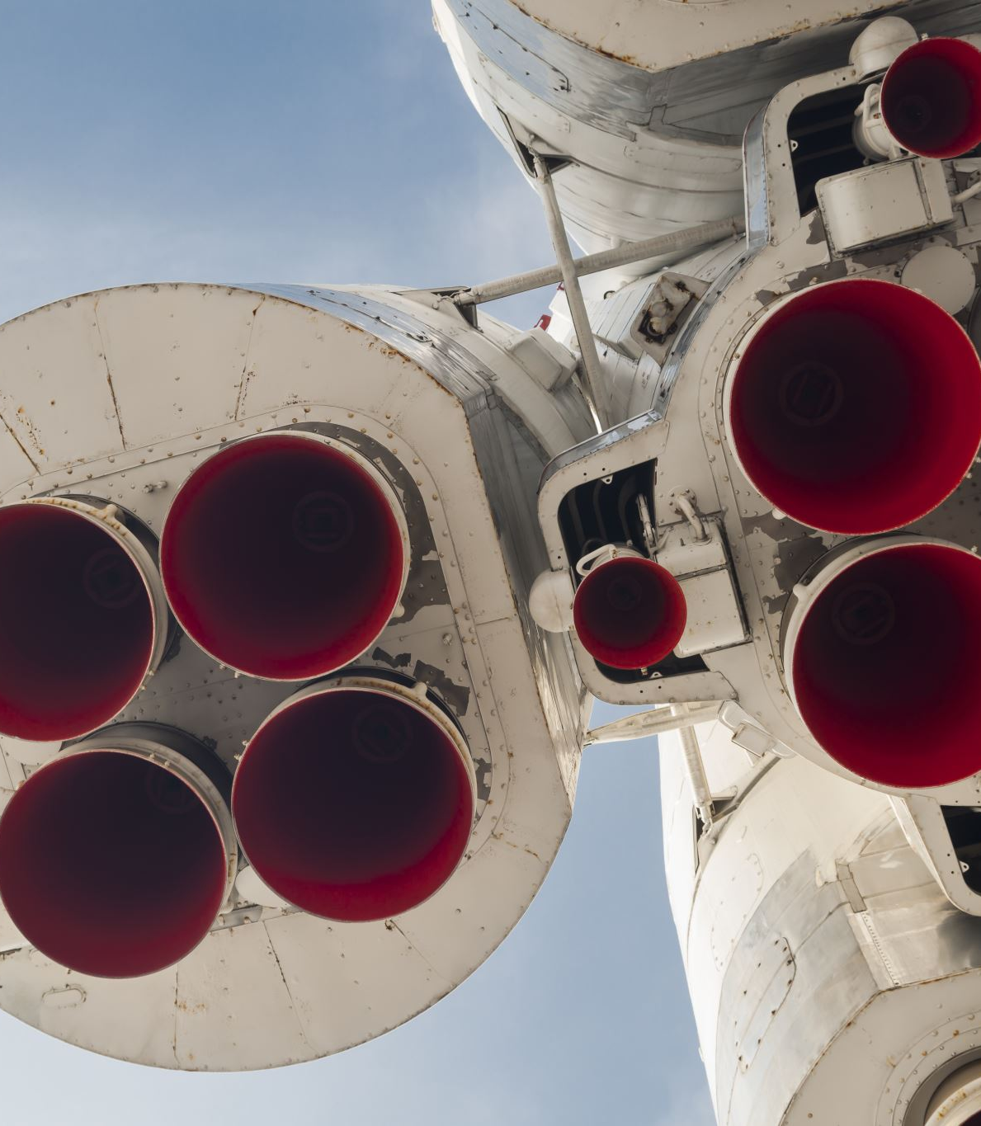
TP1 Explain the Parts of a Rocket
In flight, a rocket is subjected to the forces of weight, thrust, and aerodynamics
There are many parts that make up a rocket.
For design and analysis, engineers group parts that have the same function into systems

Slide 5
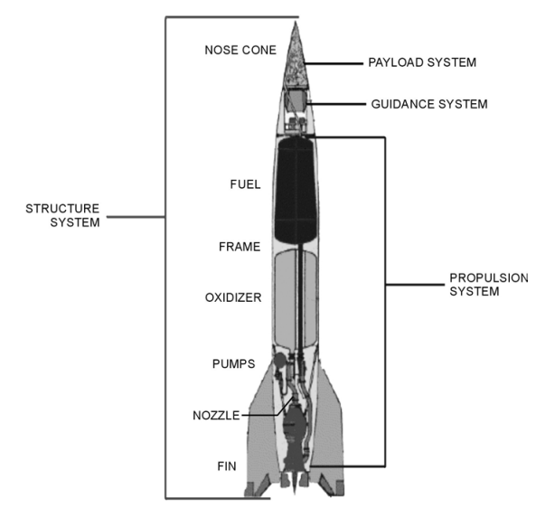
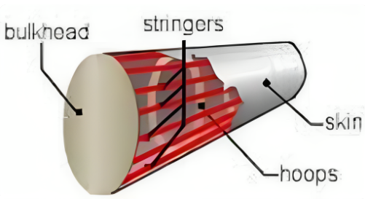
Structural System
Also known as the frame, it is similar to the fuselage of an airplane
Made from very strong but light-weight materials, like titanium or aluminum
The frame employs long “stringers” that run from the top to the bottom, which are connected to “hoops” that run around the circumference
The “skin” is then attached to the stringers and hoops to form the basic shape of the rocket
The skin may be coated with a thermal protection system to keep out the heat of air friction during flight and to keep in the cold temperatures needed for certain fuels and oxidizers
Fins are attached to rockets at the bottom of the frame to provide stability during flight

Slide 6

Propulsion System
Most of a full-scale rocket is made up of the propulsion system
Two main propulsion systems
Liquid rocket engines and solid rocket engines
The V2 used a liquid rocket engine consisting of fuel and oxidizer (propellant) tanks, pumps, a combustion chamber with nozzle, and the associated plumbing.

Slide 7

Payload System
Payload systems depend on the rocket’s mission
Following World War II, many countries developed guided ballistic missiles armed with nuclear warheads for payloads
The same rockets were modified to launch satellites with a wide range of missions; communications, weather monitoring, spying, planetary exploration, and observatories, like the Hubble Space Telescope
Special rockets were developed to launch people into Earth’s orbit and onto the surface of the Moon
Notes:
The earliest examples of payloads on rockets were fireworks for celebrating holidays
The payload of the German V2 was several thousand pounds of explosives

Slide 8
Guidance System
Very sophisticated sensors On-board computers Radars Communication equipment
The V2 guidance system included small veins in the nozzle to deflect the thrust
Modern rockets typically rotate the nozzle to maneuver the rocket.
The guidance system must also provide some level of stability so that the rocket does not tumble in flight.

Slide 9

QUESTIONS
Q1. What rocket parts make up the structure system?
Q2. What are the 4 systems in a rocket?
The nose cone
Fuel
The frame
The oxidizer
Pumps
Nozzle
Fins
structure system, propulsion system, payload system, and guidance system

Slide 10
TP2 Name the Parts of a Rocket

Slide 11
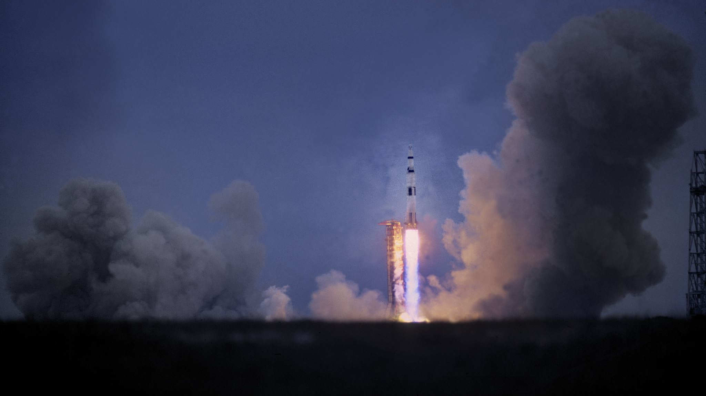
EOC240.03 IDENTIFY PARTS OF A ROCKET

