Slide 1
EOM203.01
Discuss Leadership Within a Peer Setting
Interactive Lecture + Activity
Level 2 IG

Slide 2
Teaching points
Teaching Point 1: Explain Leadership Within a Peer Setting
We’ll look at responsibilities in this teaching point
Teaching Point 2: Conduct a Goal Mapping Activity
We’ll be doing an activity in this teaching point

Slide 3
Why is this lesson important?
In the Air Cadet program:
Helps cadets understand responsibilities in the squadron
Set goals to become a leader
Outside of the program:
Know the responsibilities you have
Work to improve!

Slide 4
Teaching Point 1 - Explain Leadership Within a Peer Setting
To be a leader, know your responsibilities!

Slide 5
What do you think some of the responsibilities in the squadron are?
Here are some responsibilities we have:
Follow the chain of command
Work on your uniform
Participate and try your best
Set a good example
Be respectful to all cadets
Be friendly and fair to peers
Take initiative
Staying safe and being aware of hazards
Set Goals

Slide 6
Teaching Point 1 Confirmation Questions
Q1. List the responsibilities of level two cadets.
Q2. Why is setting a goal important?
Q3. In what ways can we show respect to cadets and officers?
Follow chain of command
Work on uniforms
Participate and try your best
Set a good example
Respect staff
Be friendly to peers
Take initiative
Keep safety in mind
Set goals
Setting a goal shows personal progress, an understanding of yourself, and it gives you a way to show commitment.
Treat others the way you want to be treated. Listening attentively, making eye contact when talking with someone, accepting differences, etc. are all ways you can be respectful.

Slide 7
Teaching Point 2 - Conduct a Goal Mapping Activity
Let’s talk about setting goals!

Slide 8
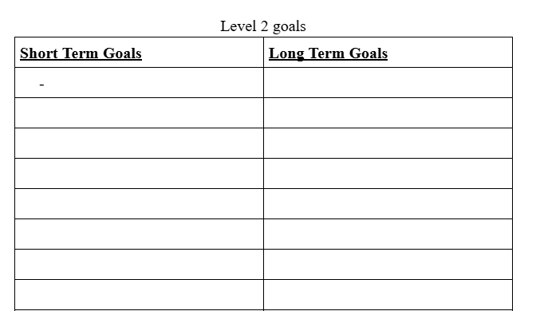
Brainstorming Some Goals
We’ll brainstorm goals for the cadet training year
Short Term Goals: Goals that are achievable in 3 months or less
Long Term Goals: Goals that will be achieved by the end of the training year (May to June)

Slide 9
Wrapping it Up
A reminder to remember why this is important:
Lets us realise responsibilities in and out of the cadet program
Set goals to take action and improve
Today, we have:
learned responsibilities in our cadet program
brainstormed short term and long term goals
set goals for the training year

Slide 10
EOM203.01
Discuss Leadership Within a Peer Setting
Interactive Lecture + Activity
Level 2 IG

