Slide 1
EOM207.04 Identify Year 2 CSTC Training Opportunities
By:
30 min lesson

Slide 2
Purpose
Get to know summer training opportunities for level 2
Preview on summer courses for you to decide early
Summer courses can open up many opportunities in air cadets in the future!

Slide 3
Teaching Points
TP1: Discuss the Speciality Areas for Year Two CSTC Training
TP2: Describe Year Two CSTC Courses

Slide 4
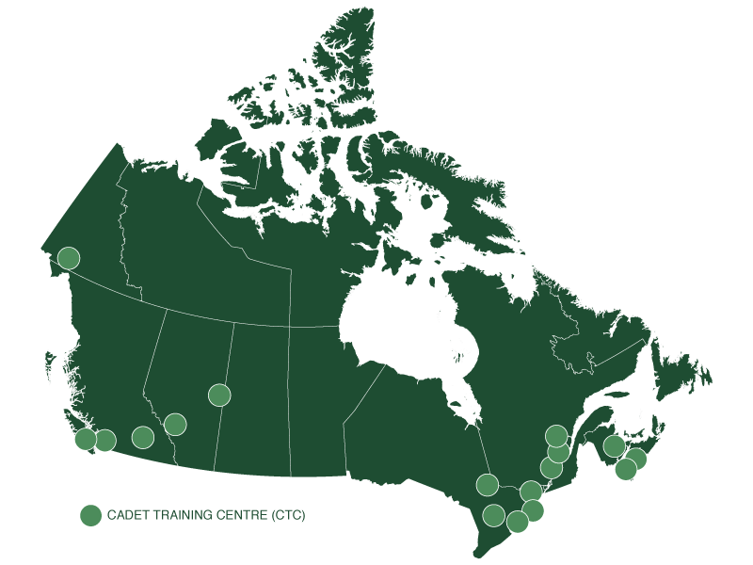
First Teaching Point: Discuss the Speciality Areas for Year Two CSTC Training

Slide 5
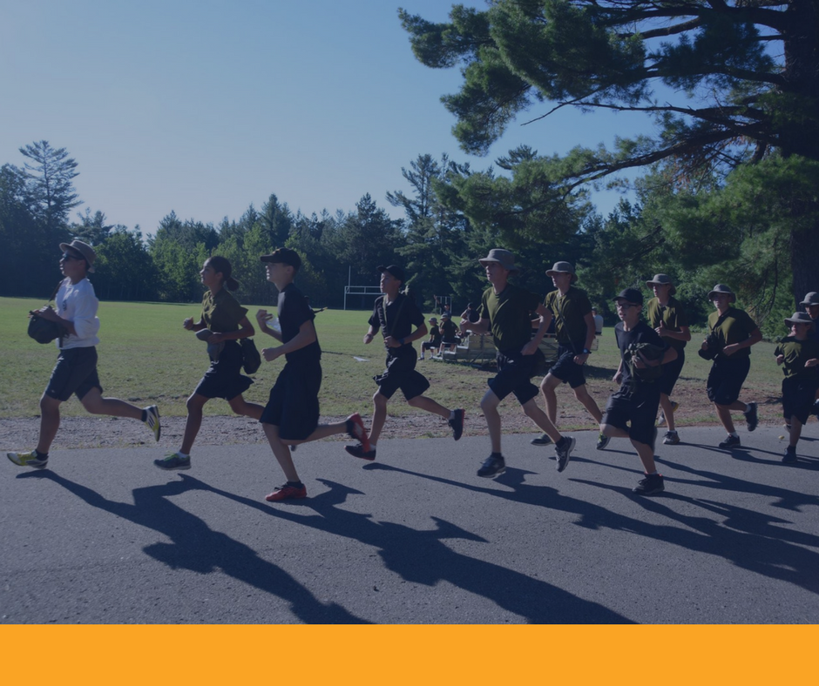
FITNESS AND SPORTS
Cadets will improve individual fitness and sport knowledge and skills. Activities include:
• rules and regulations of sports
• personal fitness.

Slide 6
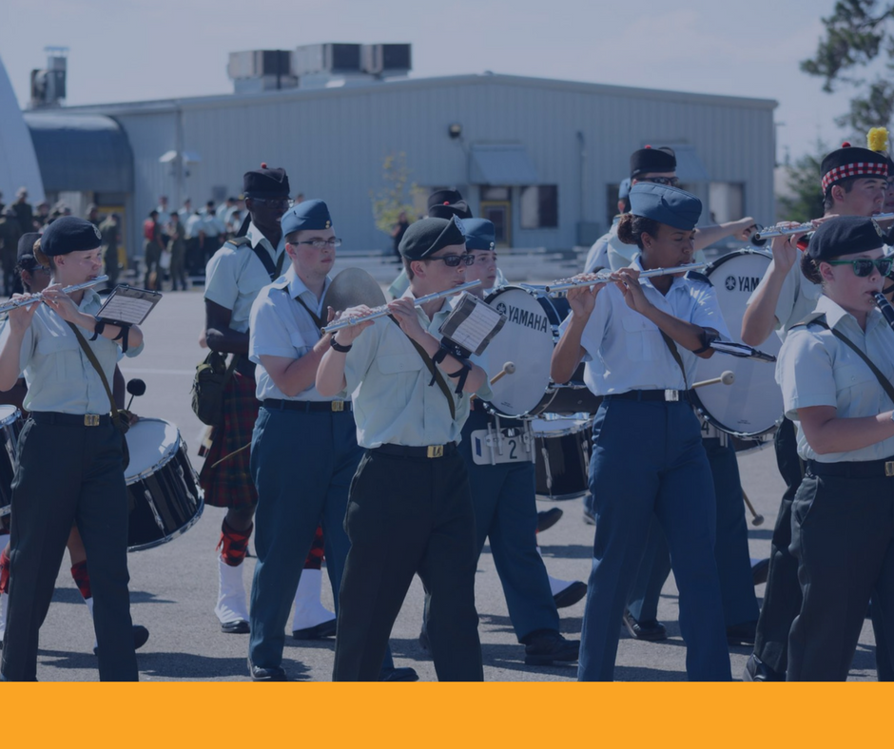
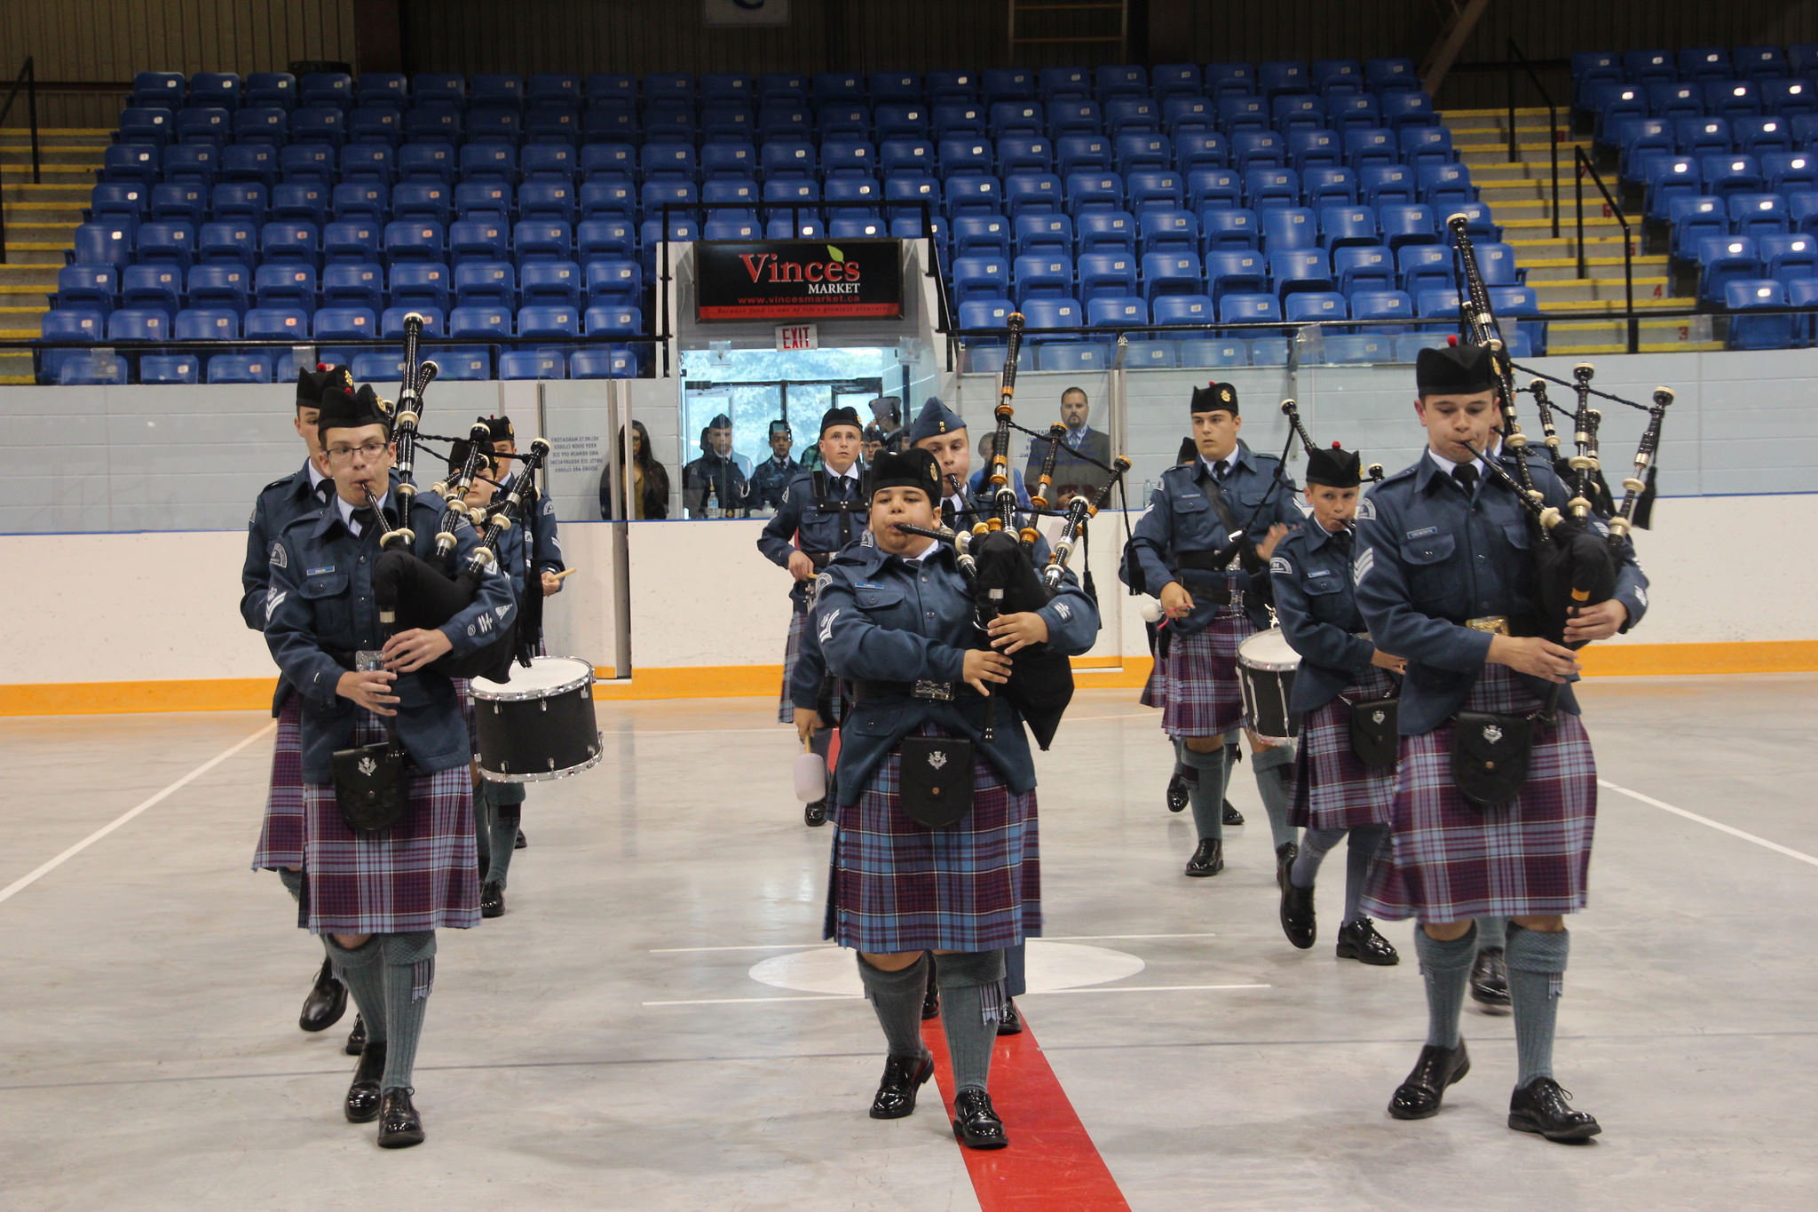
MUSIC: MIlitary Musician / Pipe & Drum Musician
Cadets will develop music knowledge and skills. Activities include:
• music theory
• playing an instrument as part of an ensemble
• playing an instrument as part of a military band / pipe and drum band
• developing individual music skills

Slide 7
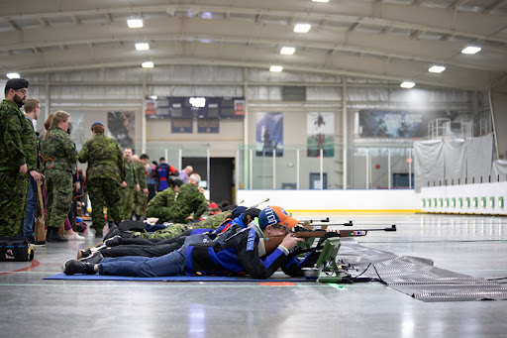
MARKSMANSHIP
Cadets will develop the knowledge and skills required to improve marksmanship and coaching abilities.
Activities include:
• acting as a range assistant
• carrying our basic
marksmanship coaching duties

Slide 8
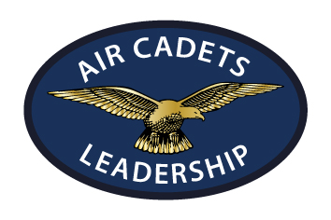
LEADERSHIP
Cadets will develop the knowledge and skills required to improve leadership abilities in a peer and small group setting. Activities include:
• leadership
• public speaking
• problem solving
• ceremonial drill

Slide 9
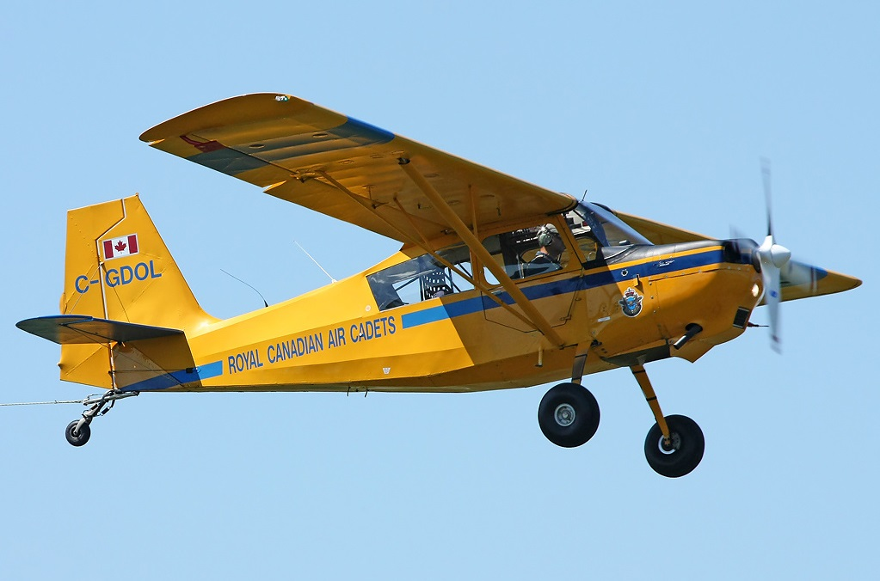
AVIATION
Cadets will develop the knowledge and skills required to improve their understanding of the fundamentals of aviation. Activities will include aspects of:
• meteorology
• aero engines
• air navigation
• airmanship

Slide 10
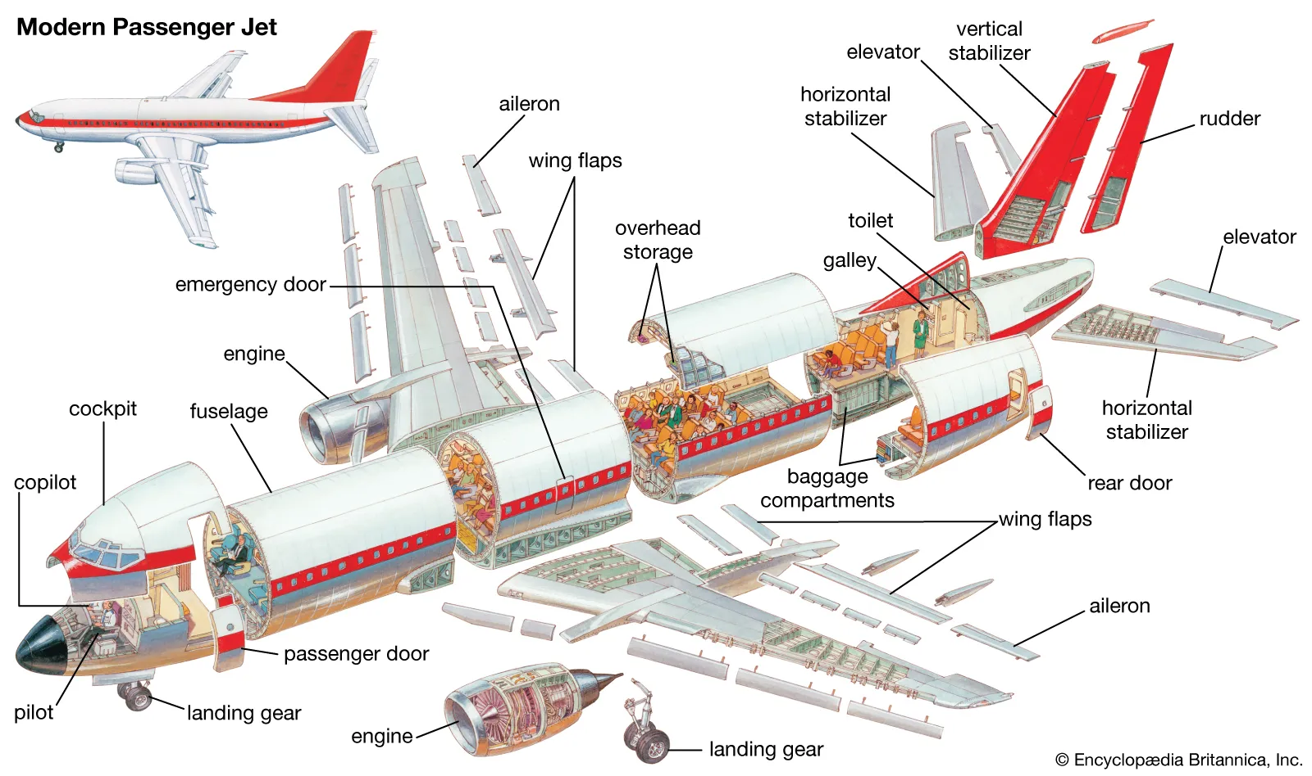
AVIATION TECHNOLOGY
Cadets will develop knowledge and skills required to improve their understanding of the fundamentals of aviation technology. Activities will include aspects of aircraft:
• fabrication
• construction
• maintenance

Slide 11
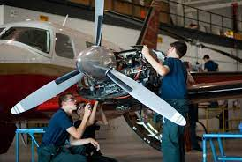
AEROSPACE
Cadets will develop knowledge and skills required to improve their understanding of the fundamentals of aerospace science. Activities will include aspects of:
• theoretical and practical principles of space science
• principles of project management.

Slide 12
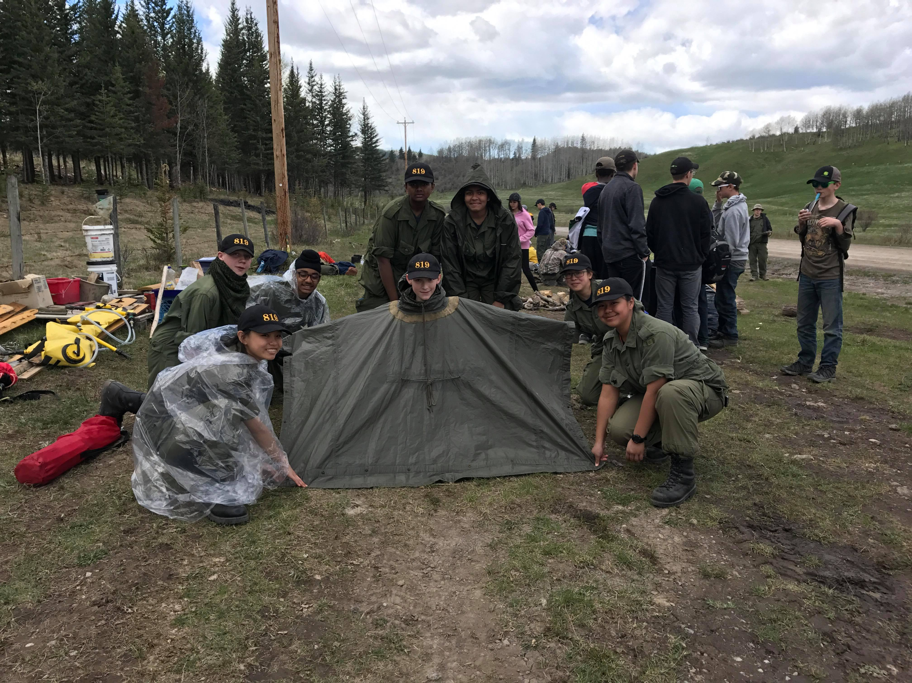
AIRCREW SURVIVAL
Cadets will develop the knowledge and skills required to improve aircrew survival abilities. Activities include:
• fire construction,
• shelter construction,
• signal construction, and
• food and water collection.

Slide 13
Discussion
Q1. Which summer training activities interest you?
Q2. Who is interested in applying for summer training this year? Why?
Q3. What specialty area are you interested in pursuing? Why?

Slide 14
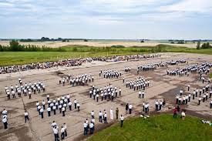
Second Teaching Point: Describe Year Two CSTC Courses

Slide 15
PREREQUISITES FOR ATTENDING A YEAR TWO CSTC COURSE
The cadet must:
• be undergoing Proficiency Level Two training by the application deadline
• successfully complete Proficiency Level Two by June 30 of the year the cadet wishes to attend the CSTC
• be medically and physically fit
• complete a CF 51 including the medical portion (application)
• have parental consent
• be recommended by the squadron Commanding Officer
!! Cadets do NOT have to complete General Training (GT) to apply for their first three-week course.

Slide 16
Common Courses
Basic Fitness and Sports. The aim of this course is to improve the cadets’ knowledge and skills in individual fitness and sports.
Military Band – Basic Musician. The aim of this course is to introduce fundamental music knowledge and skills, and for the cadets to achieve a basic music level.
Pipe and Drum Musician – Basic Pipe and Drum. The aim of this course is to introduce fundamental music knowledge and skills, and for the cadets to achieve a basic music level.

Slide 17
Elemental Courses (1/3)
Basic Leadership. The aim of this course is to build on the knowledge and skills required for an emerging leader to complete a leadership assignment in a peer and small group setting. This course also allows cadets to develop knowledge and skills in drill and ceremonial.

Slide 18
Elemental Courses (2/3)
Basic Aviation. The aim of the Basic Aviation course is to provide the cadets with the fundamentals of aviation including civilian, military and Air Cadet aviation opportunities, aviation history and basic airmanship.
Basic Aerospace. The aim of the Basic Aerospace course is to provide the cadets with the fundamentals of aerospace to include theoretical and practical principles of aerospace science and the principles of project management.

Slide 19
Elemental Courses (3/3)
Basic Aviation Technology. The aim of the Basic Aviation Technology course is to provide the cadets with the fundamentals of aviation technologies to include aircraft fabrication, construction and maintenance. Cadets are given ample opportunity for the practical application of theoretical and practical skills.
Basic Survival. The aim of the Basic Survival course is to allow cadets to apply the basic survival pattern including fire construction, shelter construction, signal construction and food and water collection. Cadets are given ample opportunity for the practical application of theoretical and practical skills.

Slide 20
TP2 Questions
Q1. How many three-week courses can cadets choose from in year two?
Q2. What are the common courses available in year two?
Q3. What are the prerequisites to attend a year two CSTC course?
A1. Eight (8) Courses
A2. Basic Fitness and Sports, Basic Military Band Musician, and Basic Pipe and Drum Musician.
A3: • Be proficiency level 2
• Complete level 2 at the end of the year (June 30)
• be medically and physically fit
• complete a CF-51 including the medical portion
• have parental consent
• be recommended by the squadron Commanding Officer.

Slide 21
Summary
We covered:
Many different areas of CSTC training opportunities
8 available courses for level 2 cadets
Requirements needed to attend the summer courses

Slide 22
Thanks For Listening
EOM207.04 Identify Year Two CSTC Training Opportunities

