Slide 1

EOM240.01 – EXPLORE CURRENT ADVANCEMENTS IN AEROSPACE TECHNOLOGY
By:

Slide 2
Teaching Points
TP1 Conduct an Activity To Explore Current Advancements in Aerospace Technology

Slide 3
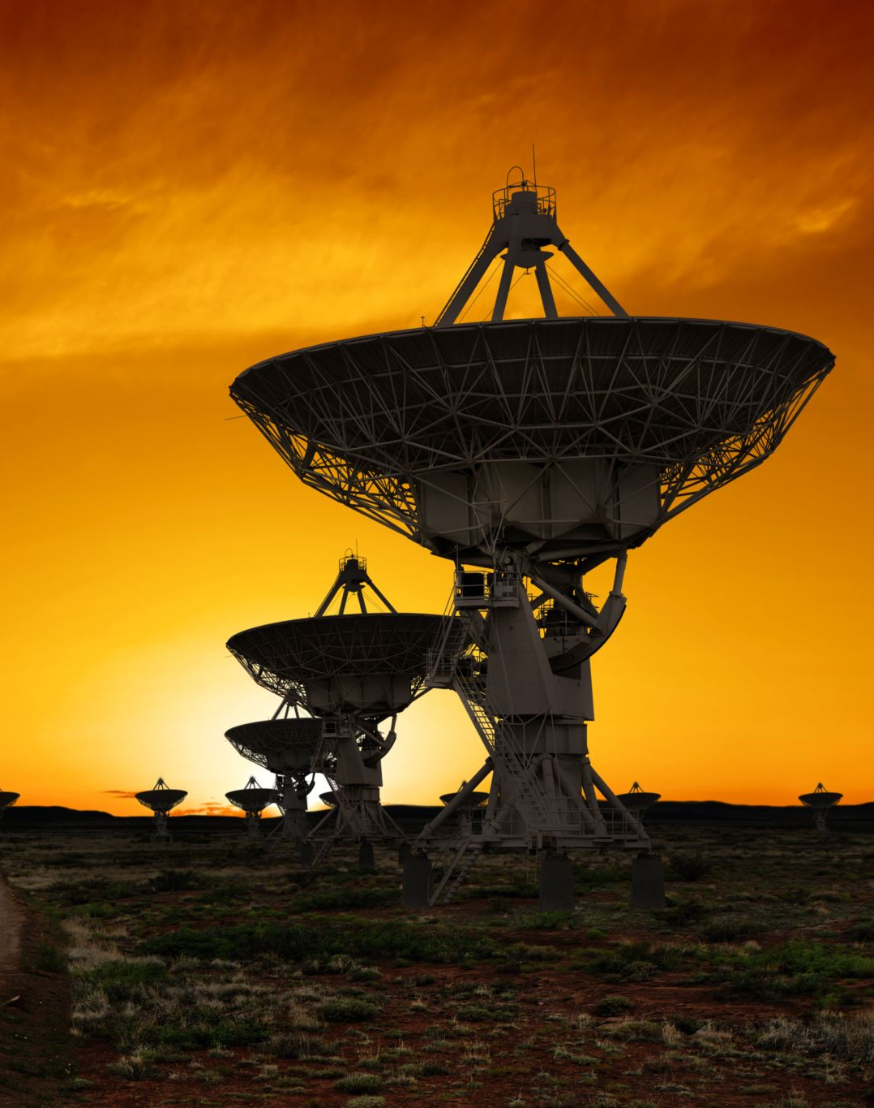
What are some current advancement in aerospace technology that has impacted Earth today?
Satellite radio
Video image stabilization and registration
Satellite TV
DeBakey blood pump
Global positioning system (GPS)
Temper foam
Advanced communications technology
Fire-resistant aircraft seats
Excimer Laser Angioplasty System
Liquid-cooled garments, etc.

Slide 4

What advancement in aerospace technology is of most interest to you and why?

Slide 5

What is a current technology item in use today designed by the Canadian Space Agency?
The Canadarm
The Canadarm 2
The Canadarm 3
Bio-Monitor
RADARSAT

Slide 6
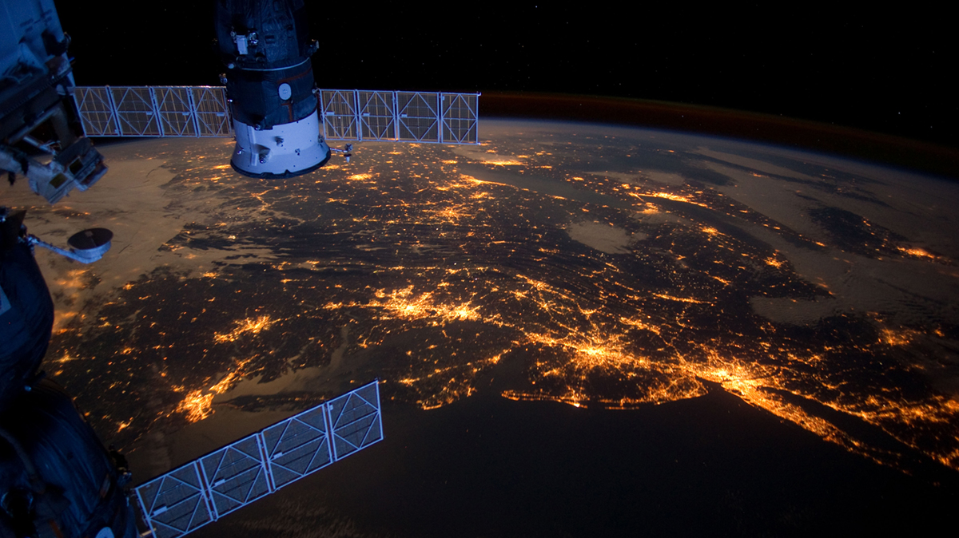
EOM240.01 – EXPLORE CURRENT ADVANCEMENTS IN AEROSPACE TECHNOLOGY

