Slide 1
EO M270.01 – IDENTIFY ASPECTS OF AIRCRAFT MANUFACTURING

Slide 2

Teaching Points
TP1 Identify Aircraft Systems
TP2 Identify the Materials Used in Aircraft Manufacturing
TP3 Discuss Careers Within the Aircraft Manufacturing Industry

Slide 3
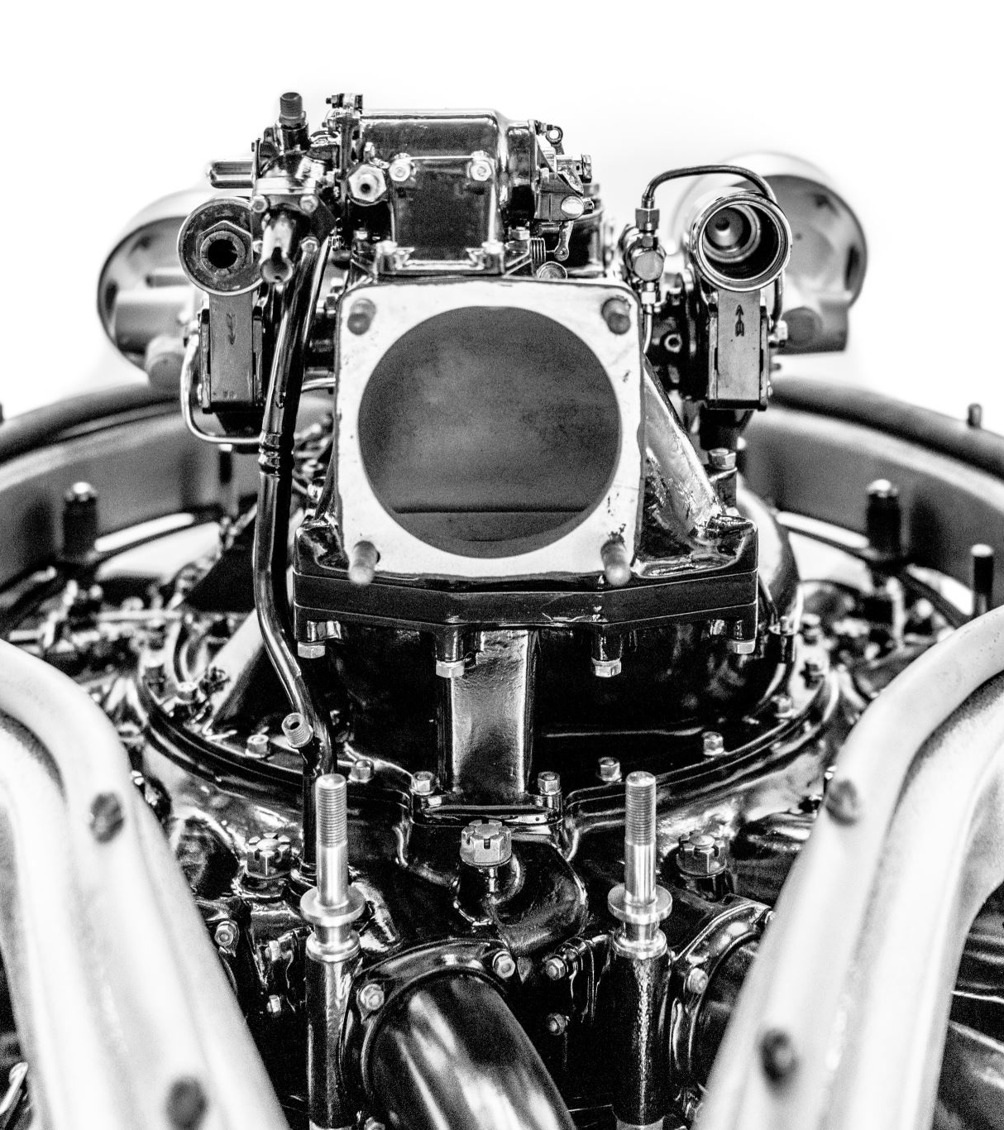
TP1 Identify Aircraft Systems
AIRCRAFT INSTRUMENT SYSTEMS
AIRFRAME ELECTRICAL SYSTEMS
HYDRAULIC AND PNEUMATIC POWER SYSTEMS
AIRCRAFT LANDING GEAR SYSTEMS
AIRCRAFT FUEL SYSTEMS

Slide 4

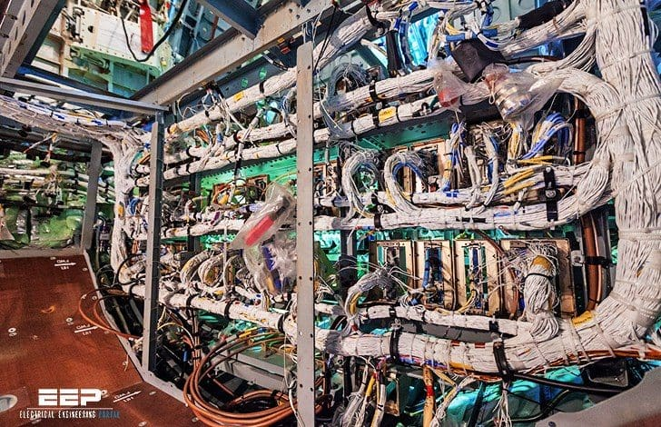
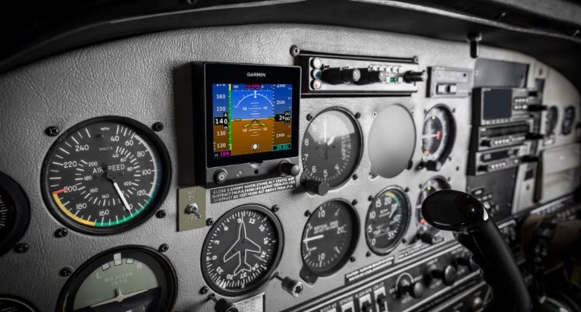
AIRCRAFT INSTRUMENT SYSTEMS
Instruments that depict airspeed and altitude of aircraft
Engine operational parameters and electrical system performance
Microprocessors and other digital electronics
AIRFRAME ELECTRICAL SYSTEMS
Generate and route electricity to various aircraft components
Notes:
Prior to World War II, few airplanes were equipped for flight without using ground reference navigation or pilotage.
Few decades later
Modern aircrafts have
Flight instruments such as altimeter, airspeed, vertical speed indictor. Integrated circuits, containing microprocessors and other digital electronics, have revolutionized flight instrumentation and control systems. New generation flight instruments show textual and analog information on brightly coloured displays.
Component manufacturers or certified repair stations service many of the electrical components.

Slide 5
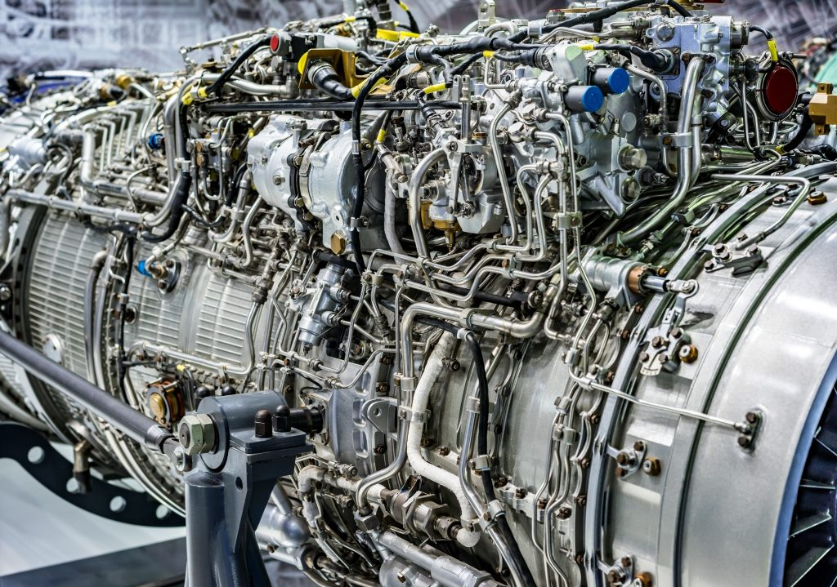
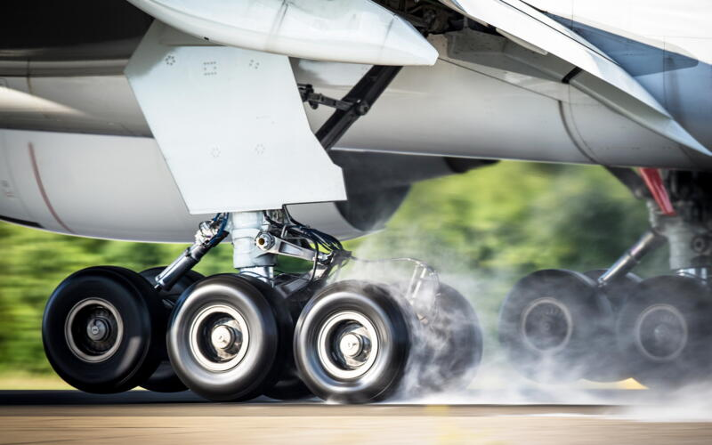
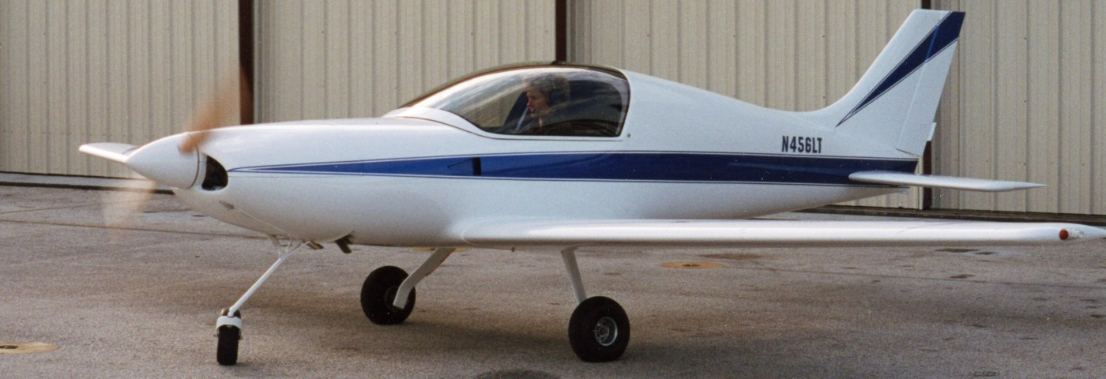
HYDRAULIC AND PNEUMATIC POWER SYSTEMS
Necessity to operate systems remotely
Instead of cables or pushrods operating the brakes, hydraulic pressure was used to solve routing problems and multiple forces on the braking surfaces
AIRCRAFT LANDING GEAR SYSTEMS
Retraction systems, shock absorbing and non-shock absorbing systems, aircraft wheels, nose wheel steering systems and aircraft brakes

Slide 6
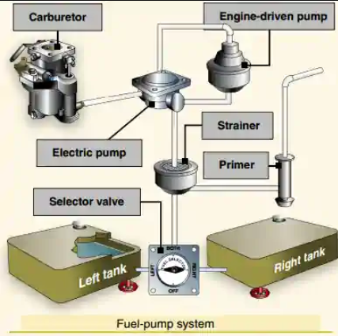
AIRCRAFT FUEL SYSTEMS
Every fuel system has:
1or more fuel tanks
Tubing to carry the fuel from the tank(s) to the engine(s)
Valves to control the flow of fuel
Provisions for trapping water and contaminants and a method for indicating the fuel quantity
Notes:
Q1. List the aircraft systems manufactured to be used in assembling an aircraft.
• Aircraft instrument systems
• Airframe electrical systems
• Hydraulic and pneumatic systems
• Aircraft landing gear systems
• Aircraft fuel systems.
Q2. What do aircraft manufacturers equip larger aircraft with for their control systems?
A2. Aircraft manufacturers equip larger aircraft with hydraulic or pneumatic control systems for their primary control systems.
Q3. What are some of the other components involved in manufacturing landing gear?
A3. Retraction systems, shock absorbing and non-shock absorbing systems, aircraft wheels, nose wheel steering systems and aircraft brakes are some of the other components involved in manufacturing landing gear

Slide 7
Q1. List the aircraft systems manufactured to be used in assembling an aircraft.
Q2. What do aircraft manufacturers equip larger aircraft with for their control systems?
• Aircraft instrument systems
• Airframe electrical systems
• Hydraulic and pneumatic systems
• Aircraft landing gear systems
• Aircraft fuel systems.
A2. Aircraft manufacturers equip larger aircraft with hydraulic or pneumatic control systems for their primary control systems.
Q3. What are some of the other components involved in manufacturing landing gear?
A3. Retraction systems, shock absorbing and non-shock absorbing systems, aircraft wheels, nose wheel steering systems and aircraft brakes are some of the other components involved in manufacturing landing gear
Notes:
Q1. List the aircraft systems manufactured to be used in assembling an aircraft.
• Aircraft instrument systems
• Airframe electrical systems
• Hydraulic and pneumatic systems
• Aircraft landing gear systems
• Aircraft fuel systems.
Q2. What do aircraft manufacturers equip larger aircraft with for their control systems?
A2. Aircraft manufacturers equip larger aircraft with hydraulic or pneumatic control systems for their primary control systems.
Q3. What are some of the other components involved in manufacturing landing gear?
A3. Retraction systems, shock absorbing and non-shock absorbing systems, aircraft wheels, nose wheel steering systems and aircraft brakes are some of the other components involved in manufacturing landing gear

Slide 8
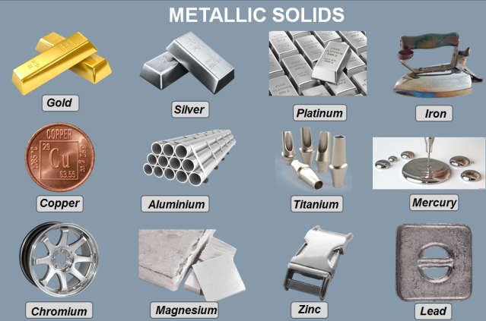
TP2 Identify the Materials Used in Aircraft Manufacturing
The first aircraft was created using steel, wire, cable, silk and wood
Metallurgists found that alloying aluminum with other metals resulted in an equivalent to structural steel
Today, military aircraft are constructed of about 65% aluminum and 35% of other alloys

Slide 9
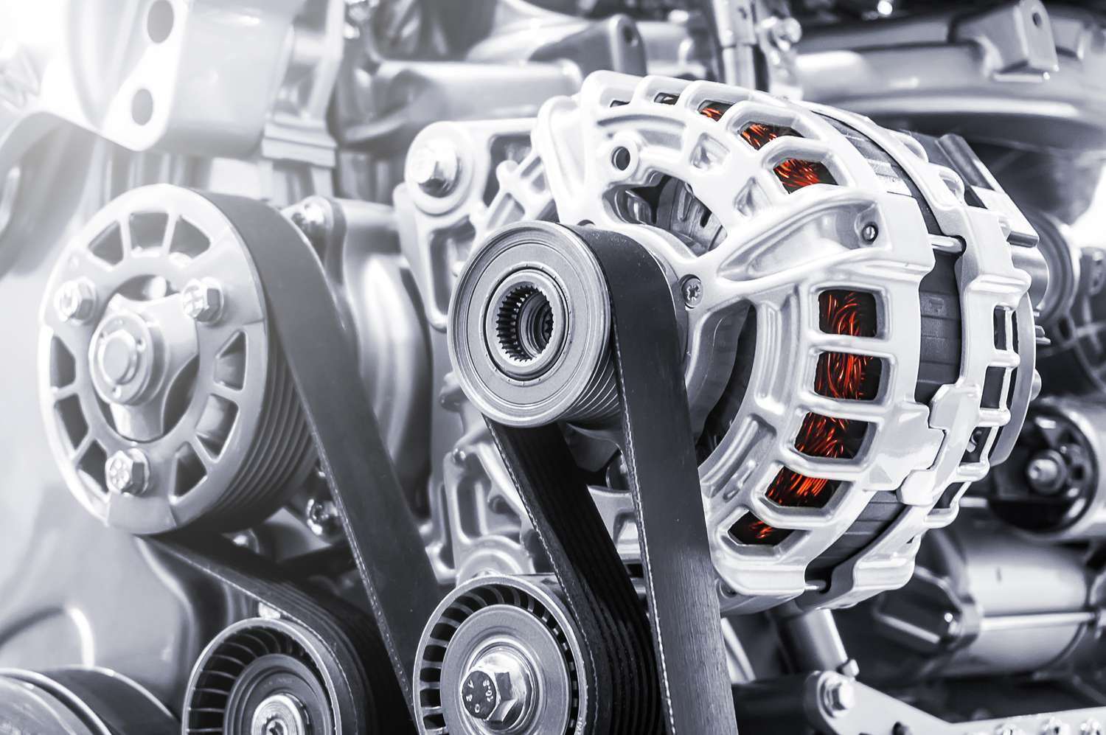
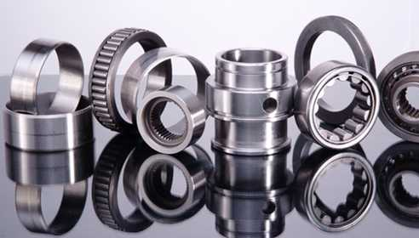
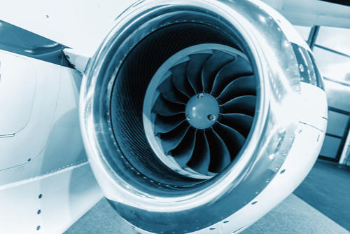
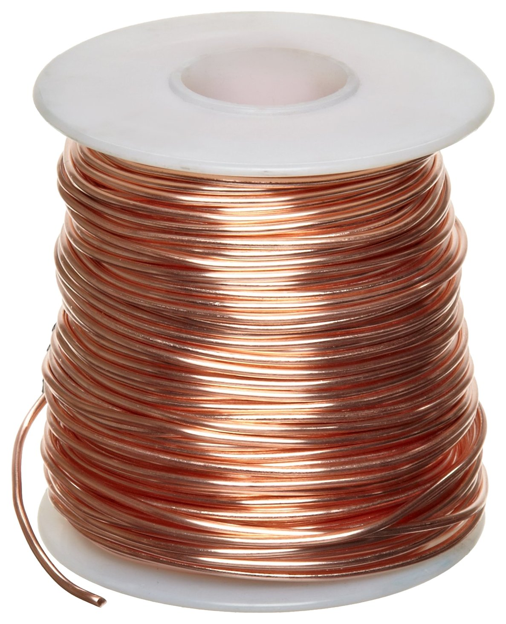
NON-FERROUS METALS
Aluminum and Its Alloys. Pure aluminum lacks sufficient strength
When alloyed, is as strong as steel with 1/3 weight
Titanium and Its Alloys -lightweight metals with very high strength
Nickel Alloys
Monel works well in gears that require high strength/toughness
Inconel used in turbine engines to maintain their strength and corrosion resistance under extremely high temperatures
Copper - primary metal used for electrical wiring

Slide 10
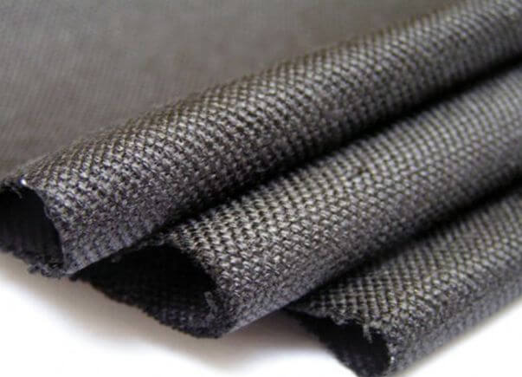
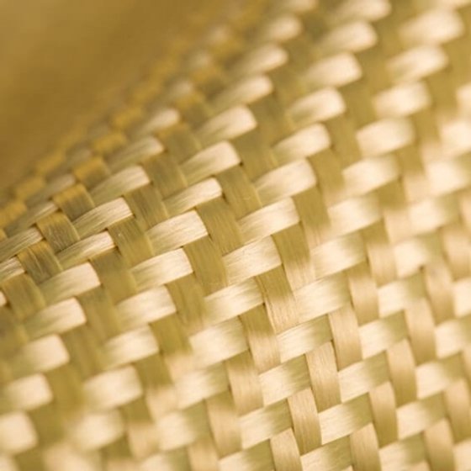
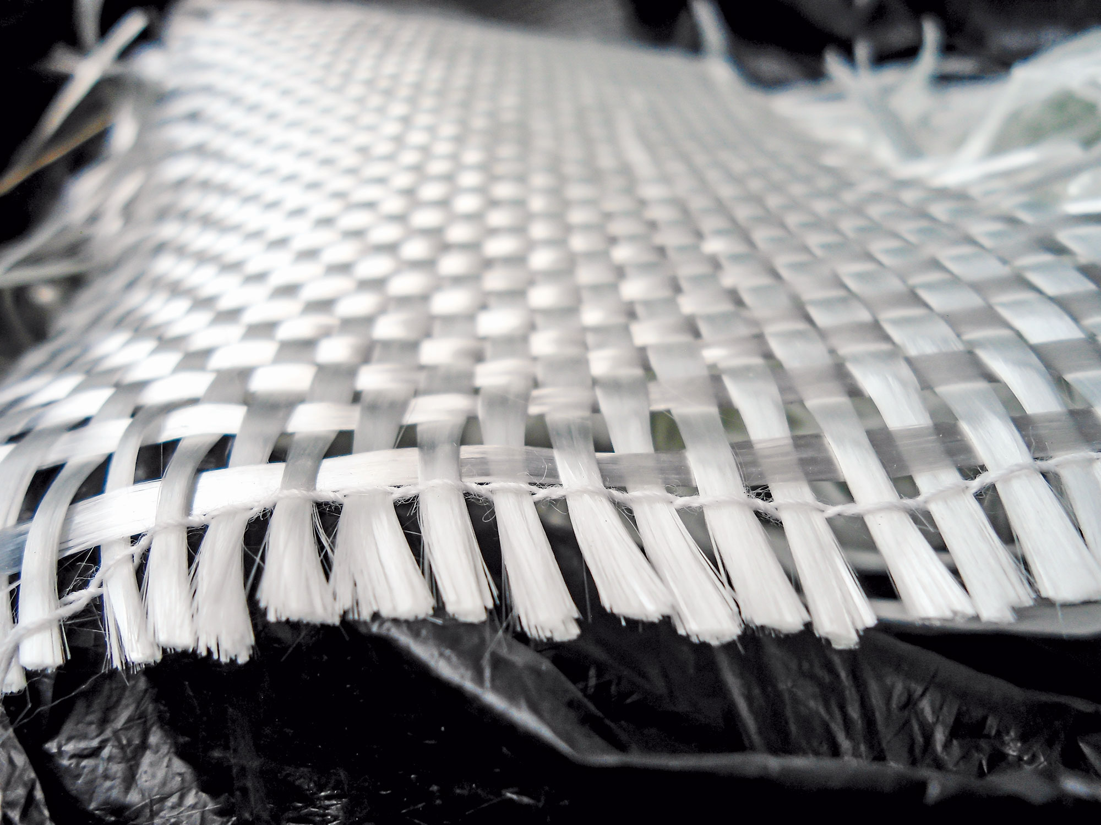
TP2 Identify the Materials Used in Aircraft Manufacturing
COMPOSITE FIBRES
Graphite Fibres
Extremely lightweight, strong, and tough
Kevlar Fibre
Useful where damage from sand or other
debris occur - landing gear/behind propellers
Glass Fibre/Fibreglass
Hardens when heated
Fibres gathered in a loose mat saturated
with resin, molded into desired shape
Notes:
Q1. What was the breakthrough that occurred in the aircraft aluminium industry?
Q2. Name four non-ferrous metals.
Q3. What are some of the more common non-ferrous metals used in aircraft manufacturing and repair?
A1. Metallurgists found that mixing, or alloying aluminum with other metals resulted in a much stronger material.
A2. Four non-ferrous metals are: • aluminum and its alloys, titanium, • nickel, and • copper.
A3. Aluminum, titanium, nickel and copper are some of the more common non-ferrous metals used in aircraft manufacturing and repair.

Slide 11
Q1. What was the breakthrough that occurred in the aircraft aluminium industry?
Q2. Name four non-ferrous metals.
Q3. What are some of the more common non-ferrous metals used in aircraft manufacturing and repair?
A1. Metallurgists found that mixing, or alloying aluminum with other metals resulted in a much stronger material.
A2. Four non-ferrous metals are: • aluminum and its alloys, titanium, • nickel, and • copper.
A3. Aluminum, titanium, nickel and copper are some of the more common non-ferrous metals used in aircraft manufacturing and repair.

Slide 12
TP3 Discuss Careers Within the Aircraft Manufacturing Industry
Q1. Share with the class three pieces of interesting information that you did not know about careers in the aircraft manufacturing industry.
Q2. Why did you find this information interesting?
Q3. What was the most interesting career to you?
Q4. What are the primary responsibilities of the career that you found most interesting?

