Slide 1

EO M270.03 – Discuss Education And Employment Opportunities In Aircraft Manufacturing And Maintenance
By:
60 min / 1 hr

Slide 2
Purpose
Learn about employers
Present career opportunities in the aircraft industry
Education paths

Slide 3
Teaching Point 1: Introduce the Aircraft Manufacturing and Maintenance Industry
Part 1: Employers in Canada
Learn about different companies/employers
Part 2: Career options
Learn about career choices, their tasks, and education requirement
Part 3: Education and training institutions
Information on places to receive education and training

Slide 4
Part 1 Overview
Provide information about the employers in Canada, such as:
• Rolls-Royce Canada,
• Standard Aero,
• Aerospace and Defence Industries Association of Nova Scotia (ADIANS),
• Air Canada Technical Services,
• CHC Helicopter Corporation,
• Field Aviation,
• Goderich Aircraft Inc.,
• Canadian Heli Structures Ltd., and
• Bombardier.

Slide 5
1.a) Rolls-Royce Canada
Facilities in Montréal, Quebec, and Vancouver, British Columbia.
Repair and overhaul on aero engines & development for the energy business
Montréal facility is the largest. Annual sales are in excess of $600 million, 90 percent of which is exported.
Vancouver-based Marine Propulsion division of Rolls-Royce manufactures an integrated unit that performs steering and propulsion functions.
Test facility was constructed with the financial assistance of the Government of Quebec. Test bed for the industrial Trent engine as well as a provider of electricity to the City of Montréal

Slide 6
1.b) Standard Aero
One of the world’s largest independent small gas turbine engine and accessories repair and overhaul companies. Standard Aero services engines used on corporate/business aircraft, commercial airliners, helicopters, and government/military aircraft.

Slide 7
1.c) Aerospace And Defence Industries Association Of Nova Scotia (ADIANS)
ADIANS supports the growing and diversified aerospace and defence industry. 80 percent of its revenue comes from maintaining the Department of National Defence’s (DND) $25 billion worth of assets.
Range of products and services from advanced composite materials to training to transmitters and receivers.
ADIANS’ initiatives foster sector strength in military and commercial development at the local, national and international level.
Helps access government programs for industrial development and facilitates discussion and cooperation amongst industry, government, and all levels of academia.
ADIANS’ development of an aerospace and defence sector export strategy, enhances current and future opportunities for manufacturers, suppliers and service companies.

Slide 8
1.d) Air Canada Technical Services
Provides quick and high quality maintenance, repair and overhaul services to commercial airlines, leasing companies and the military.
OPERATIONS
Airframe Maintenance - Cabin, painting, modification
Component Maintenance - Instruments, fuel system, landing gear
Engine Maintenance - includes repairs and overhauls
Other services include:
• On-wing support,
• Quick engine change,
• Thrust reversers,
• Engine components repairs.
Specialized Services
• Technical training,
• Fleet management and engineering,
• Technical records and publication services,
• Material management

Slide 9
1.e) CHC Helicopter Corporation
World’s largest provider of helicopter services to the global offshore oil and
gas industry
A total solutions transportation service company, providing its customers with
aircraft, pilots, maintenance, insurance, logistics support and training anywhere in the world.
CHC’s current projects include: offshore industries support, offshore search and rescue, air ambulance services, repair and overhaul services, aerial firefighting support, construction industry service, mineral exploration support, composite materials manufacturing, flight training and flight simulator facilities,
humanitarian aid work and a variety of other helicopter services around the world.

Slide 10
1.f) Field Aviation
Since 1947, Field Aviation (Field) has grown into a worldwide airline support centre serving regional aircraft including commercial, corporate, individual, and military aircraft. Field is dedicated to servicing most turboprop and regional jet aircraft.
Experienced in repairing, modifying, and refinishing regional aircraft.
One of Canada’s largest full-service support organizations with major operation centres in Calgary and Toronto.
Field employs aviation technicians that conduct a multitude of heavy checks, airframe structural repairs and modifications, exterior and interior refurbishments, along with a comprehensive array of aircraft avionics and engineering services. Field also manufactures quality spare parts for repair.

Slide 11
1.g) Goderich Aircraft Inc.
A company that provides a wide range of services for aircraft. The company services include:
• aircraft painting,
• interior refurbishment, such as:
◦ cabinets,
◦ carpet, seats, or
◦floor plan modifications, and
• avionics, maintenance, such as:
◦ large scale rebuilds,
◦ modifications, and
◦ parts sales.
Goderich Aircraft Inc. is able to complete maintenance inspections while the aircraft is undergoing other services.

Slide 12
1.h) Canadian Heli Structures LTD
C.H.S. is a Bell Helicopter Textron (BHT) “Specialty Customer Service Facility”
and is committed to the utmost in service of Bell Helicopter major structural repairs, modifications, and specialty welding on light and medium turbine helicopters.
C.H.S. is able to perform airframe repairs with the knowledge of complete overhauls to the highest standards and quality service in a timely manner.
All their maintenance is performed in compliance with Transport Canada Regulations, which is equivalent to the Federal Aviation Administration (FAA) regulations.

Slide 13
1.i) Bombardier
Bombardier Aerospace is a world leader in the design and manufacturer of innovative aviation products and services for the business, regional and amphibious aircraft markets.
This legacy of innovation consolidates more than 250 years of aviation history and has developed 19 successful new aircraft programs since 1989. Bombardier manufactures business, regional and amphibious aircraft. Their aircraft include:
• Bombardier Learjet family
• Bombardier Challenger family
• Bombardier Global family
• Bombardier CRJ series regional jets
• Bombardier Q series regional turboprops
• Bombardier amphibious aircraft (Bombardier 415).
The world’s most productive firefighting aircraft in service is the Bombardier 415, capable of search and rescue, maritime patrol, law enforcement and environmental control.

Slide 14
Part 2 Overview
Provide information about the career options in Canada, such as:
• aircraft gas turbine engine repair and overhaul technician,
• aircraft interior technician,
• aircraft maintenance technician,
• avionics maintenance technician,
• aircraft structures technician,
• aviation ground services attendant, and
• aviation and aerospace engineers.

Slide 15
2.a) Aircraft Gas Turbine Engine Repair And Overhaul Technician
Challenging and rewarding career that requires a high degree of responsibility and skill. Technicians perform the disassembly, inspection, repair, assembly and testing of gas turbine engines in sophisticated shop environments.
Education
high school diploma.
Complete a recognized structured training program in gas turbine repair and overhaul these courses may be taken at a college or through a company-sponsored program.
Work
Excellent job placement rates with opportunities in engine repair and overhaul facilities, airlines, component and propeller overhaul businesses and engine manufacturers. You can receive an aircraft gas turbine repair and overhaul technician certification through the Canadian Aviation Maintenance Council (CAMC).

Slide 16
2.b) Aircraft Interior Technician
Aircraft interior technicians are responsible for maintaining the quality of aircraft interiors and cabin furnishings as well as aircraft reconfigurations. They deal with everything and anything that has to do with interior components.
Diverse and challenging tasks. Great teamwork, creativity, and attention to detail needed
Education
high school diploma
have an apprenticeship or college training program.
Work
Promising careers as part of larger units working for airlines or major repair and overhaul companies and manufacturers. You can receive an aircraft interior technician certification through the Canadian Aviation Maintenance Council (CAMC).

Slide 17
2.c) Aircraft Maintenance Technician
Responsible for keeping aircraft operating safely and efficiently.They service, repair and overhaul aircraft components and systems.
Can perform maintenance on many different types of aircrafts.Must be extremely strict with safety and good communication. Have to stay on top of updates with technology and safety regulations. If you are looking for a challenging career with limitless potential, be sure to look into becoming an aircraft maintenance technician.

Slide 18
2.c) Aircraft Maintenance Technician
Education
High school diploma
Must complete training at a certified college or training facility.
Work
Rewarding career with airlines, aircraft manufacturers, aerospace organizations, the military, as well as repair and maintenance facilities.can be certified by the Canadian Aviation Maintenance Council (CAMC) and/or become an aviation maintenance engineer “M” class (AME)(M), which is a Transport Canada licensed trade. From there, you could go on to join management as a company’s director of maintenance.

Slide 19
2.d) Avionics Maintenance Technician
Avionics is the study and practice of complex electronic and electrical systems including navigation, guidance systems, communications, surveillance and flight control. Avionics maintenance technicians carry out tests, calibrations, repairs and maintenance on these systems. Good communication, teamwork, and safety are needed. This is arguably one of the most demanding trades in aviation.

Slide 20
2.d) Avionics Maintenance Technician
Education
high school diploma with strong grades in English, communications and mathematics
you will then complete a college program in electrical and electronics or specialized training at a certified college or training facility.
Work
A career as an avionics maintenance technician opens the door to airports, aviation electronic shops, airlines, helicopter operations, aircraft manufacturers and repair facilities and aerospace organizations. You can be certified by the Canadian Aviation Maintenance Council (CAMC) and/or become an aviation maintenance engineer “E” category (AME)(E), which is a Transport Canada licensed trade.

Slide 21
2.e) Aircraft Structures Technician
The aircraft structures technician’s job is to keep the aircraft in perfect flying condition by constructing and repairing metal and composite parts of an aircraft’s fuselage, wings and control surfaces, which include machining, painting, welding and refinishing. You will also be expected to follow aircraft fabrication and repair schemes with surgical precision for aluminum, titanium and stainless steel structures, as well as plastics and composites.

Slide 22
2.e) Aircraft Structures Technician
Education
high school diploma
additional training at a certified college or training facility.
Work
You can become certified by the Canadian Aviation Maintenance Council (CAMC) as an aircraft structures technician and find a rewarding career with airlines, maintenance and overhaul companies, aircraft manufacturers or aerospace organizations. This trade is a prerequisite to becoming an aviation maintenance engineer “S” category (AME)(S), which is a Transport Canada licensed trade.

Slide 23
2.f) Aviation Ground Services Attendant
Aviation ground services attendants use motorized equipment to service an aircraft. Ground services attendants load and unload the aircraft materials, and position the baggage/cargo to maintain a safe operating weight and balance.
The lead attendant is responsible for the final pre-flight security inspection and commands the push-back crew.
They need to be physically fit, able to work outside in any weather, have excellent math and physics skills, environmental awareness and hazardous material knowledge.
Entry level job for other positions and promotions. They can also rise
up to management positions

Slide 24
2.f) Aviation Ground Services Attendant
Education
high school diploma.
receive internal company training in aviation general practices and specialized courses.
Companies will provide the licenses and a driving permit. Canadian Aviation Maintenance Council (CAMC) certification is available with a minimum of one year’s experience in the occupation at level 1 - Cargo, and one more year’s experience at level 2 - Passenger.
Work
Some of the job titles available in this occupation include:
• Station attendant • Lead station attendant
• Cargo attendant • Commissary attendant.

Slide 25
2.g) Aviation And Aerospace Engineers
The aviation and aerospace industry holds many challenges and rewards for engineering. The following engineers are contributors in aviation and aerospace:
• Aerodynamics,
• Avionics,
• Design,
• Engineering reliability,
• Equipment,
• Field service,
• Flight test,
• Instrumentation,
Aerospace engineers research, design and develop aircraft, spacecraft, missiles, aerospace systems and their components. Countless opportunities regardless of type of engineering
• Manufacturing materials,
• Aeronautical,
• Aerospace,
• Ceramic,
• Chemical,
• Civil,
• Electronic,
• Electrical,
• Engineering physics,
• Industrial,
• Mechanical,
• Petroleum,
• Metallurgical, and
• Computer and nuclear.

Slide 26
2.g) Aviation And Aerospace Engineers
Education
university degree in your preferred area of expertise in order to become an Engineer; in fact you must receive provincial recognition or accreditation.
Work
Engineers can find stimulating and rewarding careers in all aviation and aerospace-related firms that design, manufacture, repair and overhaul aeronautical products including complete aircraft, engines, components and systems and subsystems.

Slide 27
Part 3 Overview
Provide information about education and training institutions, such as:
• Simon Fraser University,
• Canadore College of Applied Arts and Technology,
• Centennial College,
• McGill University,
• École des métiers de l’aérospatiale de Montréal,
• Gander Aerospace Training Centre,
• Holland College,
• University of Calgary,
• Nova Scotia Community College, and
• Buffalo School of Aviation.

Slide 28
Part 3
A-CR-CCP-802-PF-001.pdf - Google Drive
Go to page 845 for places of education

Slide 29
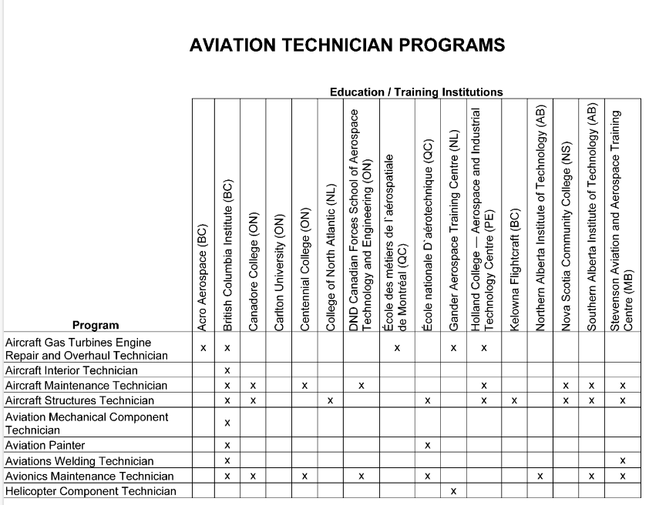
Part 3

Slide 30
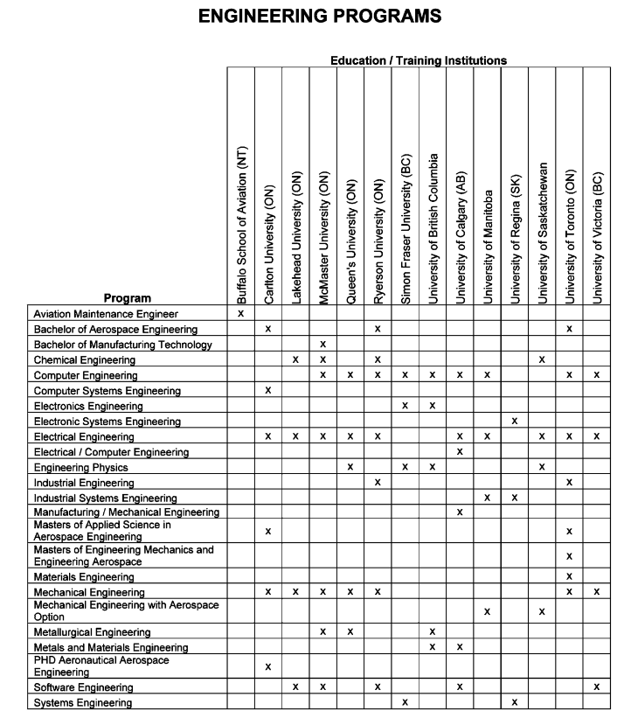
Part 3

Slide 31
Summary
Looked at Canadian employers for aviation industry and what they do
Looked at jobs in the aircraft industries, their job descriptions, and education requirements.
Looked at institutions for education and training that’ll help you achieve one of the careers we went over.

Slide 32
EO M270.03 – Discuss Education And Employment Opportunities In Aircraft Manufacturing And Maintenance
By:
60 min / 1 hr

