Slide 1
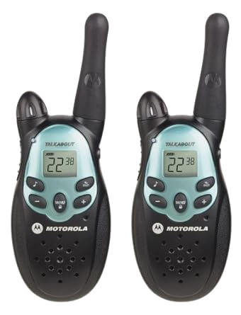
EOM290.06 Operate a Handheld Radio
By:

Slide 2
Teaching Points
01
02
03
04
05
Identify parts of the Radio
Turning the Radio On & Off
Adjusting Frequencies
Operating the Push-To-Talk (PTT) Button
Changing Batteries
How to use the radio

Slide 3
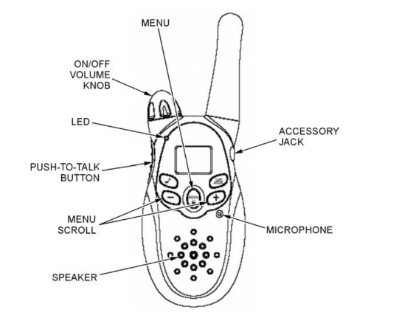
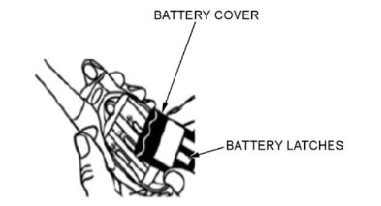
Radio Parts

Slide 4
Parts of the Radio
Speaker. Converts electric current into audible sound.
Antenna. An electrical device designed to transmit or receive radio waves.
Menu Scroll. Push to scroll through the menu options and channels.
Accessory Jack. This is used to insert accessory items such as a headset.
Microphone. Converts sound into an electrical signal.
On/Off Volume Knob. Controls volume and power to the unit.
Push-To-Talk (PTT) Button. A depressible button that allows transmissions.
Light Emitting Diode (LED). This light will be illuminated when the radio is on.
Menu. Push to start swapping channels.

Slide 5
Parts of the Radio (The Back)
Battery Cover. Covers the storage compartment of the battery
Battery Cover Latches. Secures the cover to the radio

Slide 6
How to Use the Radio: On & Off
ON: turn the on-off/volume knob clockwise. The radio will beep and the radio display will briefly show all feature icons of the radio.
OFF: turn the on-off/volume knob counterclockwise. A clicking sound will indicate the radio is turned off.

Slide 7
How to Use the Radio: Adjusting Frequencies / Channels
The radio operates on a group of frequencies that are accessed through radio channels. To set the channel of the radio, push the Menu button, this will cause the current channel to flash. Using the Menu scroll button, scroll through the channels and push the PTT button to select the desired channel.
FRS & GMRS
FRS (Family Radio Service) - Lower power use and lower range
GMRS (General Mobile Radio Service) - Higher power use and higher range. Requires FCC (Federal Communications Commission) Licence

Slide 8
How to Use the Radio: Push-To-Talk Button
To send and receive messages, check the channel activity by pressing the push-to-talk (PTT) button. Static will be heard if the channel is clear to use. Do not transmit if someone is talking on the channel.
To send messages, press the PTT button, pause, speak into the microphone, pause, and then release (hold 3-5 centimetres from your mouth).
The LED will glow continuously when sending messages.
To listen to messages, release the PTT button.

Slide 9
How to Use the Radio: Batteries
Many hand-held radios will use three AA batteries for power. To insert or replace these batteries, follow these steps:
Turn the radio so the back is facing up. Lift the battery latch to release the battery cover.
Remove the battery cover.
Insert three AA batteries as shown on the inside of the battery compartment.
Replace the battery cover and clip the battery latch to secure.
BATTERY METER
The battery icon shows the battery charge level, from full to empty. When the battery is empty, the radio chirps periodically after releasing the PTT button. The radio powers off when the voltage drops below a predetermined level.

Slide 10
How to Use the Radio: Batteries
Batteries are made of various materials comprised of heavy metals that can harm the environment if not properly discarded.
Batteries, if not properly disposed of, may cause:
The pollution when batteries are burned or disposed in landfills
Corrosion from the strong acid
Burns or other injury to eyes and skin
Batteries are not all the same and each have specific instructions for their proper disposal and/or recycling. It’s best to check with the local community recycling facility to determine the household battery recycling options.

Slide 11
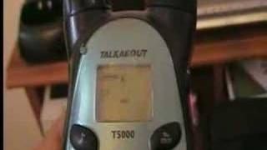
How to Use the Radio: Altogether

Slide 12
Questions
Antenna
On-Off/Volume knob
LED
Accessory Jack
PTT Button
Menu Scroll Button
Microphone
Menu Button
The back:
Speaker
Battery latches
Battery cover

Slide 13
Questions
Explain how to use the radio:
On/Off -
Changing Channel -
PTT Button -
Batteries -
Turn the knob clockwise to turn on and the radio will beep. Turn the knob counterclockwise until there is a click to turn off.
Press the menu button, then use menu scroll buttons to change channels. Use PTT button to select channel.
Press and hold PTT to talk through the microphone. Release to listen to messages.
Lift the battery latches to remove the cover and switch batteries. Replace the cover and clip battery latches after.

Slide 14
Summary
How to operate the radio
On/Off
Speaking
Switching Channels
Changing Batteries
Parts of the Radio
On-Off / Volume knob
LED
PTT button
Menu button
Menu Scroll buttons
Antenna
Accessory jack
Microphone
Speaker

Slide 15
EOM290.06 Operate a Handheld Radio - DONE!
By:

