Slide 1
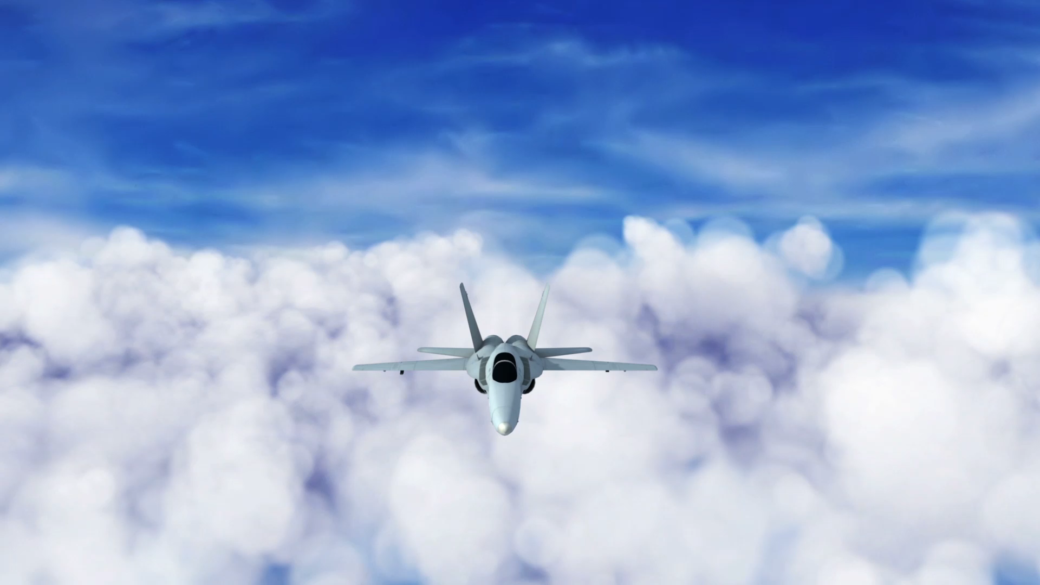
EO M231.01 – IDENTIFY THE FOUR FORCES THAT ACT UPON AN AIRCRAFT
By:

Slide 2
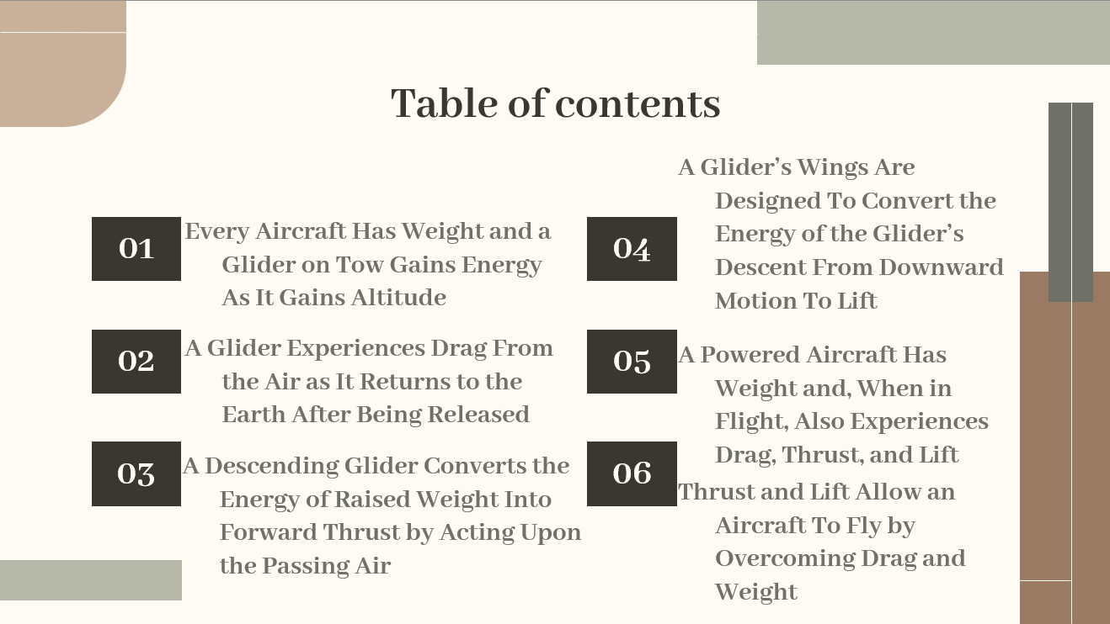

Slide 3

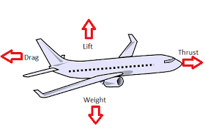
TP1 Explain That Every Aircraft Has Weight and That a Glider on Tow Gains Energy As It Gains Altitude
Every aircraft has weight, which influences the design and performance of the aircraft.
The gliders used in the Air Cadet gliding program are towed to their determined altitude by a tow-plane. There are other methods of getting altitude, such as using a winch to get up to speed on the ground.
An aircraft gains energy as it gains altitude. The energy that the glider gains as it is taken to its determined altitude can be spent quickly in a rapid descent to Earth or it can be spent slowly in a long descent.

Slide 4
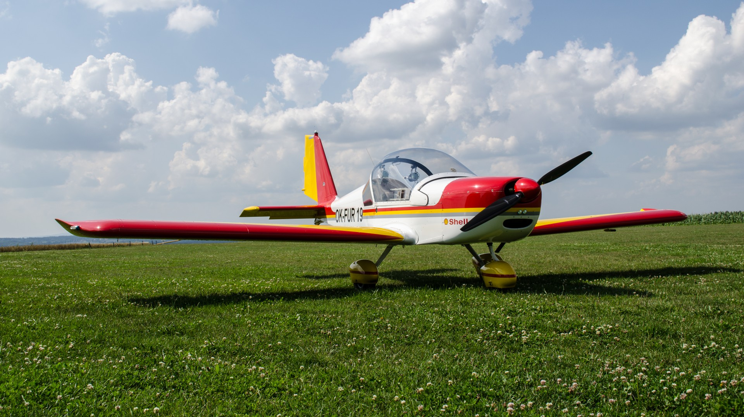
A glider’s change in height will influence its _____ while its performance is influenced by its _______ A) altitude, pilot B) energy, weight C) altitude, materials D) rate of descent, design E) none of the above
Notes:
B

Slide 5
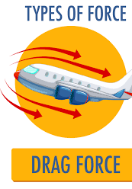

TP2 Explain That a Glider Experiences Drag From the Air as It Returns to the Earth After Being Released
Drag is the resistance that any object experiences as it moves through the air.
You may have experienced the resistance of air on a bicycle or just walking on a windy day.
Effort is put into aircraft design to minimize drag.
The design of an aircraft can minimize drag but cannot avoid it entirely. The faster an aircraft is designed to fly, the sleeker and more streamlined its design is likely to be.
A parachute is designed to maximize drag by catching air and using it to slow descent

Slide 6
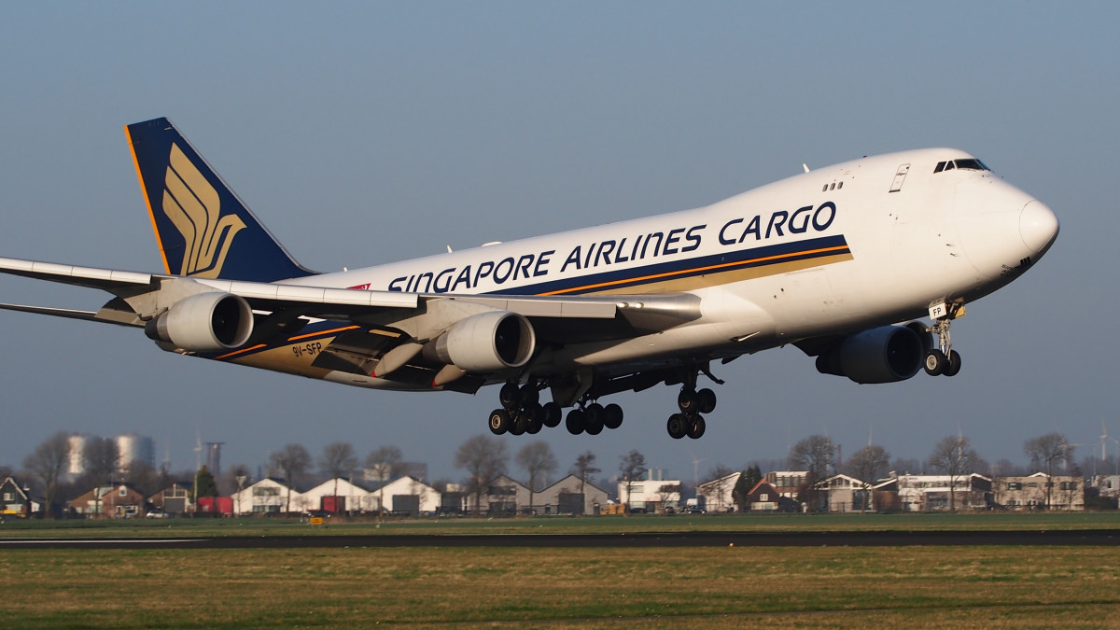
An aircraft manufacturer is attempting to improve the performance of its aircrafts and is testing a new design. What should the manufacturer keep in mind when minimizing drag. A) An aircraft would experience no drag if there was no air B) An aircraft can reduce drag to zero if given the right design C) Emergency parachutes function by pulling on the air below it D) Two of the above are correct E) None of the above are correct
Notes:
A

Slide 7
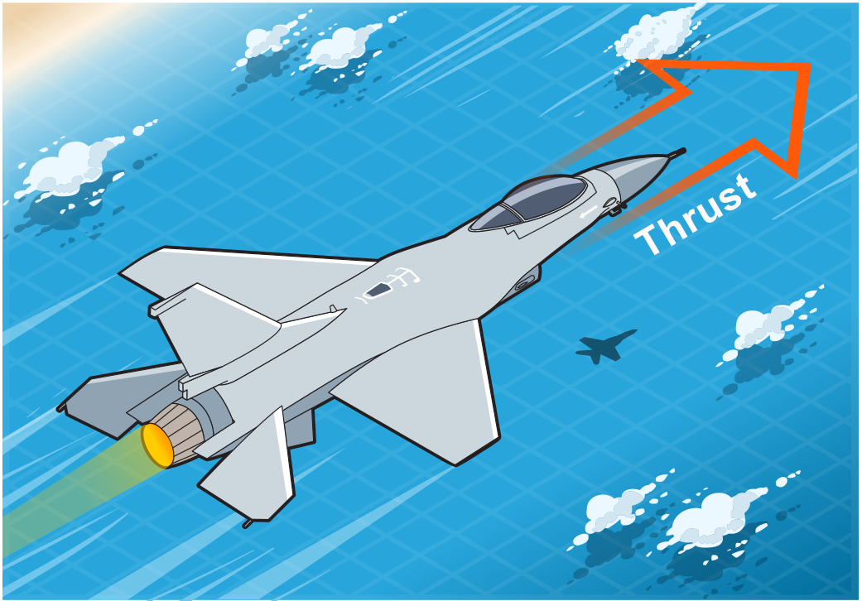

TP4 Explain That a Descending Glider Converts the Energy of Raised Weight Into Forward Thrust by Acting Upon the Passing Air
A glider moves forward as it descends, rather than falling straight down. It accomplishes this by acting on the air in a manner like a cadet diving into water.
A glider is always gliding downwards through the air, but by locating atmospheric lift (rising air) to offset the downward motion of the aircraft due to gravity, the pilot can gain altitude and fly great distances without needing to use artificial lift again.
Thrust is a force that moves an aircraft forward. A glider spends the energy it has gained and moves forward by trading the speed of descent for forward motion. It gets this control by using its weight to push upon the air below.

Slide 8
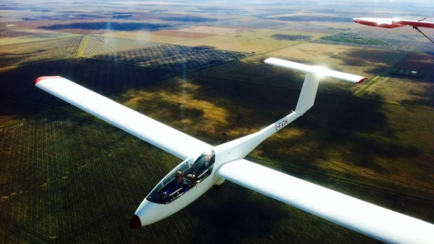
A glider is slowly descending towards the ground but locates an area of atmospheric lift, can the glider end up higher when leaving than when it entered the area?
A) No, because the warm air will counteract the force of gravity
B) Yes, because Bernoulli’s principle will generate the lift
C) No, because there is no way for atmospheric lift to counteract the force of gravity D) Yes, because lift will be generated by its engines E) None of the statements are correct
Notes:
E

Slide 9

TP5 Explain That a Glider’s Wings Are Designed To Convert the Energy of the Glider’s Descent From Downward Motion To Lift
Glider’s wings are usually very large. As air moves over and under the wing, the air is used by the wing to generate lift
The purpose of a glider’s wings is not to go fast to minimize descent.
The distance travelled forward compared to the altitude lost is referred to as glide ratio around 30m forward for 1m of descent.
The glider’s wing is designed to develop lift because lift reduces the rate of descent while allowing forward motion.
The lift of the aircraft’s wing will counteract the aircraft’s weight, to a degree, and this will improve the aircraft’s glide ratio.
Generally, the larger the wing, the more lift can be developed.
Notes:
A glider’s wings are designed to project out into the passing air. Glider’s wings are usually very large As air moves over and under the wing, the air is used by the wing to generate lift. The purpose of a glider’s wings is not to go fast to minimize descent. The object of soaring is to get as much forward distance as possible, while losing as little altitude as possible for each unit of energy that the glider loses in descent. The distance travelled forward compared to the altitude lost is referred to as glide ratio. This should be a very large number such as 30 metres forward for each metre of descent. The glider’s wing is designed to develop lift because lift reduces the rate of descent while allowing forward motion. The lift of the aircraft’s wing will counteract the aircraft’s weight, to a degree, and this will improve the aircraft’s glide ratio. Generally, the larger the wing, the more lift can be developed. A wing generates lift by acting upon the passing air in a highly sophisticated manner that will be explored in the next lesson.

Slide 10
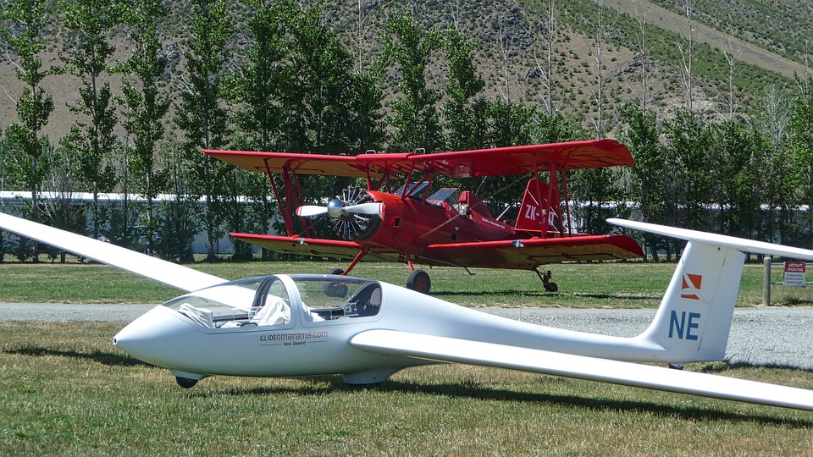
A glider is gliding through the sky. Which of the following statements is(are) TRUE?
I. Generating more lift will decrease the amount of distance travelled
II. The larger the wing, the greater the glide ratio
III. The speed of the glider has no impact on its rate of descent
IV. The glide ratio is only dependent on the glider’s thrust and weight
A)One statement is TRUE.
B)Two statements are TRUE. C)Three statements are TRUE. D)All statements are TRUE. E)None of the statements are TRUE.

Slide 11
A glider is gliding through the sky. Which of the following statements is(are) TRUE?
I. Generating more lift will decrease the amount of distance travelled
II. The larger the wing, the greater the glide ratio
III. The speed of the glider has no impact on its rate of descent
IV. The glide ratio is only dependent on the glider’s thrust and weight
A)One statement is TRUE.
More lift = higher off the ground = more time to travel (false)
More wing area to generate lift(to a degree) (true)
Speed generated will result in more lift (false)
Glide ratio is dependent on all 4 forces (false)

Slide 12

TP6 Explain That a Powered Aircraft Has Weight and, When in Flight, Also Experiences Drag, Thrust, and Lift
While a glider can gain forward motion only by trading the energy of its descent for thrust, a powered aircraft can generate thrust by running its engine like a driven propeller or a high-speed jet exhaust.
The engine adds weight to the aircraft and both the propeller and engine body add to the drag that the aircraft experiences.
A powered aircraft, therefore, will usually not have the high glide ratio of a glider.
A powered aircraft, though, can attain equilibrium, which is something a glider cannot do. Equilibrium is a condition where lift equals weight or thrust equals drag. Pilots often refer to this as flying straight and level.
Notes:
A powered aircraft also experiences weight, drag and lift as does a glider. However, while a glider can gain forward motion only by trading the energy of its descent for thrust, a powered aircraft can generate thrust by running its engine. In this case, thrust is provided to the aircraft via a driven propeller or a high-speed jet exhaust.
On the other hand, the engine adds weight to the aircraft and both the propeller and engine body add to the drag that the aircraft experiences. A powered aircraft, therefore, will usually not have the high glide ratio of a glider. A powered aircraft, though, can attain equilibrium, which is something a glider cannot do. Equilibrium is a condition where lift equals weight or thrust equals drag. Pilots often refer to this as flying straight and level.

Slide 13
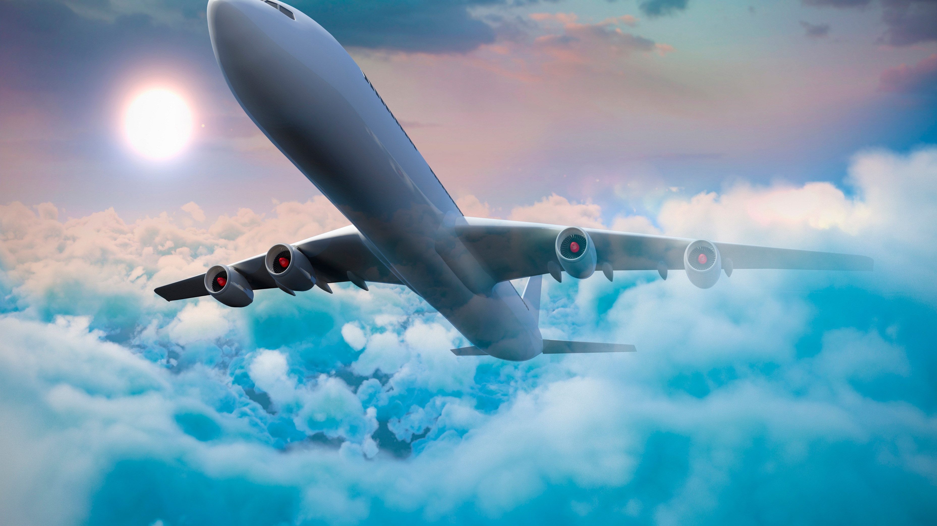
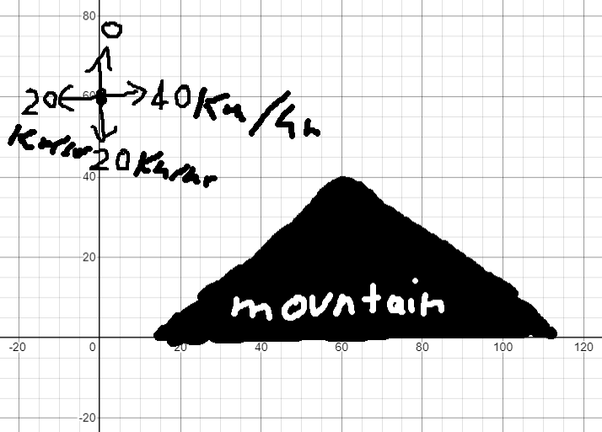
The glider in the picture is currently 60km above the ground needs to make it over the mountain 60km ahead and 40km above the ground. What can the glider do?
I) Decrease AoA
II) Decrease its weight
III) Decrease its drag
A) I and II are correct
B) II and III are correct
C) I and III are correct D) Only one of the statements are correct
E) All the statements are correct

Slide 14

The glider in the picture is currently 60km above the ground needs to make it over the mountain 60km ahead and 40km above the ground. What can the glider do?
I) Decrease AoA
II) Decrease its weight
III) Decrease its drag
D) Only one of the statements are correct
Decreasing AoA lowers lift (false)
Decreasing weight would allow glider to make it (true)
Decreasing drag to 0 would still not allow glider to make it as 40 forward over 20 down would not be enough (false)

Slide 15

TP7 Explain That Thrust and Lift Allow an Aircraft To Fly by Overcoming Drag and Weight
A glider can fly even though it does not produce its own thrust.
It can fly even though its weight is greater than its lift.
However, in the Earth’s gravity, its flight is limited by atmospheric conditions and the pilot’s skill. On a day without wind, even the most skillful pilot will soon return to Earth after being released.
With a powered aircraft, descent can be delayed by turning the energy of burning fuel into thrust because thrust can then be turned into lift by the aircraft’s wings.

Slide 16
What is the most correct sequence required for a powered aircraft to generate lift.
A) Engine→airspeed→thrust→Newton’s third law of motion→Wings→Lift B) AoA→airspeed→Engine→Wings→pressure difference→Lift C) Engine→airspeed→Bernoulli’s principle→thrust→Lift D) AoA→Engine→thrust→Bernoulli’s principle→Wings→Lift E) Engine→thrust→Newton’s first law of motion→pressure difference→Lift
AoA→Engine→thrust→airspeed→Bernoulli’s principle→Wings→pressure difference→Lift
Notes:
D

Slide 17
Conclusion – EOM231.01 IDENTIFY THE FOUR FORCES THAT ACT UPON AN AIRCRAFT

