Slide 1
EOM 231.02- Describe the production of lift by an aircraft wing
Lv.2 IG
60min

Slide 2
Importance
It is important for cadets to learn about the production of lift by an aircraft wing so that they can develop an understanding of subsequent and related principles of flight.

Slide 3
Overview
Teaching Points
TP 1. Explain that air acts like a fluid insofar as it has inertia, speed and pressure
TP 2. Introduce Bernoulli’s principle which states that a liquids pressure drops when it's speed increases
TP 3. Have the cadets explore Bernoulli’s principle
TP 4. Introduce angle of attack
TP5. Have each cadet create and fly an airfoil

Slide 4
TP 1. Explain that air acts like a fluid insofar as it has inertia, speed and pressure
Newton’s laws of motion
First Law: An object in motion will remain in motion until acted upon by a net force
Predicts that air being a gaseous fluid tends to remain in motion when it is moving
Second Law: Force is equal to mass times acceration
Requires that a force must be applied to change the airs motion
Third Law: A force will have an equal and opposite reaction force
Allows the aircraft wing to develop lift by forcing air downward which allows a reaction force upqards on the wing

Slide 5
Confirmation Questions!
Q1. How does air follow Newton’s first law of motion?
Q2. How does air follow Newton’s second law of motion?
Q3. How does air follow Newton’s third law of motion?
A1. When in motion, air tends to remain in motion.
A2. When in motion, a force must be applied to change air’s motion.
A3. When air’s motion is changed, an equal and opposite reaction results.

Slide 6
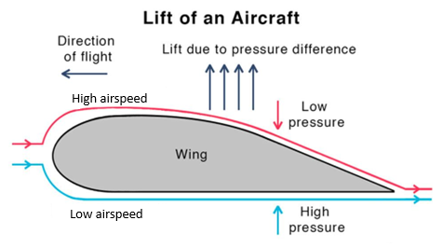
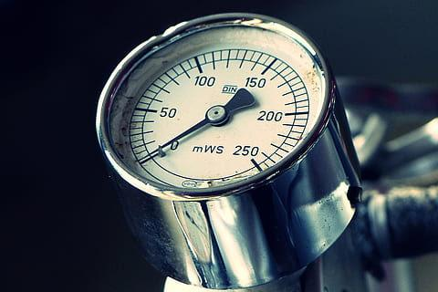
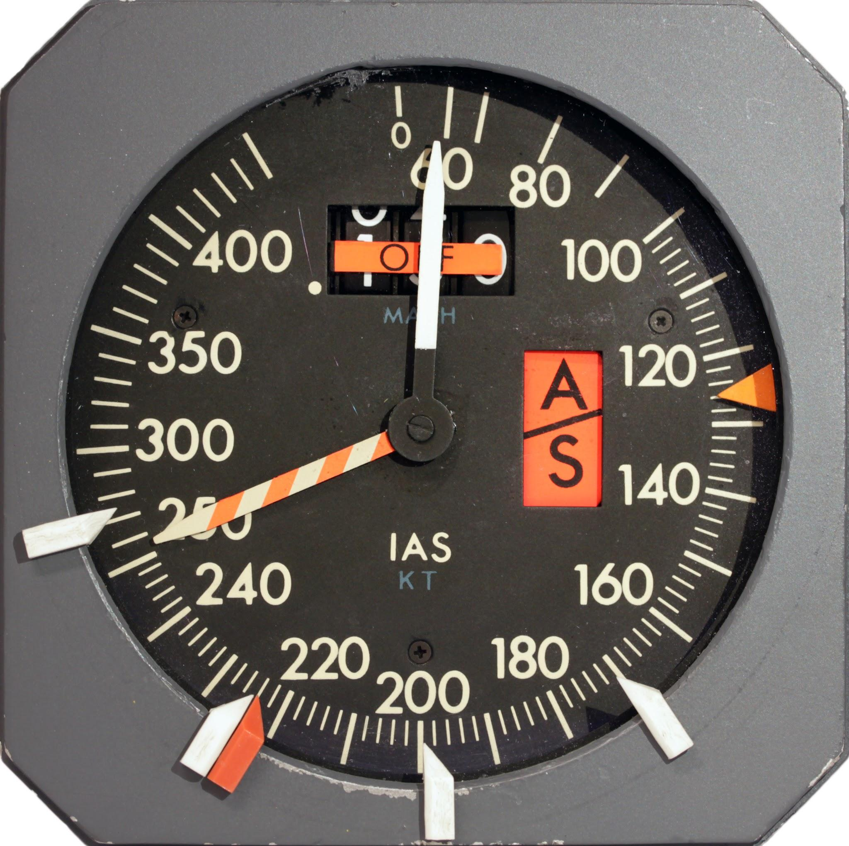
TP 2. Introduce Bernoulli’s Principle which states that liquid’s pressure drops when it's speed increases
To develop the equal and opposite reaction the wing is shaped to take advantage of Bernoulli’s Principle (BP) to make air change direction
Air behaves like a fluid because it has pressure and speed
As airspeed Increases pressure drops
A wing uses BP to deflect air which causes an equal and opposite reaction
Pressure
Airspeed

Slide 7
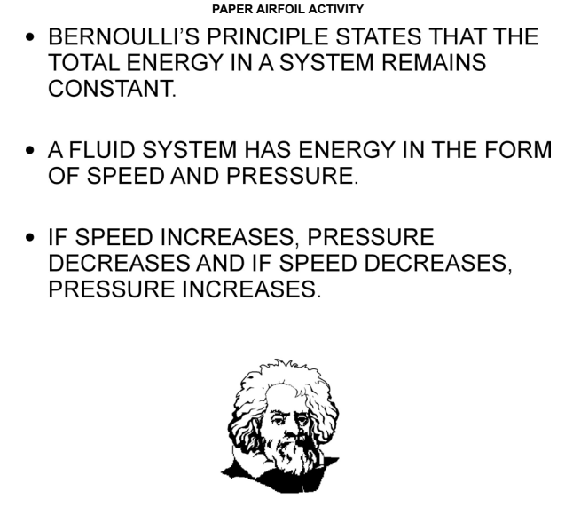
Bernoulli’s Principle

Slide 8
Confirmation Questions!
Q1. What relationship exists between air speed and air pressure?
Q2. What is the wing’s connection between Newton’s third law and Bernoulli’s Principle?
Q3. What is a wing’s shape calculated to do?
A1. An inverse relationship: as speed increases, pressure drops and as speed drops, pressure increases.
A2. A wing uses Bernoulli’s Principle to deflect air, which causes an equal and opposite reaction.
A3. A wing’s shape is calculated to decrease pressure above while increasing pressure below.

Slide 9
TP3. Have the cadets explore Bernoulli’s principle
Activity
The pressure of moving air can be examined by blowing gently over a small piece of curved paper. The air does not push the paper down as might be intuitively assumed. Instead, the paper behind the curve rises toward the moving air. This happens because the air pressure drops over the paper due to the air’s increased speed – this would seem to match the description of speed/pressure relationship. The curvature in the paper enhances the effect of the lowered air pressure.
A similar effect can be observed when air moves past any object that is light enough to be affected by the drop in air pressure associated with movement. A balloon is light enough to show this effect clearly.

Slide 10
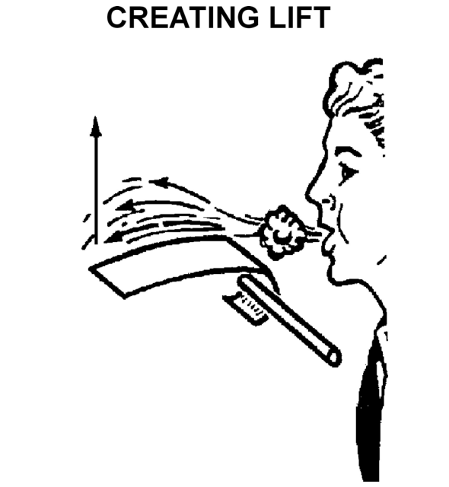
Creating lift activity

Slide 11
Confirmation Questions!
Q1. Why does the paper airfoil rise when a cadet blows over it?
Q2. Why do balloons move toward moving air?
Q3. Why was the paper deliberately curved before blowing over it?
A1. Air pressure over the paper drops as the air moves, so the still air below the paper pushes it up.
A2. Moving air pressure is lower, so still air pushes the balloon into the moving air.
A3. The curvature in the paper enhances the effect of the lowered air pressure.

Slide 12
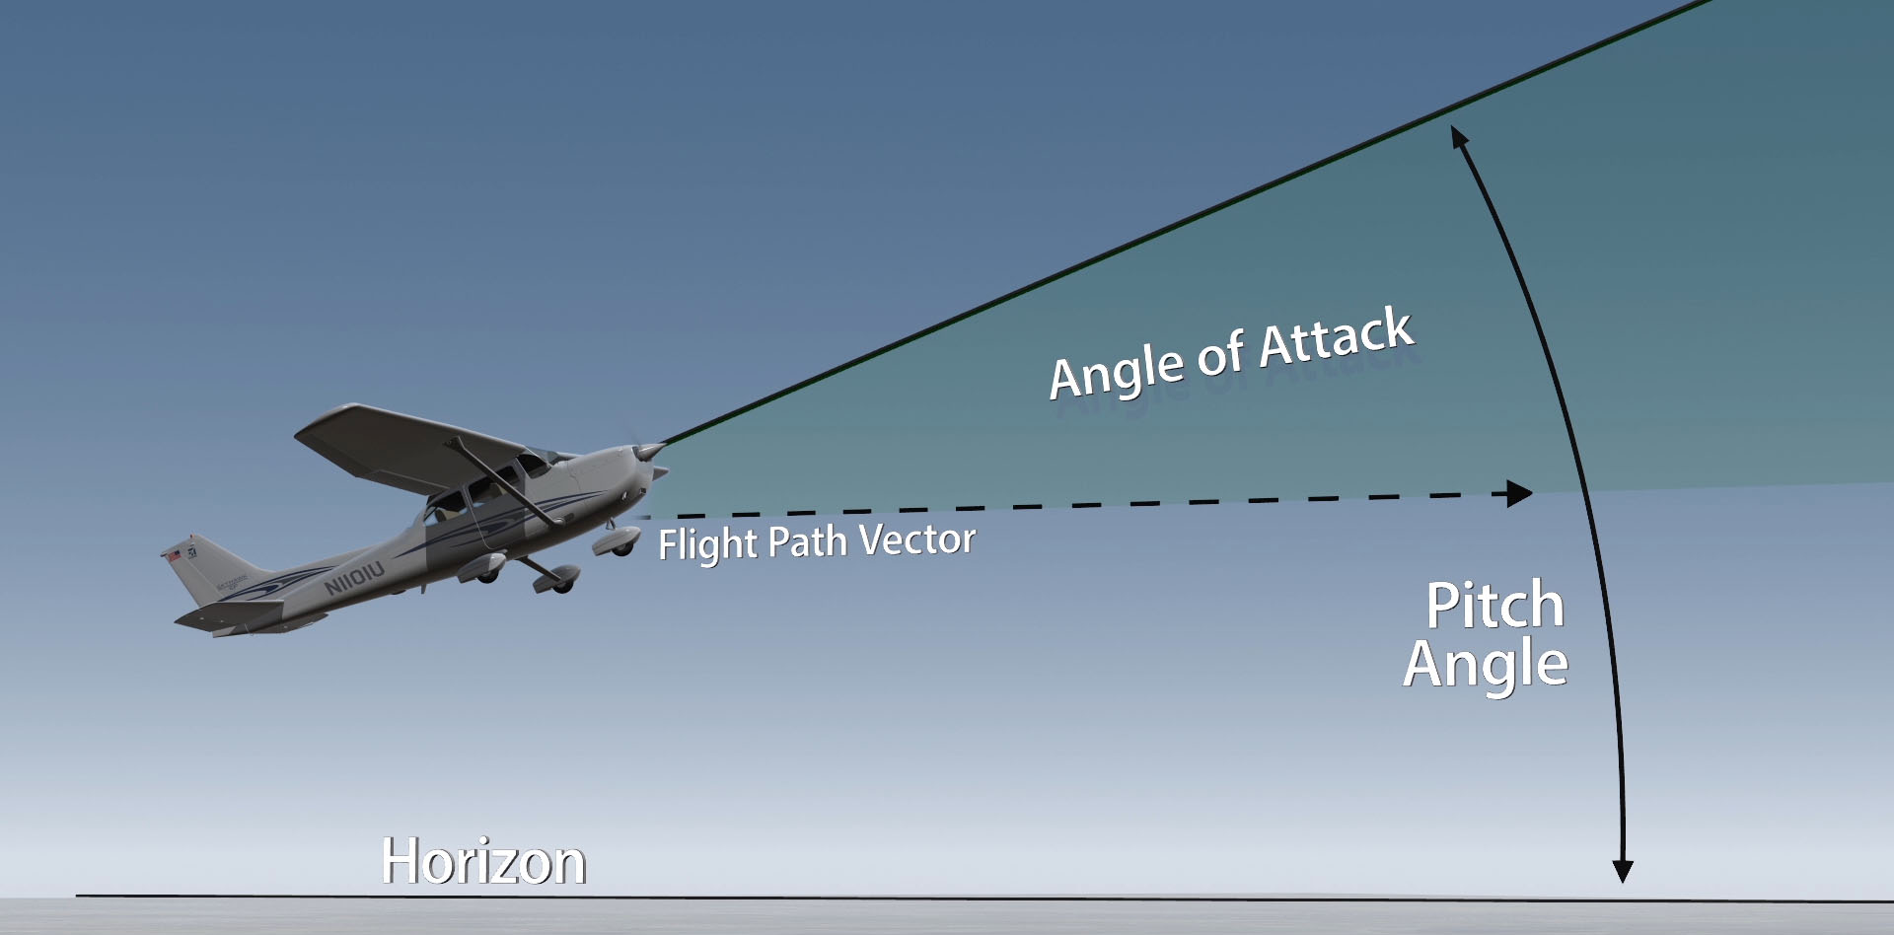
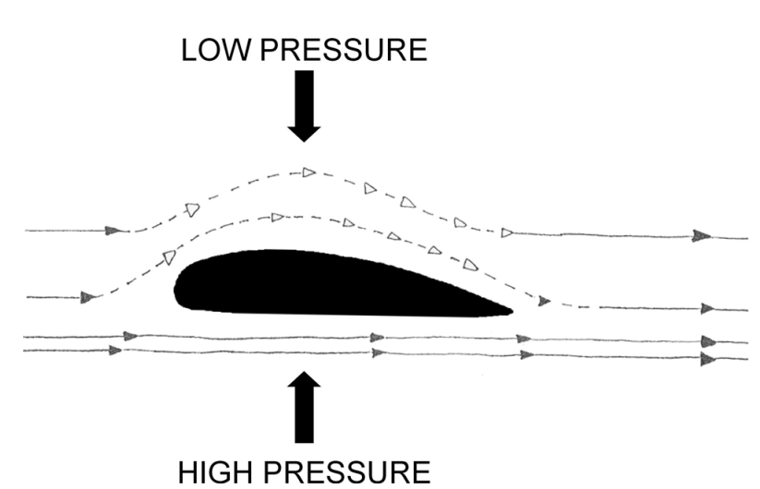
TP 4. Introduce angle of attack
An aircraft wing is an airfoil because of its cross-sectional shape
The top surface is curved outward (convex) allowing air to flow overtop further, making the air travel faster which results in lower pressure above the wing
Below the wing air is slowed to increase its pressure done by curving the surface slightly inward (concave) and by sloping the wing so that it's slightly higher at the front (leading edge) than the back (trailing edge)
This angle of the wing’s under surface which encounters moving air is called the wing’s angle of attack

Slide 13
Confirmation Questions!
Q1. Which surface of an aircraft wing is curved outward (convex)?
Q2. What shape is often given to the underside of an aircraft wing?
Q3. What happens to air pressure under a wing as angle of attack increases?
A1. The top surface of a wing is curved outward.
A2. A slight inward, or concave, curve is often given to an aircraft wing.
A3. When air’s motion is changed, an equal and opposite reaction results.

Slide 14
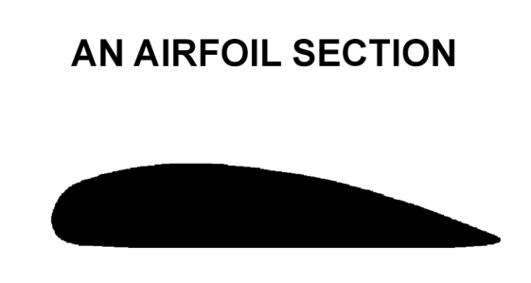
TP 5. Have each cadet create and fly an airfoil
Activity
ACTIVITY INSTRUCTIONS
Give each cadet an index card to fold into an airfoil shape with mounting holes for the launching skewers. The cadets will:
1. Fold the card in half. Tape the top of the card down to the bottom half of the card so that about 6 mm (1/4 inch) of the bottom shows, leaving the top in a curve and the bottom flat. This will produce a cross-section airfoil shape.
2. Use the hole punch (or a sharp pencil) to put two sets of holes in the thickest part of the airfoil.
3. Cut the straw so you get two pieces 5 cm (2 inches) long. Fit these mini-straws through the holes in the airfoil.
4. Set the airfoil on the base and slip a skewer or unbent paper clip through each of the mini-straws and into the base.
5. Use the hairdryer or fan to move air over the airfoil to create lift. Try it both ways—with the flat side of the airfoil on the bottom and with the flat side on the top. Note which position the airfoil is in when it climbs best.

Slide 15
End of Lesson Confirmation
Q1. How does the top surface of a wing generate lift?
Q2. How does the under-surface of a wing generate lift?
Q3. What determines how much lift is produced by a wing at a given speed?
A1. The top surface of a wing generates lift by lowering air pressure over the wing.
A2. The under-surface of a wing generates lift by raising air pressure under the wing.
A3. The angle of attack will determine how much lift is produced at a given speed.

Slide 16
EOM 231.02- Describe the production of lift by an aircraft wing
Lv.2 IG
60min

