Slide 1
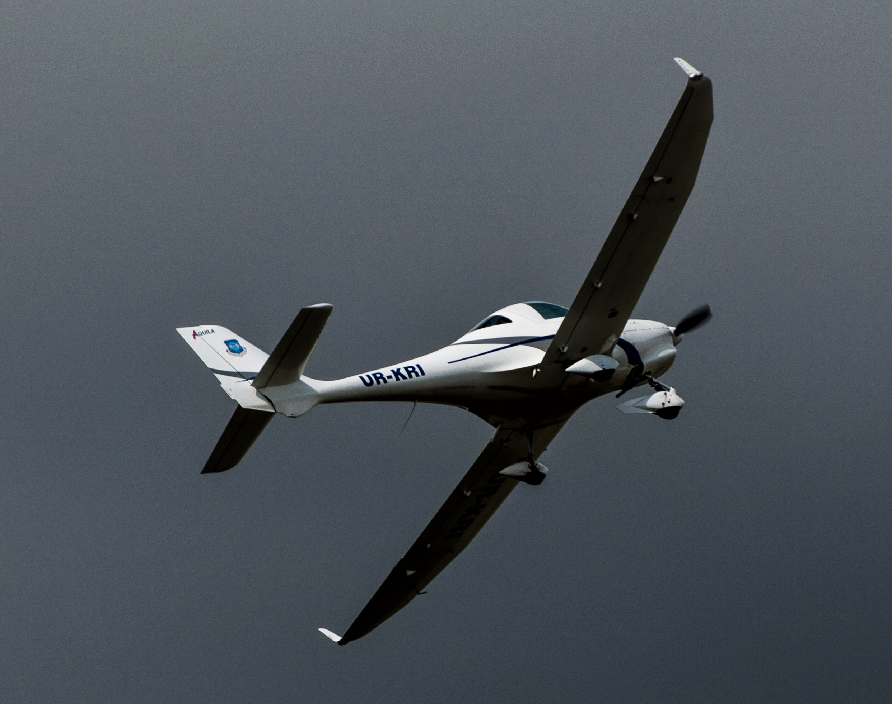
EOM231.04 – DESCRIBE THE AXIAL MOVEMENTS OF AN AIRCRAFT

Slide 2
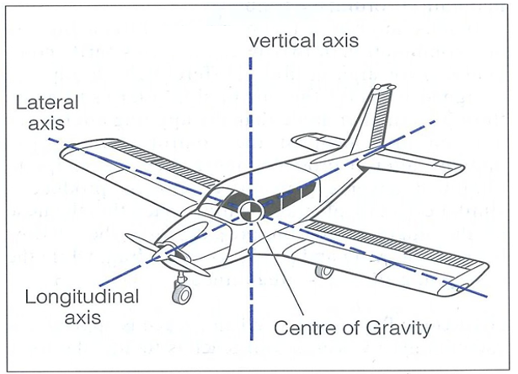
TP1 Identify the Three Axes of Aircraft Movement
All movement of the aircraft takes place around the centre of gravity
The vertical axis runs vertically through the centre of gravity.
The longitudinal axis runs lengthwise
The lateral axis runs from wingtip to wingtip

Slide 3
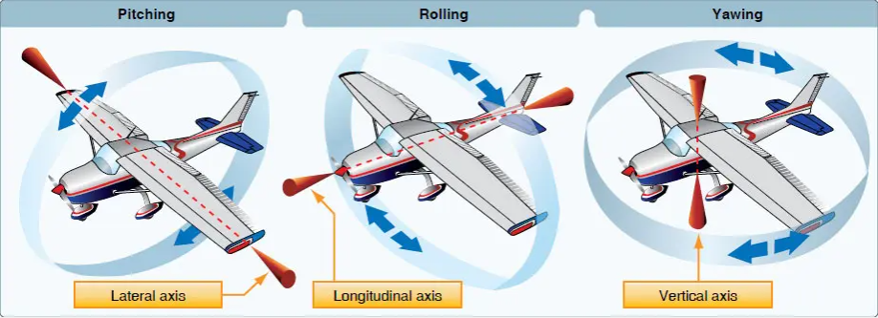
TP2 Describe the Three Axial Movements

Slide 4


Slide 5
TP3 Simultaneous Axial Movement of an Aircraft
Often, aircrafts need to perform 2 or more axial movements during flight maneuvers

Slide 6
