Slide 1
EO M231.05
Describe Aircraft Control Surfaces
Level 1 Information Guide
60 Minutes

Slide 2
Objective
Importance
By the end of this lesson the cadet shall be expected to identify and describe the locations, operations, methods and purposes of aircraft control surfaces.
It is important for cadets to learn about aircraft control surfaces so they can understand subsequent and related principles of flight.

Slide 3
Teaching
Points
TP1 | Identify Control Surface of the Empennage
TP2 | Explain How Stabilizers Reduce Unwanted Axial Movement
TP3 | Explain How the Rudder Produces Yaw
TP4 | Explain How the Elevator Controls Pitch
TP5 | Enact Control Surface Movements Controlled by a Pilot
TP6 | Identify the Wing Control Surfaces
TP7 | Explain the Operation of Ailerons
TP8 | Explain the Operation of Flaps
TP9 | Explain the Use of Trim Tabs
TP10 | Explain the Use of Dynamically Balanced Control Surfaces
TP11 | Label the Control Surfaces in a Drawing of an Aircraft

Slide 4
TP1
Identify Control
Surfaces of the Empennage

Slide 5
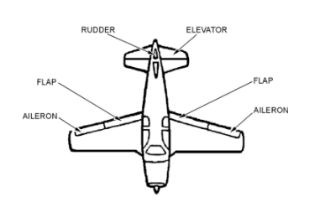
The rudder is hinged to the back of the vertical stabilizer. It is used to steer (yaw) the aircraft around the vertical axis.
The elevator is hinged to the back of the horizontal stabilizer. It is used to climb or descend by changing pitch around the lateral axis.
An aircraft’s empennage, often called the tail section. Its defining parts are the vertical and horizontal stabilizers.

Slide 6
TEACHING POINT 1
CONFIRMATION
Q1. What two stabilizers are found on the empennage?
Q2. Which two moveable control surfaces are located in the empennage?
Q3. What axial movements do the elevator and the rudder produce?

Slide 7
TEACHING POINT 1
CONFIRMATION
A1. The vertical stabilizer, or fin, and the horizontal stabilizer, or tailplane, are on the empennage.
A2. The rudder and the elevator are found in the empennage.
A3. The rudder changes yaw around the vertical axis and the elevator changes pitch around the lateral axis.

Slide 8
TP2
Explain How Stabilizers Reduce Unwanted Axial Movement

Slide 9
The vertical stabilizer, provides the aircraft with directional stability. Air moving past resists any unwanted yaw around the vertical axis.
The horizontal stabilizer, provides the aircraft with longitudinal stability. Air moving past resists unwanted roll around the longitudinal axis and unwanted pitch around the lateral axis.
Horizontal and Vertical stabilizers reduce unwanted pitch and yaw and are held straight by the passing wind

Slide 10
TEACHING POINT 2
CONFIRMATION
Q1. What axial movement does the vertical stabilizer or fin reduce?
Q2. What axial movement does the horizontal stabilizer or tailplane reduce?
Q3. How do stabilizers reduce unwanted axial movements?

Slide 11
TEACHING POINT 2
CONFIRMATION
A1. The vertical stabilizer reduces unwanted roll and unwanted yaw.
A2. The horizontal stabilizer reduces unwanted roll and unwanted pitch.
A3. Air moving past the flat stabilizer surfaces tends to resist any change of motion.

Slide 12
TP3
Explain How the Rudder Produces Yaw

Slide 13
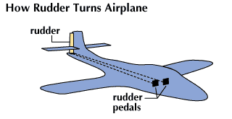
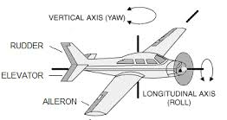
The rudder, located at the very back of the aircraft, hinged to the trailing edge of the vertical stabilizer. The rudder can be controlled to give the pilot control on the aircraft's vertical axis.
When the rudder is turned to the right side of the vertical stabilizer, the moving air will push the empennage to the left, causing the aircraft to yaw to the right around its vertical axis.
When the rudder is turned to the left side of the vertical stabilizer, the moving air will push the empennage to the right, causing the aircraft to yaw to the left around its vertical axis.
The rudder is operated by the rudder bar or pedals in the cockpit. When the bar or pedals are level the rudder is straight. Pressure applied to the right pedal moves the left pedal upwards and vice versa.

Slide 14
TEACHING POINT 3
CONFIRMATION
Q1. Where is the rudder located?
Q2. What is the rudder used for?
Q3. What controls the rudder?

Slide 15
TEACHING POINT 3
CONFIRMATION
A1. The rudder is hinged to the trailing edge of the vertical stabilizer of fin.
A2. To produce controlled yaw by rotating the aircraft about its vertical (yaw) axis.
A3. A set of pedals in the cockpit.

Slide 16
TP4
Explain How the
Elevator Controls Pitch

Slide 17
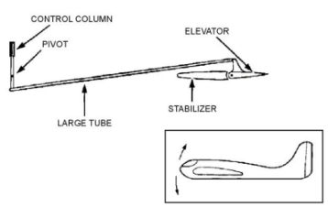
The elevator is located on the trailing edge of the horizontal stabilizer. It is used to give the pilot control over the aircraft’s lateral axis.
The pilot controls the elevator by pushing or pulling on the control column (also known as a yoke).
Pushing the control column forward lowers the elevator into the wind passing under the tailplane, pushing the empennage up. This causes the aircraft’s nose to drop and the aircraft will descend. Doing the opposite will result in the nose to rise and cause the aircraft to ascend

Slide 18
TEACHING POINT 4
CONFIRMATION
Q1. Where is the elevator control surface located?
Q2. What axial movement does the elevator control?
Q3. How does the pilot operate the elevator?

Slide 19
TEACHING POINT 4
CONFIRMATION
A1. The elevator control surface is located on the trailing edge of the horizontal stabilizer.
A2. The elevator controls pitch around the aircraft’s lateral axis.
A3. The pilot pushes on the control column to descend and pulls back to climb.

Slide 20
TP5
Enact Control
Surface Movements Controlled by a Pilot
In-Class Activity

Slide 21
In-Class Activity

Slide 22
TP6
Explain How the
Aileron Induces Roll

Slide 23
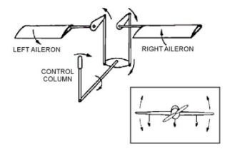
Ailerons
Ailerons are the surfaces that control roll are located near the ends of the wings on the trailing edge.
Ailerons control the aircraft's roll by changing the lift on each wing. When the
left aileron moves up↑ and the
right aileron moves down↓, the
left wing gains lift↑, and the
right wing loses lift↓,
causing the aircraft to roll right.
To stop the roll, the ailerons must be moved in the opposite direction until the aircraft levels out, then returned to neutral.

Slide 24
TEACHING POINT 6
CONFIRMATION
Q1. Which two wing control surfaces always move in opposite directions?
Q2. What axial movement do ailerons control?
Q3. How do flaps help with landings?

Slide 25
TEACHING POINT 6
CONFIRMATION
A1. The left aileron and the right ailerons.
A2. Ailerons control roll around the longitudinal axis.
A3. Flaps slow the aircraft allowing shorter landings.

Slide 26
TP7
Explain the Operation
of Ailerons

Slide 27
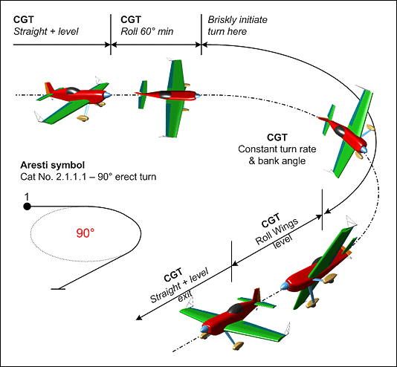
Ailerons move in opposite directions to each other and are controlled by operating the control column from side to side.
Moving the control column right lowers the left aileron and raises the right aileron, causing the aircraft to bank right.
To stop the roll and stay banked, the pilot centers the control column, retracting the ailerons. To level the aircraft, the ailerons move opposite, then return to neutral.

Slide 28
TEACHING POINT 7
CONFIRMATION
Q1. How do ailerons produce roll around the longitudinal axis?
Q2. How does the pilot control the ailerons?
Q3. How does the pilot stop the roll and stay in the banked position?

Slide 29
TEACHING POINT 7
CONFIRMATION
A1. As one aileron is raised the other is lowered so they push up on one wing and down on the other
Simultaneously.
A2. The pilot moves the control column to the left to roll to the left and to the right to roll to the right.
A3. To stop the roll and stay in a bank, the pilot returns the control column to centre.

Slide 30
TP8
Explain the Operation
of Flaps

Slide 31
The aircraft’s flaps are also located on the trailing edge of the wing, as are ailerons, but the flaps are placed nearer to the fuselage.
Flaps are used to generate lift at the expense of airspeed and both left and right flaps operate simultaneously.
Flaps are lowered to increase lift and slow the aircraft. As air moves over the lower surface of the wing, it slows down, causing the flaps to generate lift. At the same time, the flaps generate drag, which slows the aircraft. When fully lowered, the drag becomes greater than the lift.
(Flaps allow for shorter and safer landings.)

Slide 32
TEACHING POINT 8
CONFIRMATION
Q1. Where are an aircraft’s flaps located?
Q2. What are flaps used for?
Q3. How do flaps affect an aircraft’s landing performance?

Slide 33
TEACHING POINT 8
CONFIRMATION
A1. An aircraft’s flaps are located on the trailing edge of the wings, close to the fuselage.
A2. Flaps are used to slow the aircraft and simultaneously generate lift.
A3. By slowing the aircraft, flaps allow shorter and safer landings.

Slide 34
TP9
Explain the Use of Trim Tabs

Slide 35
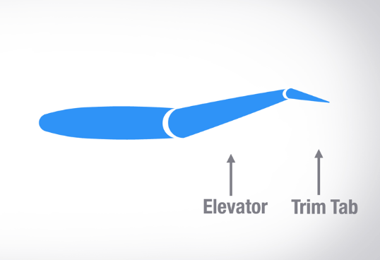
Trim tabs were developed to hold control surfaces in position without constant control pressure from the pilot.
Pilots must work hard to keep control surfaces in place, especially in crosswinds. To help with this, trim tabs were invented. These small, adjustable surfaces are attached to the edges of larger control surfaces. When extended, the wind pushes on the trim tab, holding the main control surface in position and reducing the pilot's effort.
(Often found on the trailing edge of the rudder, the elevators and on the ailerons.)

Slide 36
TEACHING POINT 9
CONFIRMATION
Q1. What are trim tabs for?
Q2. Where are trim tabs located?
Q3. How does a trim tab work?

Slide 37
TEACHING POINT 9
CONFIRMATION
A1. Trim tabs hold control surfaces in position without constant control pressure being applied by the pilot.
A2. Trim tabs are often located on the trailing edge of control surfaces.
A3. Air pushes on the trim tab when it is extended and provides force to hold the aircraft control surface in
position.

Slide 38
TP10
Explain the Use of Dynamically Balanced Control Surfaces

Slide 39
Dynamically balanced control surfaces help pilots by using air pressure to assist movement. Part of the surface extends in front of its hinge to catch the wind, reducing the effort needed to move it.
This makes the controls feel lighter and easier to handle.

Slide 40
TEACHING POINT 9
CONFIRMATION
Q1. Why are control surfaces dynamically balanced?
Q2. What do dynamically balanced controls use to help the pilot?
Q3. How does dynamic balance get the wind to help move the control surfaces?

Slide 41
TEACHING POINT 9
CONFIRMATION
A1. Control surfaces are dynamically balanced to make them easier to operate.
A2. Dynamically balanced controls use the force of the wind to help operate the control surfaces.
A3. The moving air helps operate the control surface because part of the control surface is designed to project out into the wind in front of its own hinge to catch the passing air.

Slide 42
TP11
Label the Control Surfaces in a Drawing of an Aircraft

Slide 43
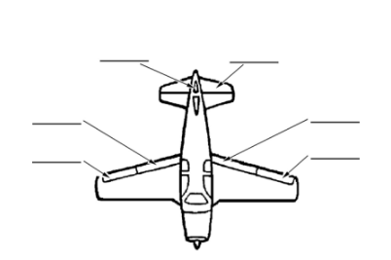
Answers Next Slide

Slide 44
Rudder
Elevator
Flap
Flap
Aileron
Aileron
The cadets’ participation in the activity will serve as the confirmation.

Slide 45
END OF LESSON CONFIRMATION
Q1. What is one moveable aircraft control surface and what is it used for?
Q2. What is a second moveable aircraft control surface and what is it used for?
Q3. What is a third moveable aircraft control surface and what is it used for?
Q4. What is a fourth moveable aircraft control surface and what is it used for?
Q5. What is a fifth moveable aircraft control surface and what is it used for?

Slide 46
END OF LESSON CONFIRMATION
A1. Elevators are used to produce controlled pitch of the aircraft.
A2. Rudders are used to produce controlled yaw of the aircraft.
A3. Ailerons are used to produce controlled roll of the aircraft.
A4. Flaps are used to create lift and slow the aircraft simultaneously.
A5. Trim tabs are used to hold the control surfaces where the pilot wants them.

Slide 47
Objective
Importance
By the end of this lesson the cadet shall be expected to identify and describe the locations, operations, methods
and purposes of aircraft control surfaces.
It is important for cadets to learn about aircraft control surfaces so they can understand subsequent and related principles of flight.

Slide 48
EO M231.05
THE END OF
Describe Aircraft Control Surfaces
Level 1 Information Guide

