Slide 1
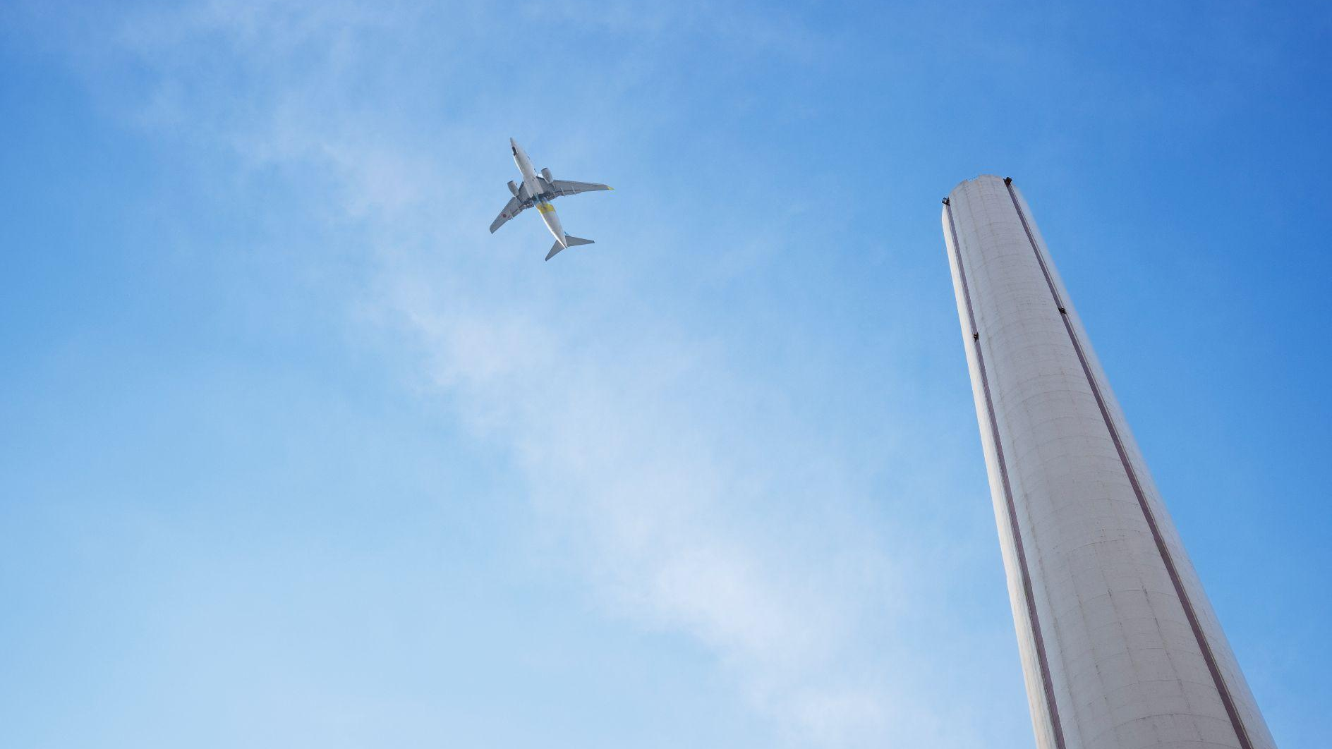

Jan 9 2024
EOM 232.01 Identify Types of Aircraft Engines
By:

Slide 2
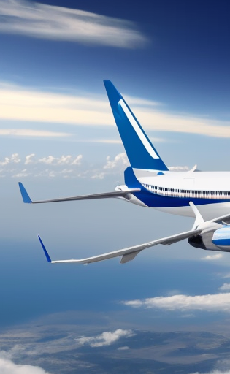
Important!
You’ll be able to identify aircraft engines
You’ll learn more about their uses in different aircrafts
Helpful for aircraft maintenance or designing

Slide 3

Teaching Points
1 2 3 4
Explain That a Powered Aircraft Needs a Means of Propulsion
Explain Combustion in Rocket, Gas Turbine and Piston-powered Engines
Explain the Oxidization Process for Different Types of Engines
Identify Aircraft and Associated Engine Types

Slide 4
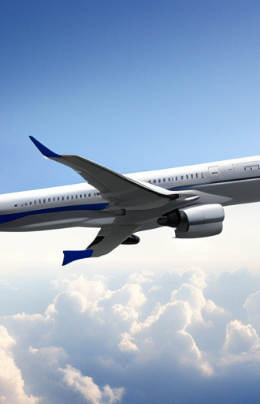
Teaching Point 1
Explain That a Powered Aircraft Needs a Means of Propulsion

Slide 5
A powered aircraft needs a propulsion to overcome drag and allow the wings to generate sufficient lift to overcome weight.
The propeller and jet engine are very closely related, providing thrust by accelerating air.
The propeller accelerates a large amount of air by a small amount
The jet engine accelerates a smaller mass of air by a large amount
The most common engine types used for aviation propulsion employ internal combustion and they include:
rocket engines
gas turbine jet engines
reciprocating piston-powered engines.

Slide 6

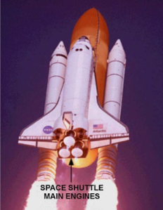
Rocket Engines
Earliest engine used for Chinese fire arrows.
Really effective method of propulsion
Commonly used today with improvements for many applications including space exploration.
Contained with their own oxidizer
Advantageous in being able to function in a vacuum such as space.

Slide 7
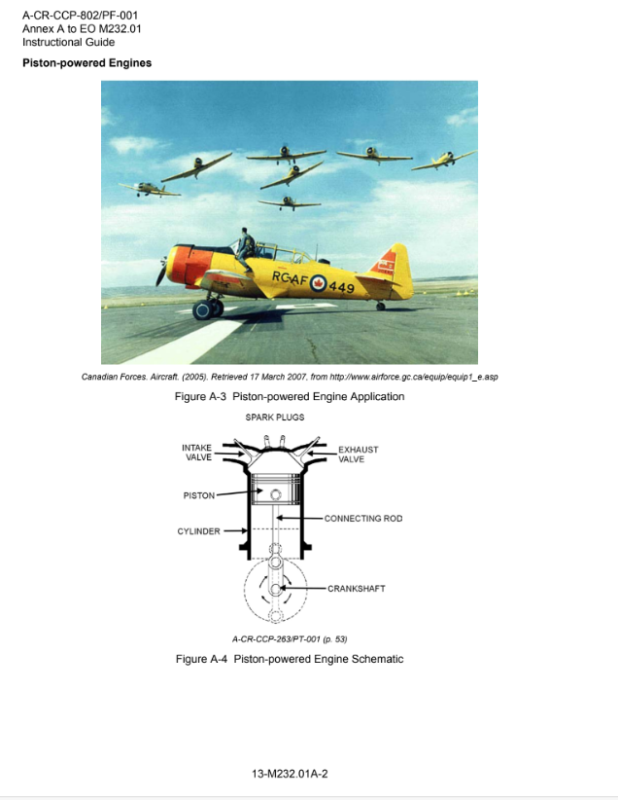
Piston-powered engines
Developed in the late nineteenth century
Most common vehicle engine of all.
Most complicated system of converting the chemical energy of fuel into motion
Found in many places
Aircraft
Automobiles
Boats
Lawnmowers

Slide 8
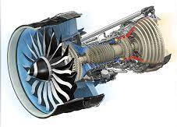
Gas turbine engines
Any turbine converts the energy of moving liquid or gases into rotary motion to turn a shaft, such as a windmill.
Gas turbine jet engines have a simple ramjet that needs high velocity airflow to run. With the turbine, high pressure air can be generated so the engine can be started from a resting position.
They must be started first with a motor before being able to produce thrust because high pressure air is required for the engine to run

Slide 9
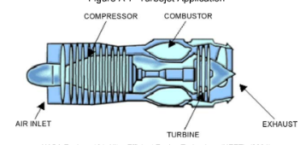
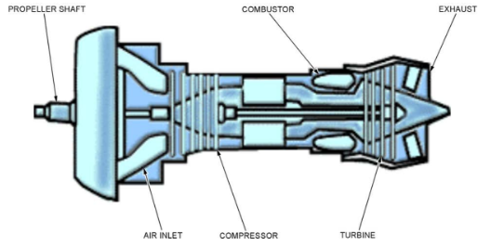
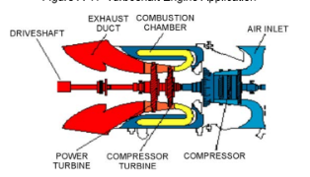
Gas Turbine variations (1/2)
A gas turbine jet engine that provides thrust, with no rotating shaft output, is a TURBOJET engine.
A gas turbine jet engine that provides thrust and also drives a propeller is a TURBOPROP engine.
A gas turbine engine that drives a helicopter rotor is usually a TURBOSHAFT engine. In a turboshaft helicopter engine, the output driveshaft is separate from the compressor turbine shaft so that engine speed is not tied to the helicopter’s main rotor speed.

Slide 10
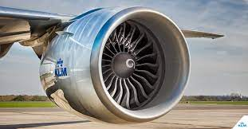
Gas Turbine Variations (2/2)
The most common variation of the gas turbine jet engine is the TURBOFAN, which is a hybrid of a turbojet and a turboprop.
The turbofan has a fan instead of a propeller that provides thrust. This allows the aircraft to go faster than normal propellers, while also reducing engine noise and being fuel efficient.
These properties make them very effective for commercial aviation.

Slide 11
TP1 Confirmation
QUESTIONS
Q1. Which engine type was the first to be used for propulsion?
Q2. What are the 4 variations of gas turbines mentioned here?
Q3. Why does a gas turbine jet engine need to have a starting motor?
ANSWERS
A1. The rocket was the first to be used for propulsion.
A2. Turbojet, Turboprop, Turboshaft, and Turbofan
A3. A gas turbine jet engine needs to have a starting motor because high-pressure air is needed to operate the engine.

Slide 12
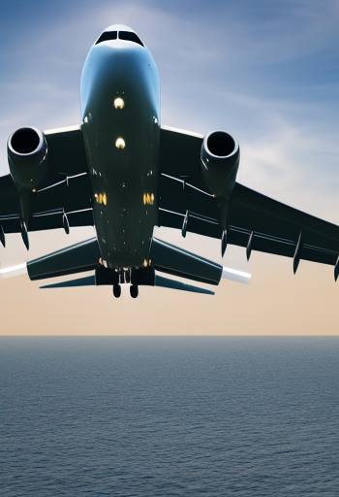
Teaching Point 2
Explain Combustion in Rocket, Gas Turbine and Piston-powered Engines

Slide 13
All rocket, jet and piston-powered engines are internal-combustion engines because they all use burning fuel to generate power from expanding gases in a closed container.
When fuel is oxidized (reacted with oxygen) it gives off heat. The heat causes expansion of the gases that result from the oxidization.
Very slow oxidization is simply oxidization
Fast oxidization, it is referred to as burning.
Very rapid oxidization is an explosion
All these processes result from fuel chemically combining with oxygen. The distinguishing characteristic between them is the speed of the reaction.

Slide 14
Usefulness of Combustion
By capturing the expanding hot gases of combustion in a tightly closed container, such as a piston-powered engine’s combustion chamber or a gas-turbine jet engine combustor, the energy of the hot gases can be put to useful work.
A common method of using this power is the turning of a shaft, such as a turbine shaft or a crankshaft. That shaft can then be used to turn an aircraft’s propeller or an automobile’s wheels.

Slide 15
TP2 Confirmation
QUESTIONS
Q1. What causes burning gases to expand?
Q2. What is the difference between fuel burning and fuel exploding?
Q3. What is a common method of using power generated by combustion?
ANSWERS
A1. The heat of combustion causes the gases to expand.
A2. The difference between burning and exploding is the speed of oxidization.
A3. Turning a shaft that can turn propellers or wheels

Slide 16
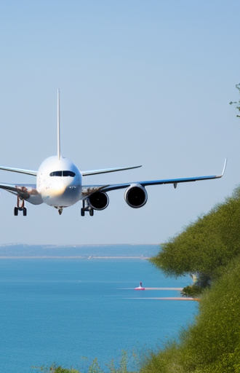
Teaching Point 3
Explain the Oxidization Process for Different Types of Engines

Slide 17
Rocket Engine
The rocket has the simplest method of oxidization and carries its own fuel and oxygen and combines them in a closed container to generate the energy.
Fuel and the oxygen must be carefully calculated and loaded before launch since a rocket can only use the loaded fuel and oxygen.
The hot expanding gases that result from an explosion in the rocket’s combustor are blasted out the back of the rocket at high speed to propel it upward.

Slide 18
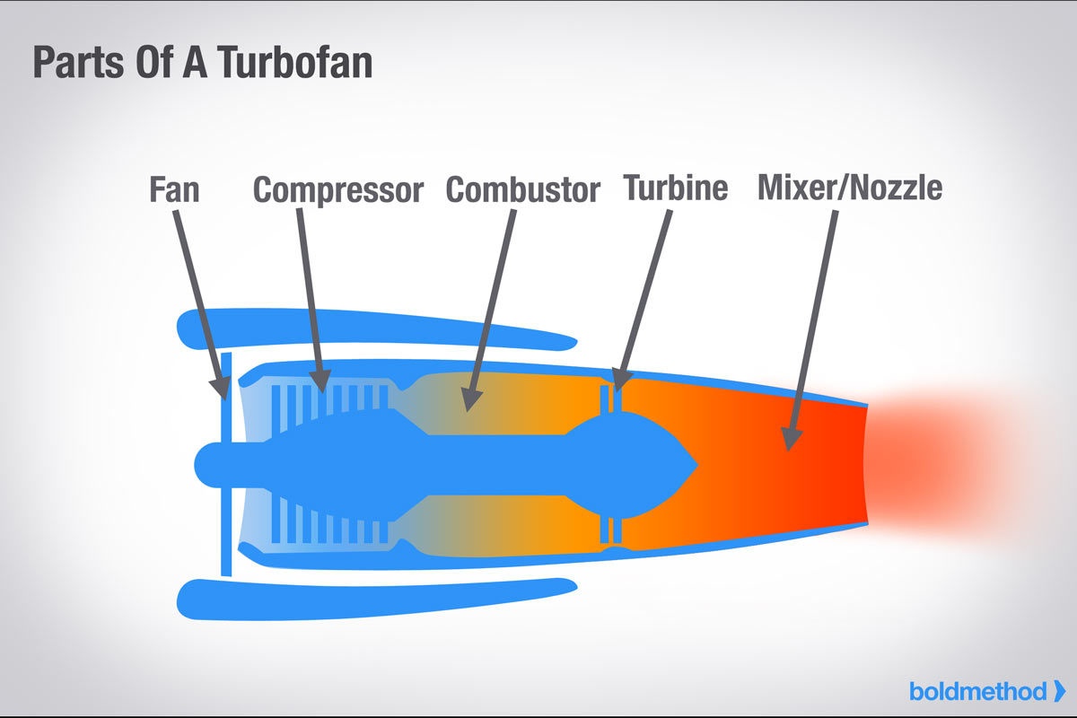
Gas Turbine Engine (1/2)
A gas turbine jet engine typically resembles a hollow cylinder with air sucked in the front and blasted out the back.
These can be seen under the wing of most airliners.
The fuel is stored in tanks, often in the wing.
The air, which contains oxygen, is sucked by a compressor fan

Slide 19
Gas Turbine Engine (2/2)
The fuel is combined with the pressurized air and the mixture is detonated in a container within the engine called a combustor.
The hot expanding gases are blasted out the back of the engine to propel the aircraft forward.
A turbine sits beside the combustor and uses a portion of the energy produced to spin a shaft that drives the compressor fan to suck the air into the engine.

Slide 20
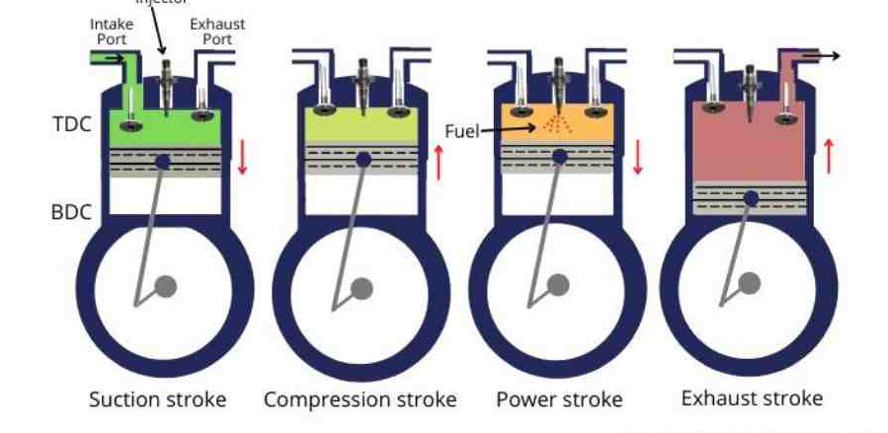
Piston-Powered Engine
The reciprocating piston-powered engine is the most common and intricate method of oxidization. In a four-stroke piston-powered engine, air is carefully mixed with small fuel droplets and then either sucked or injected into cylinders where the mixture is detonated to drive pistons in a cycle of intake, compression, power, and exhaust.

Slide 21
TP3 Confirmation
QUESTIONS
Q1. Where does a rocket get oxygen to burn fuel in outer space?
Q2. What is used to spin the turbine in a gas-turbine engine?
Q3. Where does a jet engine, such as a gas-turbine, get oxygen to burn fuel?
ANSWERS
A1. A rocket carries its own oxygen in addition to its fuel.
A2. A portion of the hot expanding gases from the engine’s combustor is used to spin the turbine.
A3. Air entering the front of the engine contains oxygen that is used for oxidization of fuel.

Slide 22
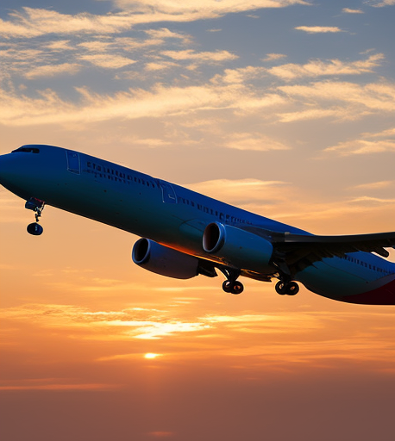
Teaching Point 4
Identify Aircraft and Associated Engine Types

Slide 23
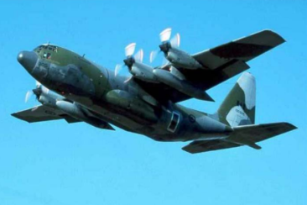
C-130 Hercules: four Alison T-56-A-7/15 turboprop engines.
The type of engines on an aircraft determined what job it was meant for: Jet-engine aircraft are generally seen as “strategic”, while turboprop-powered aircraft are “tactical”. Tactical transports are usually designed to operate on rougher, shorter, more primitive airfields than the facilities required by strategic transports.

Slide 24
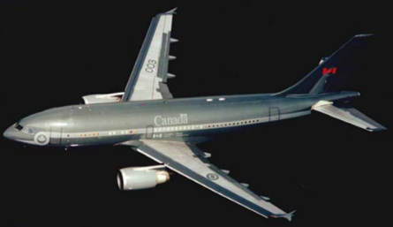
CC-150 Polaris: two General Electric CF6-80C2A2 turbofan engines.
This strategic lift aircraft’s primary role is long-range transport of people and equipment, up to 194 passengers or 32 000 kg of cargo. They have participated in operations supporting the CF, NATO and numerous UN and Red Cross initiatives.

Slide 25
Harvard North American T-6J: one nine-cylinder Pratt & Whitney radial engine.
It was assigned to No. 1 Flying Instructors School which still exists today as Canadian Forces Flying Instructors School. The training aircraft was then upgraded from the Harvard to the CT-114 Tutor. The planes were flown by the Golden Hawks, an aerobatic display team of the 1950s.

Slide 26
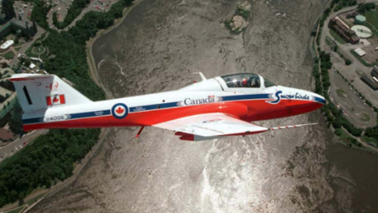
CT-114 Tutor: one General Electric J85-CAN-40 turbo jet engine.
CT-114 Tutors were flown by the Snowbirds, Canada’s world famous aerial acrobatic team. The Tutor, a Canadian designed and produced single-
engine subsonic jet trainer that entered service in the mid-1960s, was used for basic and advanced pilot training

Slide 27
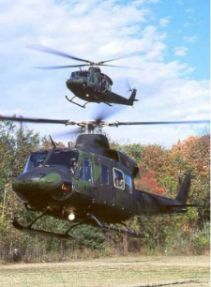
CH-146 Griffon: one Pratt & Whitney PT6T-3D turboshaft engine.
As Canada’s Utility Transport Tactical Helicopter (UTTH), the Griffon provides a reliable and cost-effective capability to conduct several operations such as airlift of equipment and personnel, surveillance and reconnaissance, casualty evacuation, search and rescue, and more.

Slide 28
End of Lesson Confirmation
QUESTIONS
Q1. Why are the rocket, gas-turbine and piston-powered engines all internal combustion engines?
Q2. What is used to spin the turbine in a gas-turbine engine?
Q3. What causes burning gases to expand?
ANSWERS
A1. The rocket, gas-turbine and piston-powered engines all use internal combustion to capture the energy
of hot expanding gases in a closed container.
A2. A portion of the hot expanding gases from the engine’s combustor is used to spin the turbine.
A3. The heat of combustion causes the gases to expand.

Slide 29

To recap we looked at:
Types of engines:
Rocket
Gas turbines
Piston-powered engine
Combustion in aircrafts
Oxidization processes in each engine
Engine applications in different aircrafts

Slide 30

Thanks for listening!
EOM232.01 Identify Types of Aircraft Engines

