Slide 1
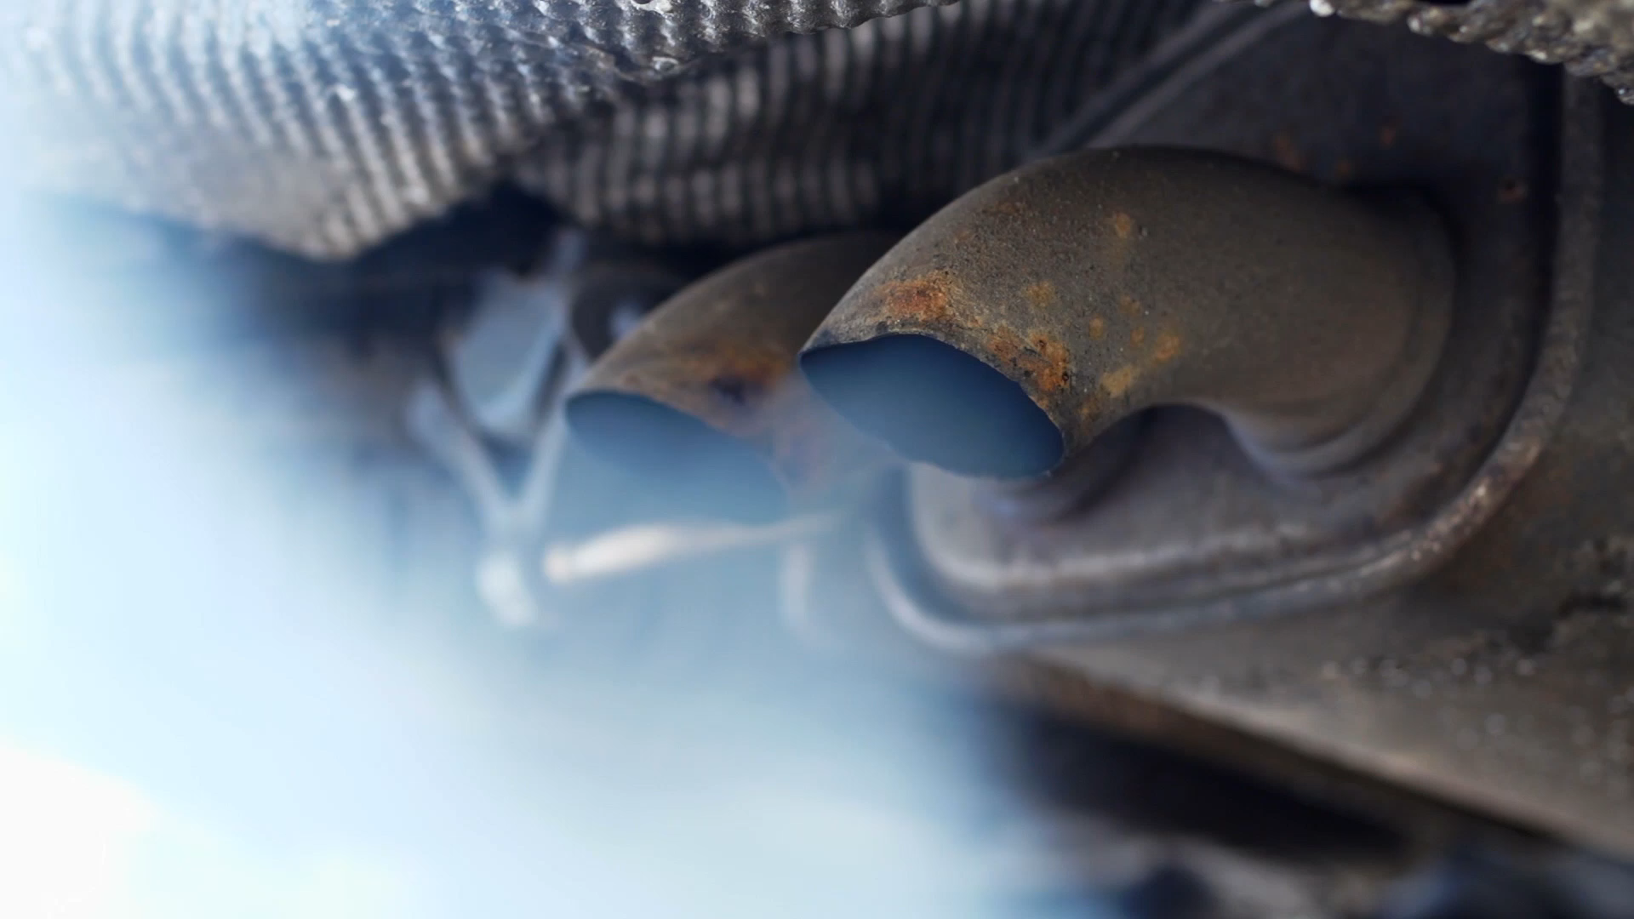
EO M232.02 – IDENTIFY THE COMPONENTS OF PISTONPOWERED INTERNAL COMBUSTION ENGINES

Slide 2
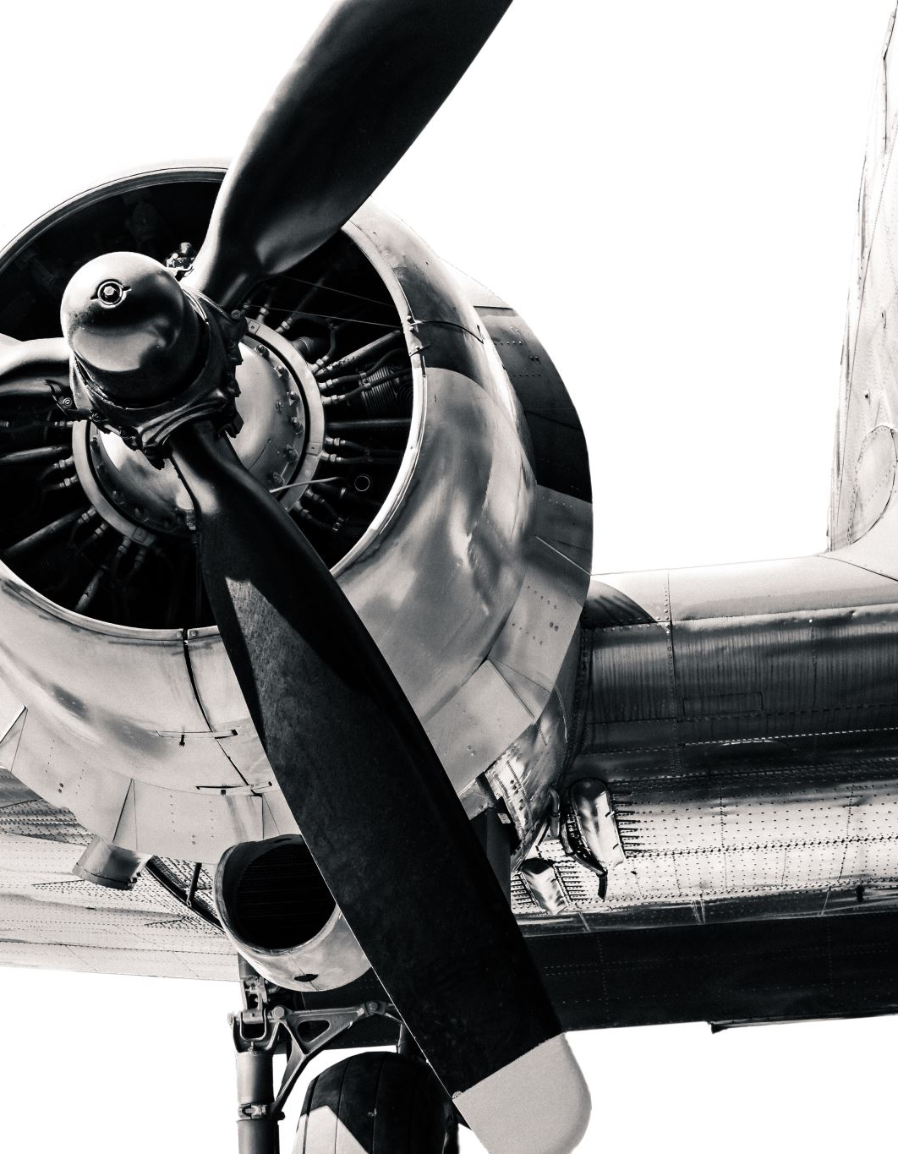
Teaching Points
TP1 Identify and Explain the Operations of the Major Components of a Piston-powered Engine
TP2 Explain the Difference Between Rotary Engines and Radial Engines
TP3 Describe Aircraft Engine Arrangements
TP4 Play a Game of Piston-powered Baseball

Slide 3
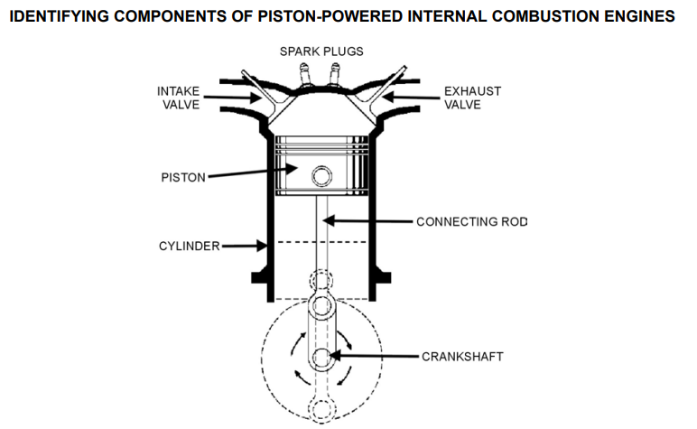
TP1 Identify and Explain the Operations of the Major Components of a Piston-powered Engine pt1
Cylinder: To understand how an engine works, it is necessary to first know what parts make up an engine. The cylinder is the main component. This is where the combustion of a gasoline and air mixture takes place
Piston: The piston is found in the cylinder and is driven up and down by the exploding air and fuel mixture

Slide 4
TP1 Identify and Explain the Operations of the Major Components of a Piston-powered Engine pt2
Connecting Rod: The connecting rod is joined to the piston and to the crankshaft with bearings which allow movement so that the reciprocating (up-and-down) motion of the piston can be transformed into rotary (spinning) motion of the crankshaft
Crankshaft: As the piston drives up and down, the connecting rod rotates around the crankshaft, turning it. The crankshaft can rotate while the piston goes up and down

Slide 5
TP1 Identify and Explain the Operations of the Major Components of a Piston-powered Engine pt3
Camshaft: The crankshaft often turns a second shaft called a camshaft
The cams are bumps on the camshaft that open and close the intake and exhaust valves at the correct time
Each cylinder has at least one set of valves operated by the cams on the camshaft
Intake valve: opens to let the mixture of gasoline and air into the cylinder and then closes.
Exhaust valve: opens to release the exhaust after mixture is burnt and then closes
Notes:
REMEMBER: DRILL TEAM AD NEXT Before we continue with this lesson, I would like to relay a quick word from our sponsor, the 110 Squadron Drill Team!

Slide 6
TP1 Identify and Explain the Operations of the Major Components of a Piston-powered Engine pt4
Distributor: The gasoline and air mixture is ignited by a spark plug. Most aircraft have 2 spark plugs in every cylinder
The fuel takes time to burn completely. Because of this, the spark must happen at a fraction of a second before the piston has reached the top. In a multi-cylinder engine such as aircraft use, an electrical signal must be sent to each cylinder’s spark plug at exactly the right time
The timing and distribution of spark sometimes relies on a central distributor, which is worked by gears from the crankshaft. Should this distributor fail, engine will stop
A better, though more expensive method, is to equip each cylinder with its own spark timing and delivery system

Slide 7
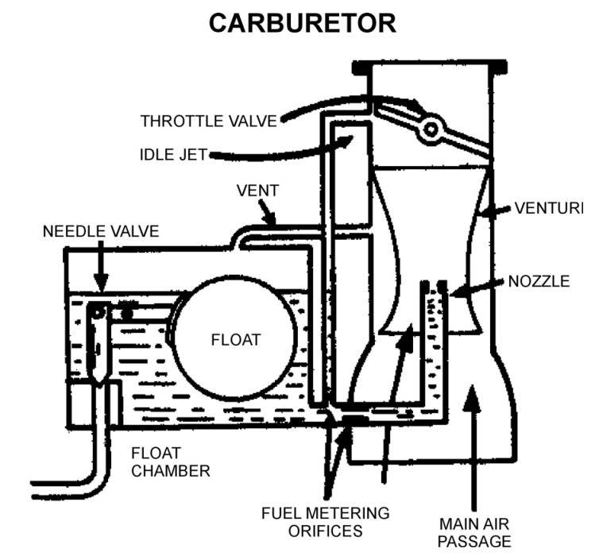
TP1 Identify and Explain the Operations of the Major Components of a Piston-powered Engine pt5
Carburetor: Before fuel is delivered to the cylinder for detonation, it is mixed with air in exact proportion. A fuel injector or a carburetor does this. For effective detonation and clean burning, the fuel must be broken into tiny droplets and mixed with air

Slide 8
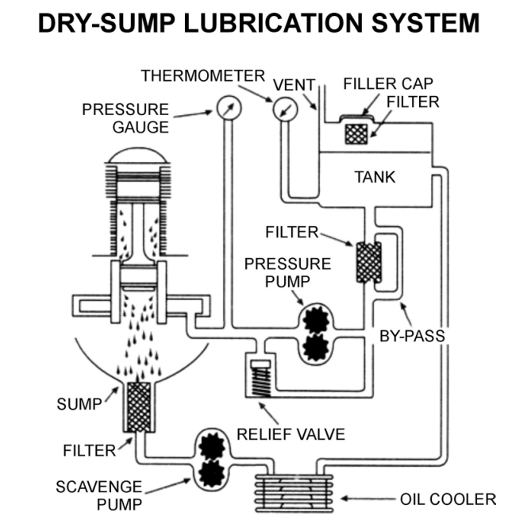
Oil Sump. The moving parts of the engine all need to be coated with engine oil. Oil is provided under pressure to make sure that all moving parts are coated. A wet sump stores the oil supply in the crankcase with the crankshaft, while a dry sump stores the oil in a separate tank and delivers it to the engine via piping

Slide 9
Which component of a piston-powered engine transforms the reciprocating motion of the piston into rotary motion?
A. Camshaft
B. Crankshaft
C. Connecting Rod
D. Distributor
Notes:
B

Slide 10
The intake valve in a piston-powered engine is responsible for:
A. Igniting the fuel mixture
B. Taking in the exhaust gases
C. Allowing the mixture of gasoline and air into the cylinder
D. Transforming reciprocating motion into rotary motion
Notes:
C

Slide 11
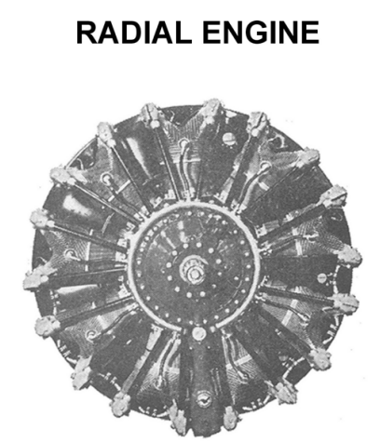
TP2 Explain the Difference Between Rotary Engines and Radial Engines pt1
Some early aircraft engines used rotary engines in which the cylinders rotated around the stationary central crankshaft
These were different than the later radial engines which the stationary cylinders were arranged around the rotating crankshaft
Many larger older aircraft had radial engines. In this design the cylinders were arranged in a circle at the front of the engine with the cylinder tops pointed outwards. The crankshaft ran through the middle of the cylinders to the front of the aircraft. Radial engines had many cylinders; some aircraft from World War II had 13 cylinders.

Slide 12
TP2 Explain the Difference Between Rotary Engines and Radial Engines pt2
Even older aircraft, before and during World War I, had rotary engines that were different but were often confused with the later radial types. In the rotary engine, the crankshaft was stationary and the cylinders rotated around the crankshaft. This is the opposite of the radial engine, which had stationary cylinders and rotating crankshaft. Rotary engine design was abandoned because the great weight of the spinning cylinders was found to interfere with turning the aircraft in flight.

Slide 13
What is the key difference between rotary engines and radial engines in early aircraft designs?
A. Rotary engines had stationary cylinders while the crankshaft rotated.
B. Rotary engines had rotating cylinders around a stationary crankshaft.
C. Radial engines had rotating cylinders around a stationary crankshaft.
D. Both engines had rotating crankshafts and cylinders.
Notes:
B

Slide 14
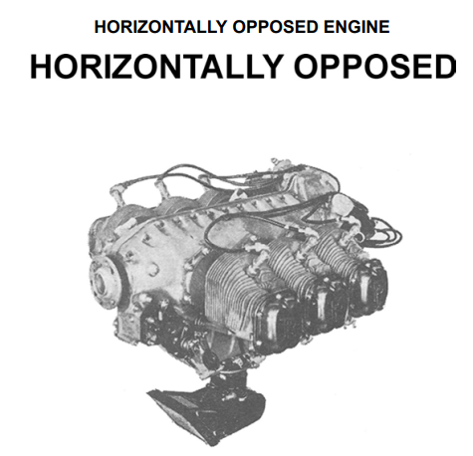
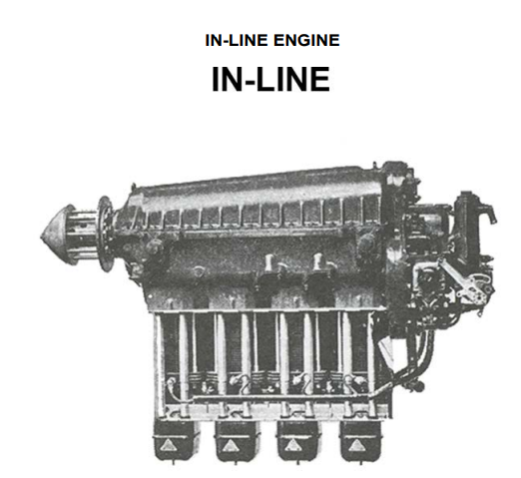
TP3 Describe Aircraft Engine Arrangements
Internal combustion engines come in a variety of styles by how the cylinders are configured.
The horizontally opposed engine is most commonly used in airplanes. This engine has two banks of cylinders lying flat, directly opposite each other and working on the same crankshaft. There may be 4, 6 or 8 cylinders. The advantage of this engine type is its flat shape that generates less form drag. Form drag is a force that opposes the aircraft’s movement through the air.
Some older aircraft have in-line engines. This was the first type of aircraft engine used greatly. In an in-line engine, the cylinders are lined up in a row from the front of the engine to the back, with the tops pointed up. The crankshaft runs under the cylinders to the front of the aircraft.

Slide 15
Which aircraft engine arrangement is most commonly used in airplanes due to its flat shape and reduced form drag?
A. In-line Engine
B. Rotary Engine
C. Radial Engine
D. Horizontally Opposed Engine
Notes:
D

Slide 16
In an in-line engine, how are the cylinders arranged?
A. In a circle with tops pointing outwards
B. Flat and opposite each other
C. Lined up in a row from front to back with tops pointed up
D. Rotating around a stationary crankshaft
Notes:
C

Slide 17
TP4 Play a Game of Piston-powered Baseball
For this review game, the instructor acts as, “pitcher”, “umpire” and “scorekeeper”.
Two teams are chosen and each is seated in a “dugout” of chairs in opposing baselines in “batting order”. A coin is tossed to see which team is at bat first.
The instructor “pitches” a question to the first batter. Teammates are encouraged to give hints to the batter, but the batter must choose the answer.
If the answer is wrong, the batter is out.
If the answer is correct, the die is thrown. If a one, two or three comes up, the player goes to first, second or third base, respectively. A four is a home run.
A five on the die means a foul ball and the player must field another question. There are two ways to be out – either answering incorrectly or rolling a six.
Players on base are “forced” ahead by the next runner and will score if forced to home base.
After three outs, the other team gets to bat.
After five runs are batted in, the next team is up at bat.
The process is repeated as long as time permits.

Slide 18
