Slide 1
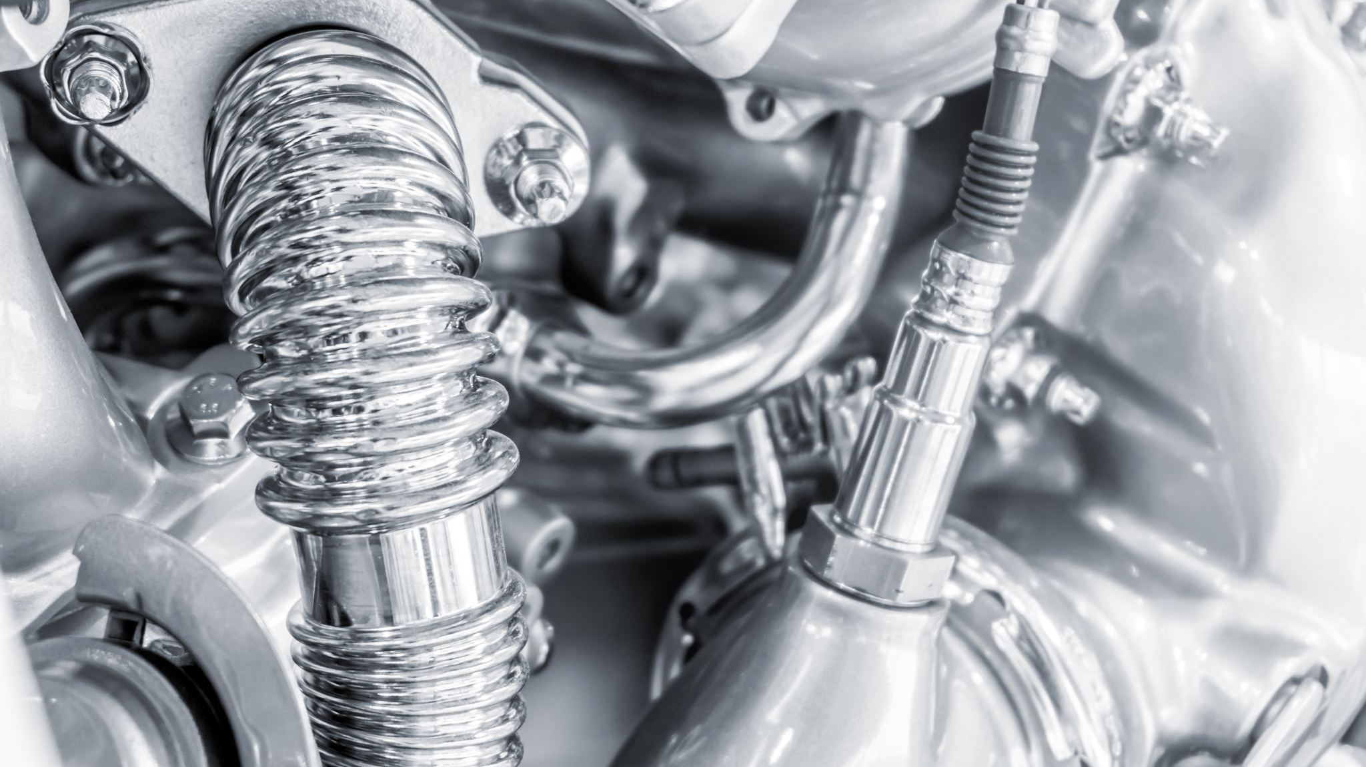


EOM232.03 – EXPLAIN THE CYCLES OF A FOUR-STROKE PISTON-POWERED ENGINE

Slide 2
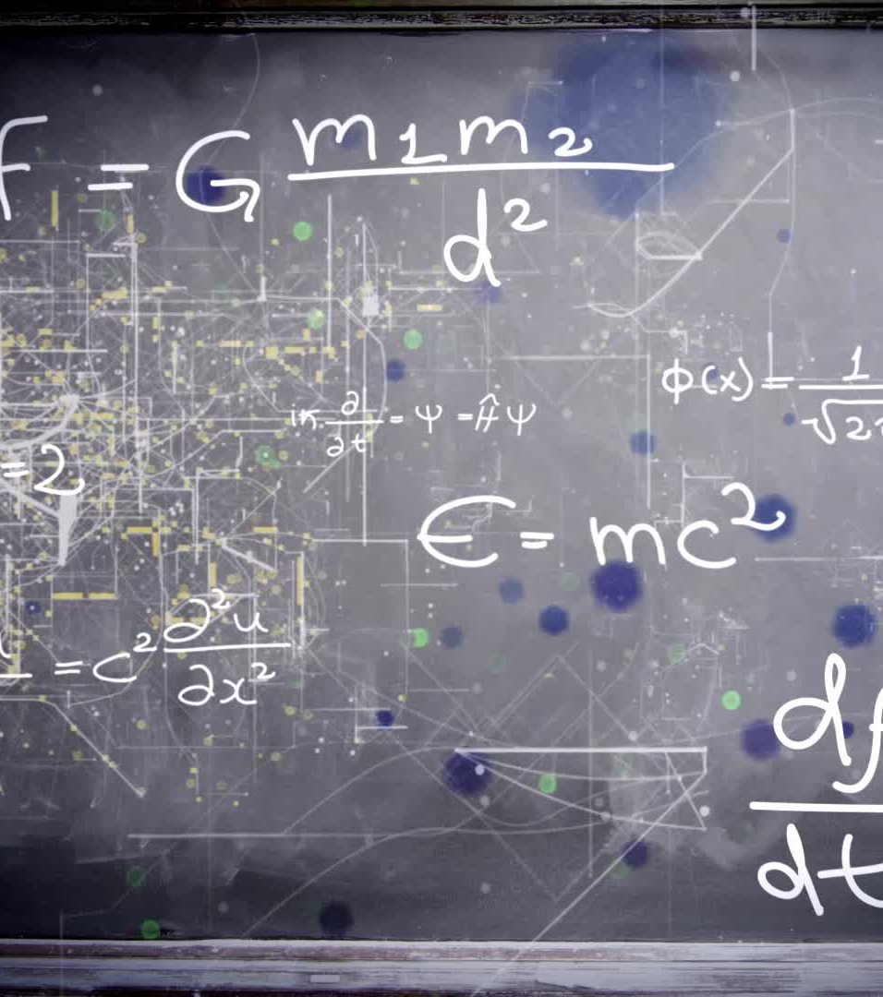

Teaching POints
TP1 Explain the Purposes of the Strokes of a Four-stroke Piston
TP2 Identify and Explain the Operation of Valves and Camshafts
TP3 Explain the Timing of Electrical Ignition Spark Distribution
TP4 Explain That all Engine Operations Must Proceed in Order

Slide 3

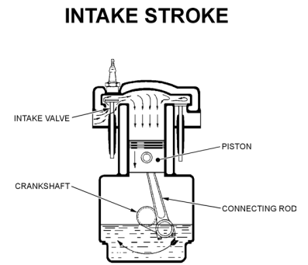
TP1 Explain the Purposes of the Strokes of a Four-stroke Piston
The parts of an engine work together in a cycle to turn the aircraft’s propeller. In most aircraft engines, this cycle has four distinct stages called strokes:
During the first (intake) stroke, the intake valve opens to let the gasoline and air mixture into the cylinder and the piston moves down to draw the mixture into the cylinder. The exhaust valve is closed during this stroke

Slide 4

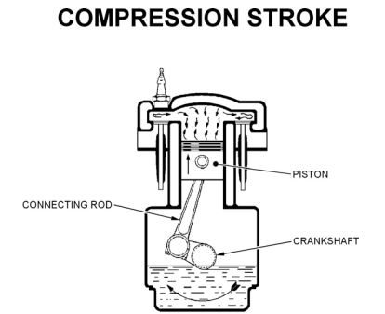
In the second (compression) stroke, both valves are closed while the piston moves up to compress the mixture

Slide 5

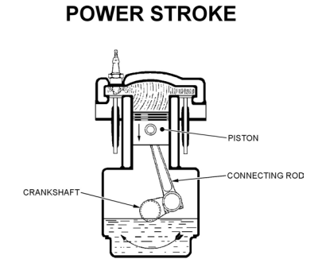
In the third (power) stroke, both valves remain closed while the spark plug ignites the gas, which burns, expands and forces the piston down again.

Slide 6

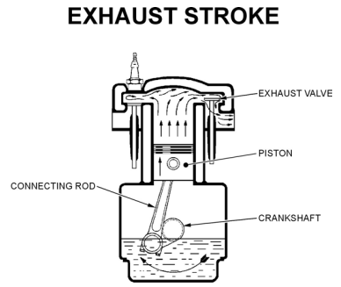
In the fourth (exhaust) stroke, the exhaust valve is open to let the burnt gases out while the intake valve is closed. The piston moves up again to force the burned gases out through the open exhaust valve.
After the exhaust stroke, the whole process repeats itself thousands of times per minute, causing the crankshaft
to turn the propeller on the aircraft.

Slide 8


Slide 9
TP2 Identify and Explain the Operation of Valves and Camshafts
Since the crankshaft rotates in time with the piston movements, its rotation is used to provide signals to the valves, telling them when to open.
The crankshaft turns a secondary shaft (camshaft) that has cams, raised on its surface. The shape of the cam is such that it mechanically pushes its associated valve open

Slide 10
TP3 Explain the Timing of Electrical Ignition Spark Distribution
Efficient, complete burning takes time. Proper timing is required.
To ensure that the fuel is burned completely, and that all energy is recovered from the fuel, the spark that sets off the detonation must be delivered while the piston is still rising on the compression stroke.
If the spark arrives during the power stroke there is not enough time to burn the fuel completely and unburned fuel is exhausted. This would be an inefficient waste of fuel Therefore, the timing of the spark plug’s electrical signal must be exact.

Slide 11

TP4 Explain That all Engine Operations Must Proceed in Order
The engine operation must proceed as follows:
Fuel and air mixture must be available for all cylinders, all the time, in a multi-cylinder engine
The intake stroke of the piston (intake valve open)(exhaust valve closed)
The compression stroke of the piston (both valves closed)
Electrical signals must be delivered to spark plugs just before the piston completes the power stroke, when both valves are closed
The power stroke of the piston (both valves closed)
The exhaust stroke of the piston (exhaust valve open)(intake valve closed)
The camshaft must push each valve open and closed at the right times

Slide 12
