Slide 1
EOM 232.04 Recognise the Functions of Oil in a 4 Stroke Piston Powered Engine
30 min lecture

Slide 2
Our end goals
Recognise the functions of oil in piston powered engines
Why oil is important to make the engine function smoothly
Note: There will be only 1 confirmation at the very end of the lesson. Please take notes!

Slide 3
Teaching Points
1 Explain That Oil Lubricates the Engine
2 Compare Friction and Heat
3 Explain That Oil Seals the Combustion Chamber
4 Explain That Oil Cools Hot Spots in the Engine
5 Explain That Oil Removes and Holds Particles Harmful to the Engine

Slide 4
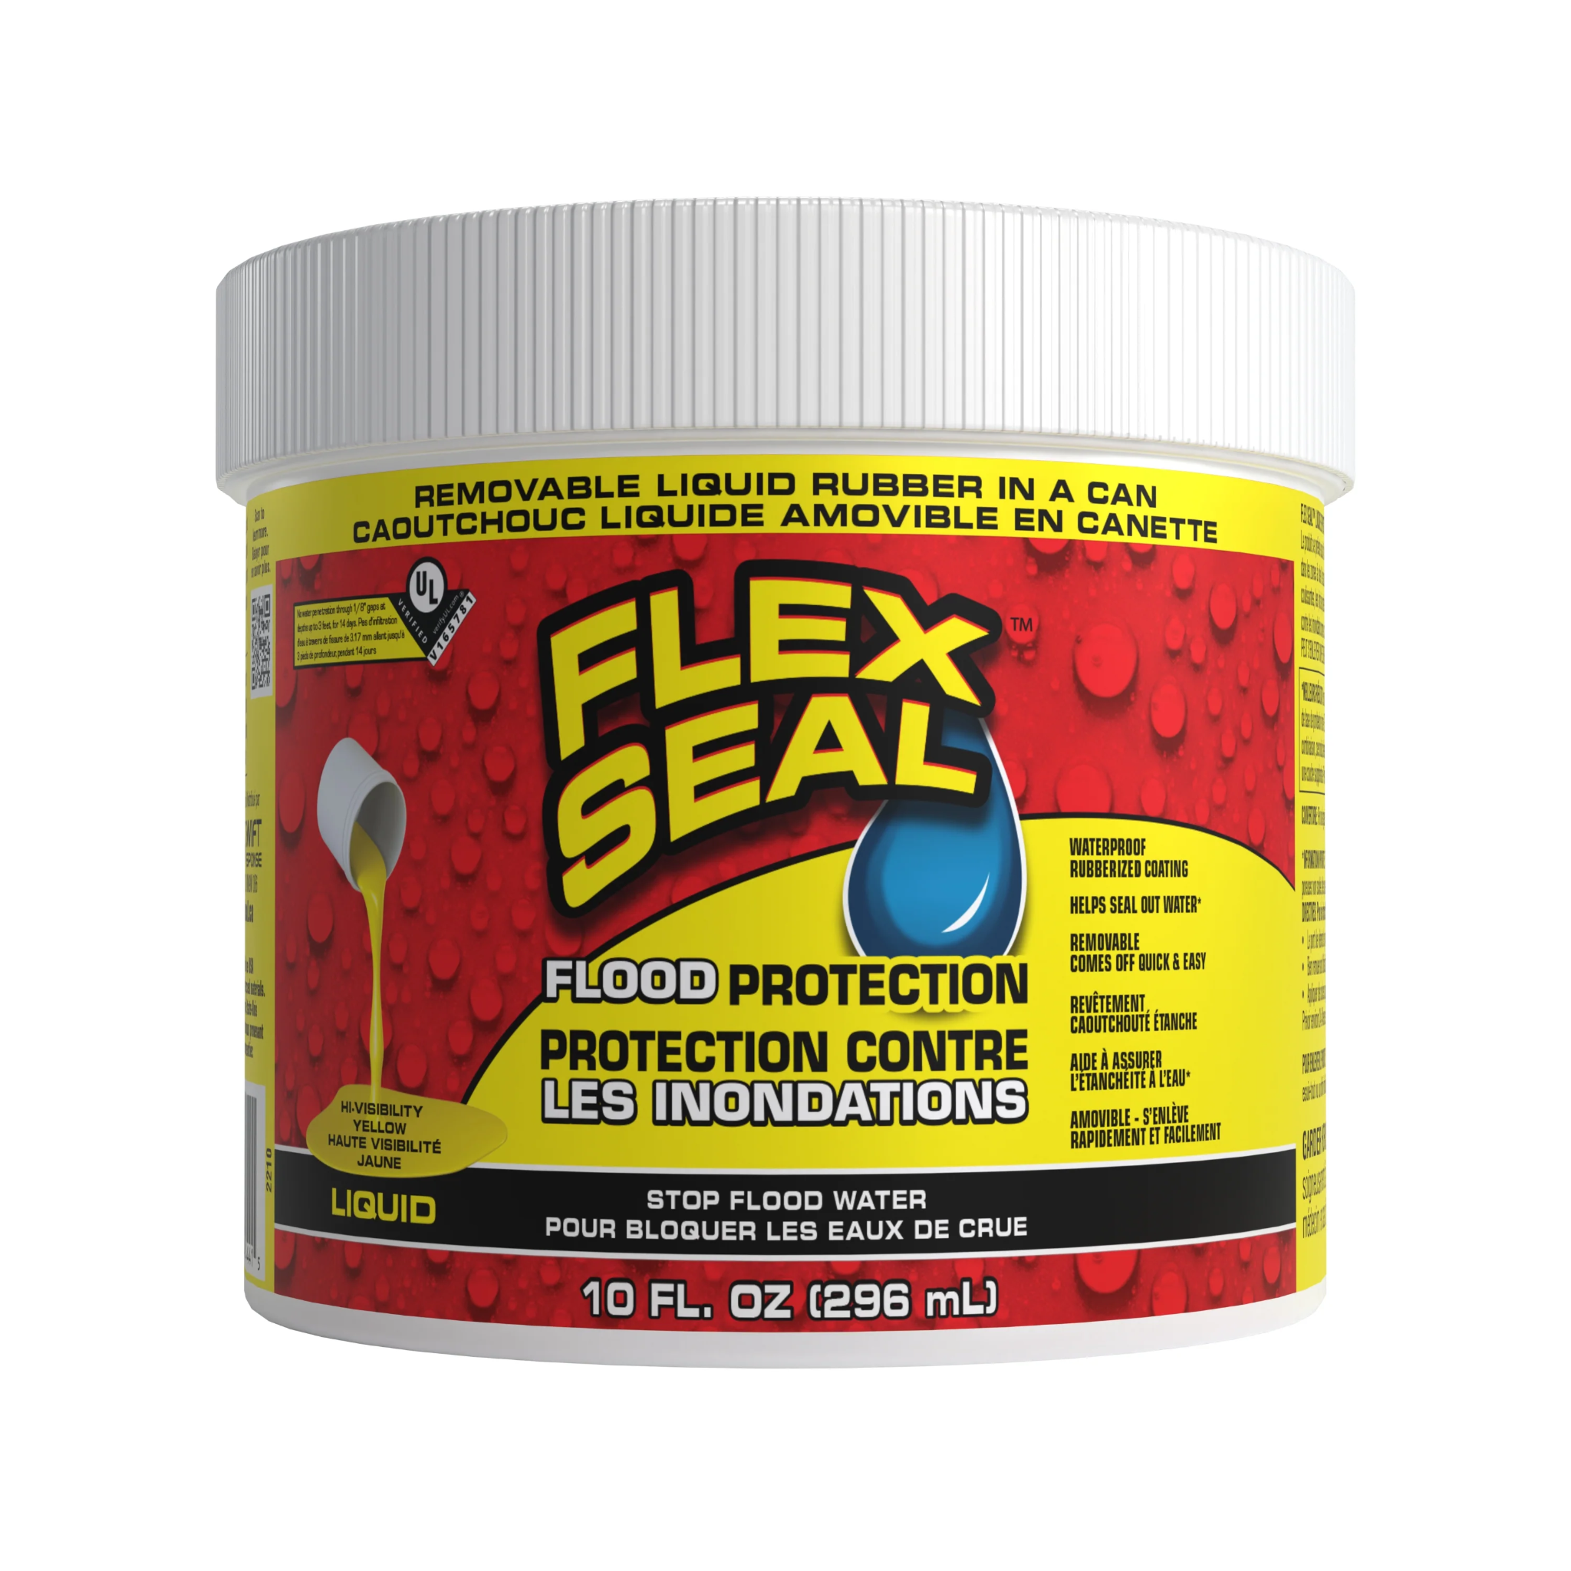
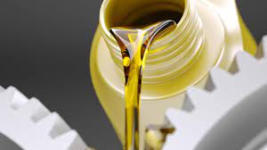
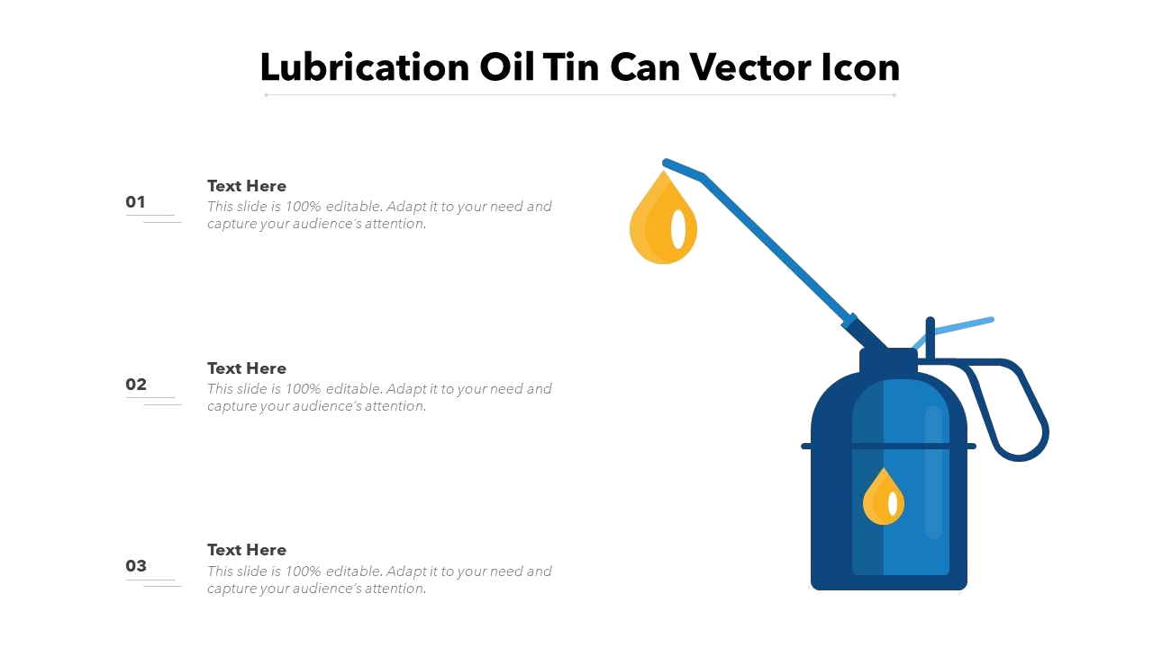
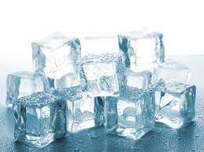
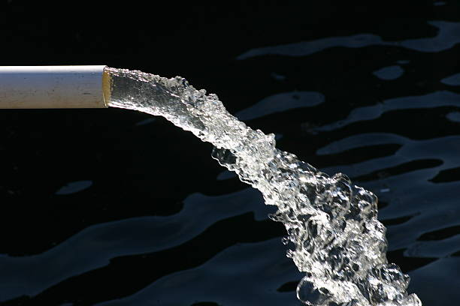
The 4 Functions of Oil !
Lubricating (TP1) Sealing (TP3)
Cooling (TP4) Flushing (TP5)

Slide 5
TP1 Explain That Oil Lubricates the Engine
LUBRICATING
Oil lubricates the engine by creating a smooth surface between parts that rub together, such as the piston when it moves up and down in the cylinder.
Oil is manufactured in different grades and viscosities. The grade of a particular sample of oil is a measure of its ability to maintain its viscosity, or resistance to flow, under extreme temperatures.

Slide 6
TP1 Explain That Oil Lubricates the Engine
The viscosity, or resistance to flow, affects the oil’s stickiness.
Low-viscosity oil flows more easily than high-viscosity oil.
Oil thins as its temperature is raised so the correct grade of oil must be selected for the intended condition when the engine is at operating temperature.
Oil that is too thin (low viscosity) will result in low oil pressure and will not protect the engine component surfaces adequately.
Oil that is too thick (high viscosity) will result in too high oil pressure and will not be delivered in sufficient quantity when the engine is cold.

Slide 7
TP1 Explain That Oil Lubricates the Engine
A good grade of oil is oil which have very small changes of viscosity in different conditions.
Cold oil is often too thick (viscous) to be delivered to the engine component’s metal surfaces in sufficient quantity so when an engine is cold it should not be run fast or given a load.
An aircraft will often be seen sitting still with the engine and propeller running while the engine oil comes up to temperature, just like a car in the winter. (yes you are suppose to warm your engine up in winter)

Slide 8
TP2 Compare Friction and Heat
How Friction Creates Heat
Movement is kinetic energy
When a moving surface comes into contact with another object, friction is generated, which converts kinetic energy into heat energy.
This is not ideal for engines because we need kinetic energy and heat energy is wasted energy, and can lower engine life.

Slide 9
TP2 Compare Friction and Heat
How can we reduce friction?
Oil creates a small layer between parts so moving parts don’t directly rub against each other.
By using oil, we can reduce the contact between moving parts and therefore, reduce friction!

Slide 10
TP3 Explain That Oil Seals the Combustion Chamber
SEALING
Oil seals the combustion chamber to prevent the expanding gases during combustion from leaking out during the power stroke.
It does this by creating a barrier between the engine components so that air and other gases cannot get through.
This is especially important in the cylinder, so that the exploding gasoline and air mixture does not escape.

Slide 11
TP3 Explain That Oil Seals the Combustion Chamber
Oil has conflicting demands to meet:
A high viscosity (resistance to flow) provides the best seal for the combustion chamber
A low viscosity enables the oil to be delivered in greater quantity to bearing surfaces.
The same oil must do both jobs and so the engine manufacturer must consider both of these competing requirements when specifying the viscosity and grade of oil to be used.

Slide 12
TP4 Explain That Oil Cools Hot Spots in the Engine
COOLING
Some parts of the engine get hotter than other parts. Areas near the combustion chamber get particularly hot and need to be cooled.
Oil cools hot spots in the engine by carrying heat away and equalizing temperature within the engine. This equalization of temperature also helps to bring a cold engine up to operating temperature quickly.

Slide 13
TP4 Explain That Oil Cools Hot Spots in the Engine
Oil must maintain its viscosity while near the heat of the combustion chamber.
Manufacturers of oil have developed viscosity modifiers that lessen the change of viscosity that results from temperature change.
Engine manufacturers take this into consideration when specifying what oil to use.

Slide 14
TP5 Explain That Oil Removes and Holds Particles Harmful to the Engine
FLUSHING
Oil flushes the engine. It removes and holds tiny particles that harm the engine. This means the oil carries away debris from the engine as it flows through. This is why it is important to change oil at frequent intervals as specified by the engine manufacturer.
As the oil is continuously circulated around the engine it passes through an oil filter. This filter fills with debris and must also be changed at regular intervals to remain effective.

Slide 15
Confirmation
Task 1: Place the correct functions of oil in the boxes below
CORRECT!
Flushing
Heating
INCORRECT
Sliding
Lubricating
INCORRECT
CORRECT!
INCORRECT
CORRECT!
Flowing
Cooling
CORRECT!
INCORRECT
Sealing
Combusting
Flowing
INCORRECT
INCORRECT
None of the above

Slide 16
Confirmation
Task 2: Answer the following multiple choice questions
What part of the engine does oil help seal?
Pistons
Combustion Chamber
Crankshaft
The entire engine
What does the viscosity number for oil mean?
Oil’s readiness to flow
Oil’s quality
Oil’s grade on its most recent math test
Oil’s resistance to flow

Slide 17
Confirmation
Task 3: Answer the following questions
How does oil clean the engine?
How does oil cool down the engine?
Explain how oil reduces friction.
Answer: It removes and holds debris found in the engine
Answer: Heat transfers to oil to equalise temperature
Answer: Oil creates a small layer between parts so moving parts don’t directly rub against each other, thus reducing friction

Slide 18
Summary
We now know…
Oil is used for
Lubricating
Sealing
Cooling
Flushing
Oil can have different viscosities
Low viscosity oil makes it easier to circulate
High viscosity oil is effective for sealing

Slide 19

THE END of EOM232.04

