Slide 1


EO M260.01 – EXPLAIN ASPECTS OF AIR TRAFFIC CONTROL (ATC)

Slide 2

Teaching Points
TP1 Explain the Role of an Air Traffic Controller at an Aerodrome
TP2 Provide a Basic Overview of Radar Technology Used in ATC
TP3 Explain NORDO (Without Radio) Procedures at a Controlled Airport

Slide 3

The power of communication

Slide 4
TP1 Explain the Role of an Air Traffic Controller at an Aerodrome
The ATC system is a vast network of people and equipment that ensures the safe operation of commercial and private aircraft.
The air traffic controller’s’ immediate concern is safety, but controllers must also direct planes efficiently to minimize delays. Their main responsibility is to organize the flow of aircraft and prevent collisions into and out of the aerodrome.
In addition, air traffic controllers keep pilots informed about changes in weather conditions such as wind shear, a sudden change in the velocity or direction of the wind that can cause the pilot to lose control of the aircraft.

Slide 5
ATC Authorization
An ATC clearance is an authorization from an ATC unit for an aircraft to proceed within controlled airspace under specific conditions. Some air traffic controllers regulate traffic through designated airspaces; others regulate airport arrivals and departures.

Slide 6
TP2 Provide a Basic Overview of Radar Technology Used in ATC
RADAR
The name “RADAR” is an abbreviation for “radio detection and ranging”. To operate, radar requires a highly directional radio transmitter/antenna and a scope/screen, to display the information received by the antenna.
The use of radar in ATC greatly increases the utilization of the airspace and permits expansion of flight information services such as traffic and weather information and navigational assistance.
ATC
Fixing positions of airplanes in flight
Detecting thunderstorm activity
Approaching and landing guidance to airplanes.
Used in:

Slide 7
TP3 Explain NORDO (Without Radio) Procedures at a Controlled Airport
NORDO
Aircraft with no radio (NORDO) are not permitted to operate at most large controlled airports served by the scheduled air carriers.
Where they are permitted to operate (less busy controlled airports), they are directed by visual signals. A pilot must be alert to the light signals from the tower letting you know what to do.
Prior to initiating a NORDO flight, the pilot should contact the control tower to inform the controllers of their intentions and to secure a clearance for operation within the airspace. The tower will then be expecting the pilot and will be prepared to give the pilot light signals.

Slide 8
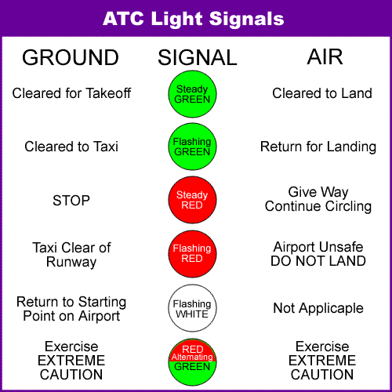
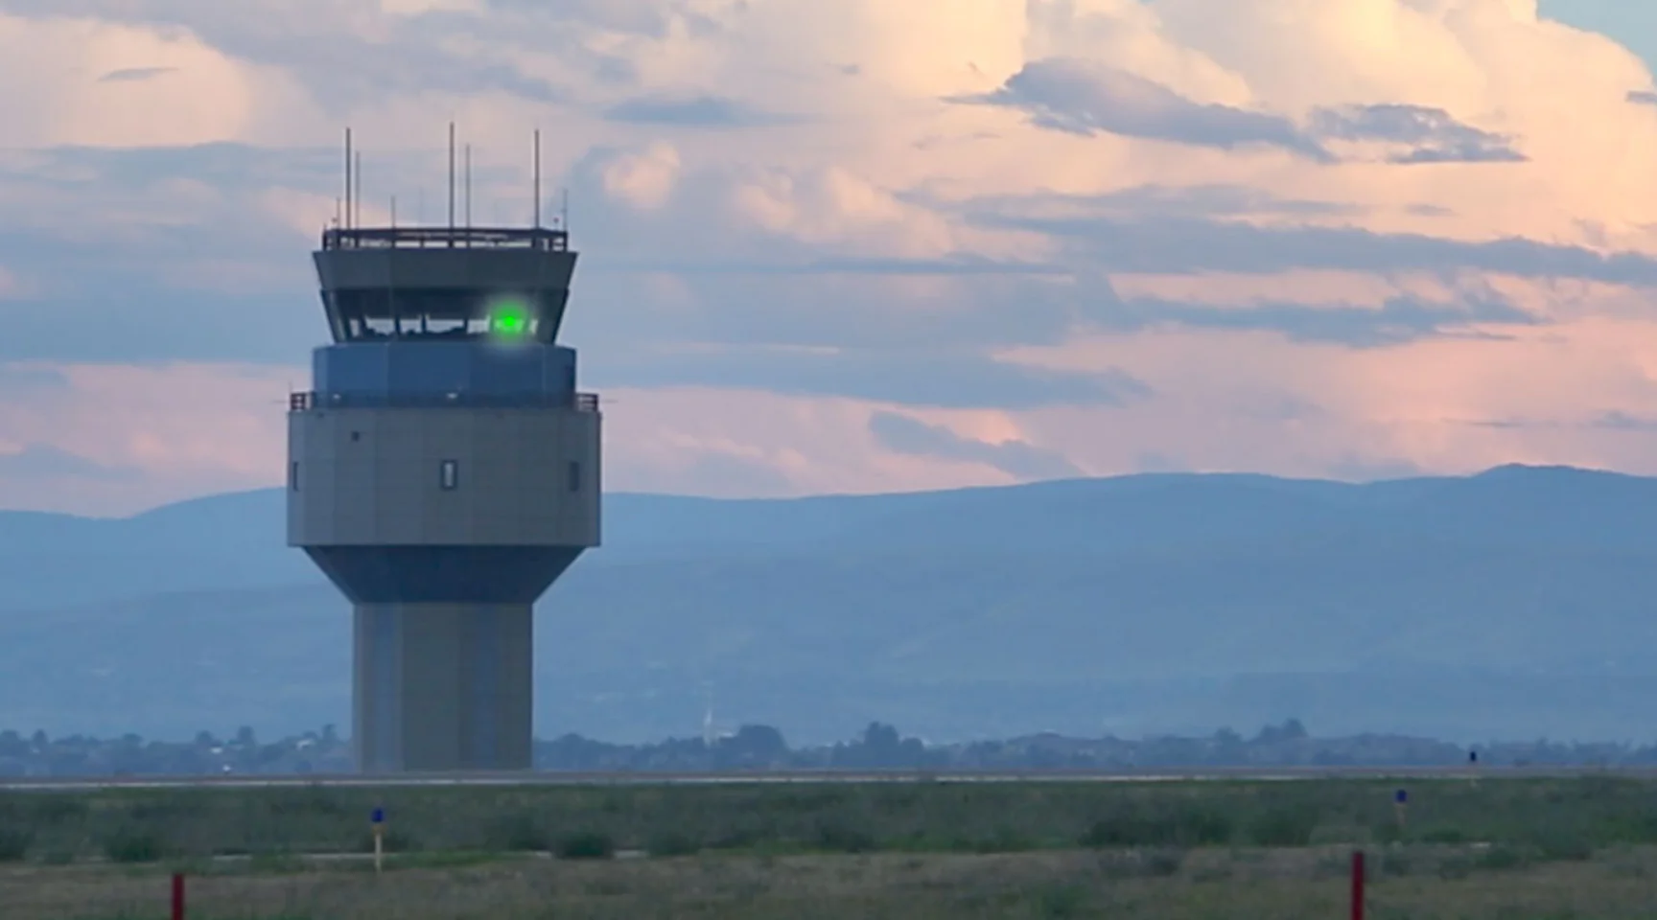
Departing Aircraft
Arriving Aircraft

