Slide 1
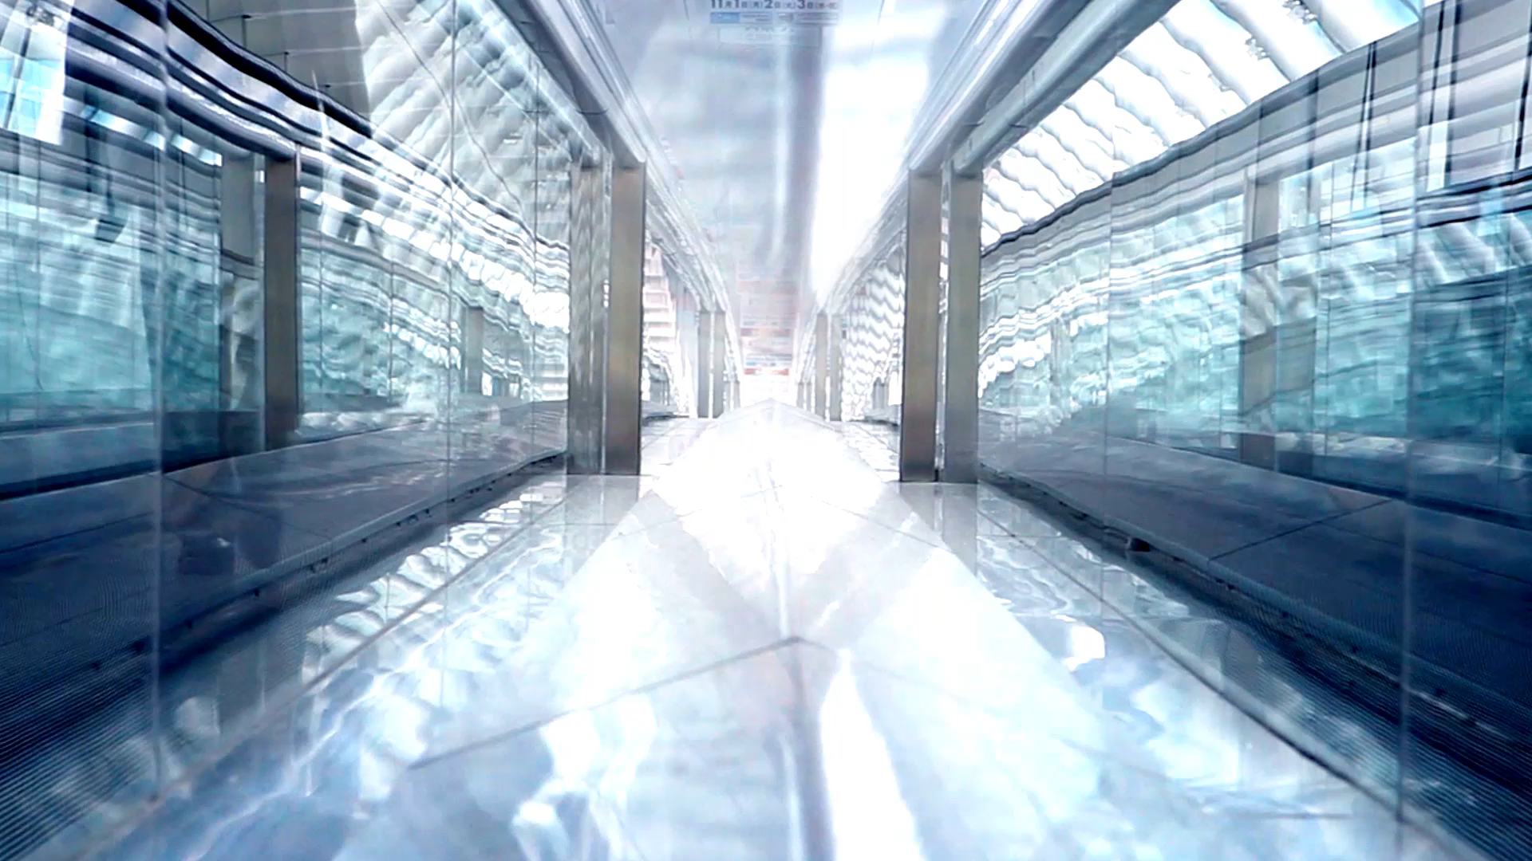
EOM260.02 – IDENTIFY ASPECTS OF BASIC AERODROME OPERATIONS

Slide 2
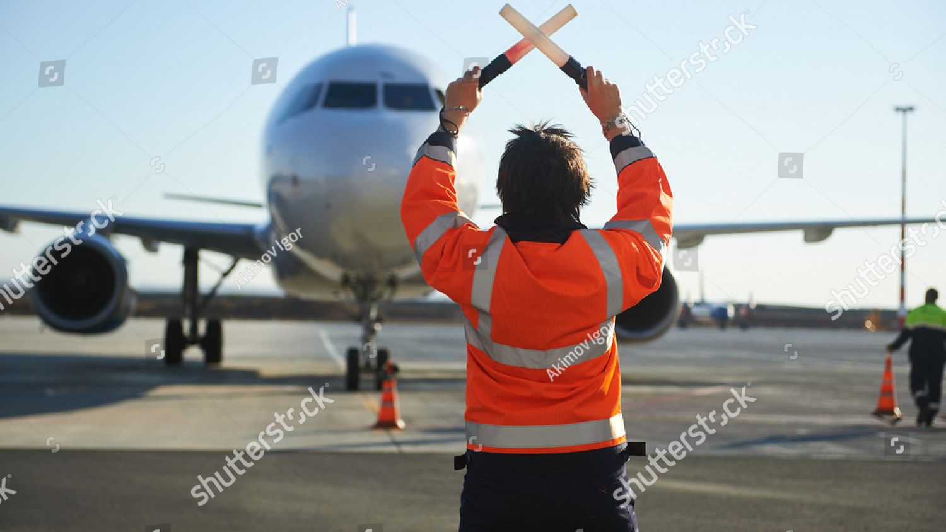
Teaching Points
TP1 Discuss Basic Aerodrome Operations
TP2 Explain the Role of Ground Controllers
TP3 Explain that Ground Facilities and Services Assist With Aircraft Arrivals and Departures
TP4 Explain What the Canadian Air Transport Security Authority (CATSA) Is and Outline its Duties

Slide 3
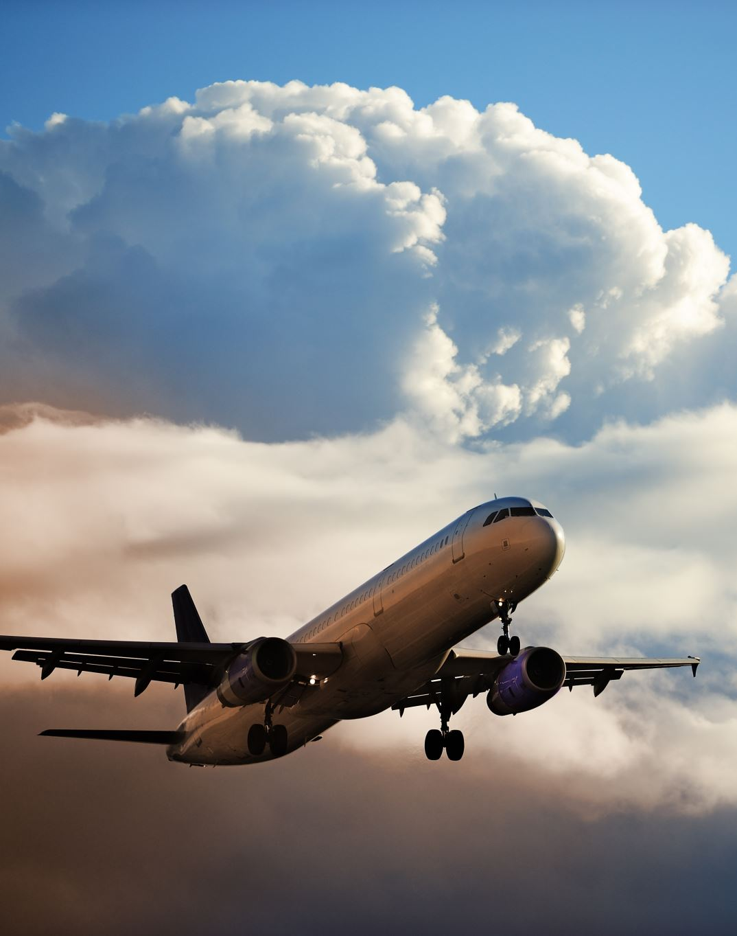
TP1 Discuss Basic Aerodrome Operations
3 Categories
Air Traffic Control
Ground Control
Airport Maintenance

Slide 4
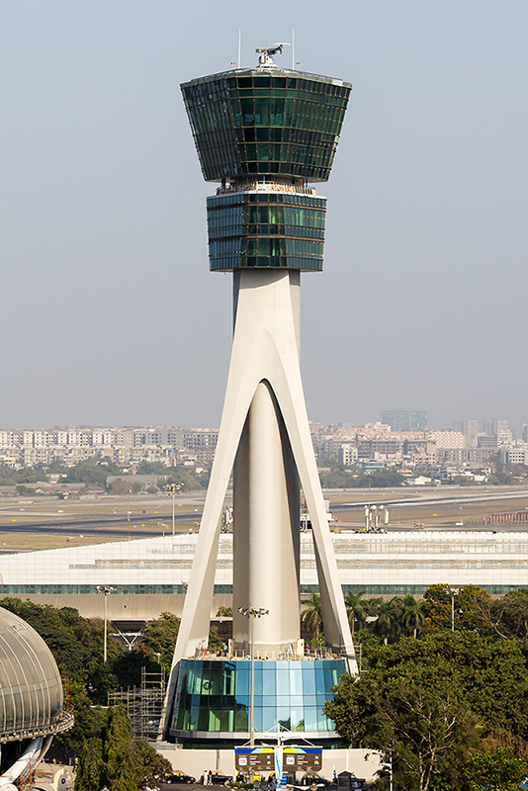

AIR TRAFFIC CONTROL
Who is actually in control of the aircraft?
Most would say that the pilot has control of the direction and course of the aircraft but they would be mistaken
The task of ensuring safe operations of aircrafts falls on air traffic controllers
They must coordinate movements of thousands of aircrafts, keep them at safe distances from each other, direct them during takeoff and landing,around bad weather and ensure that traffic flows smoothly with minimal delays

Slide 5
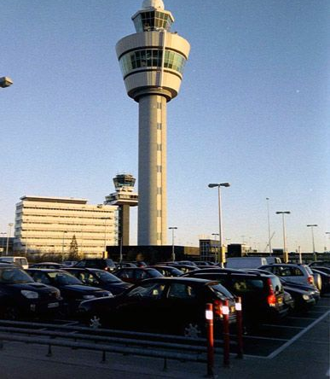
GROUND CONTROL
Ground control is responsible for the airport “manoeuvering” areas, or areas not released to the airlines or other users.
This generally includes all taxiways, holding areas, and some transitional aprons or intersections where aircraft have arrived and vacated the runways and departure gates.

Slide 6
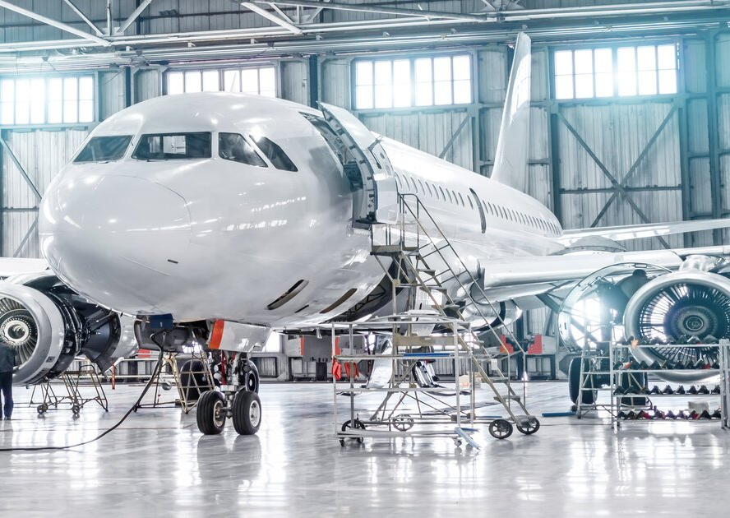
AIRPORT MAINTENANCE
Airport maintenance is responsible for a variety of airport field maintenance work, including general maintenance and construction work
They operate equipment and service a variety of power and general maintenance equipment in the upkeep of runways, taxiways, and aprons as well as perform other related duties.

Slide 7
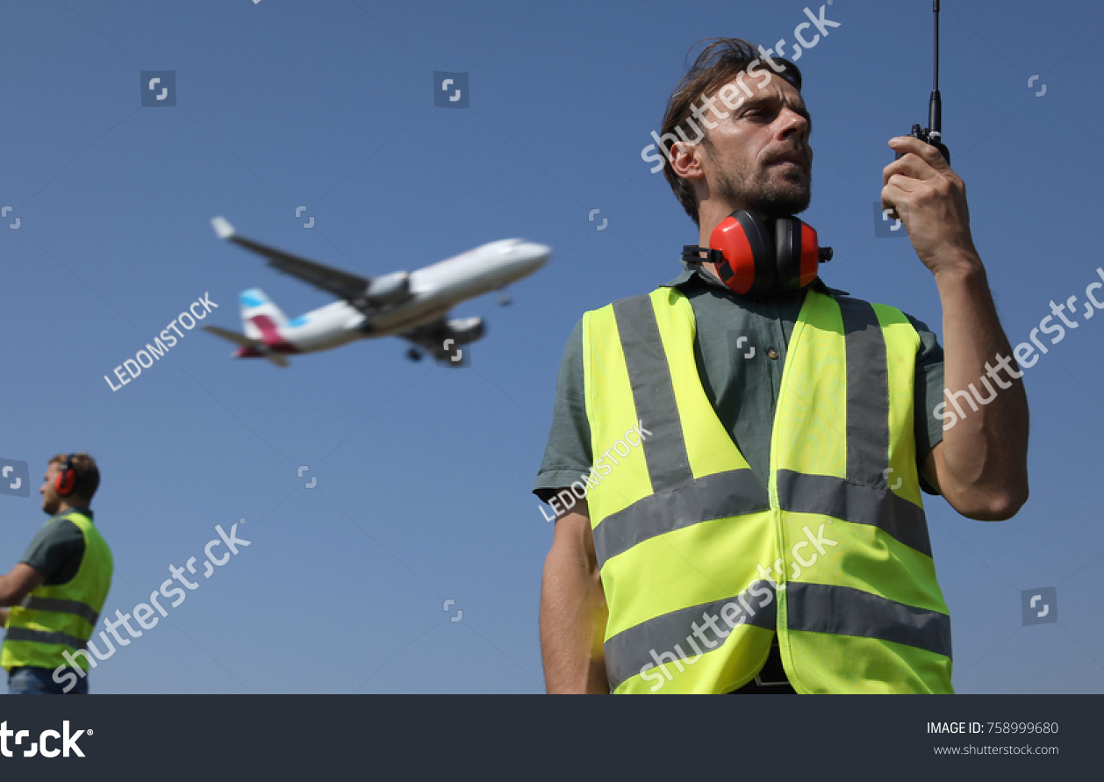
TP2 Explain the Role of Ground Controllers
The goal of ground controllers is to maintain aircraft in such a manner as to assure safe flight
They provide clearance for aircraft-to-taxi on the ground at the aerodrome while creating a safe environment while an aircraft is on the ground.
Once an aircraft has landed, ground controllers provide taxi information to pilots about passenger gates and jetways.
Marshalling personnel assist aircrafts when arriving at and departing from passenger gates and jetways.

Slide 8
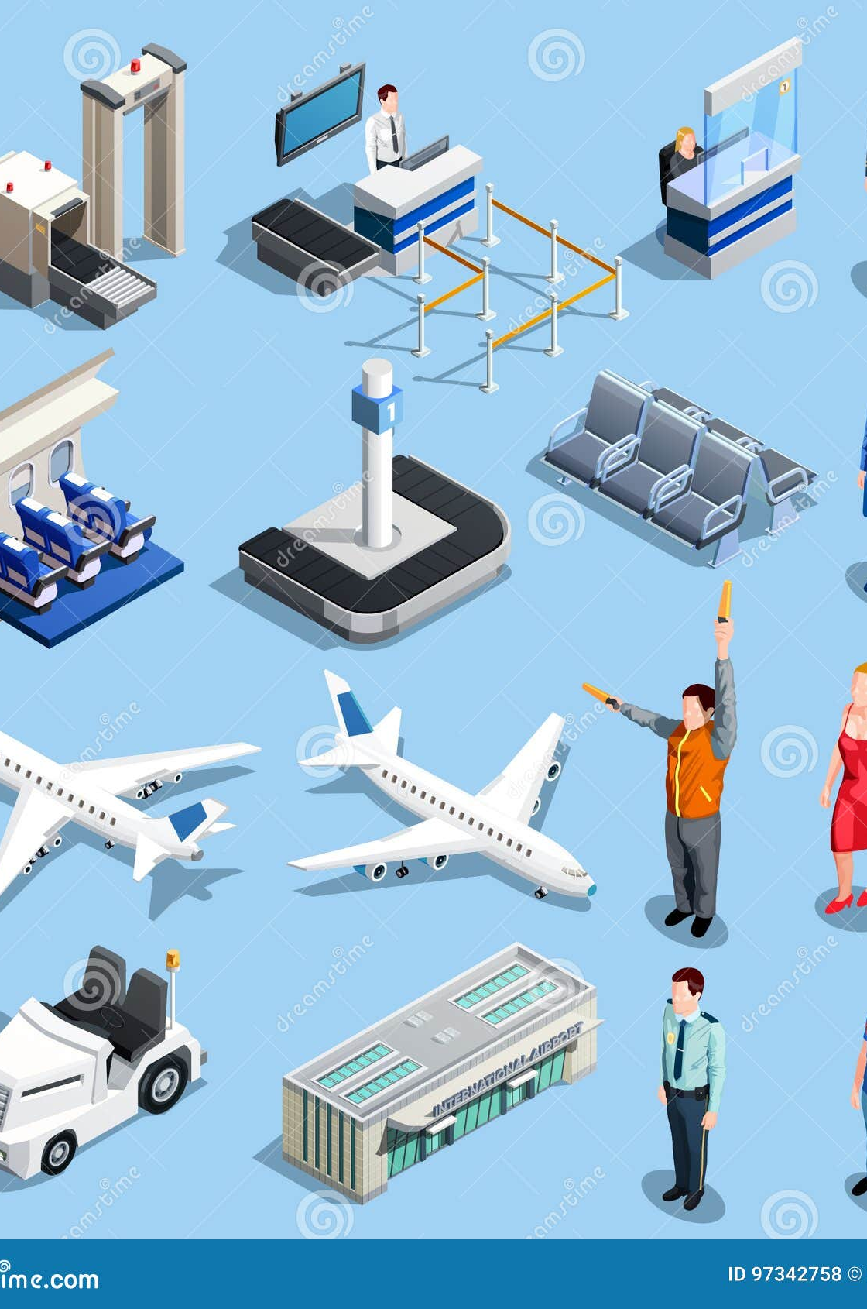
TP3 Explain that Ground Facilities and Services Assist With Aircraft Arrivals and Departures
Ground facilities and services assist with aircraft arrivals and departures.
RUNWAY MAINTENANCE
RUNWAY LIGHTING
BAGGAGE HANDLING
FUEL STORAGE SYSTEMS
DE-ICING/ANTI-ICING
Notes:
During the winter, the main focus of the work is on runway and taxiing area maintenance.
Runway lighting is used at airports which allow night landings. Seen from the air, runway lights form an outline of the runway.
Colours, directions, timing, area
Baggage handlers work both indoors and outdoors at an aerodrome. They are responsible for making sure that not only does the mail, freight and luggage get onto the right aircraft but also that it gets there on time.
The successful treatment of ice and snow deposits on airplanes on the ground is an absolute necessity for safe winter operations. A flight that is expected to operate in known ground icing conditions shall not takeoff unless the aircraft has been inspected for icing and, if necessary, has been given the appropriate de-icing/antiicing treatment. Accumulation of ice or other contaminants shall be removed so that the aircraft is kept in an airworthy condition prior to takeoff.

Slide 9
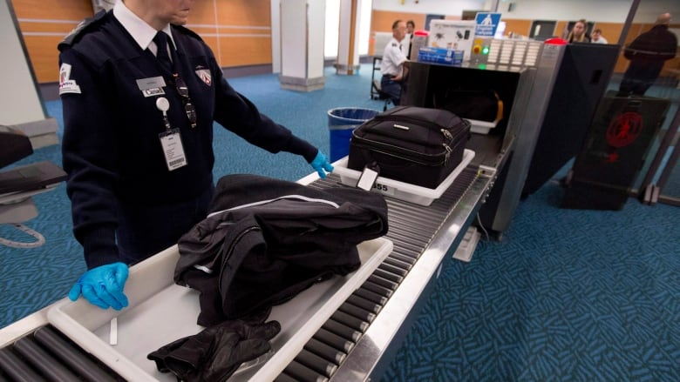
TP4 Explain What the Canadian Air Transport Security Authority (CATSA) Is and Outline its Duties
CATSA works with ground control to protect the public by securing critical elements of the air transportation system as assigned by the government
Screening of Passengers and Belongings
Usage of Explosive Detection Systems
Contracting for RCMP policing services
Implement the Canadian Air Carrier Protective Program
Implement a restricted area identification card
Non-Passenger Screening entering airport restricted areas
Supplemental airport policing
Notes:
https://jeopardylabs.com/play/identify-aspects-of-basic-aerodrome-operations

Slide 10
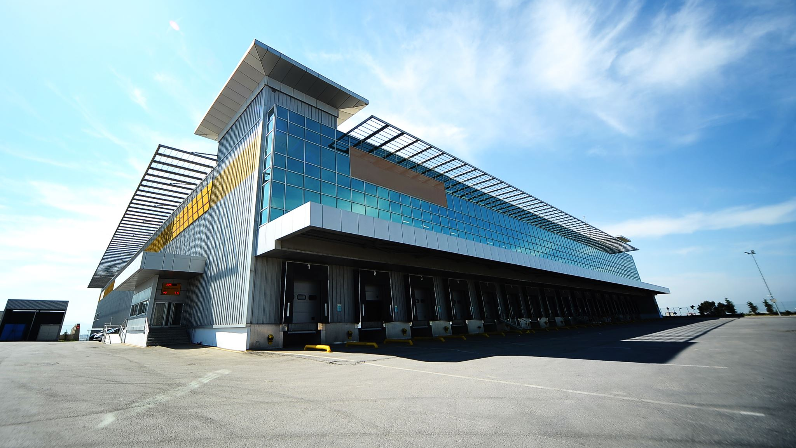
EO M260.02 – IDENTIFY ASPECTS OF BASIC AERODROME OPERATIONS

