Slide 1
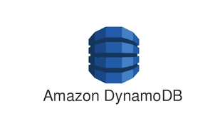
external API calls
MICROSERVICE ARCHITECTURE FOR CYBERSHOP – Roadmap
internal API calls
DB service calls
API Gateway
Service
Layer 1
customer
product
Cart
Checkout
Payment
Logger
Create
Login
Log Off
Auth
Delete
Add
Delete
List
Update
Add
Remove
List
Update
List Cart
Pay
Insert
Remove
Auth
Auth
Auth
Auth
Update
Service Layer 2
db service
write
read
update
Customer
Products
Cart
Payment
Logger

Slide 2
external API calls
MICROSERVICE ARCHITECTURE FOR CYBERSHOP – V 0.1
internal API calls
DB service calls
API Gateway
Service
Layer 1
customer
product
Cart
Logger
Create
Login
Log Off
Auth
Delete
Add
Delete
List
Update
Add
Remove
List
Update
Insert
2. Read
List
Login
Login
Service Layer 2
db service
write
read
update
delete
Customer
Products
Cart
Logger

