Slide 1
Module 3.4A - AgentOps: Evaluate
AI Governance Workshop | AgentOps on Microsoft Foundry - Technical Perspective
Notes:
This module provides 60 minutes of presentation on the Evaluate practice. Use the LAB / DEMO slide to transition to either a 60-minute participant lab or a 20-minute instructor demonstration.

Slide 2
Conditions and terms of use
© Microsoft Corporation. All rights reserved. You may use these training materials solely for your personal internal reference and non-commercial purposes. You may not distribute, transmit, resell or otherwise make these training materials available to any other person or party without express permission from Microsoft Corporation. URL’s or other internet website references in the training materials may change without notice. Unless otherwise noted, any companies, organizations, domain names, e-mail addresses, people, places and events depicted in the training materials are for illustration only and are fictitious. No real association is intended or inferred. THESE TRAINING MATERIALS ARE PROVIDED "AS IS"; MICROSOFT MAKES NO WARRANTIES, EXPRESS OR IMPLIED IN THESE TRAINING MATERIALS
Microsoft Confidential
Notes:
This slide outlines the terms and conditions for using these training materials. Please review the confidentiality requirements before proceeding.

Slide 3
Learning outcomes in this module
1
AgentOps foundations and production readiness
Connect AgentOps foundations to production readiness
2
Evaluation strategy and living datasets
Design an evaluation strategy and living datasets
3
Quality, grounding, behavior, latency, and cost signals
Interpret quality, grounding, behavior, latency, and cost
4
Red teaming and AI safety
Explain red teaming and AI safety
5
Demo, participant next steps, and discussion
Produce sample evaluation criteria through the lab or demo
Notes:
This module provides 60 minutes of presentation. It closes with a handoff to either a 60-minute participant lab or a 20-minute instructor demonstration. The final learning artifact is named on this slide.

Slide 4
AgentOps Foundations
Why AI operations need a new discipline
Notes:
The AgentOps foundation section is intentionally included in every deck so each module can be delivered independently. When delivering multiple modules in sequence, use slides 4 through 11 as a brief recap or skip familiar slides based on participant needs.
Teams can build an agent prototype quickly, but production introduces quality, safety, monitoring, cost, ownership, and release-confidence requirements.

Slide 5
The production gap
The bottleneck moved from building the first demo to proving the next version is safe to release.
A prototype can work
Production needs proof
A prompt and model return useful answers
Quality and safety thresholds are explicit
Manual testing covers the happy path
Tool calls and side effects are controlled
A small team can debug by inspection
Every release is traceable to evidence
Changes are made without release evidence
Owners can diagnose and contain failures
Notes:
Agents add non-determinism, tool-calling risk, prompt regression, and changing user behavior. Production confidence comes from evidence, not from a successful demo.

Slide 6
Building blocks of a production agent
Each tier adds components and operational complexity.
Prompts
RAG
Tools
System prompt, model, versioning, quality evaluation, and cost.
Knowledge sources, freshness, permissions, and groundedness.
MCP servers, guardrails, authentication, side effects, and failure modes.
Autonomy
Multi-agent
Memory, orchestration, approval points, traces, and loop prevention.
Orchestrators, sub-agents, coordination, emergent behavior, and cost spikes.
Notes:
Even a tool-using agent manages multiple versioned assets, evaluation targets, and operational dependencies. AgentOps must cover the full system, not only the model.

Slide 7
Microsoft Foundry is the control plane
AgentOps connects Foundry signals to release decisions and post-deployment action.
Surfaces
Capabilities
Runtime
Portal, SDK, Azure CLI and REST, plus GitHub Actions.
Agent versions, evaluators, red teaming, tracing, and Content Safety.
Foundry projects, model deployments, tools, App Insights, and Log Analytics.
Notes:
Foundry remains the platform control plane. AgentOps adds the repeatable operating model around it; it does not replace Foundry.

Slide 8
Production readiness checklist
Turn "I think it works" into "we have evidence for this release."
Target
Evaluation
Gates
The production target and agent version are explicit.
A representative dataset and release thresholds exist.
CI/CD blocks regressions and stores evidence.
Telemetry
Safety
Ownership
Traces, metrics, logs, and release correlation are wired.
Safety tests and red-team findings are tracked.
Release evidence is reviewable and owners know how to respond.
Notes:
The checklist is the contract for a production-candidate agent. Every later practice produces or consumes one of these evidence items.

Slide 9
AgentOps operating model
Four practices create release evidence and operational confidence.
Evaluate
Ship
Observe
Operate
Golden datasets, rubrics, red teaming, and thresholds.
CI/CD gates, approvals, promotion, and canary rollout.
Traces, metrics, safety signals, feedback, cost, and latency.
Incidents, runbooks, model lifecycle, cost, capacity, and improvement.
Notes:
AgentOps applies DevOps discipline to probabilistic systems. Evaluate creates signals, Ship enforces them, Observe explains production behavior, and Operate turns signals into action.

Slide 10
AgentOps maturity model
Start by moving one production-candidate agent up one level.
Initial
Defined
Managed
Optimized
Ad hoc demos and scattered logs
Versioned assets and evaluation datasets
Quality gates, continuous evaluation, and runbooks
Drift and cost guardrails, canary, and feedback loop
Notes:
Most teams sit between Initial and Defined. The practical move is to select one production-candidate agent and improve its operating maturity by one level.

Slide 11
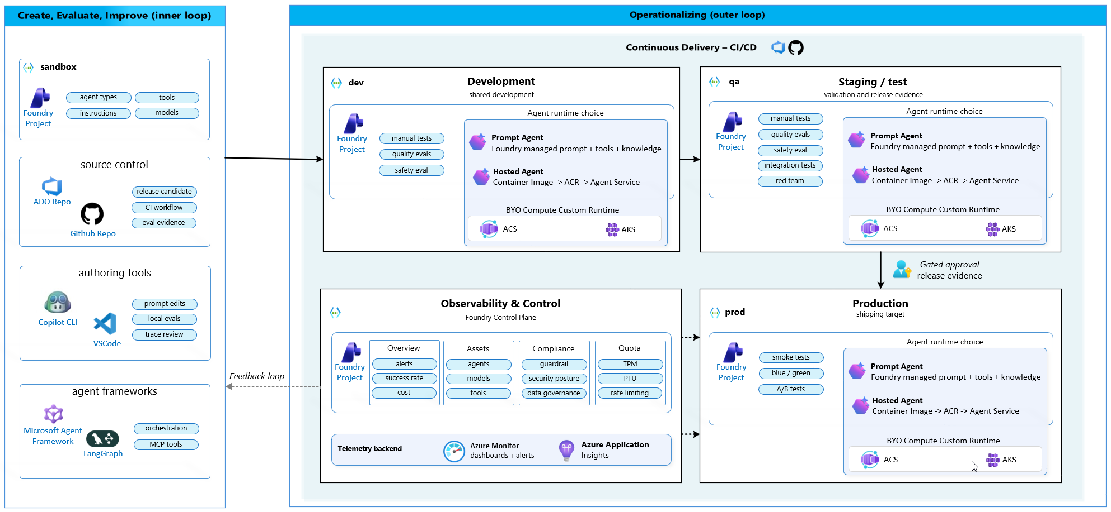
AgentOps reference architecture
The inner loop creates evidence; the outer loop promotes and operates the agent.
Notes:
The architecture connects a sandbox and source control to development, QA, and production Foundry projects. QA locks evaluation evidence before a human-approved production promotion. Production telemetry flows back into the next iteration.

Slide 12
Evaluate
The release signal for agentic systems
Notes:
Without a quality and safety signal, there is nothing to ship with confidence.

Slide 13
Evaluation strategy
Evaluation is a release signal that grows as production teaches you new failure modes.
Select
Evaluate
Compare
Learn
Choose a baseline model and representative journeys
Measure quality, grounding, behavior, latency, and cost
Check thresholds, baselines, and the previous version
Promote reviewed production traces into regression cases
Notes:
Start with a small golden dataset tied to real user journeys. A few dozen representative cases beat zero cases. The dataset is a living artifact that grows from reviewed production traces.

Slide 14
Evaluation scorecard
A release decision needs multiple signals, not one aggregate score.
Quality
Grounding
Behavior
Does the response solve the user task and follow the rubric?
Are claims supported by approved sources and retrieved context?
Did the agent resolve intent and call the correct tools?
Latency
Cost
Did the end-to-end journey stay within the user experience target?
Did token and tool-call consumption stay within the release budget?
Notes:
Foundry provides built-in evaluators for quality, groundedness, and agent-specific measures such as intent resolution and tool-call accuracy. Compare every candidate against the current baseline.

Slide 15
Red teaming and AI safety
Quality asks "is the answer good?" Red teaming asks "can someone make it misbehave?"
Harmful content
Jailbreak
Hallucination
Data exfiltration
Probe unsafe, abusive, or policy-violating outputs.
Test prompt injection, role hijacking, and instruction override.
Look for ungrounded claims and fabricated evidence.
Probe PII leakage, permission bypass, and tool abuse.
Notes:
Safety and quality are separate signals. Use red teaming before release, on a schedule, and after incidents. Convert findings into adversarial rows in the regression dataset.

Slide 16
From evaluation to release decision
Promotion is earned through evidence, not assumed from development completion.
Run
Review
Gate
Record
Execute the approved dataset and evaluators
Inspect failures, red-team findings, and outliers
Apply explicit thresholds and exception policy
Store the report as release evidence
Notes:
The output of Evaluate is a decision-ready evidence package. A passing score is not sufficient when critical safety findings remain open.

Slide 17
LAB / DEMO
Evaluate
Golden dataset, evaluator run, score comparison, and sample evaluation criteria.
SHOW
EVIDENCE
DECISION
Notes:
Delivery handoff: in hands-on mode, participants complete the guided Evaluate lab in 60 minutes and produce sample evaluation criteria. If participant environments are unavailable, use this slide for a 20-minute instructor demonstration covering the same flow. Use AgentOps Accelerator as a practical reference implementation alongside native Microsoft Foundry capabilities.

Slide 18
Start with one production-candidate agent
Your 30-day goal: move one agent from "it works in testing" to "we can operate it safely."
1
Pick one agent that is close to production.
2
Define five to ten representative user journeys.
3
Create a small golden dataset and release thresholds.
4
Run quality, grounding, behavior, latency, and cost evaluations.
5
Add adversarial tests and track red-team findings.
6
Store the evaluation report as release evidence.
Notes:
Do not attempt to evaluate the whole portfolio first. Prove the pattern on one production-candidate agent, then scale the dataset and evaluator bundle.

Slide 19
Resources
Further reading
Resource
Link
Evaluation approach in Foundry
Evaluation guide
Agent evaluators
Evaluator guide
AI Red Teaming Agent
Red teaming guide
Notes:
Use these linked first-party Microsoft resources for further learning. The AgentOps Accelerator is a practical reference implementation alongside native Microsoft Foundry capabilities.

Slide 20
Questions?
Notes:
Reserve ten minutes for questions. Invite discussion on dataset design, evaluator selection, threshold ownership, and how red-team findings become regression tests.

