Slide 1
Module 3.4C - AgentOps
Observe and Operate | AI Governance Workshop | Microsoft Foundry
Notes:
This module provides 60 minutes of presentation on the distinct Observe and Operate practices. Use the LAB / DEMO slide to transition to either a 60-minute participant lab or a 20-minute instructor demonstration.

Slide 2
Conditions and terms of use
© Microsoft Corporation. All rights reserved. You may use these training materials solely for your personal internal reference and non-commercial purposes. You may not distribute, transmit, resell or otherwise make these training materials available to any other person or party without express permission from Microsoft Corporation. URL’s or other internet website references in the training materials may change without notice. Unless otherwise noted, any companies, organizations, domain names, e-mail addresses, people, places and events depicted in the training materials are for illustration only and are fictitious. No real association is intended or inferred. THESE TRAINING MATERIALS ARE PROVIDED "AS IS"; MICROSOFT MAKES NO WARRANTIES, EXPRESS OR IMPLIED IN THESE TRAINING MATERIALS
Microsoft Confidential
Notes:
This slide outlines the terms and conditions for using these training materials. Please review the confidentiality requirements before proceeding.

Slide 3
Learning outcomes in this module
1
AgentOps foundations and production readiness
Connect AgentOps foundations to production readiness
2
Observability, tracing, and correlation
Interpret observability, tracing, and correlation
3
Telemetry-to-action feedback loop
Connect telemetry to governed action
4
Post-deployment operations, incidents, and model lifecycle
Explain post-deployment operations and model lifecycle
5
Demos, participant next steps, and discussion
Produce a sample runtime signal review through the lab or demo
Notes:
This module provides 60 minutes of presentation. It closes with a handoff to either a 60-minute participant lab or a 20-minute instructor demonstration. The final learning artifact is named on this slide.

Slide 4
AgentOps Foundations
Why AI operations need a new discipline
Notes:
The AgentOps foundation section is intentionally included in every deck so each module can be delivered independently. When delivering multiple modules in sequence, use slides 4 through 11 as a brief recap or skip familiar slides based on participant needs.
Teams can build an agent prototype quickly, but production introduces quality, safety, monitoring, cost, ownership, and release-confidence requirements.

Slide 5
The production gap
The bottleneck moved from building the first demo to proving the next version is safe to release.
A prototype can work
Production needs proof
A prompt and model return useful answers
Quality and safety thresholds are explicit
Manual testing covers the happy path
Tool calls and side effects are controlled
A small team can debug by inspection
Every release is traceable to evidence
Changes are made without release evidence
Owners can diagnose and contain failures
Notes:
Agents add non-determinism, tool-calling risk, prompt regression, and changing user behavior. Production confidence comes from evidence, not from a successful demo.

Slide 6
Building blocks of a production agent
Each tier adds components and operational complexity.
Prompts
RAG
Tools
System prompt, model, versioning, quality evaluation, and cost.
Knowledge sources, freshness, permissions, and groundedness.
MCP servers, guardrails, authentication, side effects, and failure modes.
Autonomy
Multi-agent
Memory, orchestration, approval points, traces, and loop prevention.
Orchestrators, sub-agents, coordination, emergent behavior, and cost spikes.
Notes:
Even a tool-using agent manages multiple versioned assets, evaluation targets, and operational dependencies. AgentOps must cover the full system, not only the model.

Slide 7
Microsoft Foundry is the control plane
AgentOps connects Foundry signals to release decisions and post-deployment action.
Surfaces
Capabilities
Runtime
Portal, SDK, Azure CLI and REST, plus GitHub Actions.
Agent versions, evaluators, red teaming, tracing, and Content Safety.
Foundry projects, model deployments, tools, App Insights, and Log Analytics.
Notes:
Foundry remains the platform control plane. AgentOps adds the repeatable operating model around it; it does not replace Foundry.

Slide 8
Production readiness checklist
Turn "I think it works" into "we have evidence for this release."
Target
Evaluation
Gates
The production target and agent version are explicit.
A representative dataset and release thresholds exist.
CI/CD blocks regressions and stores evidence.
Telemetry
Safety
Ownership
Traces, metrics, logs, and release correlation are wired.
Safety tests and red-team findings are tracked.
Release evidence is reviewable and owners know how to respond.
Notes:
The checklist is the contract for a production-candidate agent. Every later practice produces or consumes one of these evidence items.

Slide 9
AgentOps operating model
Four practices create release evidence and operational confidence.
Evaluate
Ship
Observe
Operate
Golden datasets, rubrics, red teaming, and thresholds.
CI/CD gates, approvals, promotion, and canary rollout.
Traces, metrics, safety signals, feedback, cost, and latency.
Incidents, runbooks, model lifecycle, cost, capacity, and improvement.
Notes:
AgentOps applies DevOps discipline to probabilistic systems. Evaluate creates signals, Ship enforces them, Observe explains production behavior, and Operate turns signals into action.

Slide 10
AgentOps maturity model
Start by moving one production-candidate agent up one level.
Initial
Defined
Managed
Optimized
Ad hoc demos and scattered logs
Versioned assets and evaluation datasets
Quality gates, continuous evaluation, and runbooks
Drift and cost guardrails, canary, and feedback loop
Notes:
Most teams sit between Initial and Defined. The practical move is to select one production-candidate agent and improve its operating maturity by one level.

Slide 11
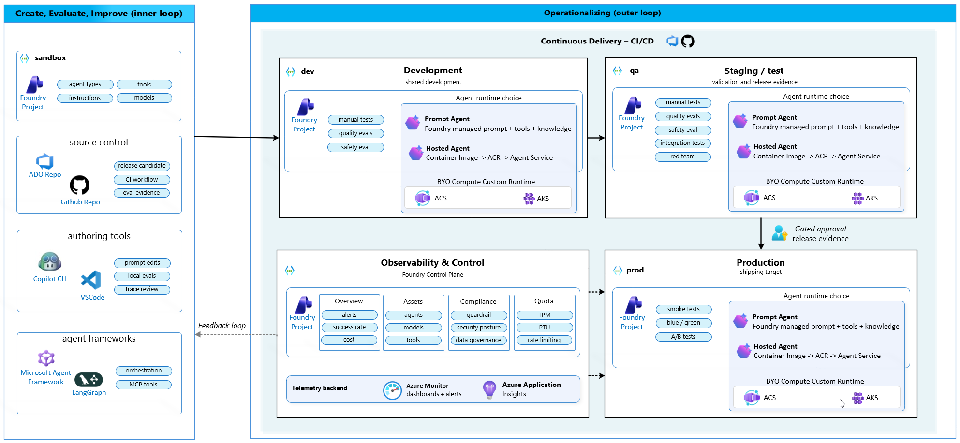
AgentOps reference architecture
The inner loop creates evidence; the outer loop promotes and operates the agent.
Notes:
The architecture connects a sandbox and source control to development, QA, and production Foundry projects. QA locks evaluation evidence before a human-approved production promotion. Production telemetry flows back into the next iteration.

Slide 12
Observe
Traces, correlation, and the closed loop
Notes:
Infrastructure monitoring asks whether the service is healthy. Agent observability asks what the agent did and why.

Slide 13
Observability for agents is more than monitoring
The unit of understanding is the decision trace, not only the endpoint status.
Tracing
Monitoring
Continuous evaluation
Prompt, plan, model calls, retrieval, tool calls, and safety events.
Latency, availability, errors, token cost, tool health, and user feedback.
Production quality signals compared with the release baseline.
Notes:
A trace explains the chain of decisions. Monitoring establishes service and dependency health. Continuous evaluation detects behavioral degradation after release.

Slide 14
Signals and correlation
Disconnected dashboards become operational evidence when every signal shares the same identifiers.
Trace ID
Session ID
Agent version
Connect the full agent journey and all child spans.
Group related user interactions and memory context.
Identify the exact prompt, model, tool, and configuration candidate.
Deployment
Eval run
Incident and owner
Connect behavior to environment, region, and rollout stage.
Compare production behavior with the evidence used for release.
Route the signal to an accountable response process.
Notes:
Required signals include prompt, plan, model call, retrieval, tool call, safety event, latency, cost, feedback, and release version. Correlation makes one trace useful across release, runtime, evaluation, and incident response.

Slide 15
From telemetry to action
The end state is not a dashboard. The end state is a governed response.
Signal | Operational action | Feedback into next release
Latency spike | Azure Monitor alert and on-call diagnosis | Add performance threshold and regression case
Tool error rate | Disable the tool or use a manual fallback | Add dependency failure test
Safety violation | Block output and open a safety incident | Add adversarial row and guardrail
Evaluation score drop | Pause canary and open a release ticket | Review rubric, dataset, and candidate
Cost anomaly | Throttle with Azure API Management (APIM) and notify FinOps | Set token and tool-call budgets
Positive feedback | Sample and review the trace | Promote it into the evaluation dataset
Notes:
A reviewed production trace becomes a new evaluation row. The evaluation row enters the gate. The gate prevents recurrence. This closes the AgentOps loop.

Slide 16
OPTIONAL DEEP DIVE
Observe
Trace waterfall, correlated spans, continuous evaluation, and signal-to-action flow.
SHOW
EVIDENCE
DECISION
Notes:
Optional deep dive: inspect a trace waterfall and correlated spans. Skip this slide in the 20-minute fallback demonstration; the primary Observe and Operate demonstration is on slide 22.

Slide 17
Operate
Running agents in production
Notes:
Shipping is not the finish line. Post-deployment operations own reliability, incidents, model lifecycle, cost, and capacity.

Slide 18
Post-deployment operations: four concerns
Production traces and incidents feed the next evaluation and release cycle.
Reliability and SLOs
Incident response
Model lifecycle
Cost and capacity
Availability, latency, error budgets, dependency failures, and graceful degradation.
Severity, containment, runbooks, on-call ownership, and postmortems supported by evidence.
Deprecation, canary upgrades, version pinning, comparison, and rollback drills.
Provisioned Throughput Units (PTU) vs. consumption pricing, workload budgets, quotas, throttling, and anomaly alerts.
Notes:
The four concerns are interlocking. Each produces signals that update evaluation datasets, gate criteria, or operating policy.

Slide 19
AI incident runbook
Containment first. Evidence-backed fix second.
Severity | Example | First action
S1 Critical | Safety event or data leak in production | Stop gate and roll back to the last good version
S2 High | Quality or grounding regression after deployment | Planned rollback or version pin
S3 Medium | Latency degradation or cost spike | Rate-limit, investigate, then act
S4 Low | Drift indicator on a single metric | Schedule analysis in the next evaluation cycle
Notes:
Severity prevents over-reaction and under-reaction. Every closed incident should update the evaluation dataset, gate criteria, runbook, or ownership model.

Slide 20
Incident triage flow
Contain the impact before debugging the root cause.
Detect
Correlate
Contain
Fix
Close
Alert, safety signal, evaluation drift, or user report
Find trace, session, agent version, and deployment
Block, disable tool, rate-limit, pin, or roll back
Analyze, change, and re-evaluate the candidate
Ship with evidence and update the operating model
Notes:
The full flow is Detect, Correlate trace, Identify version, Contain, Analyze, Fix, Re-evaluate, and Close with evidence.

Slide 21
Model lifecycle and canary upgrades
Treat every model change as a release candidate, not a configuration flip.
Baseline
Offline evaluation
Canary
Compare
Decide
Pin the current model, prompt, and tools
Run the candidate against the approved dataset
Route a controlled traffic slice to the candidate
Review quality, cost, latency, and safety
Roll forward or roll back with evidence
Notes:
Triggers include deprecation, new model availability, cost or performance pressure, and vendor change. The AI platform team coordinates while the application team validates behavior.

Slide 22
LAB / DEMO
Observe and Operate
Trace inspection, incident triage, containment, and sample runtime signal review.
SHOW
EVIDENCE
DECISION
Notes:
Delivery handoff: in hands-on mode, participants complete the guided Observe and Operate lab in 60 minutes and produce a sample runtime signal review. If participant environments are unavailable, use this slide for a 20-minute instructor demonstration covering both practices. Use AgentOps Accelerator as a practical reference implementation alongside native Microsoft Foundry capabilities.

Slide 23
Start with one production-candidate agent
Your 30-day goal: move one agent from "it works in testing" to "we can operate it safely."
1
Instrument one production-candidate agent with OpenTelemetry traces.
2
Correlate traces with session, version, deployment, evaluation run, and owner.
3
Define alerts for latency, tool errors, safety, evaluation drift, and cost.
4
Write a severity-based incident runbook with containment actions.
5
Practice one rollback or model canary decision using release evidence.
6
Review production traces weekly and promote learnings into evaluation.
Notes:
The goal is not another dashboard. The goal is one complete feedback loop from a production signal to a safer next release.

Slide 24
Resources
Further reading
Resource
Link
Agent tracing overview
Tracing guide
Agent Monitoring Dashboard
Dashboard guide
Application Insights overview
Monitoring guide
Notes:
Use these linked first-party Microsoft resources for further learning. The AgentOps Accelerator is a practical reference implementation alongside native Microsoft Foundry capabilities.

Slide 25
Questions?
Notes:
Reserve ten minutes for questions. Invite discussion on correlation standards, alert ownership, incident severity, model deprecation, cost budgets, and rollback readiness.

