Slide 1
Module 3.4B - AgentOps: Ship
AI Governance Workshop | AgentOps on Microsoft Foundry - Technical Perspective
Notes:
This module provides 60 minutes of presentation on the Ship practice. Use the LAB / DEMO slide to transition to either a 60-minute participant lab or a 20-minute instructor demonstration.

Slide 2
Conditions and terms of use
© Microsoft Corporation. All rights reserved. You may use these training materials solely for your personal internal reference and non-commercial purposes. You may not distribute, transmit, resell or otherwise make these training materials available to any other person or party without express permission from Microsoft Corporation. URL’s or other internet website references in the training materials may change without notice. Unless otherwise noted, any companies, organizations, domain names, e-mail addresses, people, places and events depicted in the training materials are for illustration only and are fictitious. No real association is intended or inferred. THESE TRAINING MATERIALS ARE PROVIDED "AS IS"; MICROSOFT MAKES NO WARRANTIES, EXPRESS OR IMPLIED IN THESE TRAINING MATERIALS
Microsoft Confidential
Notes:
This slide outlines the terms and conditions for using these training materials. Please review the confidentiality requirements before proceeding.

Slide 3
Learning outcomes in this module
1
AgentOps foundations and production readiness
Connect AgentOps foundations to production readiness
2
CI/CD gates for agentic AI
Explain CI/CD gates for agentic AI
3
Release evidence and approval policy
Review release evidence and approval policy
4
Environment promotion and canary rollout
Describe environment promotion and canary rollout
5
Demo, participant next steps, and discussion
Produce a sample release checklist through the lab or demo
Notes:
This module provides 60 minutes of presentation. It closes with a handoff to either a 60-minute participant lab or a 20-minute instructor demonstration. The final learning artifact is named on this slide.

Slide 4
AgentOps Foundations
Why AI operations need a new discipline
Notes:
The AgentOps foundation section is intentionally included in every deck so each module can be delivered independently. When delivering multiple modules in sequence, use slides 4 through 11 as a brief recap or skip familiar slides based on participant needs.
Teams can build an agent prototype quickly, but production introduces quality, safety, monitoring, cost, ownership, and release-confidence requirements.

Slide 5
The production gap
The bottleneck moved from building the first demo to proving the next version is safe to release.
A prototype can work
Production needs proof
A prompt and model return useful answers
Quality and safety thresholds are explicit
Manual testing covers the happy path
Tool calls and side effects are controlled
A small team can debug by inspection
Every release is traceable to evidence
Changes are made without release evidence
Owners can diagnose and contain failures
Notes:
Agents add non-determinism, tool-calling risk, prompt regression, and changing user behavior. Production confidence comes from evidence, not from a successful demo.

Slide 6
Building blocks of a production agent
Each tier adds components and operational complexity.
Prompts
RAG
Tools
System prompt, model, versioning, quality evaluation, and cost.
Knowledge sources, freshness, permissions, and groundedness.
MCP servers, guardrails, authentication, side effects, and failure modes.
Autonomy
Multi-agent
Memory, orchestration, approval points, traces, and loop prevention.
Orchestrators, sub-agents, coordination, emergent behavior, and cost spikes.
Notes:
Even a tool-using agent manages multiple versioned assets, evaluation targets, and operational dependencies. AgentOps must cover the full system, not only the model.

Slide 7
Microsoft Foundry is the control plane
AgentOps connects Foundry signals to release decisions and post-deployment action.
Surfaces
Capabilities
Runtime
Portal, SDK, Azure CLI and REST, plus GitHub Actions.
Agent versions, evaluators, red teaming, tracing, and Content Safety.
Foundry projects, model deployments, tools, App Insights, and Log Analytics.
Notes:
Foundry remains the platform control plane. AgentOps adds the repeatable operating model around it; it does not replace Foundry.

Slide 8
Production readiness checklist
Turn "I think it works" into "we have evidence for this release."
Target
Evaluation
Gates
The production target and agent version are explicit.
A representative dataset and release thresholds exist.
CI/CD blocks regressions and stores evidence.
Telemetry
Safety
Ownership
Traces, metrics, logs, and release correlation are wired.
Safety tests and red-team findings are tracked.
Release evidence is reviewable and owners know how to respond.
Notes:
The checklist is the contract for a production-candidate agent. Every later practice produces or consumes one of these evidence items.

Slide 9
AgentOps operating model
Four practices create release evidence and operational confidence.
Evaluate
Ship
Observe
Operate
Golden datasets, rubrics, red teaming, and thresholds.
CI/CD gates, approvals, promotion, and canary rollout.
Traces, metrics, safety signals, feedback, cost, and latency.
Incidents, runbooks, model lifecycle, cost, capacity, and improvement.
Notes:
AgentOps applies DevOps discipline to probabilistic systems. Evaluate creates signals, Ship enforces them, Observe explains production behavior, and Operate turns signals into action.

Slide 10
AgentOps maturity model
Start by moving one production-candidate agent up one level.
Initial
Defined
Managed
Optimized
Ad hoc demos and scattered logs
Versioned assets and evaluation datasets
Quality gates, continuous evaluation, and runbooks
Drift and cost guardrails, canary, and feedback loop
Notes:
Most teams sit between Initial and Defined. The practical move is to select one production-candidate agent and improve its operating maturity by one level.

Slide 11
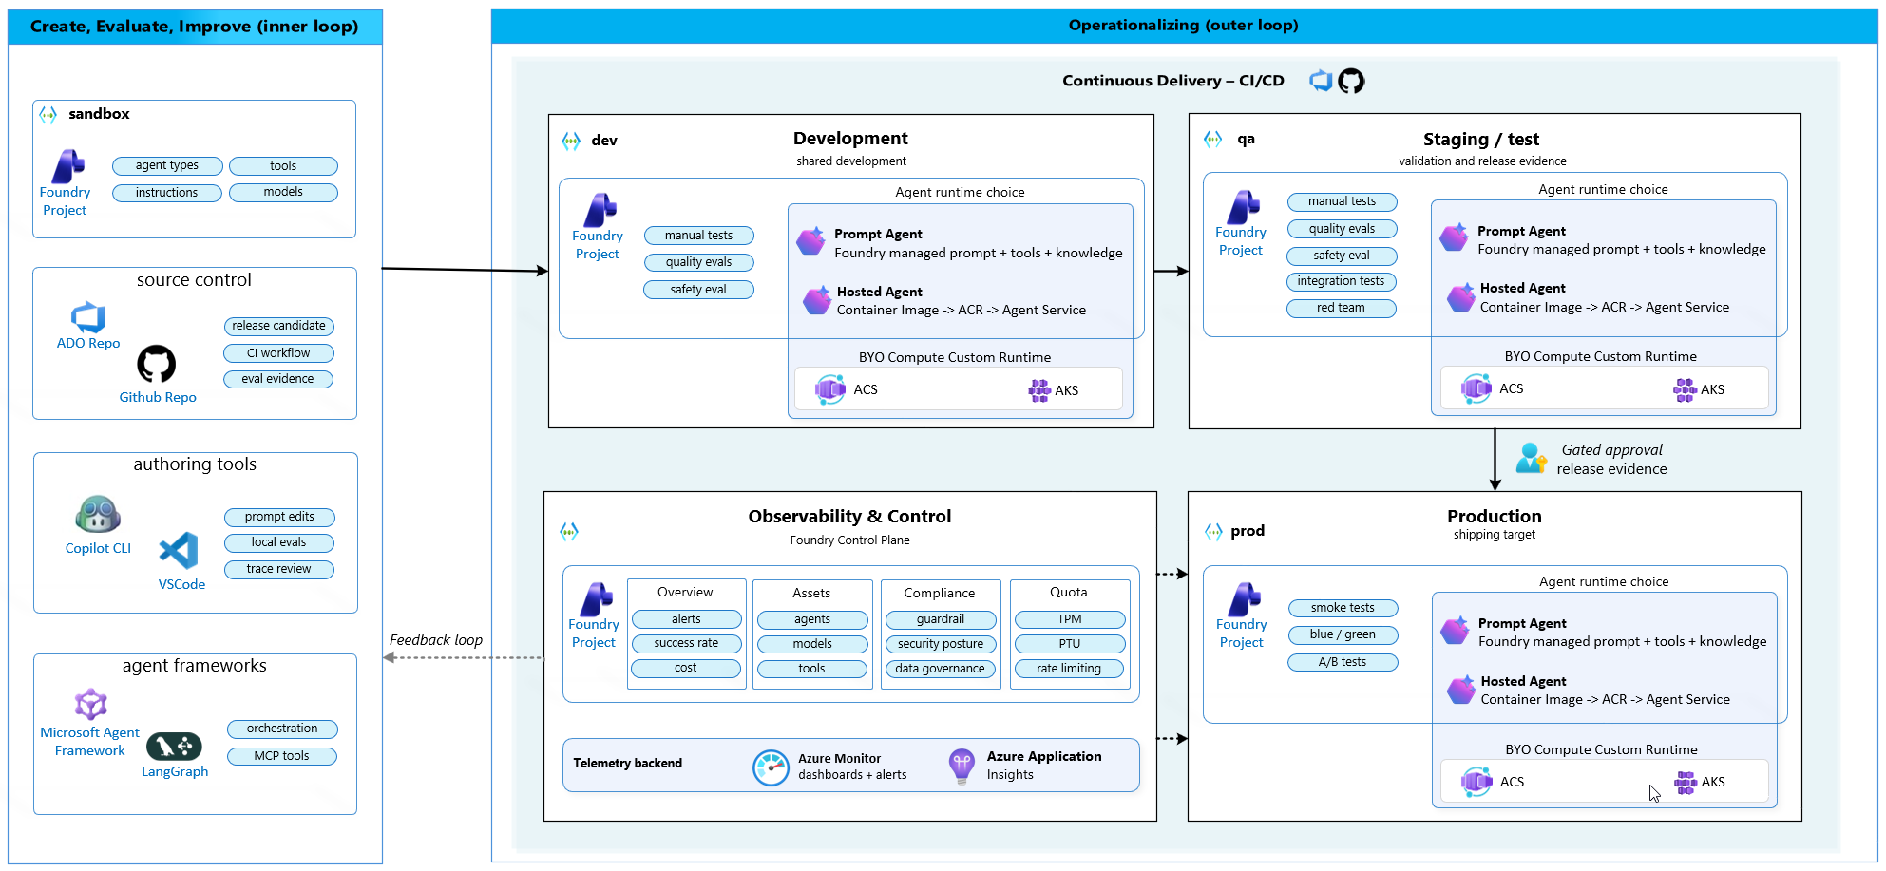
AgentOps reference architecture
The inner loop creates evidence; the outer loop promotes and operates the agent.
Notes:
The architecture connects a sandbox and source control to development, QA, and production Foundry projects. QA locks evaluation evidence before a human-approved production promotion. Production telemetry flows back into the next iteration.

Slide 12
Ship
Gates that enforce release evidence
Notes:
Signals without enforcement are reports. CI/CD gates turn evaluation and governance requirements into release controls.

Slide 13
CI/CD gates for agentic AI
The strongest moment is a failed gate: the pipeline stops the regression before users experience it.
Build
Evaluate
Decide
Deploy
Package the versioned agent, prompts, tools, and configuration
Run quality, safety, and integration checks
Apply thresholds and exception policy
Promote only the approved candidate and evidence
Notes:
PR gates block bad prompts before merge. Deployment gates block bad versions before the next environment. Watchdogs catch drift between releases.

Slide 14
Three gate types
Use each gate where it has the strongest leverage.
Pull request gate
Deployment gate
Runtime watchdog
Blocks regressions before code, prompts, or agent configuration merge.
Requires approved evaluation, safety, and readiness evidence before promotion.
Detects quality, safety, latency, or cost drift between releases.
Notes:
A gate must have an explicit owner, threshold, artifact, and exception path. If a failed gate can be ignored without evidence, it is not an effective control.

Slide 15
Release evidence package
Every gate produces an artifact that another person can review.
Evaluation report
Readiness report
Approval record
Dataset version, evaluator configuration, scores, failures, and baseline comparison.
Target version, dependencies, telemetry, open risks, and ownership confirmation.
Decision, approver, exceptions, conditions, and the immutable candidate version.
Notes:
Release evidence is not a screenshot. It is a traceable package linked to the exact version promoted through the pipeline.

Slide 16
Environment promotion
Evidence gets stricter from development to QA to production.
Development
QA
Approval
Production
Manual tests plus quality and safety evaluation
Integration tests, red teaming, and locked release evidence
Human decision backed by the evidence package
Smoke tests and blue-green or canary rollout
Notes:
Use separate Foundry projects for development, QA, and production. The runtime choice stays consistent; the evidence and controls become stricter.

Slide 17
Human approval and canary rollout
A gated approval is an evidence review, not a rubber-stamp click.
Approval confirms
Canary validates
Candidate version is immutable
Live quality remains within tolerance
Thresholds and safety checks passed
Latency and cost stay within budget
Open risks and exceptions are explicit
Safety and tool-call signals remain stable
Rollback owner and trigger are defined
Roll forward or roll back with evidence
Notes:
QA locks the release evidence. Production uses smoke tests and canary comparison rather than re-running the full evaluation on a different candidate.

Slide 18
LAB / DEMO
Ship
Pipeline gate, failed regression, evidence artifact, and sample release checklist.
SHOW
EVIDENCE
DECISION
Notes:
Delivery handoff: in hands-on mode, participants complete the guided Ship lab in 60 minutes and produce a sample release checklist. If participant environments are unavailable, use this slide for a 20-minute instructor demonstration covering the same flow. Use AgentOps Accelerator as a practical reference implementation alongside native Microsoft Foundry capabilities.

Slide 19
Start with one production-candidate agent
Your 30-day goal: move one agent from "it works in testing" to "we can operate it safely."
1
Choose one production-candidate agent and identify its current promotion path.
2
Version prompts, tools, model configuration, and evaluation assets together.
3
Add a pull-request evaluation gate with explicit thresholds.
4
Generate an evaluation and readiness artifact on every candidate build.
5
Define approval, exception, canary, and rollback policies.
6
Promote the same immutable candidate through development, QA, and production.
Notes:
Start with one enforceable gate that blocks a known regression. Expand controls after the team trusts the evidence and exception process.

Slide 20
Resources
Further reading
Resource
Link
Agent development lifecycle
Lifecycle guide
Evaluation approach in Foundry
Evaluation guide
AgentOps Accelerator
Accelerator guide
Notes:
Use these linked first-party Microsoft resources for further learning. The AgentOps Accelerator is a practical reference implementation alongside native Microsoft Foundry capabilities.

Slide 21
Questions?
Notes:
Reserve ten minutes for questions. Invite discussion on gate ownership, exception policy, environment boundaries, and canary rollback triggers.

