Slide 2
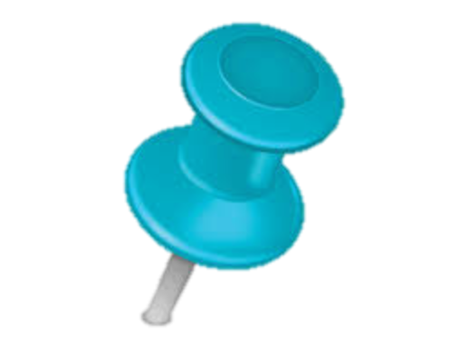




Agreed
SLA₁
Cloud
subscriptions
Service Agreed
SLA
Service Agreed
SLA
Service Agreed
SLA
Query +
preferences
Agreed
SLA₂
Data services

Slide 3

FACETS
DIMENSIONS
Schema
Description
Meta data
Knowledge
Data warehouse
Database federation
Environment
Cloud
Multi-Cloud
Data integration
Confidentiality
Privacy
Security
Data quality
SLA
Data protection
Data provenance
Others
Language
SLA
Model
Resources
Security

