Slide 1

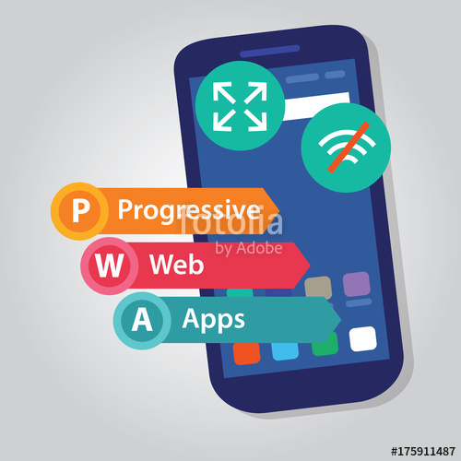
PWA
Andre Wollny
Batman & Robin

Slide 2


The Case
Gotham City – Fights between 3 groups of workers – Riots starting
Desktop Dynamite
Mobile Monkeys
vs
vs
Web Winners

Slide 3



The Case
Gordon Calling Batman

Slide 4

The Case
Batman calms down the situation
But… Wait… Message from Riddler
?
Don‘t put the blame on me.
Write once run everywhere is the key!

Slide 5



The Case
First Attempts

Slide 6


The Case
Not really successfull

Slide 7

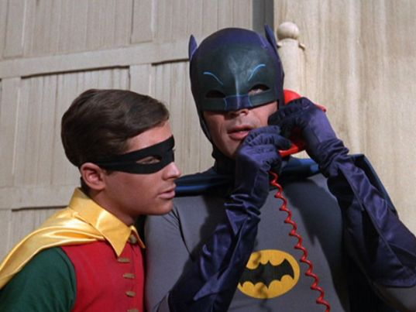



The Case
New try – calling google – working
together

Slide 8
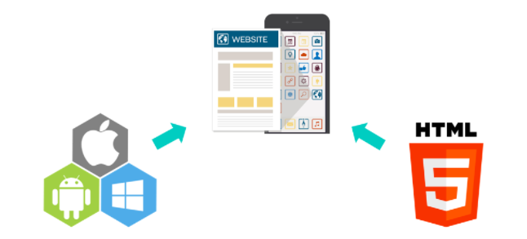
The Solution PWA - Characteristics
Reliable (offline – no dinosaur)
Performant / Fast
Safe (HTTPS)
Notifications
Installable / Enganging
Fresh (Up to date)
No need for a store

Slide 9
The Solution PWA – HOW?
Service Workers
“Proxy“- Decision Maker for us
“Brain“
PWA
Internet
ServiceWorker
FB
Storage
Cache
Storage
Local Device

Slide 10
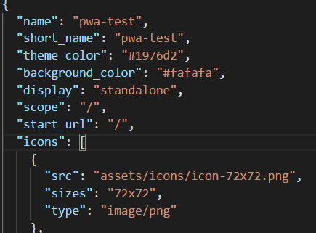
The Solution PWA – HOW?
Manifest
→ tells browser how to
handle web app
- Name
- Icons
- StartUrl

Slide 11


The Solution PWA – HOW?
OK Robin..we are using Angular
Have a look
Time for the Bat Belt!

Slide 12

The Solution PWA – HOW?
Angular 5
Service Worker beta
Lots of manual steps
Breaking changes
Angular 6
ng add @angular/pwa
→ Much more easy
Smaller bundle sizes
Angular Elements

Slide 13
The Solution PWA – HOW?
What is the belt doing?
Updating package.json
"@angular/pwa": "^0.6.1"
Creating new Config File
ngsw-config.json: Angular Service Worker package
Creating manifest
./src/manifest.json

Slide 14
The Solution PWA – HOW?
What is the belt doing?
Register Service Worker (Bootsrap)
src/app/app.module
ServiceWorkerModule.register('/ngsw-worker.js', { enabled: environment.production })
Something more
(assets/icons)

Slide 15
The Solution PWA – HOW?
ServiceWorker-Configuration (ngsw-config.json)
Groups for assets (img) and data
Cache
maxAge: timelimit (1 hour) maxSize: limit count (20)
timeout: 10s
stragety
freshness
(Only if the network times out -timeout-, does the request fall back to the cache)
performance
(If a resource exists in the cache, the cached version is used)
Notifications (Updates, Messages)
Router aware (groups of urls)

Slide 16
The Solution PWA – HOW?
Example
"dataGroups": [{
"name": "api-freshness",
"urls": [
"/new"
],
"cacheConfig": {
"maxSize": 100,
"maxAge": "1h",
"timeout": "10s",
"strategy": "freshness"
}
}, {
"name": "api-performance",
"urls": [
"/",
"/jobs","/show"
],
"cacheConfig": {
"maxSize": 100,
"maxAge": "1d",
"strategy": "performance"
}
}]

Slide 17

The Solution PWA – HOW?
Addtional Help
Youtube (older stuff)
Google io 17
https://www.youtube.com/watch?v=C8KcW1Nj3Mw
Angular and Service Workers
https://www.youtube.com/watch?v=8rmBA9Asbfw
Bring PWA into Stores
MS is crawling
https://medium.freecodecamp.org/i-built-a-pwa-and-published-it-in-3-app-stores-heres-what-i-learned-7cb3f56daf9b
Support Status
https://jakearchibald.github.io/isserviceworkerready/index.html#moar
PWA Builder
https://www.pwabuilder.com/

Slide 18

Peace in Gotham? Future
→ Every Angular App is a PWA
More support to come
Downside / still to improve:
- switch to dist
- own http server
- more configuration
- sometimes still feels unnatural

Slide 19

Peace in Gotham? Live Demo
Creating standard Angular app and convert to PWA

