Slide 1
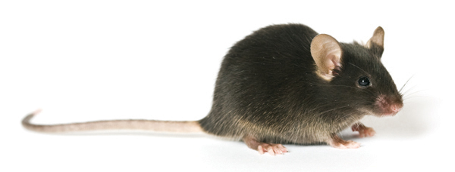
CD45.2 male BMT T-cell depleted
15.106 cells
CD45.1 female BMT T-cell depleted
5.106 cells
DLI
Matahari T cell 106 cells
5,5Gy
5,5Gy
W11+7 days (TM008) or
W11+ 42 days (TM006)
WT or MHCI-KO mice
D0
W10
W11
Mh T cells sort
RNA purification
MoGene 2.0 ST Array analysis

