Slide 1
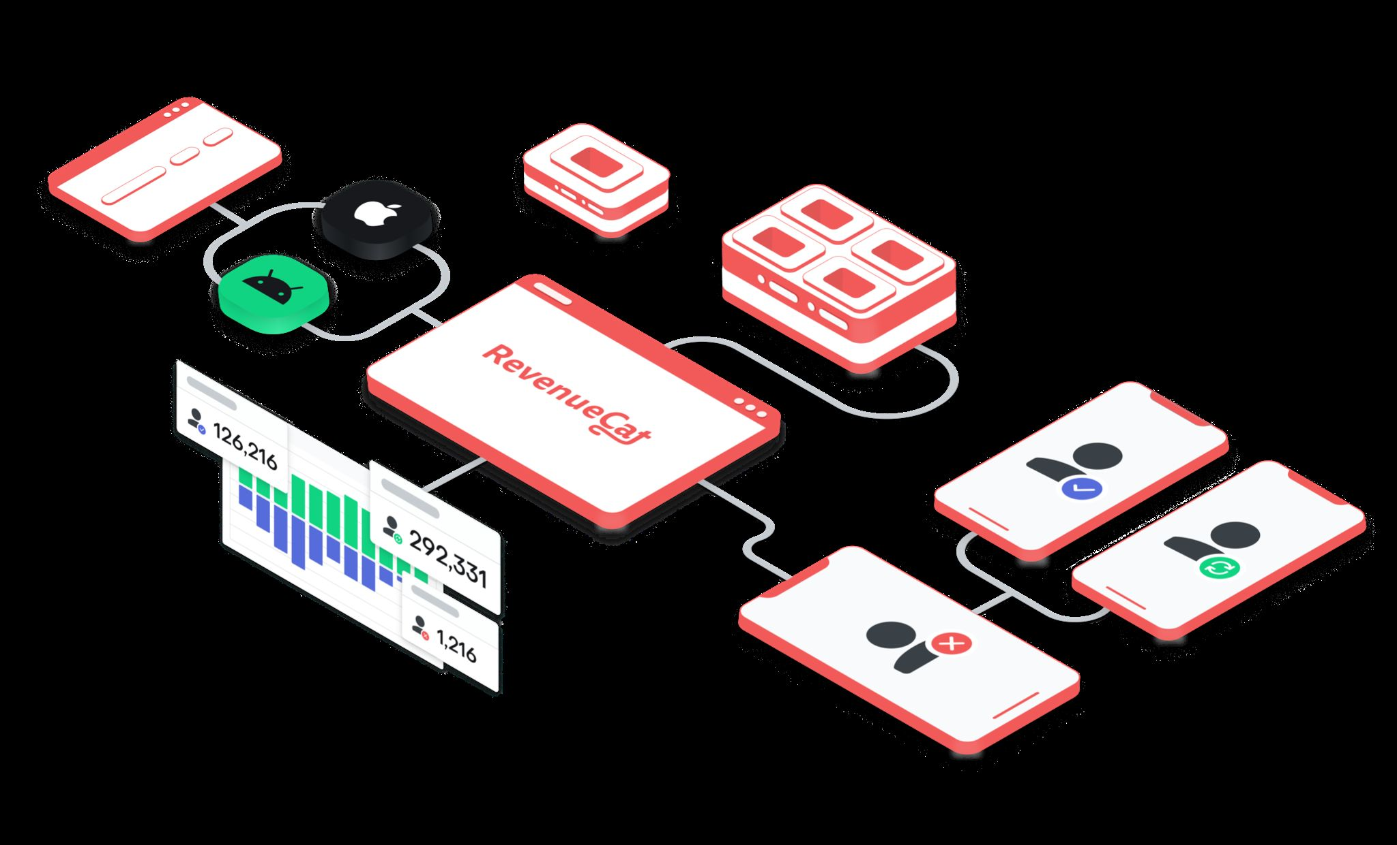
REVENUECAT
DROIDCON USA · 2026
ANDROID MONETIZATION, WITHOUT THE MAZE
Monetize your Android app
the right way.
Perttu Lähteenlahti
Senior Developer Advocate, RevenueCat
01
Notes:
Open by framing monetization as product design, not extraction. This talk builds the whole path from value to durable access.

Slide 2
REVENUECAT
DROIDCON USA · 2026
THE UNCOMFORTABLE TRUTH
A great app with no business model is still a side project.
Monetization is part of product design, not the thing you bolt on at launch.
02
Notes:
Many strong apps never become durable businesses because billing is postponed until launch week.

Slide 3
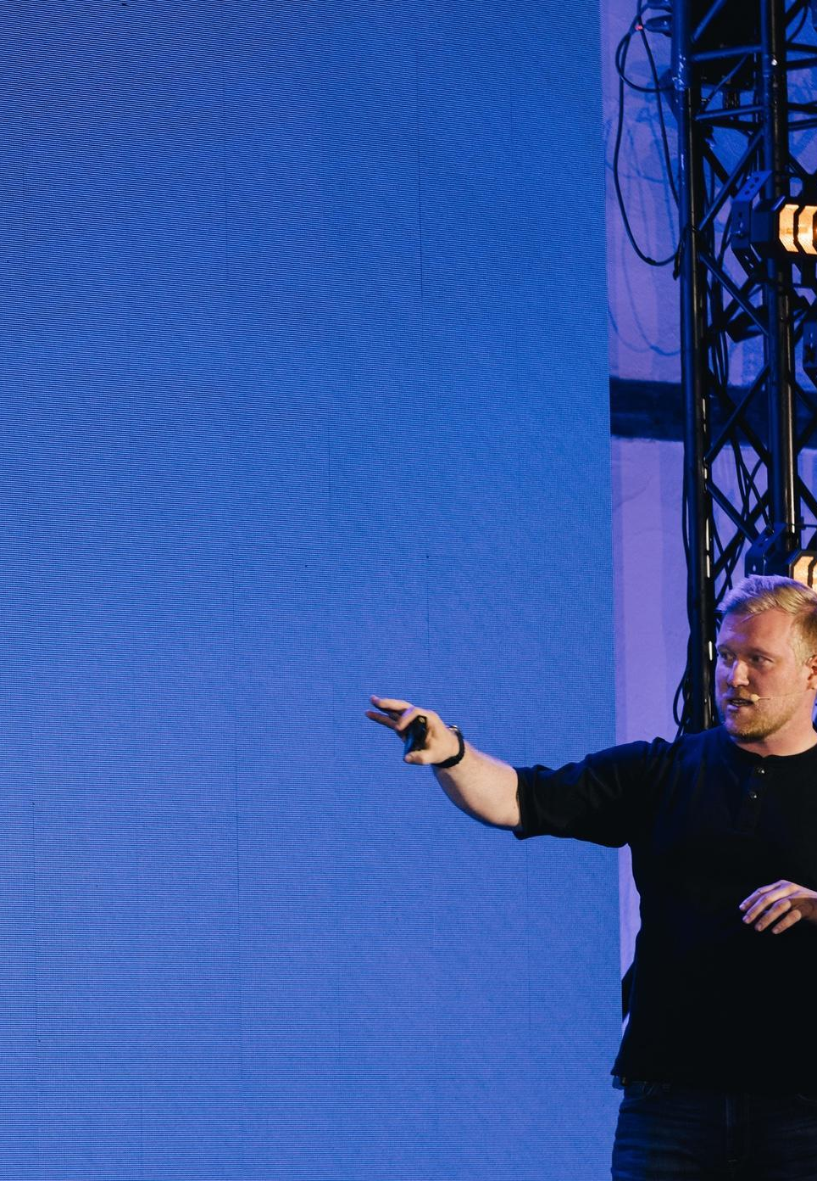
REVENUECAT
DROIDCON USA · 2026
PERTTU LÄHTEENLAHTI
I help developers
make more money.
→
Senior Developer Advocate at RevenueCat
→
Android, Flutter, and subscription infrastructure
→
@plahteenlahti · perttu.dev
03
Notes:
Keep the introduction short. Establish Android and subscription credibility, then continue.

Slide 4
REVENUECAT
DROIDCON USA · 2026
THE THESIS
Monetization is a system, not a checkout button.
Model, catalog, identity, paywall, access, recovery, measurement.
04
Notes:
This system framing is the backbone. A checkout button can work while the business still fails.

Slide 5
REVENUECAT
DROIDCON USA · 2026
115,000+ SUBSCRIPTION APPS · $16B+ OBSERVED REVENUE
Android’s gap happens before the trial.
0.9%
2.6%
32.5%
Google Play median
download → paid by day 35
App Store median
download → paid by day 35
Google Play median trial → paid
— almost identical to iOS
RevenueCat · State of Subscription Apps 2026
05
Notes:
The Android disadvantage is early in the funnel. Once users start a trial, median paid conversion is essentially at parity with iOS.

Slide 6
REVENUECAT
DROIDCON USA · 2026
TODAY
Build the whole path from value to access.
01
02
03
04
05
MODEL
CATALOG
PAYWALL
ENTITLEMENT
ROUTES
What customers pay for
Products, packages, offerings
How the choice is presented
What the purchase unlocks
Store, web, restore, support
06
Notes:
Use the dependency chain as the agenda: model, catalog, paywall, entitlement, routes.

Slide 7
REVENUECAT
DROIDCON USA · 2026
CHOOSE THE MODEL
Charge in the same rhythm that users receive value.
01
02
03
04
05
PAID APP
ADS
CONSUMABLES
SUBSCRIPTION
CURRENCY
One payment before the first experience.
Monetize attention across a large free audience.
Pay whenever a scarce unit is used.
Recurring payment for recurring outcomes.
A wallet for repeated micro-transactions.
Durable utility
Scale
Credits / boosts
Evolving products
Economies / AI
07
Notes:
The right model follows the frequency and shape of value. Hybrid models are valid when each layer has a clear job.

Slide 8
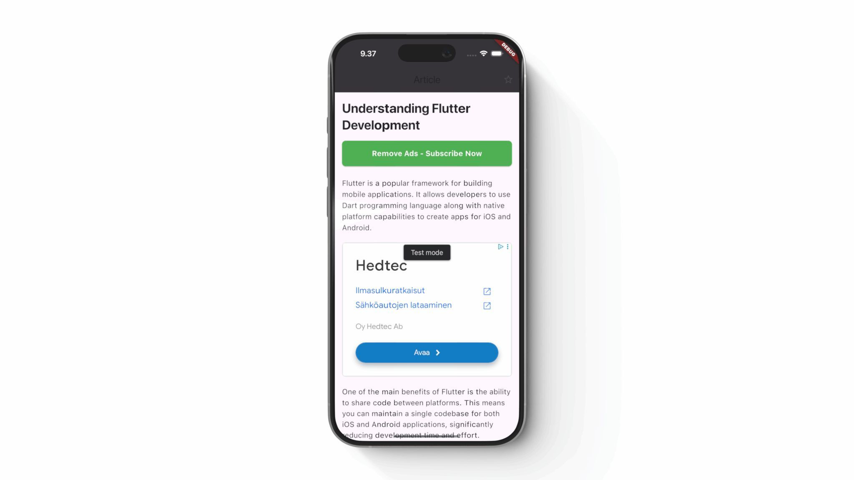
REVENUECAT
DROIDCON USA · 2026
ADS · MONETIZE AT SCALE
Ads optimize attention, not access.
→
Low friction for a large free audience
→
Revenue grows with sessions and inventory
→
Experience cost: distraction, privacy, performance
08
Notes:
Ads are operationally simple but product-expensive: incentives bend toward more attention, not always better outcomes.

Slide 9
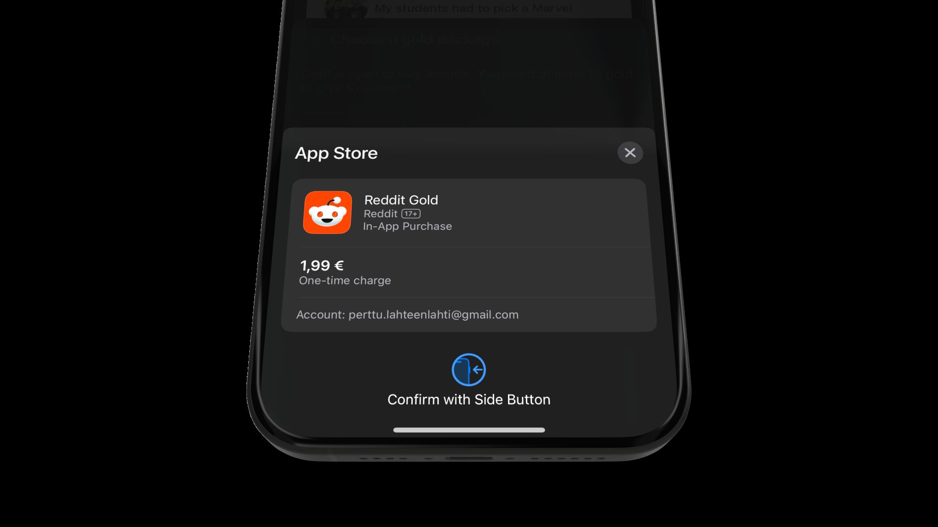
REVENUECAT
DROIDCON USA · 2026
CONSUMABLES · PAY AS YOU GO
If value gets used up, sell it in units.
→
Coins, credits, boosts, tokens, extra storage
→
Easy entry; revenue depends on repeat use
→
Make the unit legible before setting the price
09
Notes:
Examples include AI credits, cloud render minutes, storage, or game boosts. Make one unit understandable.

Slide 10
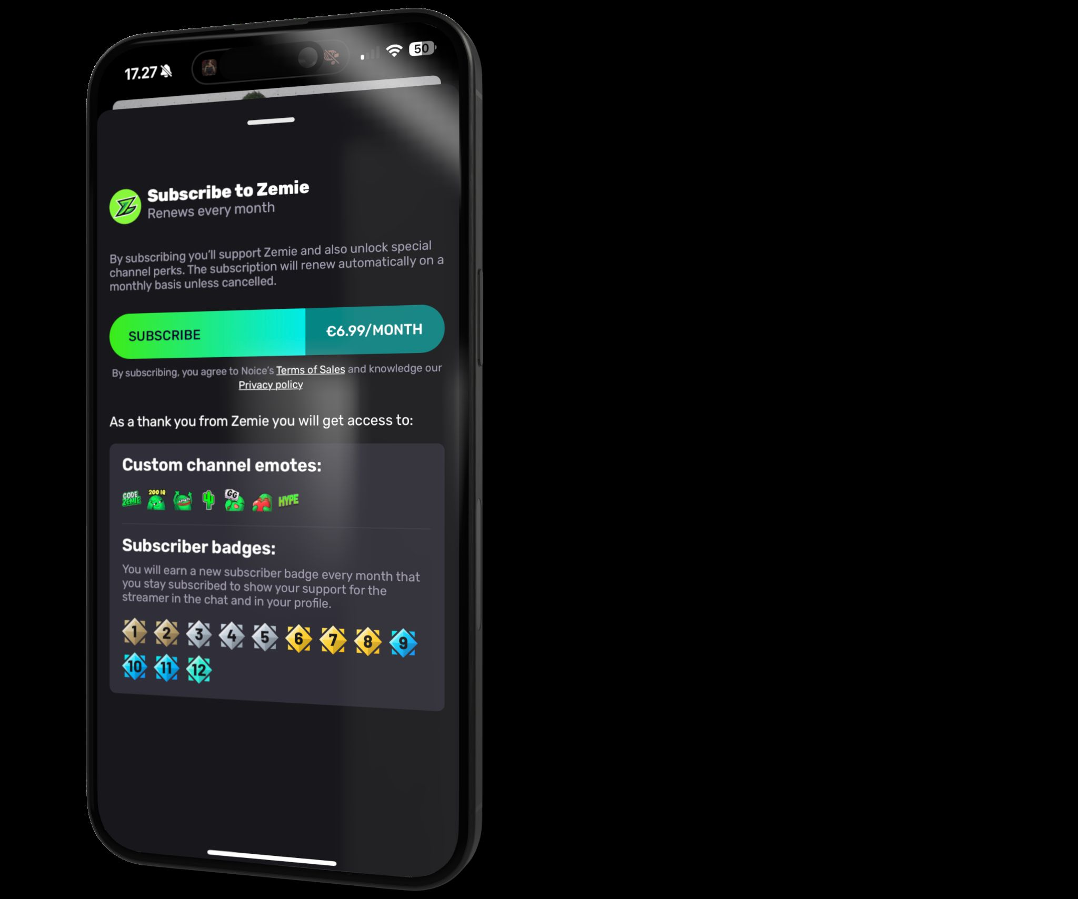
REVENUECAT
DROIDCON USA · 2026
SUBSCRIPTIONS · RECURRING REVENUE
A subscription is a promise you must keep renewing.
→
Predictable revenue and stronger commitment
→
Trials, intro offers, and regional pricing
→
Churn is feedback: ongoing value was not obvious enough
10
Notes:
Recurring payment is fair only when value recurs. Trials and annual plans are tools, not retention substitutes.

Slide 11
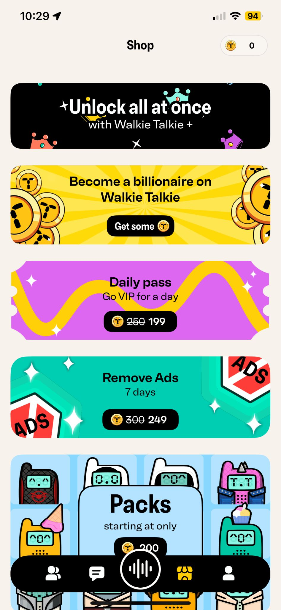
REVENUECAT
DROIDCON USA · 2026
VIRTUAL CURRENCY · FLEXIBLE, BUT NOT VAGUE
Currency works when users understand the exchange.
→
Useful for games, creator tools, and variable AI costs
→
Bundles make comparison harder — use that responsibly
→
Track liability, refunds, and unused balances
11
Notes:
Virtual currency can match variable cost, including AI inference. It becomes hostile when the exchange rate is intentionally unreadable.

Slide 12
REVENUECAT
DROIDCON USA · 2026
THE PURCHASE BUTTON IS ONLY ONE TRANSITION
Your real product is the purchase lifecycle.
AVAILABLE
PENDING
PURCHASED
ENTITLED
RECOVERING
REVOKED
Localized products and eligibility
Confirmation may leave the app
Verified and acknowledged
CustomerInfo unlocks access
Retry, restore, offline cache
Expiry, refund, mismatch
If any state is undefined, support becomes your state machine.
12
Notes:
The button is one transition in a longer state machine. Walk through each state and ask who owns it.

Slide 13
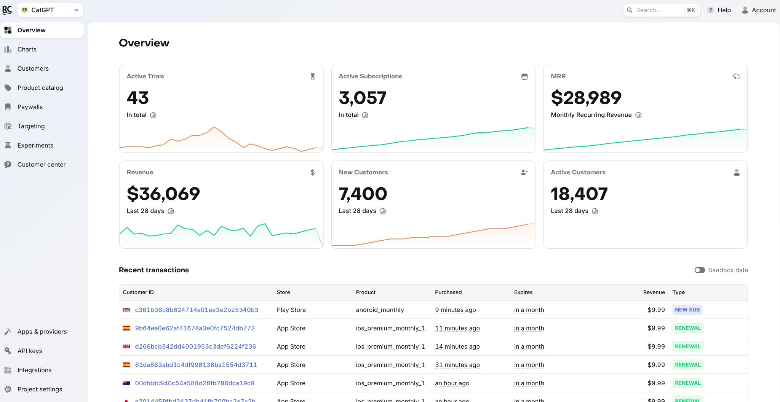
REVENUECAT
DROIDCON USA · 2026
WHY REVENUECAT
One source of truth across stores and surfaces.
→
Normalizes purchase state and store quirks
→
Connects Android, iOS, and web to one customer
→
Paywalls, experiments, targeting, analytics
→
Free to $2.5k monthly tracked revenue; then 1%
RevenueCat product documentation and pricing · checked July 2026
13
Notes:
RevenueCat removes the store state machine from the app team’s critical path. Pricing was rechecked for this deck.

Slide 14
REVENUECAT
DROIDCON USA · 2026
ARCHITECTURE
Translate transactions into access.
GOOGLE PLAY
OR WEB
REVENUECAT
YOUR APP
→
→
Owns the payment and transaction
Validates and normalizes CustomerInfo
Checks an entitlement and unlocks
14
Notes:
The app should never reason from a raw receipt or SKU. It should ask for customer state, then make one access decision.

Slide 15
REVENUECAT
DROIDCON USA · 2026
TWO DEPENDENCIES, THREE MOVES
Configure. Present. Unlock.
// build.gradle.kts
implementation(
"com.revenuecat.purchases:" +
"purchases:10.8.0"
)
// Includes Paywalls for Compose
implementation(
"com.revenuecat.purchases:" +
"purchases-ui:10.8.0"
)
01
02
03
CONFIGURE
PRESENT
UNLOCK
Application start
Current offering
Entitlement state
RevenueCat Android codelab · checked July 2026 · verify the latest version before shipping
15
Notes:
The UI module includes the core SDK, so most Compose apps only need purchases-ui. Verify versions before shipping.

Slide 16
REVENUECAT
DROIDCON USA · 2026
01 · CONFIGURE
Initialize once, as early as possible.
class MainApplication : Application() {
override fun onCreate() {
super.onCreate()
Purchases.logLevel = LogLevel.DEBUG
Purchases.configure(
PurchasesConfiguration.Builder(
this, "goog_public_sdk_key"
).build()
)
}
}
Use the public Google SDK key. Never ship a secret API key in the app.
RevenueCat Android SDK documentation
16
Notes:
Configure in Application.onCreate with the public SDK key. DEBUG logging is for development.

Slide 17
REVENUECAT
DROIDCON USA · 2026
IDENTITY
Your identity choice becomes subscription architecture.
// Start anonymous
Purchases.configure(config)
// Identify after sign-in
Purchases.sharedInstance.logIn(appUserId) {
customerInfo, created, error ->
// refresh access
}
→
Anonymous IDs fit no-login, single-device flows
→
Custom IDs enable cross-device and cross-platform access
→
Use a stable, non-guessable ID — never an email
RevenueCat · Identifying Customers
17
Notes:
Identity is where cross-device bugs begin. Anonymous is valid; custom IDs should be stable, private, and owned by authentication.

Slide 18
REVENUECAT
DROIDCON USA · 2026
VOCABULARY
Keep store configuration out of your UI language.
PRODUCT
PACKAGE
OFFERING
PAYWALL
ENTITLEMENT
A store SKU: monthly, annual, lifetime, credits.
Equivalent products across Android, iOS, and web.
The set of packages you choose to sell now.
The interface that presents an offering.
The durable access level a purchase unlocks.
18
Notes:
Product is the store SKU. Package normalizes platforms. Offering is what you sell. Paywall is how. Entitlement is what the customer gets.

Slide 19
REVENUECAT
DROIDCON USA · 2026
OFFERINGS · CHANGE THE OFFER, NOT THE APP
Fetch the decision your UI should render.
val offering = try {
Purchases.sharedInstance
.awaitOfferings()
.current
} catch (e: PurchasesException) {
logger.warn(e) { "Offerings unavailable" }
null
}
val annual = offering?.annual?.storeProduct
→
Dashboard chooses the current offering
→
Packages carry localized store products
→
Handle “no offering” as a real product state
RevenueCat Android codelab · Offerings
19
Notes:
Fetch the current offering with the coroutine API. Treat null, timeout, and misconfigured catalog states deliberately.

Slide 20
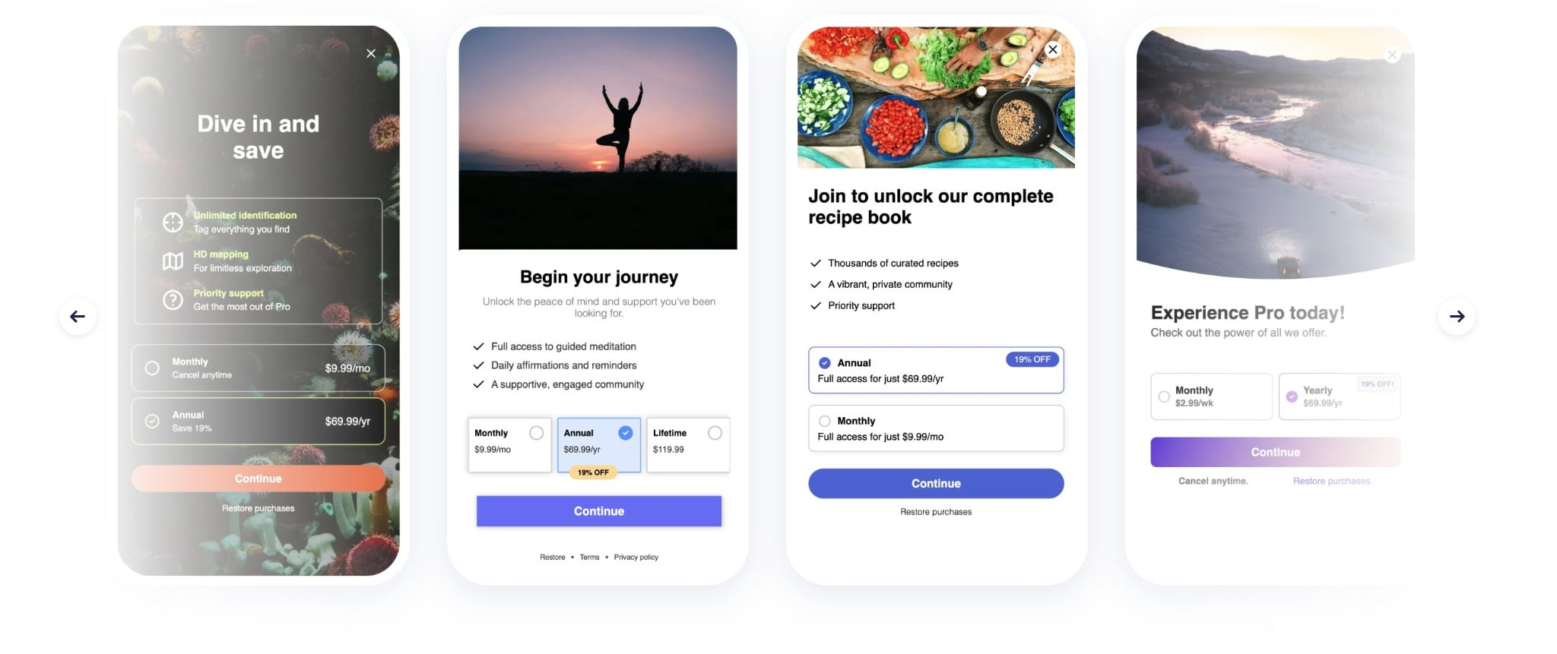
REVENUECAT
DROIDCON USA · 2026
PAYWALLS · NATIVE UI, REMOTE DECISIONS
Ship the surface once. Keep learning after release.
→
Pair one paywall with one offering
→
Edit copy, layout, and packages remotely
→
Measure views, starts, purchases, and restores
20
Notes:
The app renders native UI; the team keeps learning and changing decisions in the dashboard.

Slide 21
REVENUECAT
DROIDCON USA · 2026
02 · PRESENT
Gate the moment — not the whole app by accident.
@Composable
fun LockedFeature(onDismiss: () -> Unit) {
PaywallDialog(
PaywallDialogOptions.Builder()
.setRequiredEntitlementIdentifier("pro")
.setDismissRequest(onDismiss)
.build()
)
}
Present based on a required entitlement, then dismiss when purchase succeeds.
RevenueCat · Displaying Paywalls on Android
21
Notes:
This reflects the current Android Compose API shape. The key product choice is the required entitlement.

Slide 22
REVENUECAT
DROIDCON USA · 2026
A PAYWALL IS A PROMISE WITH A BUTTON
Answer five questions before asking for money.
01
02
03
04
05
WHAT CHANGES?
WHY NOW?
WHICH PLAN?
CAN I TRUST IT?
CAN I RECOVER?
Name the outcome, not a list of premium features.
Show it at a value moment, not on a timer.
Make monthly versus annual obvious.
Show localized price, terms, and trial details.
Keep close, restore, account, and support visible.
22
Notes:
Use the five questions as a live critique framework. The outcome comes before the price.

Slide 23
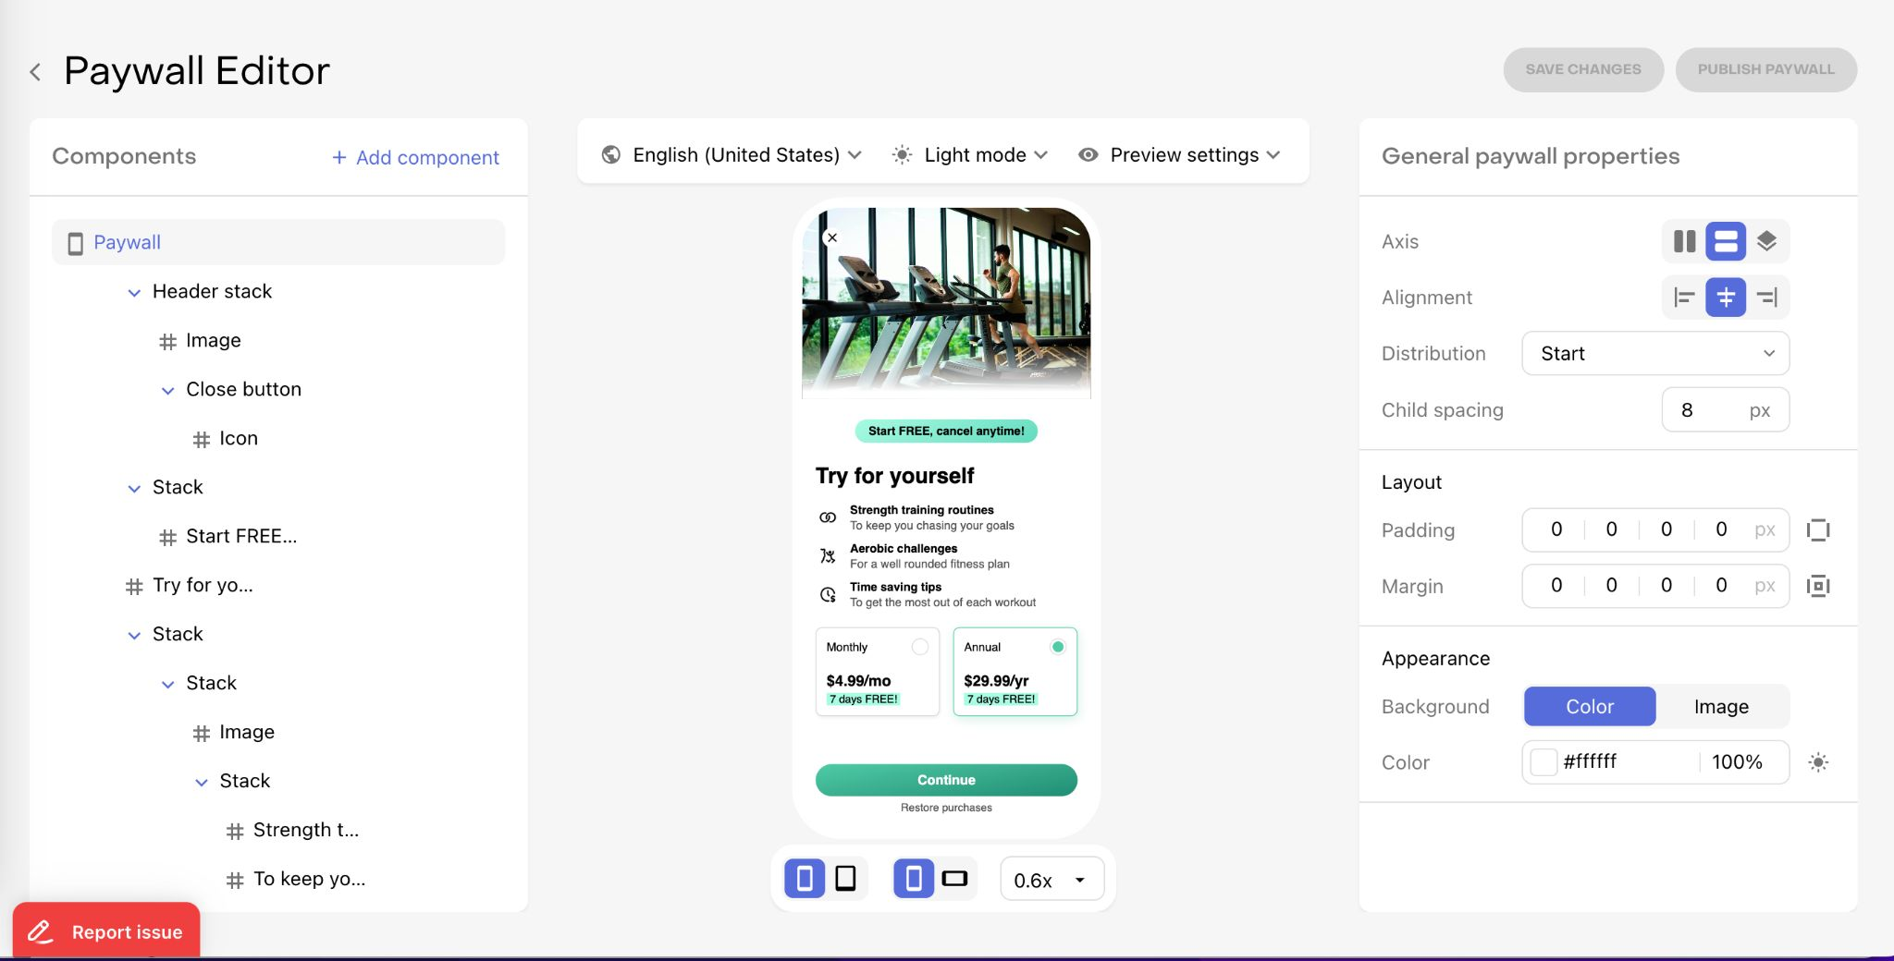
REVENUECAT
DROIDCON USA · 2026
EXPERIMENTS · LEARN ONE THING AT A TIME
Test decisions, not entire personalities.
→
Start with offer, price, trial, or annual emphasis
→
Keep acquisition source and audience visible
→
Optimize downstream retention, not only conversion
23
Notes:
Changing everything at once can improve conversion while teaching nothing. Tie the hypothesis to one decision.

Slide 24
REVENUECAT
DROIDCON USA · 2026
ENTITLEMENTS
Products change. Access should stay stable.
Entitlements decouple what the customer bought from what your app unlocks.
24
Notes:
Entitlements are the stability layer across replaced SKUs, web products, and promotional grants.

Slide 25
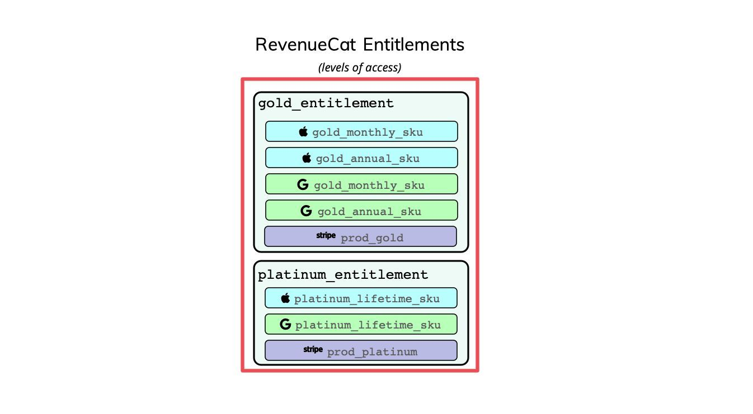
REVENUECAT
DROIDCON USA · 2026
03 · UNLOCK
Ask one product question: “Does this customer have pro?”
Purchases.sharedInstance.getCustomerInfoWith(
onError = { error ->
// keep the last known access state
},
onSuccess = { customerInfo ->
val hasPro = customerInfo
.entitlements["pro"]
?.isActive == true
}
)
RevenueCat · Getting Subscription Status
25
Notes:
Preserve the last known access state during transient errors rather than punishing a paying customer.

Slide 26
REVENUECAT
DROIDCON USA · 2026
A RECOVERY JOURNEY, NOT A CHECKBOX
Restore purchases is a product feature.
Purchases.sharedInstance.restorePurchasesWith(
onError = { error ->
showRecoveryError(error)
},
onSuccess = { customerInfo ->
val restored = customerInfo
.entitlements["pro"]
?.isActive == true
updateAccess(restored)
}
)
→
Trigger it from an explicit customer action
→
Refresh the same entitlement gate on success
→
Show the App User ID in support diagnostics
RevenueCat · Restoring Purchases
26
Notes:
Restore only from an explicit user action. Feed CustomerInfo through the same entitlement gate used after purchase.

Slide 27
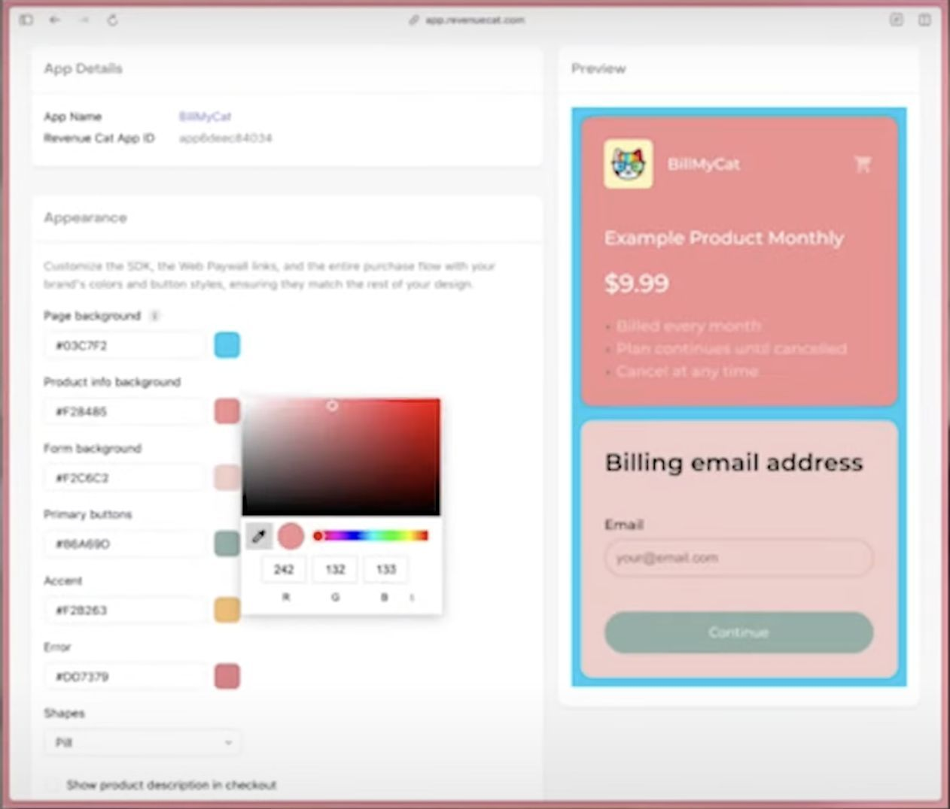
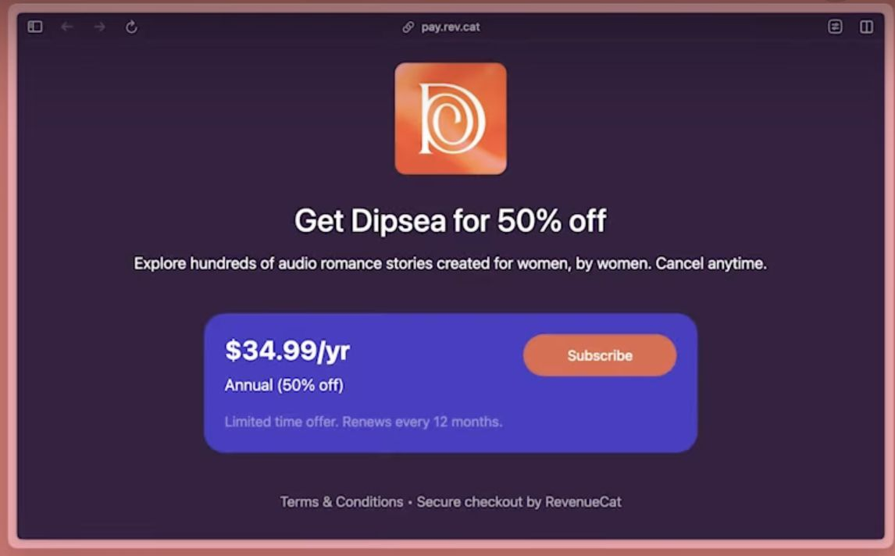
REVENUECAT
DROIDCON USA · 2026
WEB BILLING · A NEW ROUTE INTO THE SAME ENTITLEMENT
Web expands acquisition — not just payment options.
→
Campaigns, email, creators, bundles, and win-back
→
Web links, paywalls, SDK, or funnels
→
One CustomerInfo unlocks the same Android experience
RevenueCat Web documentation
27
Notes:
Treat web as an acquisition channel: email, creators, ads, bundles, and win-back can all enter the same entitlement system.

Slide 28
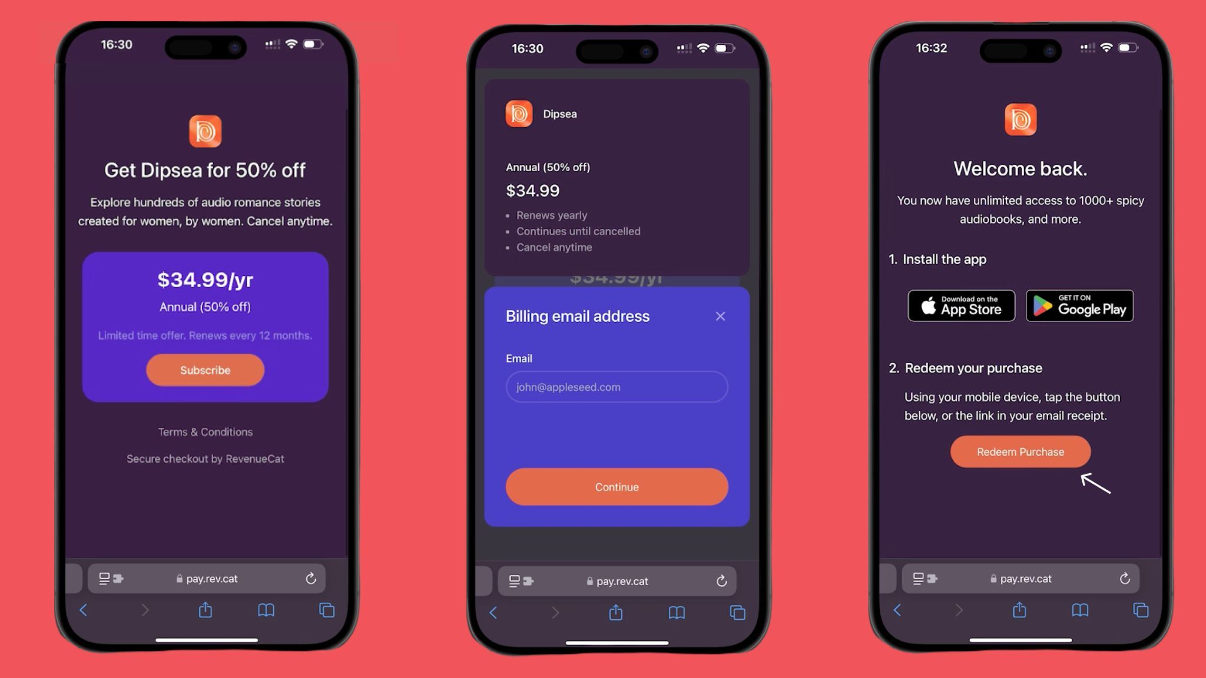
REVENUECAT
DROIDCON USA · 2026
WEB → APP
The best checkout still loses if access is hard to redeem.
01
02
03
PURCHASE
LINK
UNLOCK
Customer pays on the web
Landing page and email deep-link
App redeems and refreshes access
28
Notes:
The transaction is not complete for the customer until the app opens and access appears. Mention the email fallback.

Slide 29
REVENUECAT
DROIDCON USA · 2026
U.S. BILLING IN 2026 · RE-CHECK BEFORE SHIPPING
More choice does not mean fewer obligations.
ENROLL FIRST
OFFER CHOICE
CURRENT APIs
REPORT
Use the relevant U.S. alternative billing or external-link program.
Program flows present Play Billing alongside the alternative route.
Billing choice requires Play Billing Library 9.1+.
External transaction tokens connect purchases to Play reporting.
Google Play Payments policy · U.S. policy update · Billing Choice program · checked 2026-07-15
29
Notes:
This is volatile. Current U.S. programs allow alternative routes under requirements: enrollment, choice UI, current API, and reporting.

Slide 30
REVENUECAT
DROIDCON USA · 2026
DO NOT HARDCODE A COURT CASE
Make checkout routing a server decision.
when (checkoutConfig.route) {
PLAY_BILLING -> showPlayPaywall()
USER_CHOICE -> showBillingChoice()
EXTERNAL_WEB -> openApprovedLink()
else -> showPlayPaywall()
}
// Config comes from your backend.
// Re-check policy before every release.
→
Inputs: region, enrollment, app version, eligibility
→
Output: Play, user choice, or permitted external route
→
Ship a safe default when config is missing
30
Notes:
Put eligibility and route selection behind one remotely controlled configuration object. Default safely to Play Billing.

Slide 31
REVENUECAT
DROIDCON USA · 2026
BEFORE LAUNCH
A monetization launch is ready when the unhappy paths work.
✓
Model matches the value rhythm
✓
Products map to stable entitlements
✓
Identity flows are deliberate
✓
Paywall has restore and a clear promise
✓
Refunds, retry, and offline state are tested
✓
Conversion and retention are measured
✓
Support can find a customer
✓
Policy checked per region before release
31
Notes:
The happy path is the demo. The unhappy paths are the product. Invite the audience to photograph the checklist.

Slide 32
REVENUECAT
DROIDCON USA · 2026
THE TAKEAWAY
Monetize in the same rhythm that you create value.
Then make purchase state boring, access stable, and the offer easy to change.
32
Notes:
Return the system to one sentence: value rhythm first, infrastructure second, optimization third.

Slide 33

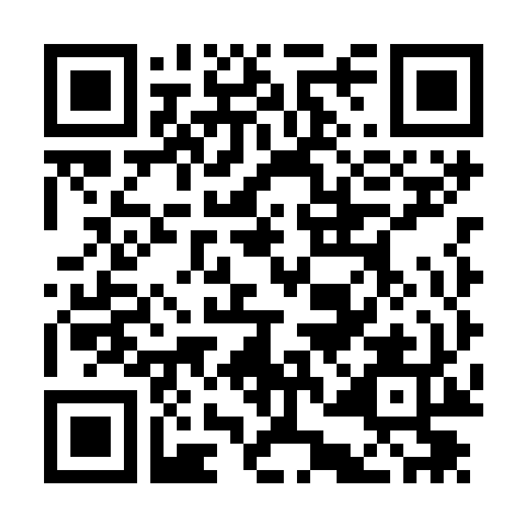
REVENUECAT
DROIDCON USA · 2026
QUESTIONS?
Go build something
worth paying for.
Perttu Lähteenlahti · @plahteenlahti
FULL GUIDE + CODE
perttu.dev/articles/how-to-make-money-with-your-android-app
33
Notes:
The QR opens the full article and implementation resources. Close on the maker and take questions.

