Slide 1
Presentation-week 3
Question 5
Turtle Probelm

Slide 2
Process of Programming
Read and analyze the question
Break down the question into smaller ones
Write each part of the program
Debug
Assemble
Debug

Slide 3

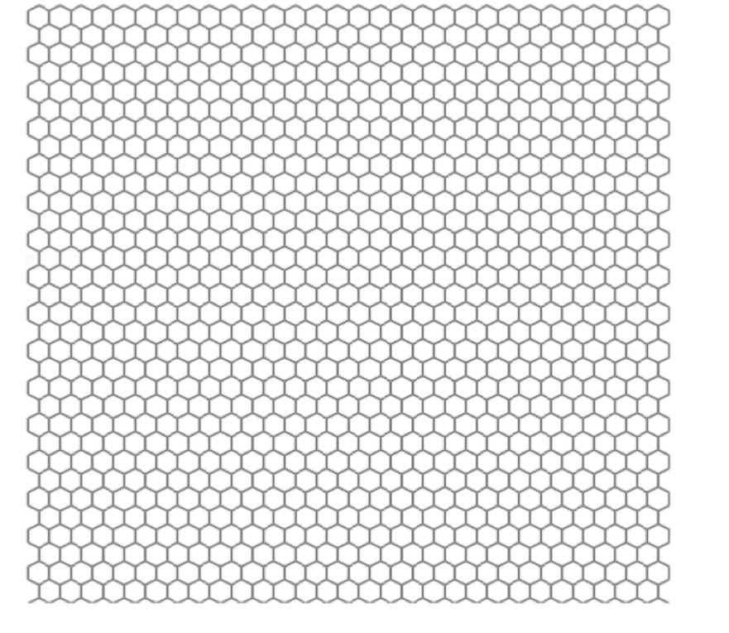
Write a program that uses Turtle functions to draw a grid of hexagons (a bee-hive pattern) as shown in the figure below. Further, each of the six lines of each hexagon should be drawn in a different color. Avoid repetition of code as much as possible. Hint: Write a function that draws a hexagon, then another function that draws a row of hexagons, then a function that draws a bunch of rows (to make a grid). (You will need to use for loops.)
turtle picture from:https://www.pinterest.ca/pin/turtle-sticker-by-littlemandyart--694328467551382209/

Slide 4
the pattern seems obvious, but each side with different colour?

Slide 5
The first thought came up to me is draw a hexagon and repeat, but...
overlapping and one hexagon changes the line color of another

Slide 6
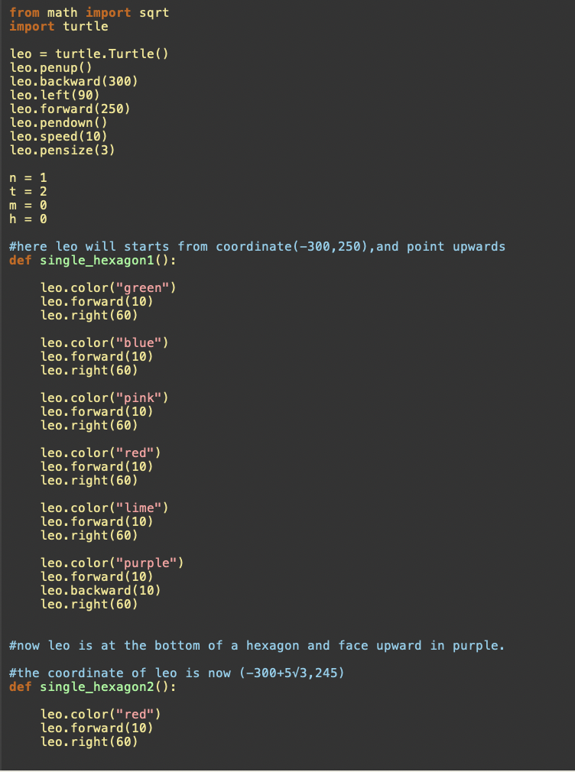
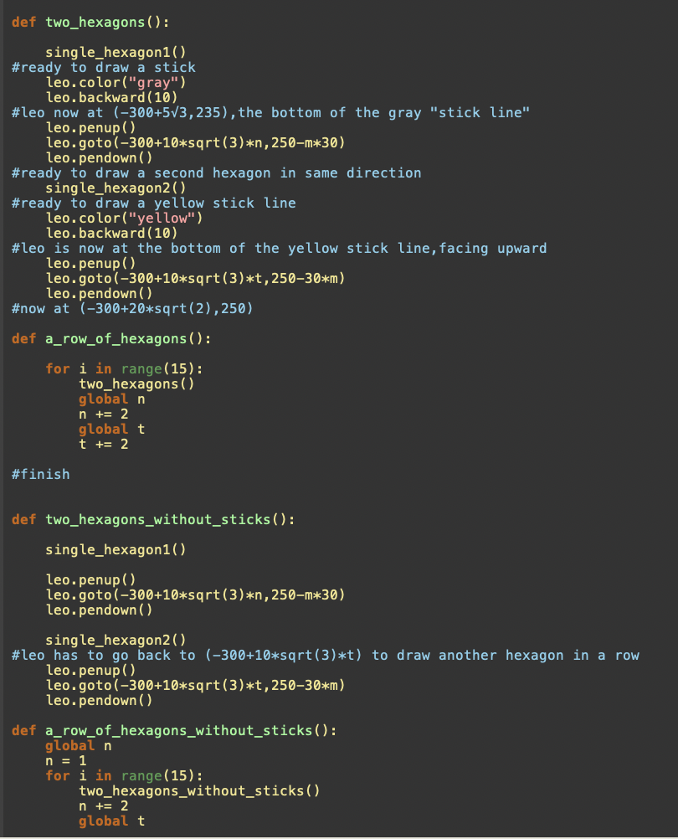
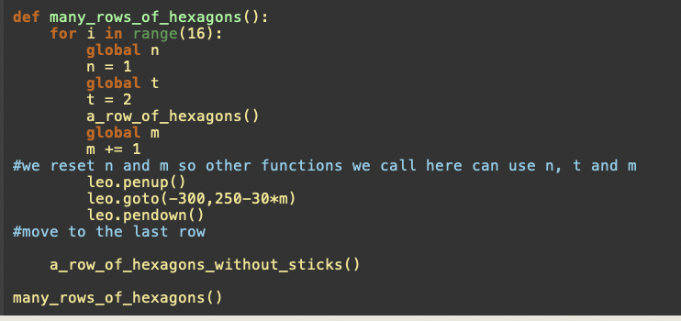
then the codes are very tedious and redundant

Slide 7
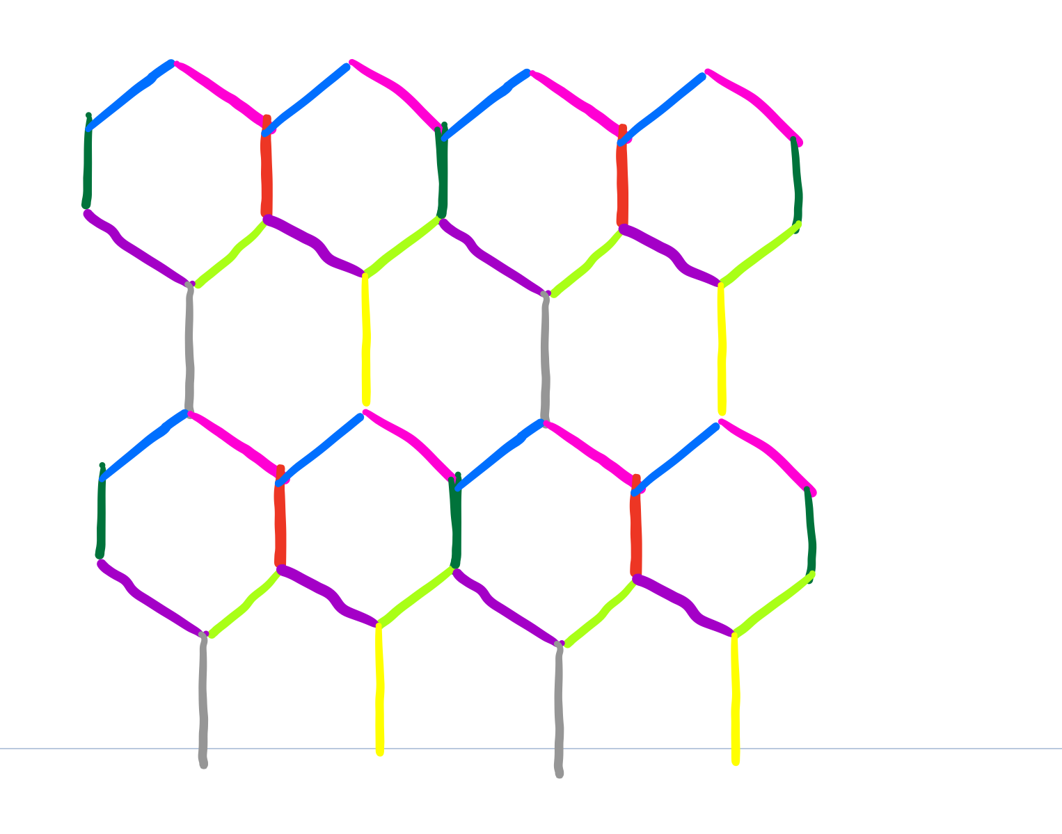

Slide 8
1. write a function that draws the top line
2. write a function that draws the bottom line
3. write a function that draws the sticks between hexagons
4. put together everything

Slide 9
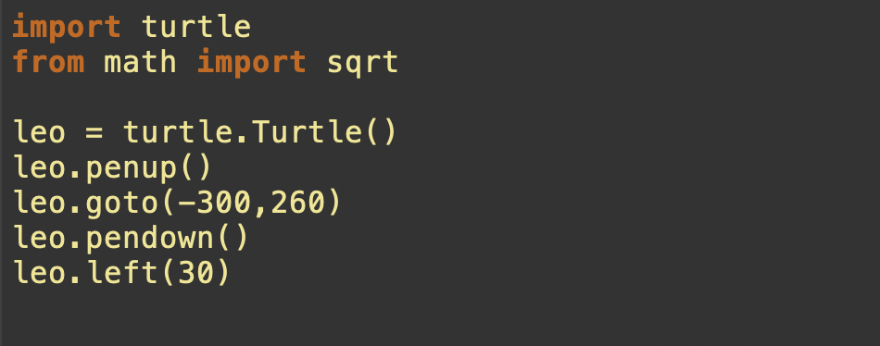
Move turtle to appropriate position

Slide 10
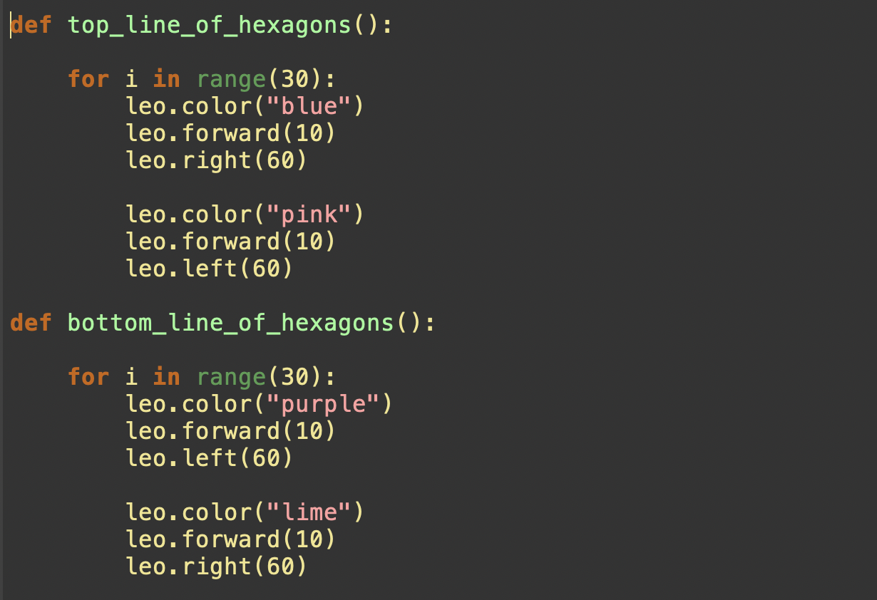
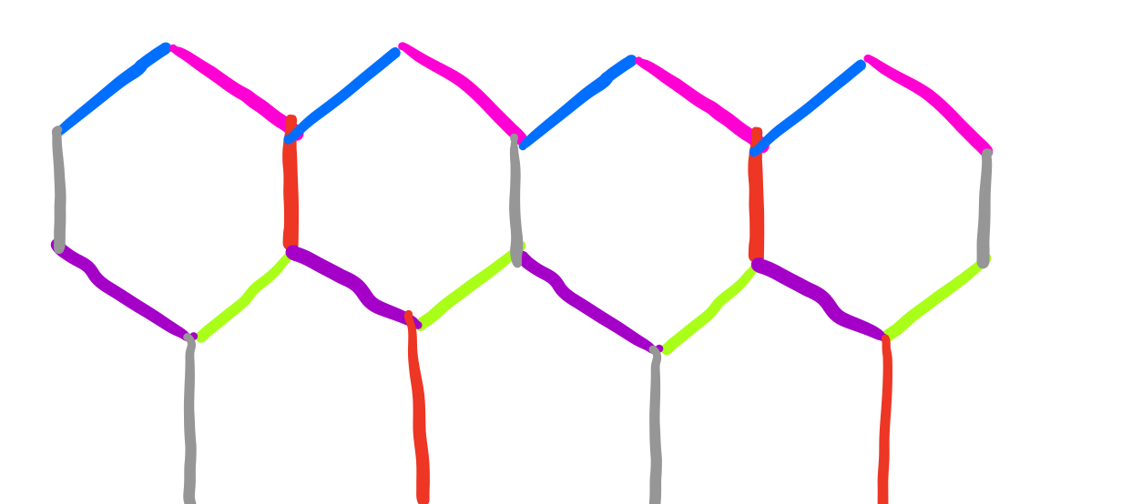
Upper line and bottom line

Slide 11
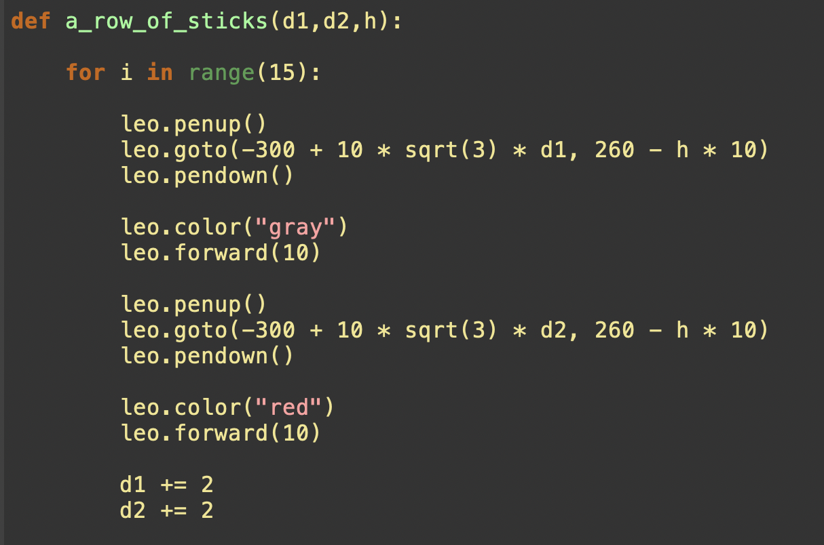
row of sticks
0
1
0
（-300+sqrt(3)*30，260）
（-300+sqrt(3)*10，260）
（-300，260）
（-300+sqrt(3)*20，260）

Slide 12
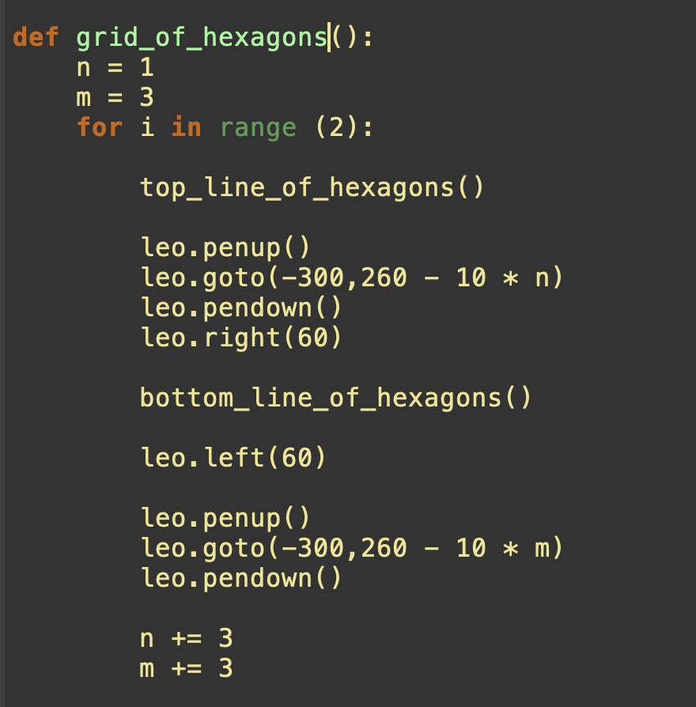
assemble

Slide 13
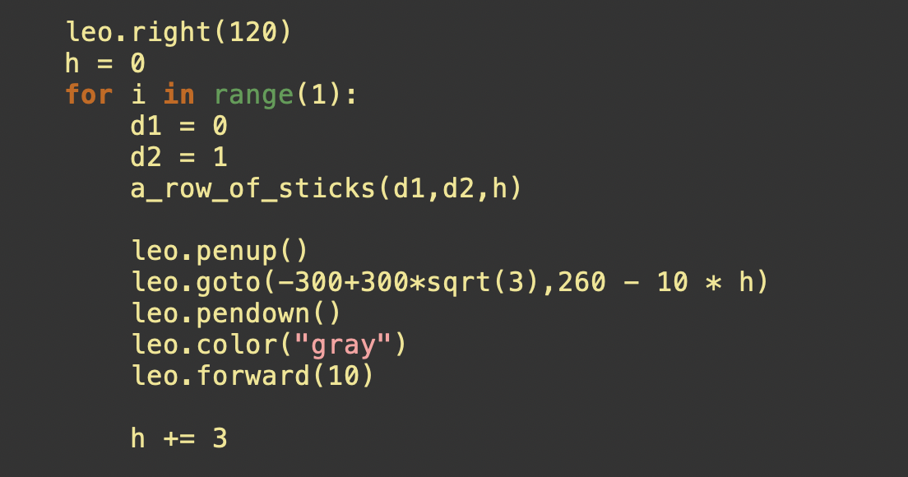
assemble
(-300,260)
two in a loop, so one left
(-300,260 - 30)
(-300,260 - 60)

Slide 14
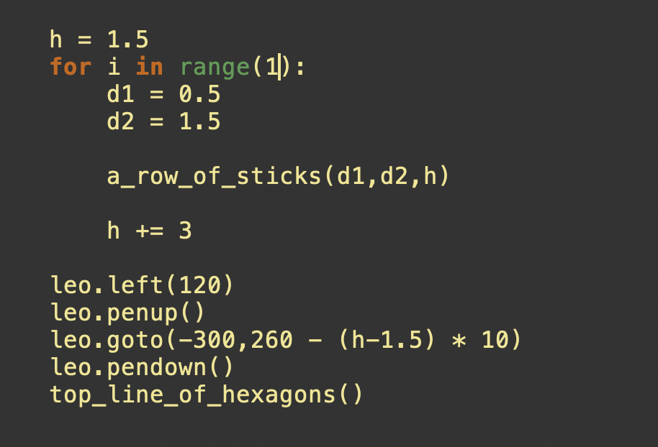
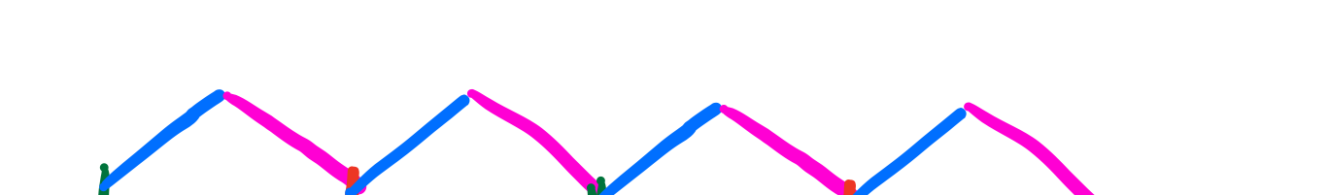
assemble
(-300+0.5*sqrt(3)*10,260-10*0.5)
(-300+0.5*sqrt(3)*10,260-10*3.5)
(-300+0.5*sqrt(3)*10,260-10*5)

