Slide 1


Montana University System
Student Financial Services
April 18, 2013

Slide 2

Reorganized July 2012
Regent and Commissioner interest at an all-time high
  New priority level for student services
  Goal #1 in Regents Strategic Plan is Access and Affordability
Increased focus on affordability, financial aid policy and administration and financial literacy nationally
Other student services topics

Slide 3
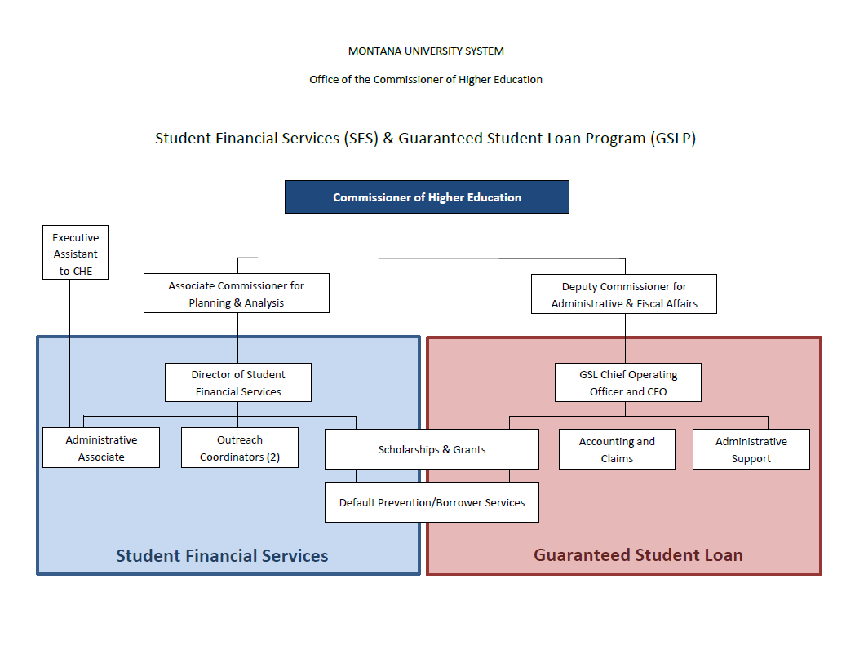

Slide 4

Lead and coordinate the following student services for the Montana University System:
  Financial Aid Policy and State Aid Administration
  Financial Literacy Education
  Default Prevention
  Other student related topics (Veterans Success Initiative, Affordability)

Slide 5

Scholarship Administration
Financial Aid Policy
Financial Literacy
College Access Challenge Grant
Veterans Success Initiative
Affordability Taskforce
Notes:
Mention funding for veterans of $1 million

Slide 6

Develop and implement system-wide policies
Analyze the effectiveness of financial aid policies and practices
Recommend strategies and lead efforts for improvement/administration of aid
Develop and administer the need-based aid portion of the College Access Challenge Grant (CACG)
Direct OCHE administered state aid
  Montana University System Honors Scholarships Program
  Governor’s Best and Brightest Scholarships Program
  Montana Tuition Assistance Program
  Montana Higher Education Grant

Slide 7

Develop a coordinated and collaborative approach to financial literacy that enhances and connects existing campus and system efforts
  Implement College Access Challenge Grant financial literacy program including development of best practices and sub-grants to campuses
Improve financial literacy material and on-line information, as well as broaden scope to include K-12
  Partnering with OPI and Department of Labor
Continue to utilize Affordability Taskforce as system advisory council for financial literacy efforts

Slide 8

Provide central default prevention services
Increase centralized default prevention efforts for students receiving federal direct loans
Develop a plan for eventual phase out of default prevention services for students who received GSL loans and work to ensure sustainable services for direct loan students
Notes:
We are the first and only state providing centralized, coordinated default prevention services to our campuses and students under the direct loan program
Added staff to focus on direct loan borrowers
Converted existing staff
Each campus is assigned a specific counselor to work with the campus staff and borrowers from that campus

Slide 9

Administration of FFELP
$1.5 billion portfolio to be serviced
Claim payment to lenders
Infrastructure for SFS: IT, Default Prevention resources

Slide 10


Slide 11


Slide 12

Established by Board of Regents in 2011
Analyzed data related to affordability
  Affordability is driven by more than cost of tuition
  Student debt on the increase
  Percentage of students borrowing increasing
  Low-income students borrowing at a higher percentage and higher amounts
  State support for financial aid - $6M/year = 40th
  Net Price and median income compared tuition
  Student loan defaults are increasing
Notes:
64% of our students borrow, average debt is $25,140 for a bachelors degree, $18,259 for AA, $14,831 for certificate
90% of our Pell students borrow for an average of $27,482
Our financial aid in the MUS breaks down as this: PELL $66 million, state aid $6 million, loans $221 million, up from $123 million 10 yrs ago

Slide 13

Increase tuition assistance for low and moderate income students
Provide a system-wide, coordinated and collaborative financial literacy effort aimed at students most likely to generate high levels of debt
Increase centralized default prevention efforts

Slide 14

Student Financial Aid & Services
Increase tuition assistance for Montana residents in order to improve affordability and increase retention and completion rates of lower and moderate income students, as well as provide coordinated services that promote financial literacy and increase default prevention.

Slide 15
Financial Literacy Education – program implemented with future expansion planned
Default Prevention – program implemented and expanded
Tuition Assistance – unable to increase tuition assistance. Looking at our current programs to assess effectiveness and efficiency

Slide 16

Board of Regents meeting in March indicated continued, significant interest at the Regent level and resulted in the Commissioner assigning the Taskforce two items:
    Conduct a review and analysis of our state based aid programs
    Provide recommendations for improving or revamping our state based aid programs
State financial aid programs discussion items:
  What is the role of financial aid? Specifically, what is the role or niche for our state aid?
  How effective is our state aid? What is it accomplishing at each campus?
  How can we use our state aid to incentivize specific actions or behaviors from our students?
  How do we align state financial aid programs with the MUS goals of increasing completions and decreasing time to degree?

Slide 17

Data analysis is critical
Need component critical
Do no harm
Align aid with campus success metrics
Incentivize students with financial aid
Incentivize campuses
Student performance requirements

Slide 18

Affordability Taskforce Call, May 1, 2013
Financial Aid Directors Retreat May 30, 2013?
Additional Affordability Taskforce Calls over the summer months
Draft Recommendations to Board of Regents at September or November meeting
New program (if developed and approved) in place by January 2014 to be awarded for fall 2014

Slide 20

In March the Department of Education released draft cohort default rates for both the two year and three year calculations.
  MGSLP Fiscal Year 2011 Two-Year Draft Cohort is 2.57%.
  MGLSP Fiscal Year 2010 Three-Year Draft Cohort is 5.6%.

Slide 21
Last year’s official MGSLP Two-Year default rate for 2010 is 3.7%.
The official MGSLP Three-Year default rate for 2009 is 5.2%.
The national Two-Year default rate for 2010 is 8.8%.
The national Three-Year default rate for 2009 is 13.37%.

Slide 22
The Department has not released the national draft cohort default rates.

Slide 23

Overall, the draft MUS Two-Year Default Rate is 8.23%.
My data for the draft MUS Three-Year Default Rate is not complete, but based on the data we have it is approximately 9.17%.

Slide 24

School Name | 2011 2 YR DRAFT | MGSLP Draft Rate | PUT/DL Rate
Helena College | 12.39% | 3.81% | 14.99%
Great Falls College | 11.24% | 3.81% | 14.46%
Miles Community College | 13.02% | 4.29% | 18.03%
MSU Billings | 7.71% | 1.43% | 10.57%
Dawson | 11.32% | 0.00% | 16.44%
Western | 9.12% | 3.25% | 13.98%
MT Tech | 11.20% | 3.43% | 15.42%
Flathead Valley CC | 15.42% | 7.61% | 17.15%
Northern | 8.82% | 9.03% | 8.71%
MSU Bozeman | 4.21% | 1.02% | 6.28%
University of Montana | 8.34% | 2.07% | 12.15%
MUS TOTALS | 8.23% | 2.36% | 11.42%

Slide 25

School Name | 2010 3 YR DRAFT | MGSLP Draft Rate | Rate
Helena College | 13.96% | 7.14% | 23.81%
Great Falls College | 11.86% | 5.46% | 22.12%
Miles Community College | #DIV/0! | 10.14% | #DIV/0!
MSU Billings | 11.79% | 7.29% | 17.68%
Dawson | 12.94% | 12.00% | 14.29%
Western | 13.01% | 5.29% | 27.27%
MT Tech | 9.43% | 4.38% | 15.57%
Flathead Valley CC | #DIV/0! | 12.24% | #DIV/0!
Northern | 13.04% | 8.33% | 18.82%
MSU Bozeman | 5.79% | 3.41% | 10.61%
University of Montana | 8.77% | 5.33% | 15.13%
MUS Totals | 9.17% | 5.56% | 15.80%

Slide 26

Why are the FFELP default rates so much lower than the default rates for PUT/DL?
  No consistent standard for default between servicers.
  Lack of servicer follow up for deceased borrowers.
  Lack of personal connection with our student borrowers.

Slide 27

What does that mean?
  Servicers have different standards for default, and sometimes have different standards for default for different types of loans.
  Everyone agrees that technical default is reached at the 270th day of delinquency. No one agrees about a borrower’s options for preventing default after day 270.

Slide 28

Great Lakes defines all of their loans as defaulted after the 270th day of delinquency.
  After that day, the borrower is not eligible for deferment or forbearance, and has no option to recall the loan. This standard is applied to all loan types.

Slide 29
PHEAA (Fed Loan Servicing) defines default as the 361st day of delinquency for all loans.
Nelnet defines default for PUT loans as day 270, but does not consider a Direct Loan to be defaulted until day 361.
Sallie Mae defines default for PUT loans as day 270 (day 269 is the last day the borrower is eligible for a verbal forbearance). Direct Loans have until day 360.

Slide 30
ACS freezes PUT loans at day 270 in preparation for default. They will still accept deferment forms if the borrower calls them and explains their situation. Direct Loans are frozen in preparation for default at day 360 but will still accept deferment forms if the borrower calls them.
ACS reps have stated that the borrower may request a hearing to recall the loans, but no one knows what kind of criteria the borrower needs to meet to be successful for recall.

Slide 31

Having the majority of servicers with a 270 days default date for PUT means that the default rate for PUT loans will be higher than the average for FFELP and for Direct Loans.

Slide 32

Became a large issue in September of 2012.
  Until September, we had been receiving an average of 10,000 delinquent loans a month.
  For the month of September, we received 22,521 delinquent loans.

Slide 33

2012
School | January | February | March | April | May | June | July | August | Sept | Oct | Nov | Dec | Total
Carroll College | 155 | * | * | * | 118 | 141 | 147 | 164 | 445 | 123 | 375 | * | 1668
Miles Community College | 153 | 154 | 126 | 118 | 119 | 133 | 125 | 146 | 288 | 319 | 283 | 282 | 2246
Dawson Community College | 80 | 85 | ** | 73 | 78 | 133 | 79 | 79 | 180 | 175 | 174 | 172 | 1308
MSU - Billings | 1645 | 1443 | ** | ** | ** | ** | 1385 | 1340 | 3337 | 3248 | 3056 | 3298 | 18752
Montana Tech | 532 | 619 | 501 | 504 | 529 | 536 | 522 | 576 | 1177 | 1191 | 1108 | 1169 | 8964
MSU - Bozeman | 3855 | 3773 | 3161 | * | 3099 | 3408 | 3365 | 3308 | 5440 | 5276 | 4994 | 5185 | 44864
MSU - Northern | * | 377 | 282 | 270 | 302 | 325 | 300 | 298 | 1085 | 1122 | 1087 | 1120 | 6568
Rocky Mountain College | 216 | 216 | 187 | 173 | 186 | 212 | 219 | 187 | 576 | 514 | 499 | 475 | 3660
UM - Missoula | 3168 | 3767 | 3235 | 3029 | 3099 | 2995 | 2882 | 3173 | 6618 | 6454 | 6252 | 6394 | 51066
UM - Western | 346 | 387 | 279 | 310 | 279 | 279 | 271 | 269 | 553 | 561 | * | 602 | 4136
Flathead Valley Community College | 433 | 563 | * | 462 | 494 | 528 | 507 | 509 | 710 | 700 | 702 | 783 | 6391
Helena College | 459 | 486 | 451 | 412 | 428 | 441 | 414 | 425 | 869 | 861 | 828 | 879 | 6953
Great Falls College | 547 | 565 | 500 | 536 | 576 | 619 | 575 | 671 | 1086 | 1046 | 1041 | 1103 | 8865
Salish Kootenai College | 123 | 149 | 172 | 158 | 160 | 158 | 160 | 158 | 157 | 170 | * | 349 | 1914
Total | 11712 | 11733 | 8894 | 6045 | 9467 | 9908 | 10951 | 11303 | 22521 | 21760 | 20399 | 21811 | 167355
* No file received.
**Formatting Issues

Slide 34
As we continued to work on these accounts, we discovered some issues:
  Many servicers still had the borrower’s campus address as their current address.
  Many accounts did not have a valid address or any current contact information for the borrower.
  In response, we hired a full-time skip tracer for PUT/DL accounts who is in addition to our FFELP skip tracer.

Slide 35
The number of deceased borrowers whose loans have not been written off is greater than it should be.
  In a given month, we identify 10-12 borrowers who are deceased but whose loans have not been written off.
  We are not doing anything special to identify these borrowers (we do not run them through any special databases, or conduct special campaigns).

Slide 36
We identify deceased borrowers through returned mail, family members, and from your calls to inform us.
  We then locate an obituary for the borrower, and call the servicer to let them know that the borrower is deceased, and where and when they passed away.
  Some servicers will not request a death certificate, even for borrower that they know is deceased.

Slide 37
The three servicers who are the most difficult to deal with regarding a deceased borrower are PHEAA and ACS.
  PHEAA will not request a death certificate for a borrower, and will not accept a copy of a death certificate.
  ACS will usually not request a death certificate for a borrower, and if the certificate is received after the loan has defaulted, they will shred it, rather than forward it to the Department of Education.
  Sallie Mae will not request a Death Certificate either

Slide 38
To date, Great Lakes is the only servicer who has been willing to obtain a death certificate based on our call to them with the borrower’s information.
In all other cases, we request the death certificate from the state the borrower passed away in and forward it to the servicer.
If a deceased borrower defaults, they still count in the cohort default rate.

Slide 39

Servicers have a huge loan volume to service.
They are typically not familiar with Montana, and have a more difficult time recognizing when an account has an issue.
They are more likely to place a borrower into a verbal forbearance on the phone to resolve the delinquency right away, rather than taking the time to counsel the borrower regarding the interest benefits of a deferment.

Slide 40

Staffing:
  In addition to the full-time skip tracer we have hired an additional full-time counselor who is assigned only to default prevention for PUT/DL accounts.
  We have reassigned some of our FFELP counselors to work on PUT/DL accounts

Slide 41

We have upgraded our efficiencies for generating letters and emails to borrowers.
We continue to work with most of the servicers to see what we can do to make sure that we are receiving information from them as quickly as possible, and that we are providing good information back to them.

Slide 42

The number of delinquent accounts is slowly going down for PUT/DL.
For the last four months of 2012, we were receiving an average of 21,623 delinquent PUT/DL loans a month.
For first three months of 2013, we have averaged 17,360 delinquent PUT/DL loans a month.

Slide 43

ACS was the only servicer who did not reply to our requests for third party access to their system. They use Nelnet’s system, but never replied to our signed access forms in any way.
On January 10, 2013 the Department issued an electronic announcement stating that they are planning on ending their ACS contract, and will be transferring accounts assigned to ACS to other servicers.

Slide 44


Slide 45

(UNOFFICIAL) Level State Funding for:
  MTAP
  MHEG
  SWS
  State SEOG Match
  State Perkins

Slide 46
*** DRAFT ***
Financial Aid Allocation Summary
FY 2014
 | MTAP | MHEG | SEOG | Perkins | Work Study
University of Montana | $545,422 | $137,361 | $104,892 | $25,581 | $253,414
Montana State University Bozeman | $535,343 | $134,822 | $132,874 | $31,853 | $248,731
MSU - Billings | $224,757 | $56,604 | $49,912 | $5,309 | $104,427
MT Tech of UM - Butte | $128,033 | $32,244 | $17,742 | $5,537 | $59,486
MSU - Northern | $59,165 | $14,900 | $12,732 | $0 | $27,489
WMC of UM | $73,210 | $18,437 | $9,475 | $0 | $34,015
College of Technology - Great Falls | $81,560 | $20,540 | $13,891 | $0 | $37,894
College of Technology - Helena | $69,283 | $17,449 | $9,749 | $0 | $32,190
Total-Mt. University System | $1,716,773 | $432,357 | $337,376 | $68,280 | $797,646
Dawson Community College | $13,959 | $3,515 | $11,645 | $0 | $6,485
Miles Community College | $19,795 | $4,985 | $9,421 | $0 | $9,197
Flathead Valley Community College | $106,884 | $26,918 | $17,547 | $0 | $49,660
Total-Community Colleges | $140,637 | $35,419 | $38,613 | $0 | $65,343
Fort Peck Community College | $24,191 | $6,092 | $0 | $0 | $0
Salish Kootenai College | $43,424 | $10,936 | $0 | $0 | $0
Little Big Horn College | $29,619 | $7,459 | $0 | $0 | $0
Blackfeet Comm College | $34,645 | $8,725 | $0 | $0 | $0
Dull Knife Memorial College | $8,108 | $2,042 | $0 | $0 | $0
Stone Child College | $12,464 | $3,139 | $0 | $0 | $0
Fort Belknap College | $8,913 | $2,245 | $0 | $0 | $0
Total-Tribal Colleges | $161,364 | $40,638 | $0 | $0 | $0
TOTAL | $2,018,775 | $508,414 | $389,880 | $68,280 | $862,989

Slide 47

MTAP
  Minimum Earned Income = $3,625
    $7.25 (Fed Min Wage) X 500
  Maximum EFC = 8,145
    5,645 + 2500
State Work Study
  The student must be accepted or enrolled as a FT student at the institution. (BOR 504.2)

Slide 48

Unused Funds (MTAP, MHEG, SWS)
  Can’t be carried to FY14
  Who will have extra?
  Who can use more?

Slide 49

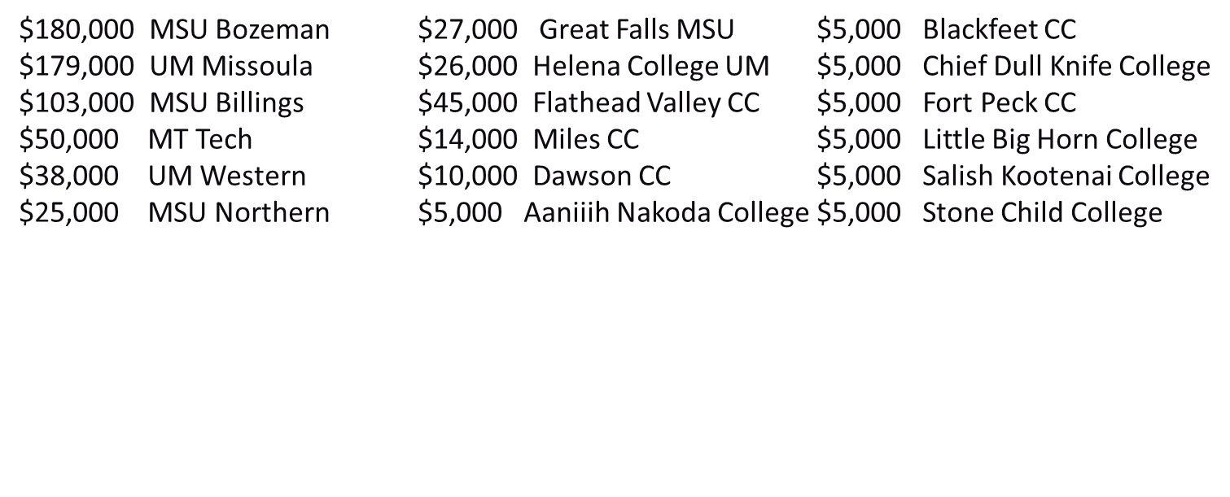
Awarded to First-time, Full-time students 2012-2013
Estimated Family Contribution (EFC) of $3,000-$7,999
732 scholarships $1,000 each = $732,000

Slide 50

Review of state aid
Improvement/consistency of data and information
Veterans Success Initiative
Financial Literacy Program Expansion
Default Prevention

