Slide 1
Lecture1: Introduction to Computer Networks
CSC 307
Lecturer: Dr.(Mrs.) F.A. Oladeji
Room 106 Computer Science
foladeji@unilag.edu.ng
07033629809

Slide 2
CSC 307 – Net-centric Computing
CONTENTS:
Concepts, protocols-OSI, TCP/IP; topologies, LAN-contention-CDMA, Token ring, FDDI WAN formation, routing algorithm, internetworking, switches, protocol converter (Gateway)
Internet and Web
Communication
Networking
Network security
Client-server
Compression technique, multimedia technologies.
Mobile computing
Network Management

Slide 3
CSC 307- NETCENTRIC COMPUTING
Textbooks
Computer Networks and Internets with Internet Applications, 3rd Edition
Author: Douglas E-Comer
2. Data and Computer Communications, 3rd Edition
Author ; Williams Stallings.
Course Modality:
Practical 10
Group Work 10
Tests 20
Exam 60
Total 100
Mode of interaction: through phone calls, email, group mail

Slide 4
- A network is a set or collection of nodes or points which are linked or connected together e.g. network of roads, a network of fuel depots, a network of product distributors
- Computer Network refers to a set or collection of computers that are linked or connected together in some pattern or simply a set of autonomous computer systems connected together through transmission channel for the purpose of sharing data
Historical development of computer Networks
* Development of multi-user systems
* Limitations of multi-user systems
* Development of top-end PCs
* Limitations of PCs
- Motivation/Benefits of Computer Networks
* Fast Communication
** Messages / Information
** Data
** Software
** Access to specified remote devices
* Sharing of computer resources
** Messages / information
** Data
** Software
** Devices e.g. printers, moderns, telephone lines.
** RAM space
Low Cost

Slide 5
Types of Computer Networks
Local Area Networks
Metropolitan Area Network
Wide Area Network
Intranet
Extranet
Internet

Slide 6
INTERCONNECTIVITY, STANDARDS, PROTOCOLS
Network entities : Computer systems, Network operating systems, network service applications, transmission channels, network vendors
Multivendor
- early networks are vendor-based
- For Interconnectivity & Inter-operability or OPENNESS between diverse, disparate products, upward compatibility, there is need to have certain common denominators in network entities , designs & implementation.
- There is a need for protocols or rules
- Protocol refers to rules, conventions, guidelines, agreed to/adopted by a group of stakeholders for the
design & implementation of products.
A protocol or protocol suite adopted by a group & widely circulated and accepted becomes a
STANDARD.
These common denominators are provided by many national and international organizations.
Examples of Standards and Regulations Organizations:
ISO – International Standards Organization
IEEE – Institute of Electrical & Electronic Engineers
ITU – International Telecommunications Union
CCITT – Consultative Committee in International Telegraphy and Telephony
NCC – National Communications Commission
SON – Standards Organization of Nigeria

Slide 7
-TCP/IP was the first set of protocols developed for use
- It is a result of protocol research and development conducted on the experimental packet-switched network – the ARPANET, funded by the Defense Advanced Research Projects Agency (DARPA) of USA.
-Communication task for TCP/IP are organized into five relatively independent layers :
OSI Model TCP/IP Model
Process/Application
Host-to-Host
(Transport)
Internet
Network
Interface layer
Physical
Application
Presentation
Session
Transport
Network
Data Link
Physical

Slide 8
The model is a framework for defining standards for linking heterogeneous computers.
-The OSI is concerned with the exchange of information between a pair of open systems and not and with the internal functioning of each individual system.
-The OSI model/architecture has seven layers which are listed with a brief definition as follows :
- Physical – Concerned with mechanical, electrical functional and procedural
characteristics of physical links
* Data link – Provides for the reliable transfer of data across the physical link.
* Network - Responsible for establishing, maintaining, and terminating network connections
* Transport – Provides reliable, transparent transfer of data between end points.
* Session – Establishes, manages, and terminates sessions between cooperating applications
* Presentation – Performs transformations on data to provide standardised application interface e.g.
encryption, text compression.
* Application – Provides services to users of the OSI environment e.g. transaction services, file
transfer etc.

Slide 9
The Physical and Network Interface Layers of the TCP/IP model use existing Physical and Data link standards, such as Ethernet and Token Ring, thereby making TCP/IP hardware-
independent.
As a result, the protocol is widely used to connect heterogeneous systems.
The Internet layer provides procedures needed to allow data to traverse multiple
interconnected networks. The Internet Protocol (IP) is used at this layer to provide the routing
function across multiple networks.
The Transport layer (Host-to-Host) provides the requirements needed for data to be exchanged
reliably regardless of the nature of the applications that are exchanging data. The Transmission
Control Protocol (TCP) is the most commonly used protocol to provide this functionality.
Finally, the Application layer contains the logic needed to support the various user applications.

Slide 10
LAN Topology
Network design or Architecture – The way a network is physically connected together. It has effect on network selection and management.
Common topology are: Star, Ring, Bus, Distributed Star.
Factors that influence choice of topology:-
- The complexity & cost of network cable installation
Redundant, or fail-safe design
Fault isolation
Strategy for physical expansion and reconfiguration of the network.
Ring – A faulty node disturbs the network (Token ring)
Star – It is the superior choice for fault detection and isolation.
Bus – More difficult to diagnose faulty systems

Slide 11
NETWORK TOPOLOGY (contd.)
11
STAR

Slide 12
NETWORK TOPOLOGY (contd.)
12
RING
Broadcast method – A message can be sent from a PC to multiple destinations at the same time.

Slide 13
NETWORK TOPOLOGY (contd.)
13
BUS
Broadcast

Slide 14
NETWORK INTERFACE CARDS-
Network designs have three categories : Star network, Ring network, and Bus network.
A Star network:
- Contains a central connecting device called or Hub or Switch and one or more workstations connected to the central device, forming a “Star”.
-The “Star” arrangement is logical. Faulty node can easily be detatched
- The hub controller cordinates transmission among the nodes
Ring – IBM Token Ring – Concept of TOKEN (Broadcasting)
- Fibre Distributed Data Interconnect (FDDI)
- Copper Distributed Data Interconnect (CDDI)
- Uses two layers of rings in a counter rotating form. Outer carries data, while inner is used when the outer ring fails.
Uses token pass for coordination
The Bus network is a kind of broadcast topology characterised by a single communication channel shared by all communicating computers e.g. consists of a single, long cable to which computers attach.
In the Bus network, one computer is allowed to transmit message onto the bus while others are required to receive or not to transmit, at any one time
Uses CSMA/CD technology for coordination.
* Carrier Sense Multiple Access (CSMA)
* Carrier Sense Multiple Access / Collision
- Use of ethernet cards at MAC layer

Slide 15

Transmission media

Slide 16
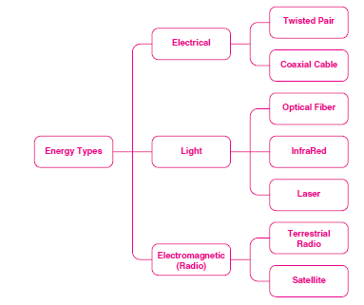
Network cables & signal types

Slide 17
Network Cables
Networking cables are used to connect one network device to other network devices
Three types of cable dominates the network markets
Twisted pair
Coaxial cable
Fibre
Cables are used depending on the network's topology and size

Slide 18
Twisted Pair Cable
The devices can be separated by a few meters
or nearly unlimited distances
Twisted pair cabling is a form of wiring in which two wires are twisted together for the purposes of canceling out electromagnetic interferences.
Used for home and corporate Ethernet networks
There are three types of twisted pair cables: Shielded, Unshielded and Foiled

Slide 19
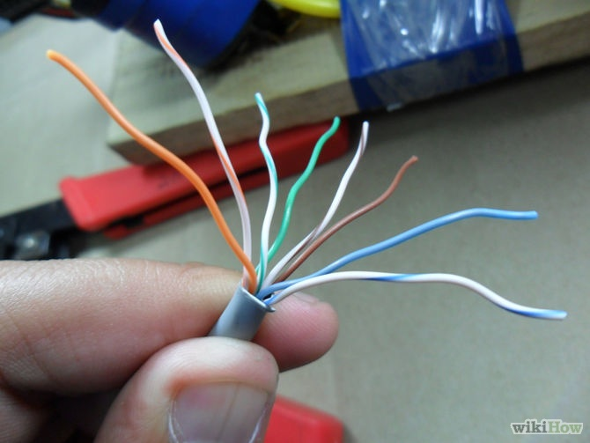
Twisted Pair Cable

Slide 20
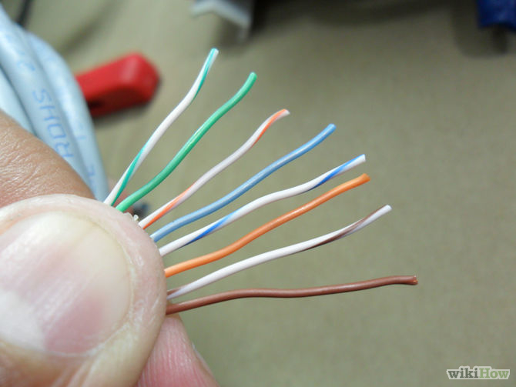
Twisted pair cable

Slide 21
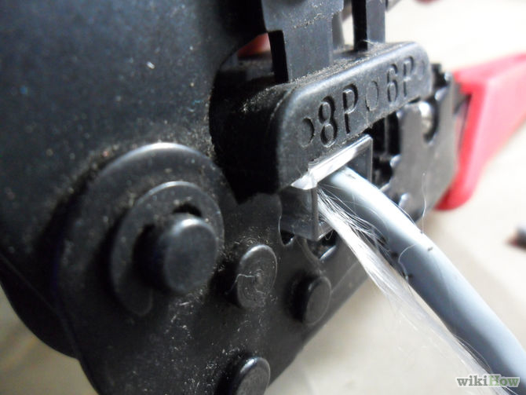
Preparation of Twisted Pair

Slide 22
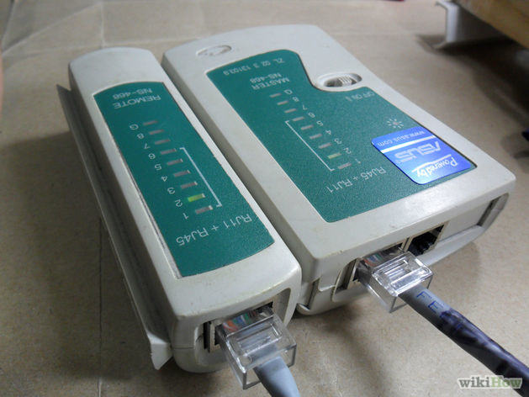
Meter for Testing Twisted Pair Cable

Slide 23
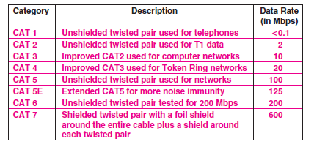
Twisted Capabilities (pg. 118)

Slide 24
Coaxial Cable
More rugged than the twisted pair
Has the conducting wire called ether coated within a shield (thin or thick)
Can tolerate interference more than twisted.
When used with Ethernet NIC, requires the use of BNC and terminator

Slide 25
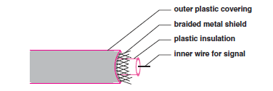
Coaxial cable

Slide 26
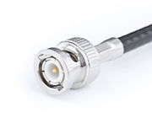
BNC Connector

Slide 27
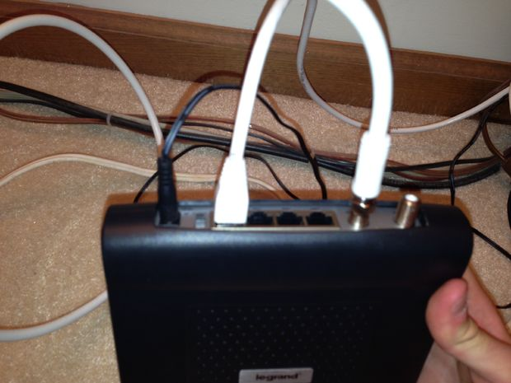
Coaxial cable

Slide 28
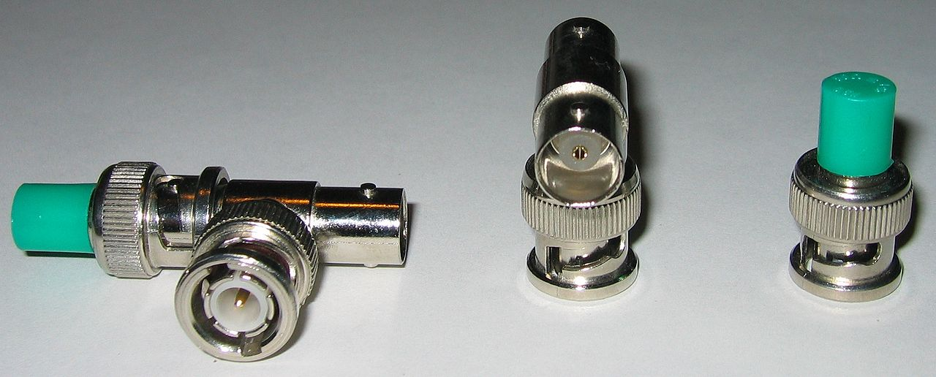
BNC & Terminator

Slide 29

Coaxial crimping tools

Slide 30
Fibre Cable
An optical fiber cable consists of a center glass core surrounded by several layers of protective material
It is expensive but has higher bandwidth and can transmit data over longer distances
Can be used to form a ring network (FDDI)

Slide 31

Fibre Cable

Slide 32
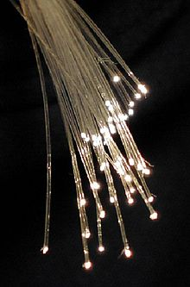
Strands of Glass

Slide 33


Slide 34
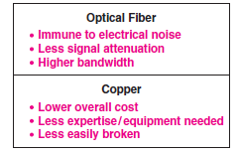
Optical fibre vs Copper fibre

Slide 35

Forming A WAN

Slide 36
WAN- Switching Types
The least expensive networks use technologies that span a short distance inside a single building), LAN, PAN
the most expensive span long distances (e.g., across several cities). MAN, WAN
Two types of switching
Circuit switching
Packet switching

Slide 37
Packet Switches
packet switching systems rely on exchanging packets; hence packet switching
Layer 2 switch connects local site computers to a router ( connects to other sites)
each packet must contain the identification of the intended recipient.
The goal is to allow as many computers as possible to send packets simultaneously.
The fundamental paradigm used to achieve this is known as store and forward.

Slide 38
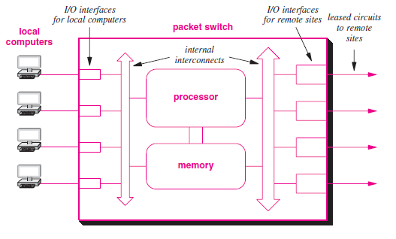
A Switch

Slide 39
Packet Switches -Buffering
To perform store and forward processing, a packet switch buffers packets in memory.
The store operation occurs when a packet arrives:
I/O hardware inside the packet switch places a copy of the packet in memory.
The forward operation occurs once a packet has arrived and is waiting in memory.
The processor examines the packet, determines its destination, and sends the packet over the I/O interface that leads to the destination.

Slide 40
How is Switching done?
As each packet arrives, I/O hardware on
the packet switch places the packet in memory and informs the packet switch processor.
The processor examines each packet’s destination, and determines which port to use to send the packet
a WAN does not need to be symmetric i.e. the interconnections among packet switches and the capacity of each connection can be chosen to accommodate the expected traffic and provide redundancy in case of failure. Fig 18.3

Slide 41
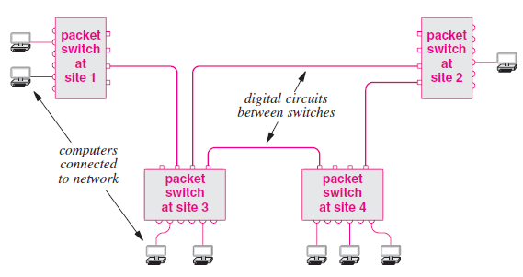

Slide 42
Addressing In A WAN
Each computer connected to a WAN is assigned an address.
WANs addresses follow a key concept that is used in the Internet: hierarchical addressing. Conceptually, hierarchical addressing divides each address into two parts: (site, computer at the site) Fig 18.4
When a packet arrives, a packet switch must choose an outgoing path over which to forward the packet.

Slide 43
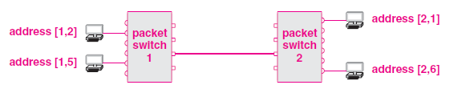
WAN Addressing contd.

Slide 44
WAN forwaring
If a packet is destined for a local computer, the switch sends the packet directly to the computer. Otherwise, the packet must be forwarded over one of the connections that leads to another switch.
To make the choice, a packet switch examines the destination address in the packet, and extracts the packet switch number.
If the number in the destination address is identical to the packet switch’s own ID, the packet is intended for a computer on the local packet switch.
Otherwise, the packet is intended for a computer on another packet switch called the next hop

Slide 45
WAN Forwarding contd.
Note that a packet switch does not need to keep complete information about how to reach all possible computers, nor does a switch need to compute the entire route a packet will follow through the network.
Instead, a switch bases forwarding on packet switch IDs, which means that a switch only needs to know which outgoing link to use to reach a given switch.
To make the computation efficient, packet switches use table lookup. That is, each packet switch contains a forwarding table† that lists all possible packet switches and gives a next hop for each. Fig 18.5

Slide 46
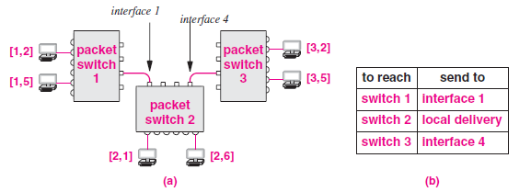
Routing Table

Slide 47
In/Out Packets
packets that originate on directly connected computers and packets that arrive from other packet switches use the same mechanism.

Slide 48
Internet Addresses
Each network designer chooses addresses, packet formats, and delivery techniques independent of the details of the underlying hardware
To provide uniform addressing in the Internet, IP defines an abstract addressing scheme that assigns each host a unique protocol address;
applications use the IP addresses to communicate
A 32-bit number called Internet Protocol address, IP address, or Internet address is used on TCP/IP network Fig. 21.2 Fig 21.1 21.3

Slide 49
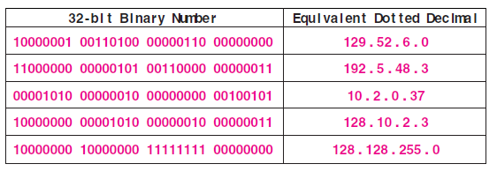
32-bit Adresses

Slide 50
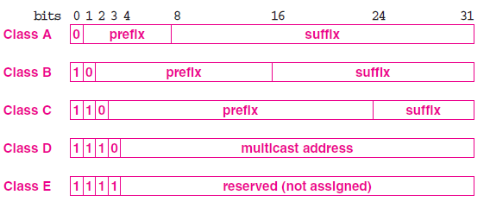
Classful Addresses

Slide 51
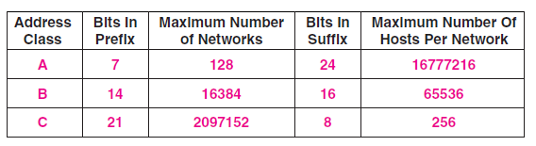
Available Addresses

Slide 52
ICANN
The original IP addressing scheme divided addresses into classes.
Class D addresses are still used for multicasting.
dotted decimal addresses range from 0.0.0.0 through 255.255.255.255.
a central organization, the Internet Corporation for Assigned Names and
Numbers (ICANN) distributes IP addresses

Slide 53
ICANN vs ISP
ICANN does not assign individual prefixes. Instead, ICANN authorizes a set of registrars to do so. Registrars make blocks of addresses available to ISPs, which provide addresses to subscribers.
Thus, to obtain a prefix, a corporation usually contacts an ISP

Slide 54
Subnet Addresses
Classful addressing scheme became a limitation.
Everyone demanded a class A or B to have enough addresses for future growth;
Many addresses were unused.
Two new mechanisms as remedies:
Subnet addressing
Classless addressing

