Slide 1
LECTURE NOTE SERIES II
FORMING A LOCAL AREA NETWORK

Slide 2
TOPOLOGY
Network design or Architecture – The way a network is physically connected together. It has effect on network selection and management.
Common topology are: Star, Ring, Bus, Distributed Star.
Factors that influence choice of topology:-
- The complexity & cost of network cable installation
Redundant, or fail-safe design
Fault isolation
Strategy for physical expansion and reconfiguration of the network.
Ring – A faulty node disturbs the network (Token ring)
Star – It is the superior choice for fault detection and isolation.
Bus – More difficult to diagnose faulty systems

Slide 3
NETWORK TOPOLOGY (contd.)
3
STAR

Slide 4
NETWORK TOPOLOGY (contd.)
4
RING
Broadcast method – A message can be sent from a PC to multiple destinations at the same time.

Slide 5
NETWORK TOPOLOGY (contd.)
5
BUS
Broadcast

Slide 6
NETWORK ARCHITECTURE OR TOPOLOGY
Network designs have three categories : Star network, Ring network, and Bus network.
- A Star network: Contains a central connecting device called or Hub or Switch and
one or more workstations connected to the central device, forming a “Star”.
The “Star” arrangement is logical. Faulty node can easily be detatched
- The hub controller cordinates
Ring – IBM Token Ring – Concept of TOKEN (Broadcasting)
- Fibre Distributed Data Interconnect (FDDI)
- Copper Distributed Data Interconnect (CDDI)
- Uses two layers of rings in a counter rotating form. Outer carries data, while inner is used when the outer ring fails.
Uses token pass for coordination
The Bus network is a kind of broadcast topology characterised by a single communication channel shared by all communicating computers e.g. consists of a single, long cable to which computers attach.
In the Bus network, one computer is allowed to transmit message onto the bus while others are required to receive or not to transmit, at any one time
Uses CSMA/CD technology for coordination.
* Carrier Sense Multiple Access (CSMA)
* Carrier Sense Multiple Access / Collision

Slide 7

Transmission media

Slide 8
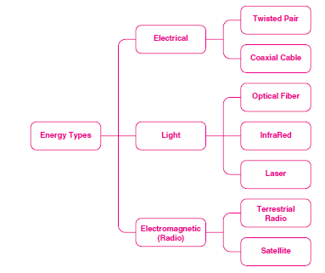
Network cables & signal types

Slide 9
Network Cables
Networking cables are used to connect one network device to other network devices
Three types of cable dominates the network markets
Twisted pair
Coaxial cable
Fibre
Cables are used depending on the network's topology and size

Slide 10
Twisted Pair Cable
The devices can be separated by a few meters
or nearly unlimited distances
Twisted pair cabling is a form of wiring in which two wires are twisted together for the purposes of canceling out electromagnetic interferences.
Used for home and corporate Ethernet networks
There are three types of twisted pair cables: Shielded, Unshielded and Foiled

Slide 11
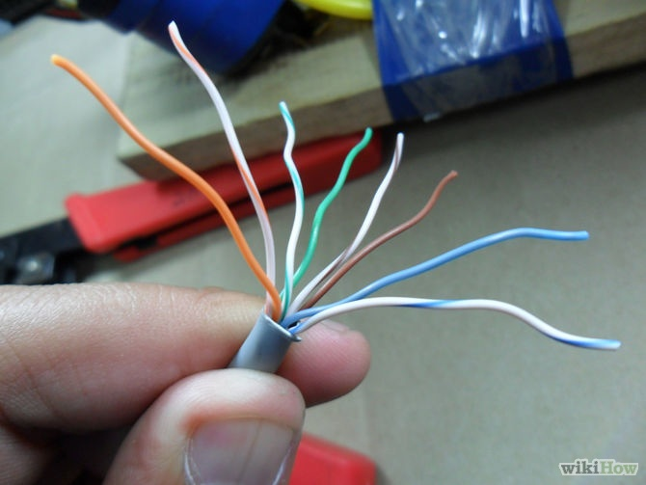
Twisted Pair Cable

Slide 12
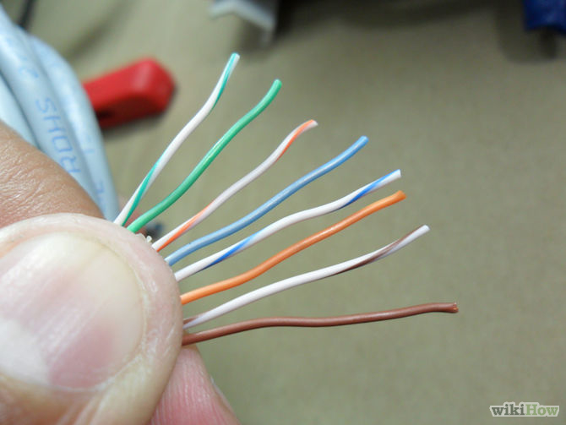
Twisted pair cable

Slide 13
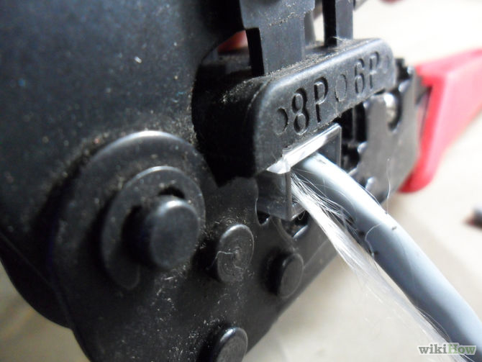
Preparation of Twisted Pair

Slide 14
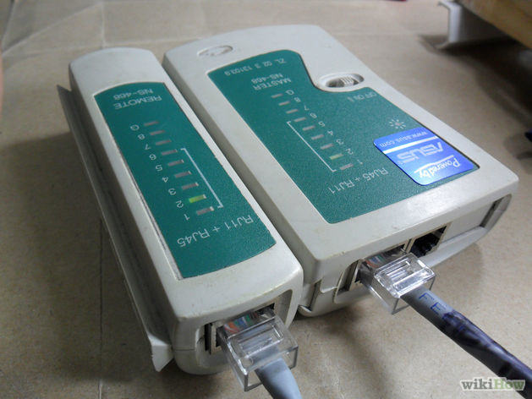
Meter for Testing Twisted Pair Cable

Slide 15
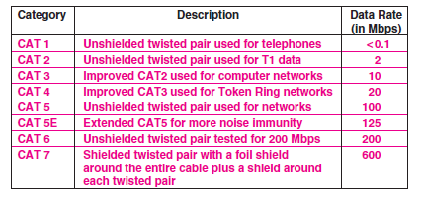
Twisted Capabilities (pg. 118)

Slide 16
Coaxial Cable
More rugged than the twisted pair
Has the conducting wire called ether coated within a shield (thin or thick)
Can tolerate interference more than twisted.
When used with Ethernet NIC, requires the use of BNC and terminator

Slide 17
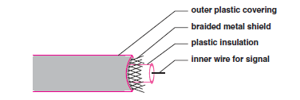
Coaxial cable

Slide 18
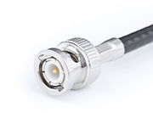
BNC Connector

Slide 19
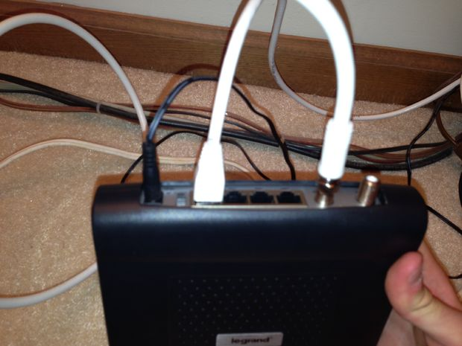
Coaxial cable

Slide 20
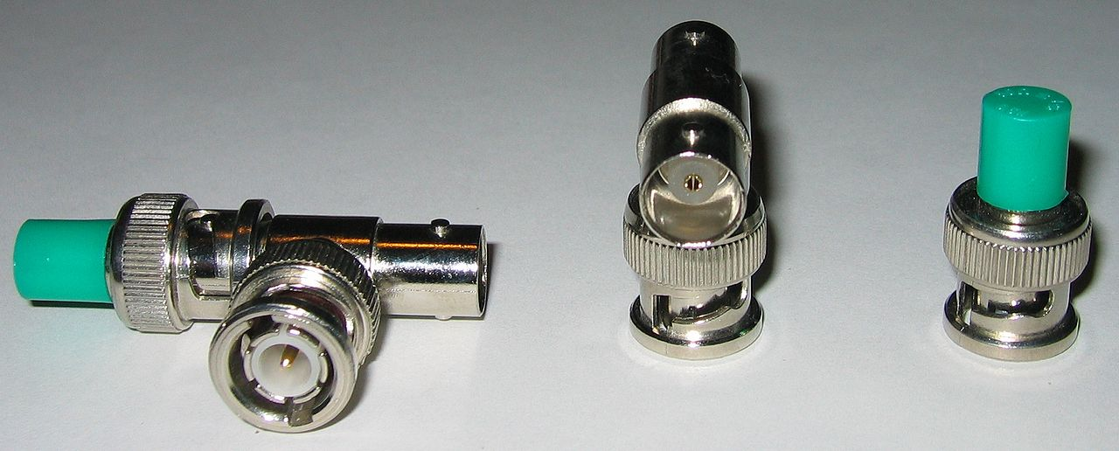
BNC & Terminator

Slide 21

Coaxial crimping tools

Slide 22
Fibre Cable
An optical fiber cable consists of a center glass core surrounded by several layers of protective material
It is expensive but has higher bandwidth and can transmit data over longer distances
Can be used to form a ring network (FDDI)

Slide 23
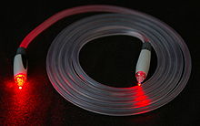
Fibre Cable

Slide 24
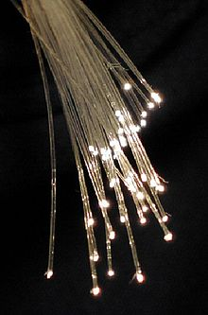
Strands of Glass

Slide 25


Slide 26
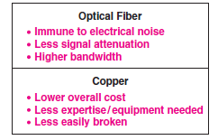
Optical fibre vs Copper fibre

Slide 27

Forming A WAN

Slide 28
WAN- Switching Types
The least expensive networks use technologies that span a short distance inside a single building), LAN, PAN
the most expensive span long distances (e.g., across several cities). MAN, WAN
Two types of switching
Circuit switching
Packet switching

Slide 29
Packet Switches
packet switching systems rely on exchanging packets; hence packet switching
Layer 2 switch connects local site computers to a router ( connects to other sites)
each packet must contain the identification of the intended recipient.
The goal is to allow as many computers as possible to send packets simultaneously.
The fundamental paradigm used to achieve this is known as store and forward schemes.

Slide 30
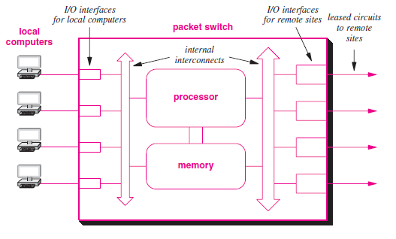
A Switch

Slide 31
Packet Switches -Buffering
To perform store and forward processing, a packet switch buffers packets in memory.
The store operation occurs when a packet arrives:
I/O hardware inside the packet switch places a copy of the packet in memory.
The forward operation occurs once a packet has arrived and is waiting in memory.
The processor examines the packet, determines its destination, and sends the packet over the I/O interface that leads to the destination.

Slide 32
How is Switching done?
As each packet arrives, I/O hardware on
the packet switch places the packet in memory and informs the packet switch processor.
The processor examines each packet’s destination, and determines which port to use to send the packet
a WAN does not need to be symmetric i.e. the interconnections among packet switches and the capacity of each connection can be chosen to accommodate the expected traffic and provide redundancy in case of failure. Fig 18.3

Slide 33
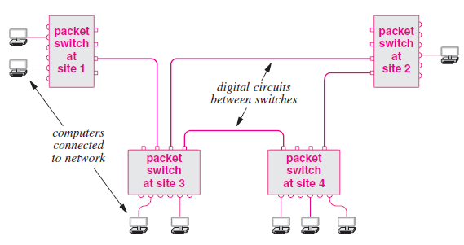
How a router works!!

Slide 34
Addressing In A WAN
Each computer connected to a WAN is assigned an address.
WANs addresses follow a key concept that is used in the Internet: hierarchical addressing. Conceptually, hierarchical addressing divides each address into two parts: (site, computer at the site) Fig 18.4
When a packet arrives, a packet switch must choose an outgoing path over which to forward the packet.

Slide 35
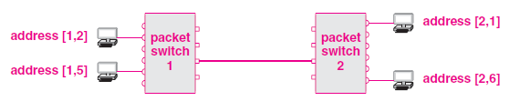
WAN Addressing contd.

Slide 36
WAN forwading
If a packet is destined for a local computer, the switch sends the packet directly to the computer. Otherwise, the packet must be forwarded over one of the connections that leads to another switch.
To make the choice, a packet switch examines the destination address in the packet, and extracts the packet switch number (a network).
If the number in the destination address is identical to the packet switch’s own ID, the packet is intended for a computer on the local packet switch.
Otherwise, the packet is intended for a computer on another packet switch called the next hop

Slide 37
WAN Forwarding contd.
Note that a packet switch does not need to keep complete information about how to reach all possible computers, nor does a switch need to compute the entire route a packet will follow through the network.
Instead, a switch bases forwarding on packet switch IDs, which means that a switch only needs to know which outgoing link to use to reach a given switch.
To make the computation efficient, packet switches use table lookup. That is, each packet switch contains a forwarding table† that lists all possible packet switches and gives a next hop for each. Fig 18.5

Slide 38
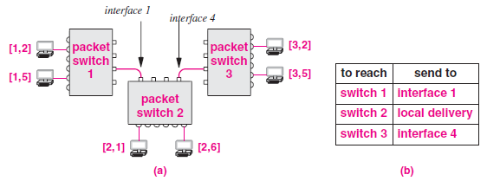
Routing Table

Slide 39
In/Out Packets
packets that originate on directly connected computers and packets that arrive from other packet switches use the same mechanism.

Slide 40
Internet Addresses
Each network designer chooses addresses, packet formats, and delivery techniques independent of the details of the underlying hardware
To provide uniform addressing in the Internet, IP defines an abstract addressing scheme that assigns each host a unique protocol address;
applications use the IP addresses to communicate
A 32-bit number called Internet Protocol address, IP address, or Internet address is used on TCP/IP network Fig. 21.2 Fig 21.1 21.3

Slide 41
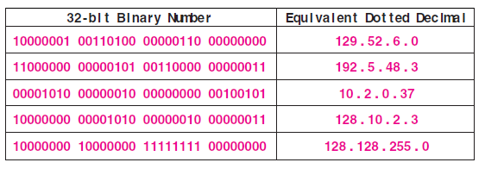
32-bit Addresses

Slide 42
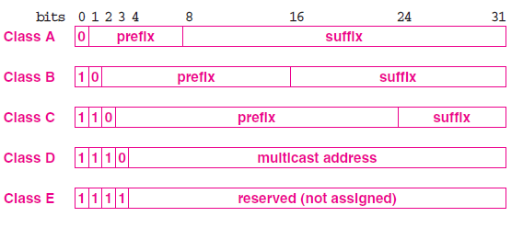
Classful Addresses

Slide 43
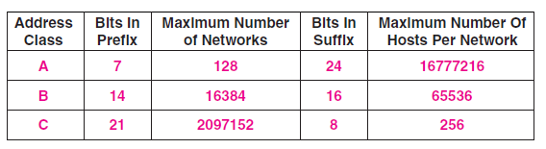
Available Addresses

Slide 44
ICANN
The original IP addressing scheme divided addresses into classes.
Class D addresses are still used for multicasting.
dotted decimal addresses range from 0.0.0.0 through 255.255.255.255.
a central organization, the Internet Corporation for Assigned Names and
Numbers (ICANN) distributes IP addresses

Slide 45
ICANN vs ISP
ICANN does not assign individual prefixes. Instead, ICANN authorizes a set of registrars to do so. Registrars make blocks of addresses available to ISPs, which provide addresses to subscribers.
Thus, to obtain a prefix, a corporation usually contacts an ISP

Slide 46
Subnet Addresses
Classful addressing scheme became a limitation.
Everyone demanded a class A or B to have enough addresses for future growth;
Many addresses were unused.
Two new mechanisms are proposed as remedies:
Subnet addressing
Classless addressing

Slide 47
Basics of Subnetting
Subnetworks
Subnet mask
Boolean operations: AND, OR, and NOT
Performing the AND function

Slide 48
Subnetworks
To create a subnet address, a network administrator borrows bits from the original host portion and designates them as the subnet field.

Slide 49
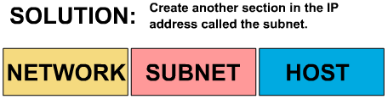
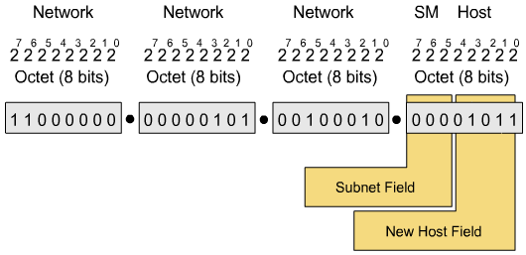
Subnetworks

Slide 50
Subnet Mask
Determines which part of an IP address is the network field and which part is the host field
Follow these steps to determine the subnet mask:
1. Express the subnetwork IP address in binary form.
2. Replace the network and subnet portion of the address with all 1s.
3. Replace the host portion of the address with all 0s.
4. Convert the binary expression back to dotted-decimal notation.

Slide 51
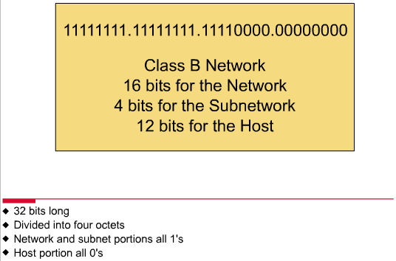
Subnet Mask

Slide 52
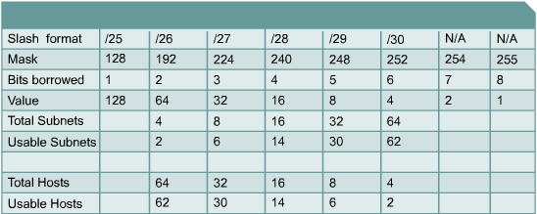
Establishing the Subnet Mask Address
To determine the number of bits to be used, the network designer needs to calculate how many hosts the largest subnetwork requires and the number of subnetworks needed.

Slide 53
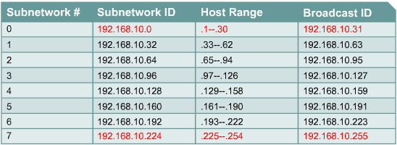
Subnetting example

Slide 54
Boolean Operations: AND, OR, and NOT
AND is like multiplication.
OR is like addition.
NOT changes 1 to 0, and 0 to 1.

Slide 55
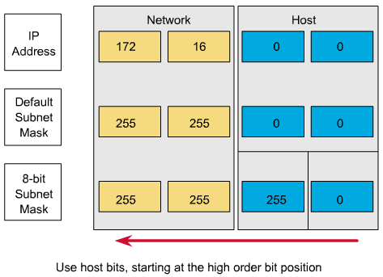
Range of Bits Needed to Create Subnets

Slide 56
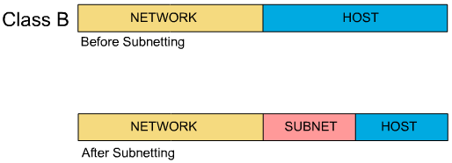
Subnet Addresses

Slide 57
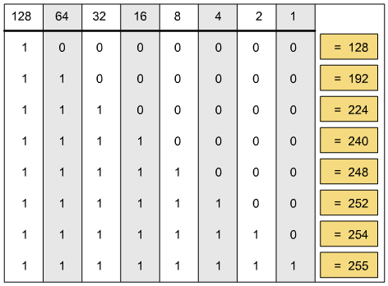
Decimal Equivalents of 8-Bit Patterns

Slide 58
Creating a Subnet
Determining subnet mask size
Computing subnet mask and IP address
Computing hosts per subnetwork
Boolean AND operation
IP configuration on a network diagram
Host and subnet schemes
Private addresses

Slide 59
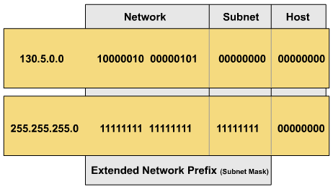
Determining Subnet Mask Size
Class B address with 8 bits borrowed for the subnet
130.5.2.144 (8 bits borrowed for subnetting) routes to subnet 130.5.2.0 rather than just to network 130.5.0.0.

