Slide 1
Web Platform for Digital Deployment of Virtual Servers
Plamen Kolev

Slide 2

Goals
Aim
Give developers a platform for easy deployment, management and monitoring of virtual servers
Objectives
Provide a platform that makes it convenient to manage the following from a web interface
Deploy a virtual machine of the user's choice quickly by filling minimal amount of details
Configure firewall settings
Allow console access ( Set up authentication credentials (SSH keys) for your instances )
Monitor disk/CPU usage of your virtual instances

Slide 3
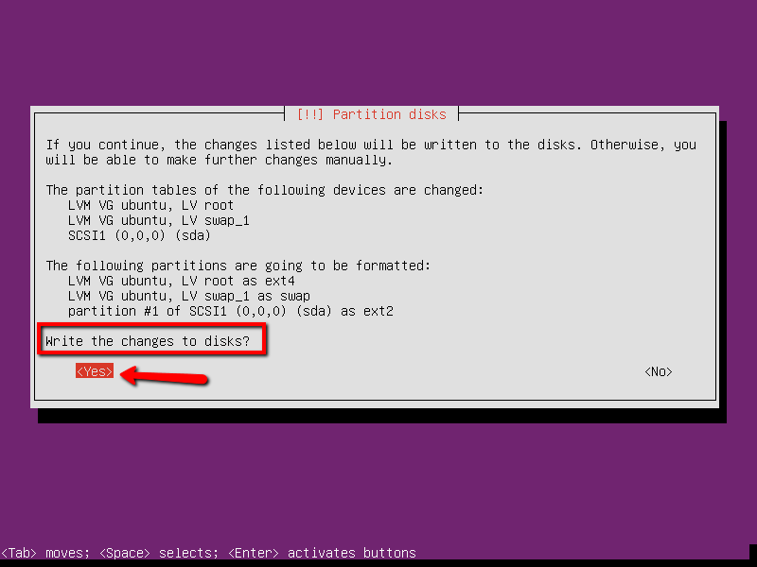
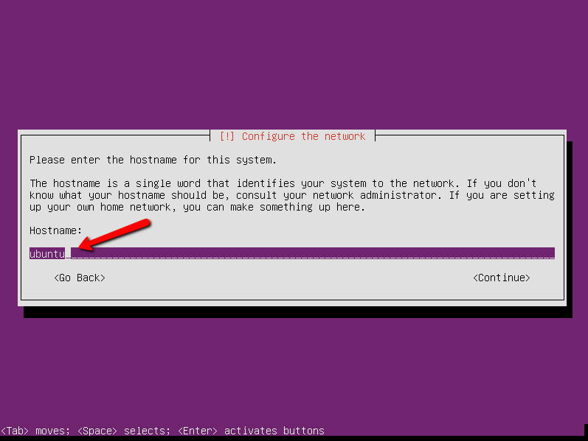
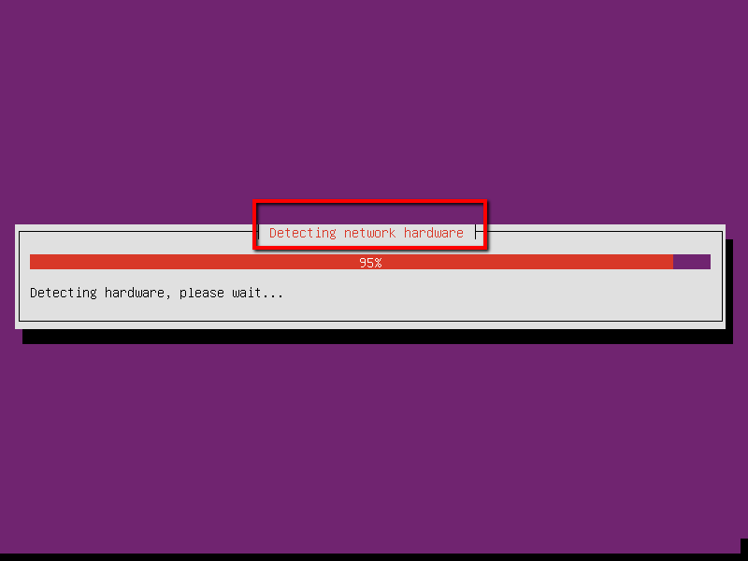
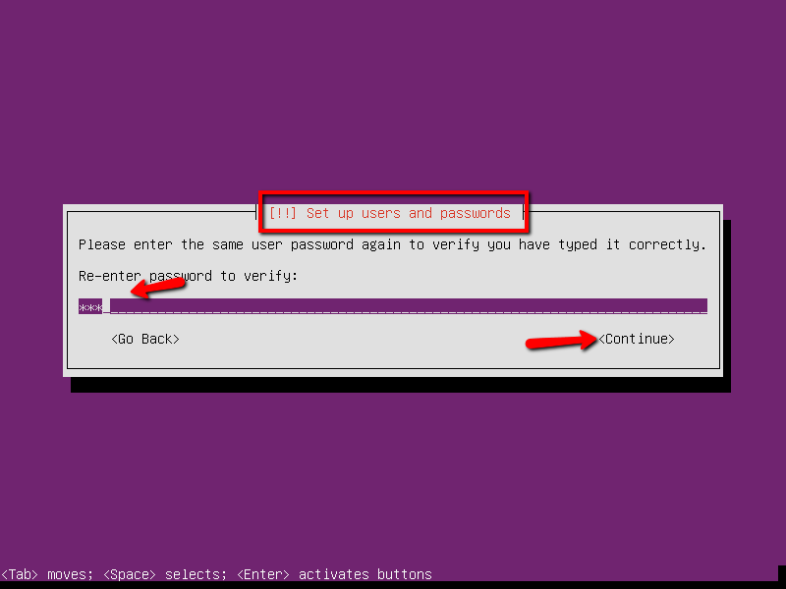
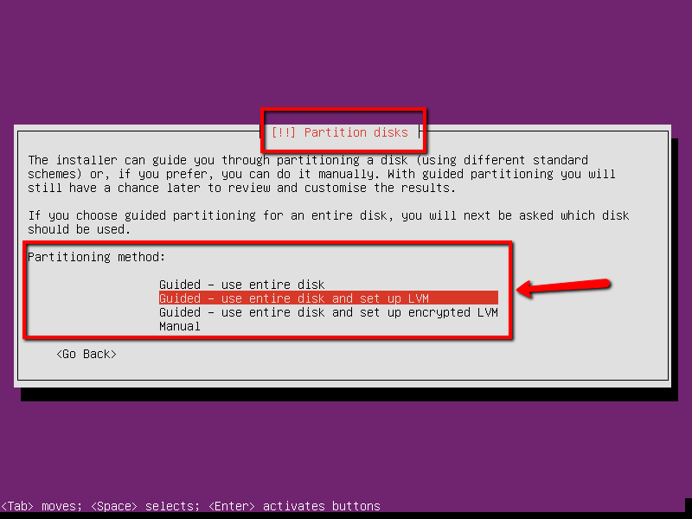
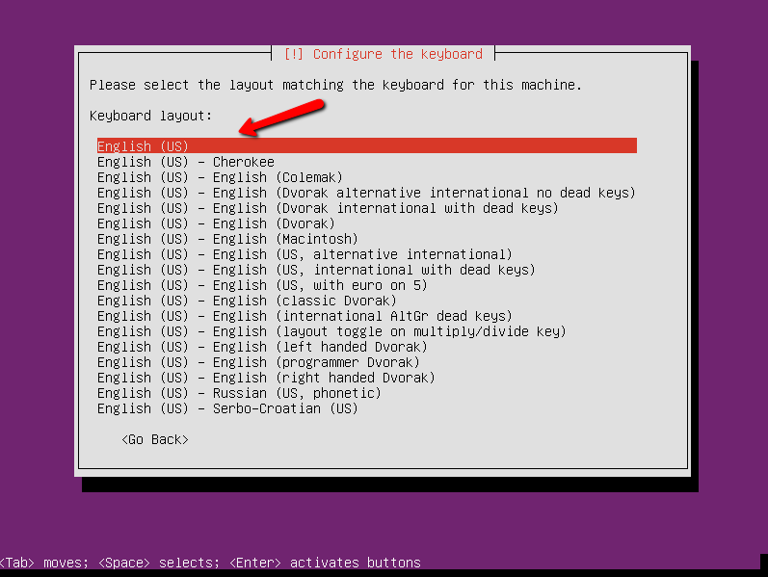
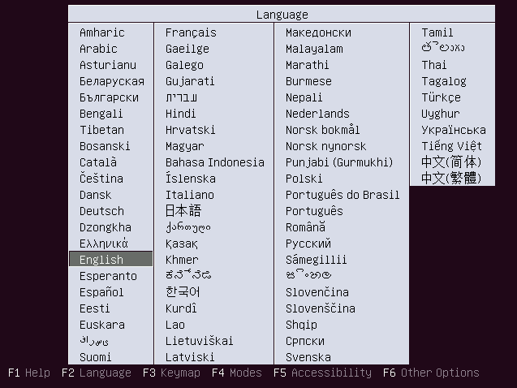
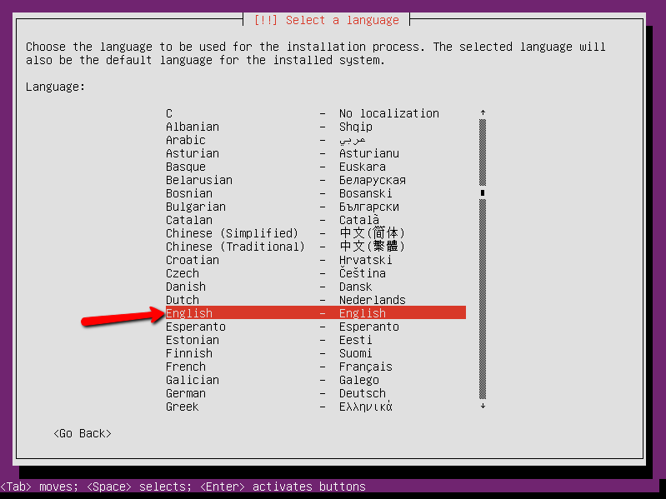
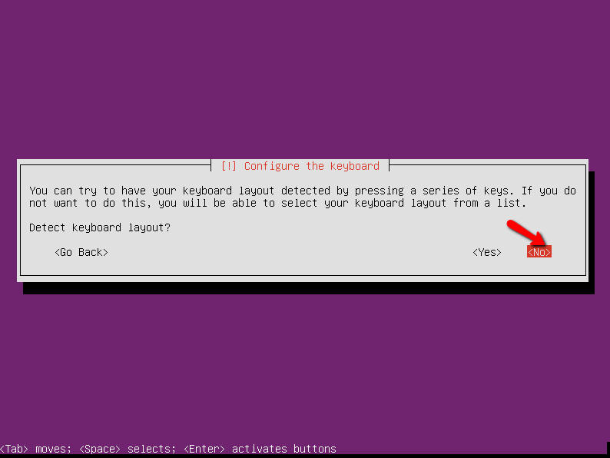
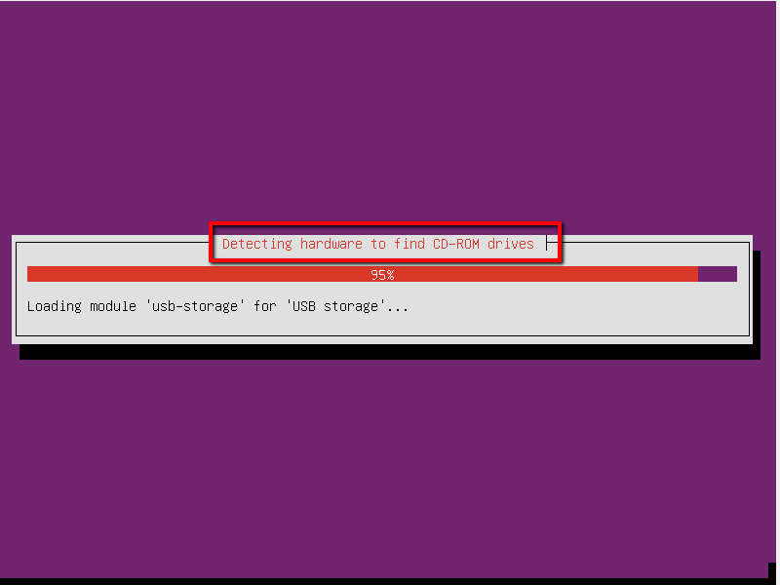
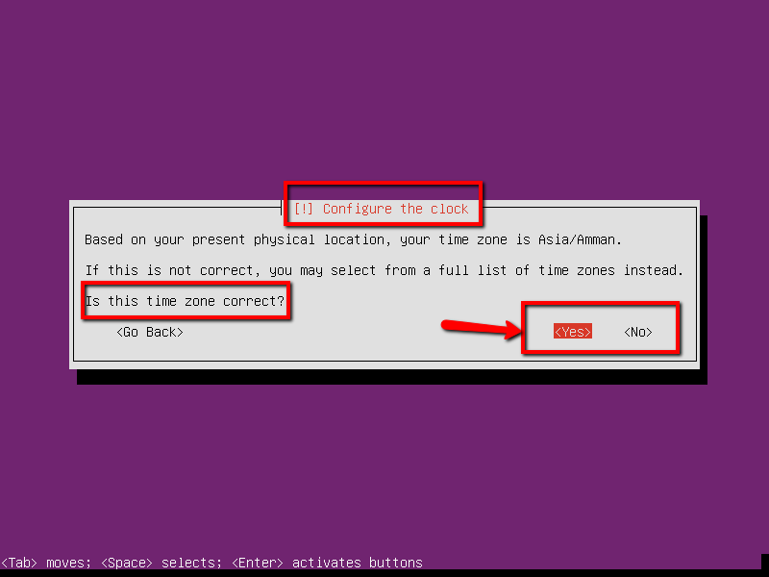
Setting up a server in 30 easy steps

Slide 4

The benefits

