Slide 1
Web Platform for Digital Deployment of Virtual Servers
Plamen Kolev

Slide 2

Goals
Aim
Create a platform for deployment, management and monitoring of virtual servers
Objectives
Provide a platform that makes it convenient to manage the following from a web interface
Deploy a virtual machine of the user's choice quickly by filling minimal amount of details
Configure firewall settings
Allow console access ( Set up authentication credentials (SSH keys) for your instances )
Monitor disk/CPU usage of your virtual instances
Installation of common applications (nginx, mysql, text editors)

Slide 3
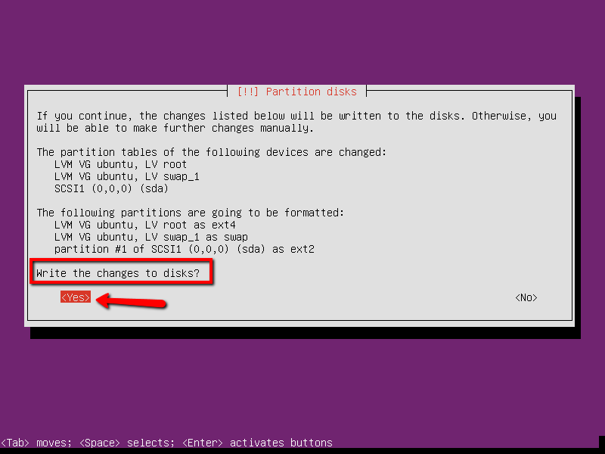
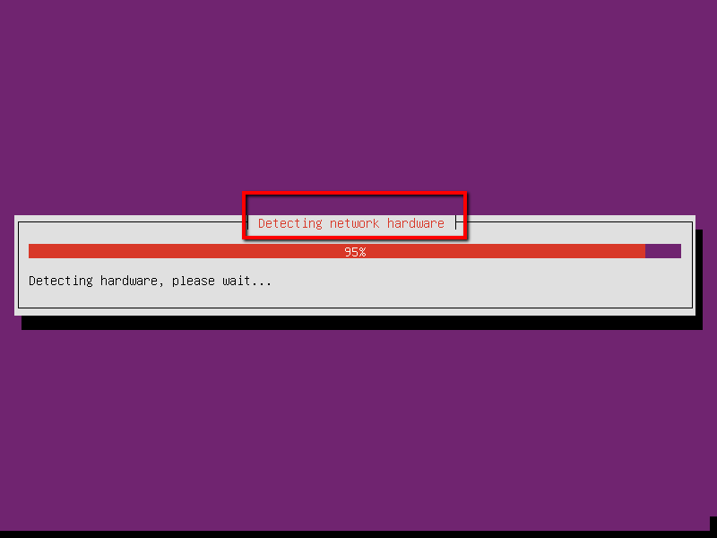
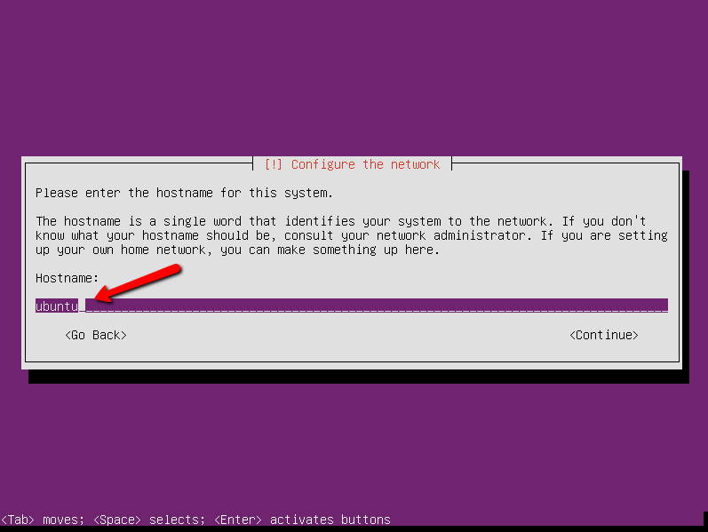
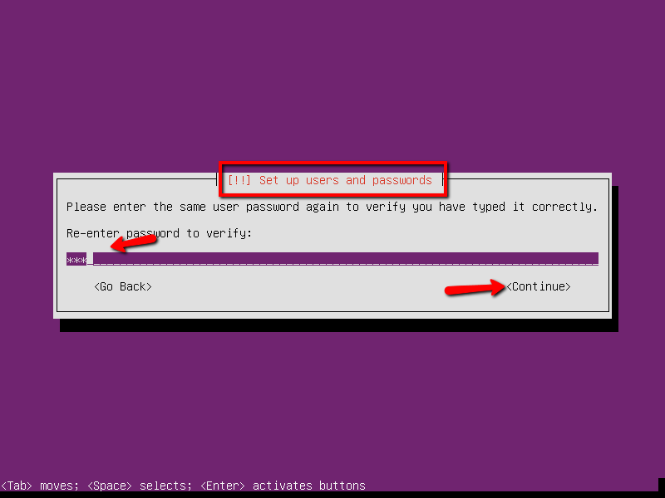
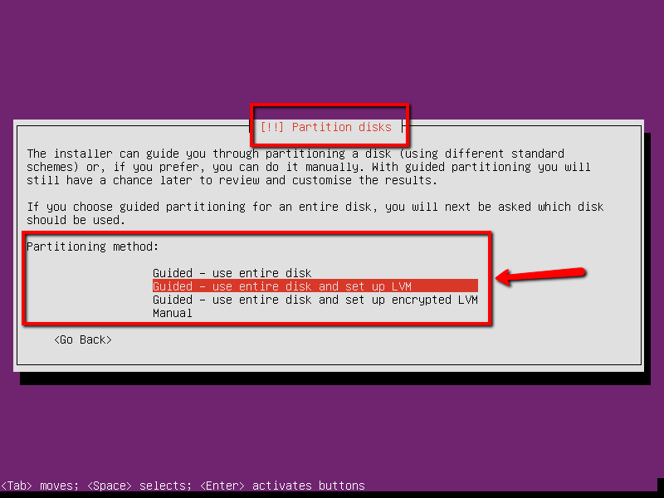
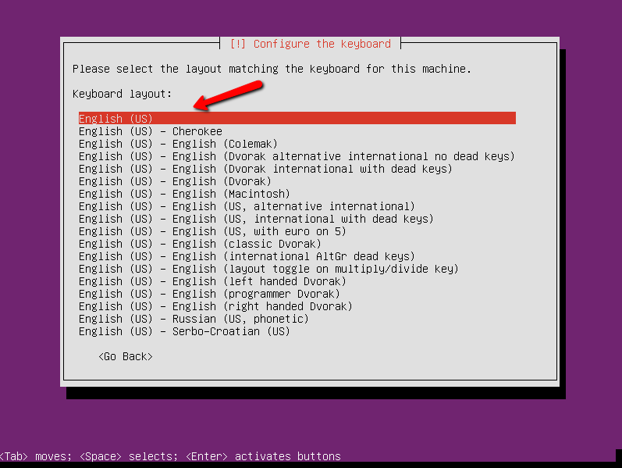
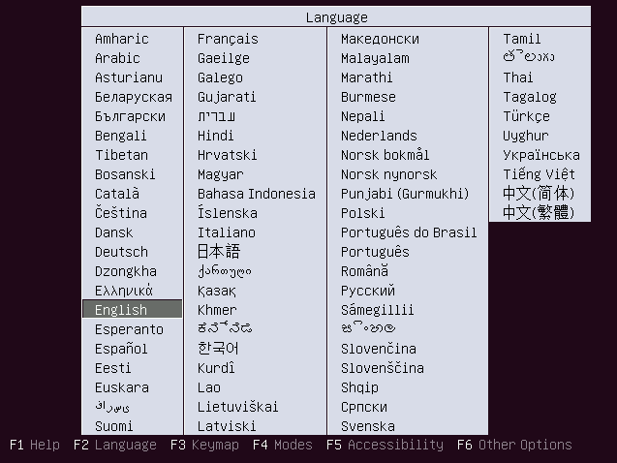
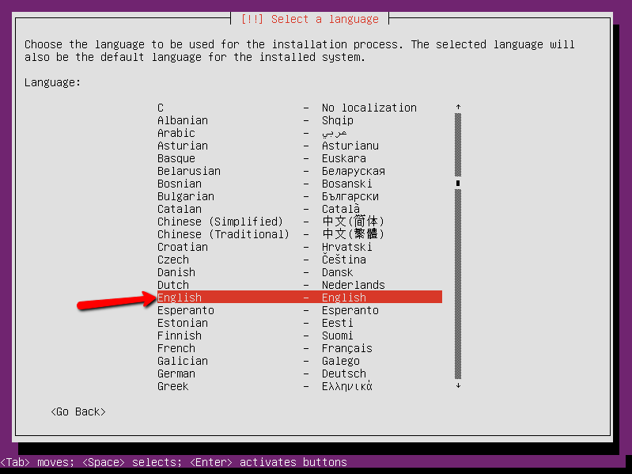
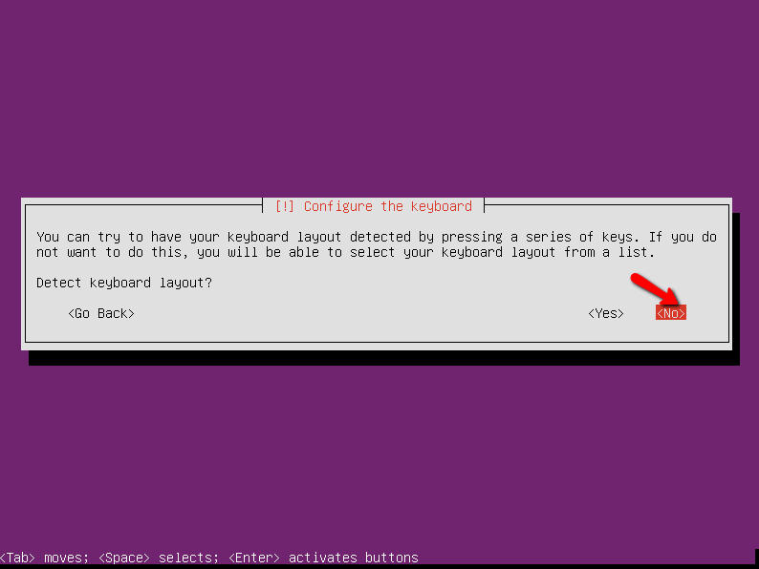
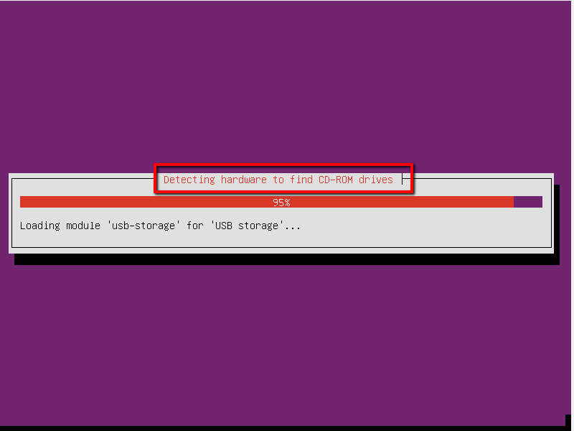
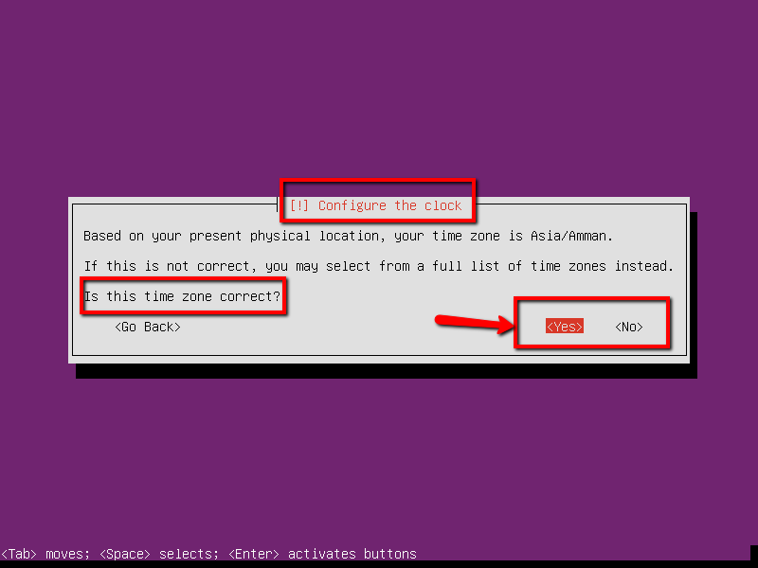
Setting up a server in 30 steps (hardware installation and configuration not included)
Notes:
I added this slide just to make a point.
If you are an android developer you don’t have time to read the virtualbox/vmware tutorial now how to deploy your environment, it would be better if you just said “ENVIRONMENT, GO!”

Slide 4
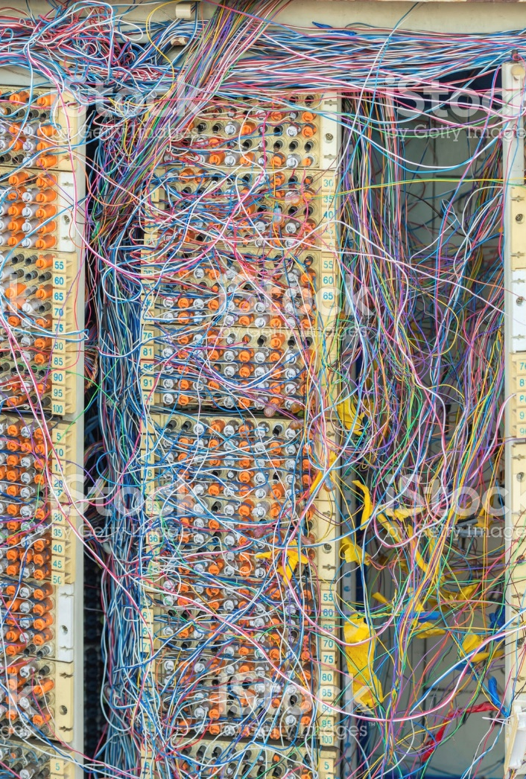
Why build the platform?
The benefits of virtualised hardware
Easy server migrations
Avoids software issues caused by incompatible hardware
Popularity of Cloud
More time to develop your ideas
Huge corporate demand (Amazon AWS brings $10 billion per year)
Notes:
Benefits:
When big companies deploy their software, they are often very concerned with the hardware specification on which they are running, as different architectures have different oddities.
Some of their clients might have old hardware, some might have new and buggy hardware, all of these details have to be factored in during development = COST
In a virtualized environment, the developer is running on top of an abstraction layer that “irons out” all these oddities.
That means that a developer can be more productive (ignoring the dev work that goes into wrestling with the infrastructure)
Virtual server migration is very easy ! One day your servers are in London, the other in Amsterdam, they could be anywhere and it (mostly) doesn’t matter. This means that your company is not held at gunpoint by the provider of your physical servers
Maintaining servers in-house is very expensive and requires very talented people.
The emerging of cloud computing has lowered the barrier to entry for app developers. They just click a button and their dev environment is waiting for actions (0 configuration)

Slide 5


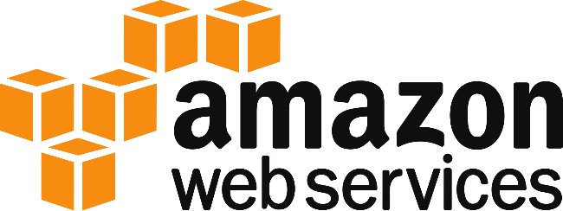

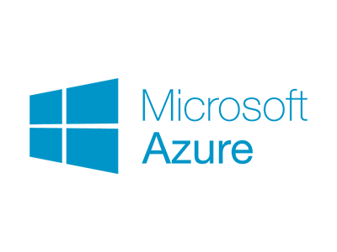

Existing solutions

Slide 6
How to build the platform ?
A headless Debian linux machine running virtualbox server
Linux shell scripts talk to virtualbox via it’s API
Create machines
Configure machines
Destroy machines
define firewall rules
Install and update software
Manage login credentials
Web management interface that abstracts away the shell script functionality to the user

Slide 7
Project Planning

Slide 8

Questions ?

