Slide 1
Azure Infrastructure Services #1
Azure Architecture. Core Services. Management Tools
SoftUni Team
Technical Trainers
Software University
http://softuni.bg

Slide 2
Have a Questions?
sli.do
#Azure
facebook.com
/groups/AzureEssentialsDecember2019/

Slide 3
Table of Contents
Cloud Concepts
Azure Architecture
Azure Services, Products, and Solutions
Core Services
Management Tools

Slide 4
Cloud Concepts
Main Definitions and Concepts

Slide 5
High Availability
Goal is our solution to be up and running as much as possible
Fault Tolerance is the readiness to survive a faults
Disaster Recovery are the actions taken to recover from failure
Scalability is the ability to follow the demand
Scale up/down by increasing/reducing resources (CPU, RAM, …)
Scale out/in by adding/removing instances (nodes)
Agility is the speed at which we can scale

Slide 6
CapEx vs. OpEx
Capital Expenditures (CapEx)
Paid upfront
Accounted for 3 or more years
Examples: Buying equipment
Operational Expenditures (OpEx)
Recurring monthly or annual payment
Accounted in the current month or year
Examples: Subscription fees

Slide 7
Cloud Computing
Computing services (servers, storage, networking, software) provided from a company and accessed over the internet
Multiple platforms like Azure, AWS, GCP, etc.
Benefits
Cost, speed, security, coverage, scalability, reliability, etc.
Drawbacks
Vendor lock-in, security risks, privacy risks, reliability risks

Slide 8
Cloud Building Blocks
Infrastructure
Physical resources in the data center of the cloud service provider (CSP) – servers, storage, network equipment, software
Resource Sharing
Combination of hardware and software, responsible for isolation and resource sharing. Usually delivers services via virtualization
Development Platforms
Provides functional support (API) for cloud applications. APIs include cloud storage access, user authentication, etc.
Application Software
System components used by the end users
Application Software
Development Platforms
Resource Sharing
Infrastructure

Slide 9
Types of Cloud Computing
Based on who operates (owns) the cloud
Also who has access to the cloud services
Public
Hybrid
Private

Slide 10
Public
Cloud infrastructure is owned by a cloud provider
Services are accessible to the public over the Internet
Users can consume services without the need to purchase and set up hardware and software
Users are typically charged for the duration for which these services are used
Sovereign clouds are public clouds that are physically isolated from other public clouds and to which access is restricted to specific organizations (governments) or countries. For example US, Germany and China

Slide 11
Private
Cloud infrastructure is owned by an organization
The environment is procured, set up, operated, and maintained by the organization
Infrastructure is accessible to specific users via the intranet
Resources are shared among an organization's end users
Security and terms of use are defined by the organization

Slide 12
Hybrid
Infrastructure includes an owned private cloud and a leased public cloud
Organization uses its private cloud for most of the time
Only when needed it offloads tasks and data to the public cloud
This process is known as cloud bursting
It can be used also for dealing with regulatory requirements

Slide 13
Types of Cloud Services
Traditional On-Premises
Infrastructure as a Service (IaaS)
Platform as a Service (PaaS)
Software as a Service (SaaS)
Data
Data
Data
Data
Applications
Applications
Applications
Applications
Runtime
Runtime
Runtime
Runtime
Middleware
Middleware
Middleware
Middleware
Operating System
Operating System
Operating System
Operating System
Virtualization
Virtualization
Virtualization
Virtualization
Servers
Servers
Servers
Servers
Storage
Storage
Storage
Storage
Networking
Networking
Networking
Networking
Managed by us
Managed by cloud vendor

Slide 14
Infrastructure as a Service (IaaS)
Cloud providers make computing resources available to clients, usually in the form of virtual machines
Computing resources are provided to users as a service
Users can scale the resources that they deploy
The same physical resources are shared among multiple users
Usually there are resource offerings at different costs and follow a utility pricing model (typically calculated by the hour)
Data
Applications
Runtime
Middleware
Operating System
Virtualization
Servers
Storage
Networking

Slide 15
Platform as a Service (PaaS)
Provides a software platform without the complexity of purchasing, installing, and maintaining the underlying hardware and software
It can be database server, web server, etc.
A web-based user interface for using and configuring the platform.
Multitenant architecture in which multiple concurrent users utilize the same tools
Built-in mechanisms enabling the platform to scale dynamically to meet demand
Pricing is based on usage (for example execution time)
Data
Applications
Runtime
Middleware
Operating System
Virtualization
Servers
Storage
Networking

Slide 16
Software as a Service (SaaS)
The infrastructure, the platform, and the software itself are managed by the cloud provider
Usually a web-based access to the software service
Software is managed from a central location by the cloud provider
Software is delivered in a one-to-many model
The cloud provider handles software upgrades and patches
Pricing is based on a monthly or annual subscription fee
Data
Applications
Runtime
Middleware
Operating System
Virtualization
Servers
Storage
Networking

Slide 17
Azure Architecture
Organization and Offerings

Slide 18
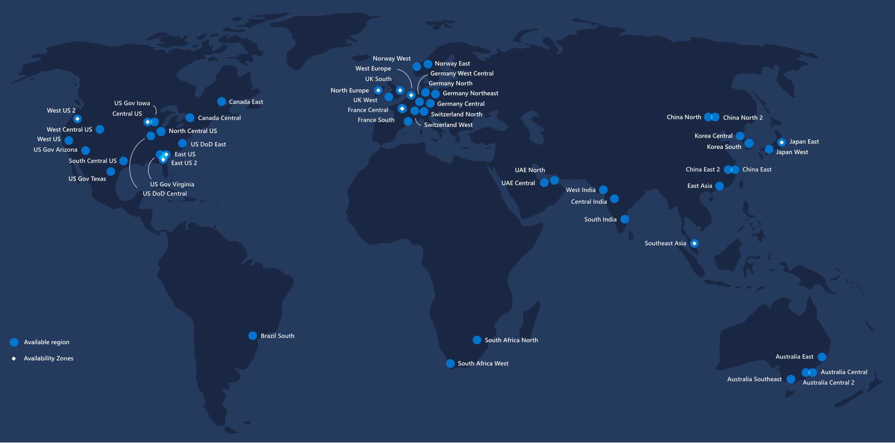
Overview
54
Regions Worldwide
Available in
140
Countries

Slide 19
Building Blocks
Regions
Set of datacenters deployed within a latency-defined perimeter and connected through a dedicated regional low-latency network
Geographies
Discrete market, typically containing two or more regions, that preserves data residency and compliance boundaries
Availability Zones
Physically separate locations within an Azure region. Each Availability Zone is made up of one or more datacenters equipped with independent power, cooling, and networking

Slide 20
Azure Administration Levels
We need an account to use Microsoft services
Single account can be in multiple tenants
Tenant is created when you create your first Azure subscription
New Azure Active Directory is created with the new tenant
We can have multiple subscriptions under the same tenant
Resource groups to separate resources in terms of logical or billing level
Resources are manageable items available through Azure
Account
Tenant
Subscription
Resource Groups
Resources

Slide 21
Azure Subscriptions
Azure Subscription is the billing unit
Three different types
Sponsored Subscriptions
Pay-As-You-Go
Enterprise Agreement
They can be used to separate Azure environments by financial and administration logic
Management groups can be used to manage multiple subscriptions

Slide 22
Azure Trial (Sponsored) Subscriptions
Azure Free Account (https://azure.microsoft.com/en-us/free)
Free for 12 months
200$ (170 EUR) credit for the first 30 days
Requires a credit/debit card
Azure for Students (https://azure.microsoft.com/en-us/free/students)
Free for 12 months
100$ credit for the whole period
No credit/debit card required
Both can be converted to Pay-As-You-Go

Slide 23
Resource Groups and Resources
Resource groups are created within a certain location (region)
All the resources in a group should share the same lifecycle. They are deployed, updated, and deleted together
Each resource can only exist in one resource group
Resource can be added or removed to a resource group at any time
Resource ca be moved from one resource group to another group
Resource group can contain resources that are located in different regions
Resource group can be used to scope access control for administrative actions
A resource can interact with resources in other resource groups

Slide 24
Azure Services
Brief Overview

Slide 25
Azure Core Services*
Compute
Virtual Machines, Virtual Machine Scale Sets, App Services, …
Networking
Virtual Networks, Load Balancers, VPN Gateways, …
Storage
Storage Accounts, Recovery Services, …
Database
Azure CosmosDB, Azure SQL, SQL Data Warehouses, …

Slide 26
Azure Solutions*
Combinations of Azure services and related products
Internet of Things
Azure IoT Central, Azure IoT Hub, Azure IoT Edge, …
Big Data and Analytics
HDInsight, Data Lake Analytics, …
Artificial Intelligence
Azure Machine Learning, Azure Cognitive Search, …
https://azure.microsoft.com/en-us/solutions/

Slide 27
Azure Marketplace
Central place that offers tested and approved appliances
Solutions ranging from open source container platforms to threat detection to blockchain
Provision end-to-end solutions quickly and reliably

Slide 28
Always Free Services
Resource Groups
Virtual Networks (up to 50)
Load Balancers (Basic)
Azure Active Directory (Basic)
Network Security Groups
Free-tier Web Apps (up to 10)

Slide 29
Practice: Azure Portal
First Steps in the Portal

Slide 30
Core Services
Brief Overview

Slide 31
Virtual Machines
Offer various predefined configurations of CPU, RAM, HDD, etc.
Every configuration exposes some limits as well
Both Windows and Linux are supported
Can be created from publicly available image or our own image
License fees may apply based on the chosen OS
Azure charges an hourly price based on the VM’s size and operating system
For partial hours, Azure charges only for the minutes used
Storage is priced and charged separately
https://docs.microsoft.com/en-us/azure/virtual-machines/

Slide 32
Virtual Machines Series
Bs-Series (Economical burstable VMs)
Development and test servers
A-Series (Entry-level economical VMs for dev/test)
Suitable for entry level workloads like development and test
D-Series (General purpose compute)
Suitable for most production workloads
F-Series (Compute optimized virtual machines)
Optimized for compute intensive workloads
https://azure.microsoft.com/en-us/pricing/details/virtual-machines/series/

Slide 33
Resources Created with Virtual Machines
Virtual Machine
One or More Disk(s)
Network Interface
Virtual Network
Network Security Group
Public IP Address*
Storage Account*

Slide 34
Virtual Networks (VNet)
Fundamental building block for our private network in Azure
Enables many Azure resources to communicate with each other, the internet, and on-premise networks
During creation we must specify a custom IP address space
Subnets enable us to segment a virtual network
VNet is scoped to a single region/location and subscription
Network traffic can be filtered via network security groups
There is no charge for using Azure VNet
https://docs.microsoft.com/en-us/azure/virtual-network/virtual-networks-overview

Slide 35
Storage
Azure Storage is a managed service providing cloud storage
It is highly available, secure, durable, scalable, and redundant
Azure Storage includes
Azure Blobs (objects)
Azure Data Lake Storage Gen2
Azure Files
Azure Queues
Azure Tables
Each service is accessed through a storage account
https://docs.microsoft.com/en-us/azure/storage/common/storage-introduction

Slide 36
Storage Accounts
Names must be between 3 and 24 characters in length and may contain numbers and lowercase letters only. Must be globally unique
Multiple types, but General-purpose v2 is the recommended
Standard and premium performance tiers are offered
Hot, cool, and archive access tiers are available
Replication options vary, but include Locally-redundant storage (LRS), Geo-redundant storage (GRS), etc.
All data the storage account is encrypted on the service side
https://docs.microsoft.com/en-us/azure/storage/common/storage-account-overview

Slide 37
Azure Managed Disks
Main advantage over the unmanaged disks is that there is no need to create separate storage accounts to hold the VHDs
Azure managed disk is a virtual hard disk (VHD)
Stored as page blobs (random IO storage object in Azure)
Available types of disks are Ultra disk, Premium solid-state drive (SSD), Standard SSD, and Standard hard disk drive (HDD)
Disk roles include OS Disk, Temporary Disk, and Data Disk
https://docs.microsoft.com/en-us/azure/virtual-machines/windows/managed-disks-overview

Slide 38
OS Disk
Every virtual machine has one attached operating system disk
That OS disk has a pre-installed OS, which was selected when the VM was created
This disk contains the boot volume.
This disk has a maximum capacity of 2,048 GiB

Slide 39
Temporary Disk
Every VM contains a temporary disk. It is not a managed disk
It provides short-term storage for applications and processes
It is intended to only store data such as page or swap files
Data on the temp disk may be lost during a maintenance event
On Azure Linux VMs, the temporary disk is /dev/sdb by default
On Windows VMs the temporary disk is D: by default
During a successful standard reboot of the VM, the data on the temporary disk will persist

Slide 40
Data Disks
Data disks are managed disks
They are used to store application data, or other data we need to keep
They are registered as SCSI drives and labeled with a letter of our choice
Each data disk has a maximum capacity of 32,767 GiB
The size of the virtual machine determines
How many data disks can be attached to it
The type of storage that can be used to host the disks

Slide 41
Practice: Core Services
Basic Exploration of Core Services

Slide 42
Management Tools
Something for Everyone’s Taste

Slide 43
Plenty of Tools
Azure Portal
Azure Cloud Shell
Azure CLI
Azure PowerShell
Azure (Unified) SDKs
Azure Mobile App
Other Tools (Azure Storage Explorer, Azure Data Studio, …)
Available in the Azure Poral under the Azure Cloud Shell

Slide 44
Azure Portal
Nice-looking and responsive web UI
Offers full control over all services
Suitable for execution of single non-repetitive tasks
Accessible from anywhere and on any connected device
Most modern browsers are supported (Microsoft Edge, Safari, Chrome, Firefox, and Internet Explorer 11)
Available via portal.azure.com
https://docs.microsoft.com/en-us/azure/azure-portal

Slide 45
Azure Cloud Shell
An interactive, authenticated, browser-accessible shell for managing Azure resources
Supports both Bash or PowerShell modes
Can be started from the Azure Portal or via shell.azure.com
Integrated code editor and many other tools
Requires Azure Files* share to persist the home folder
* Regular costs apply
https://docs.microsoft.com/en-us/azure/cloud-shell/overview

Slide 46
Azure CLI
Free command line utility, installed additionally
Supported on Windows (+WSL), Linux, macOS, and Docker
Actions are triggered via commands (nouns), sub-commands (verbs) and properties
For example to create a resource group
Most properties have long (--name) and short (-n) form
az noun verb --properties [...]
az group create --name RG-Demo --location westeurope
https://docs.microsoft.com/en-us/cli/azure

Slide 47
Azure PowerShell Module
Free command line utility, installed additionally
Requires PowerShell (5.1+) or PowerShell Core (6.x+)
Supported on Windows, Linux, and macOS
Actions on resources are available through separate commands
For example, to create a resource group:
Action-AzTargetResource
New-AzResourceGroup -Name RG-Demo -Location WestEurope
https://docs.microsoft.com/en-us/powershell/azure

Slide 48
Azure (Unified) SDKs
Collections of libraries for programming languages
Used to build applications that manage and interact with Azure services
Unified SDKs focus on consistency, familiarity, and language idiomaticity
Unified SDKs support .NET, Java, JavaScript, and Python
For new projects Unified SDKs are the recommended way
https://aka.ms/azurecom-sdk-dl-{java,python,net,js}

Slide 49
Azure Mobile App
Available both on App Store and Google Play
Monitor the health and status of Azure resources
Quickly diagnose and fix issues
Run commands to manage Azure resources
https://azure.microsoft.com/en-us/features/azure-portal/mobile-app/

Slide 50
Consoles Crash Course
Key Concepts for CMD, Bash, and PowerShell

Slide 51
CMD
This is the classic command line interface of Windows
Usually no Tab completion of commands and arguments
Environment variables are declared and used like:
Individual lines in a multi-line command are separated with ^
set LOCATION=westeurope
set RESOURCE_GROUP=RG-Demo-CMD
az group create --name %RESOURCE_GROUP% --location %LOCATION%
C:\> az group create --name %RESOURCE_GROUP% ^
More? --location %LOCATION%

Slide 52
Bash
Case sensitive shell available in most Unix-like OSes
Usually tab completion is available
Environment variables are declared and used like:
Individual lines in a multi-line command are separated with \
LOCATION=westeurope
RESOURCE_GROUP=RG-Demo-Bash
az group create --name $RESOURCE_GROUP --location $LOCATION
$ az group create --name $RESOURCE_GROUP \
>> --location $LOCATION

Slide 53
PowerShell (Core)
Case in-sensitive shell available in Windows, Linux, and macOS
Usually tab completion is available
Environment variables are declared and used like:
Individual lines in a multi-line command are separated with `
$LOCATION="westeurope"
$RESOURCE_GROUP="RG-Demo-PS"
New-AzResourceGroup -Name $RESOURCE_GROUP -Location $LOCATION
PS C:\> New-AzResourceGroup -Name $RESOURCE_GROUP `
>> -Location $LOCATION

Slide 54
Practice: Azure The Right Way
Experiment with Console Management Tools

Slide 55

Resources
Azure Portal - https://docs.microsoft.com/en-us/azure/azure-portal/
Azure Cloud Shell - https://docs.microsoft.com/en-us/azure/cloud-shell/
Azure CLI - https://docs.microsoft.com/en-us/cli/azure/
Azure PowerShell - https://docs.microsoft.com/en-us/powershell/azure/
Azure Virtual Machines - https://docs.microsoft.com/en-us/azure/virtual-machines/
Azure Virtual Network - https://docs.microsoft.com/en-us/azure/virtual-network/
Azure Storage - https://docs.microsoft.com/en-us/azure/storage/

Slide 56
Summary
According to Microsoft Azure is the top cloud platform
Multiple regions (some with availability zones)
Offers wide range of services varying among regions
Core services include Compute, Networking, and Storage
Many subscription options incl. Student and Trial
Small set of always free services
For some services payments is per usage, for others - time
Multiple means of interaction with Azure

Slide 58












SoftUni Diamond Partners

Slide 59

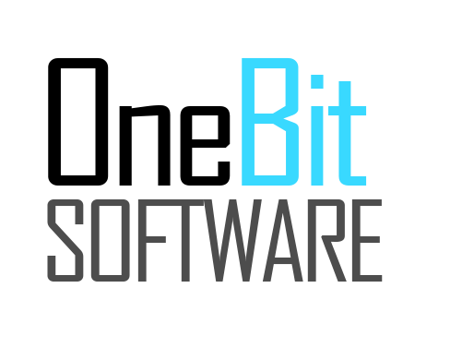


SoftUni Organizational Partners

Slide 60

License
This course (slides, examples, demos, videos, homework, etc.) is licensed under the "Creative Commons Attribution-NonCommercial-ShareAlike 4.0 International" license

Slide 61





Trainings @ Software University (SoftUni)
Software University – High-Quality Education, Profession and Job for Software Developers
softuni.bg
Software University Foundation
http://softuni.foundation
Software University @ Facebook
facebook.com/SoftwareUniversity
Software University Forums
forum.softuni.bg

