Slide 1
Azure Databases
Relational Databases. NoSQL Databases. Analytics
SoftUni Team
Technical Trainers
Software University
http://softuni.bg

Slide 2
Have a Questions?
sli.do
#Azure
facebook.com
/groups/AzureEssentialsDecember2019/

Slide 3

Previous Module (M2)
Quick Overview

Slide 4
What We Covered
Scaling and Templating
Network Security and Load Balancing
Storage Blobs and Files
Resource Access and Security
Monitoring
Costs

Slide 5
This Module (M3)
Topics

Slide 6
Table of Contents
Relational Databases
NoSQL Databases
Analytics

Slide 7
Relational Databases
Azure Relational Database Offerings

Slide 8
Multiple Offerings
Azure Database for MariaDB
Azure Database for MySQL
Azure Database for PostgreSQL
Azure SQL Database
SQL Server on Virtual Machines
SQL Server Stretch Database
Azure SQL Database Edge
Azure SQL*
https://azure.microsoft.com/en-us/product-categories/databases/

Slide 9
Azure SQL
SQL Databases
Single Database - fully managed, isolated database
Elastic Pool - collection of databases with a shared set of resources
Database Server - groups of single databases and elastic pools
SQL Managed Instances
Fully managed instance, easy migration
SQL Virtual Machines
Full administrative control over SQL & OS
Option for Bring Your Own License (BYOL)
https://docs.microsoft.com/en-us/azure/sql-database/

Slide 10
Purchasing Models
vCore-based
Choose the number of vCores, the amount of memory, and the amount and speed of storage
DTU-based (DTU = Database Transaction Unit)
Offers a blend of compute, memory, and I/O resources in three service tiers
Serverless
Automatically scales compute based on workload demand, and bills for the amount of compute used per second
https://docs.microsoft.com/en-us/azure/sql-database/sql-database-purchase-models

Slide 11
Service Tiers*
General Purpose (Standard)
Designed for common workloads
Offers budget-oriented balanced compute and storage options
Business Critical (Premium)
Designed for OLTP applications with high transaction rate and lowest-latency I/O
Offers the highest resilience to failures by using several isolated replicas
Hyperscale
Designed for very large OLTP database
Offers the ability to auto-scale storage and scale compute fluidly
* Basic, Standard, and Premium are applicable for the DTU model
https://docs.microsoft.com/en-us/azure/sql-database/sql-database-service-tiers-general-purpose-business-critical

Slide 12
Tools
Azure Portal
SQL Server Management Studio (SSMS)
SQL Server Data Tools for Visual Studio (SSDT)
Visual Studio Code
Azure Data Studio

Slide 13
Practice: Relational Databases
Azure SQL

Slide 14
NoSQL Databases
Azure Cosmos DB

Slide 15
Before NoSQL Databases
RDBMS offer structured data and universal language (SQL)
RDBMS follow ACID rules:
Atomicity – transactions are threated as single units
Consistency – transactions bring DB from one valid state to another. Written data must be valid according to all rules
Isolation – concurrent execution of transactions leaves the DB in the same state as if they were executed sequentially
Durability – committed transaction remains committed even in case of system failure
Reasons to move on – hard to scale & the need for unstructured data

Slide 16
NoSQL Databases
NoSQL = Not-only-SQL
NoSQL databases store unstructured data
Data is stored in a denormalized form
Key features offered:
Speed – very fast response, usually the data is stored in memory
Scale – easily scalable, following the ever-growing demand
Continuous availability – redundant copies across multiple locations with no downtime
Location independence – serve data quickly to multiple locations

Slide 17
NoSQL Types: Key-Value
Main characteristics
Collection of keys associated with values
Keys are represented with strings
Values are stored as BLOBs
No query language, just simple commands (put, get, delete, …)
Use Cases
Session tracking, shopping carts, …
Examples
Redis, Cassandra, Memcached, Couchbase

Slide 18
NoSQL Types: Document
Main characteristics
Similar to key-value DBs, but values store XML, JSON, or BSON
Offers storage of complex data like trees, collections, dictionaries
Doesn’t support relations and joins
No query language
Examples
MongoDB, CouchDB, OrientDB

Slide 19
NoSQL Types: Column Store
Main characteristics
Store data in column families as rows
Rows have many columns associated with them
Each row can have different set of columns
Offer compression, aggregation queries, and scalability
They are fast to load and query
Examples
Cassandra, DynamoDB, Hbase

Slide 20
NoSQL Types: Graph
Main characteristics
Data is stored in the form of nodes and edges
Nodes are the data entries
Edges are the relationships between the data entries
Edges can have their own properties and direction
Examples
Neo4J, FlockDB, OrientDB

Slide 21
Azure Cosmos DB
It is the Microsoft’s NoSQL database solution
Supports all four NoSQL models
Offers multiple APIs
Some of the features include
Global distribution for highly responsive and highly available apps
Elastic scalability of throughput and storage
Five consistency levels ranging from strong to eventual
https://docs.microsoft.com/en-us/azure/cosmos-db/introduction

Slide 22
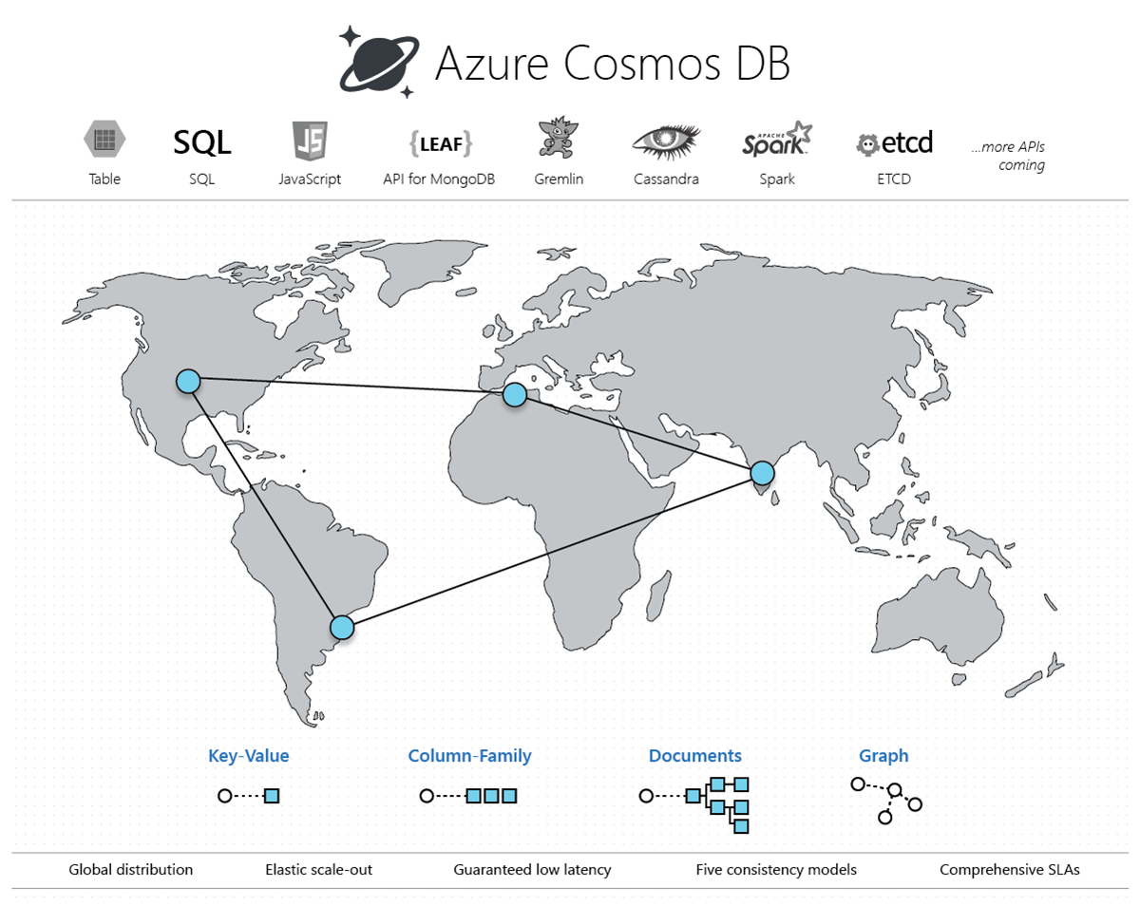
A Picture is Worth a Thousand Words
…

Slide 23
Azure Cosmos DB Supported APIs
Core (SQL)
Document database that can be queried with SQL
Azure Cosmos DB for MongoDB API
Document database to support transition from MongoDB
Cassandra
Supports both Cassandra Query Language (CQL) and Cassandra-based tools
Azure Table
Applications written for Azure Table storage can migrate with no code change
Gremlin
Used to store and operate with graph data
Used for flawless migration to Cosmos DB
https://docs.microsoft.com/en-us/azure/cosmos-db/introduction

Slide 24
Azure Cosmos DB SQL
Standard clauses
SELECT, FROM, WHERE, ORDER BY, GROUP BY
Subqueries
Joins
Aggregate functions
COUNT, SUM, MIN, MAX, and AVG
Many system functions
ABS, ROUND, TRUNC, CONCAT, LEFT, TRIM, UPPER, …
https://docs.microsoft.com/bg-bg/azure/cosmos-db/sql-query-getting-started

Slide 25
Practice: NoSQL Databases
Azure Cosmos DB

Slide 26
Analytics
Azure Stream Analytics

Slide 27
Azure Analytics Services
Broad and important set of services
Typically those are complex services that depend on others
Here we can find
SQL data warehouses
Azure Databricks
HDInsight clusters
PowerBI Embeded
Stream Analytics jobs
…

Slide 28
Stream Analytics (ASA)
Real-time analytics and complex event-processing engine
Designed to analyze and process high volumes of fast streaming data from multiple sources simultaneously
Sources include devices, sensors, clickstreams, social media feeds, and applications
Patterns and relationships can be identified
Findings can be used to trigger actions and initiate workflows
Supports alerts, feeding information to a reporting tool, or storing transformed data for later use

Slide 29
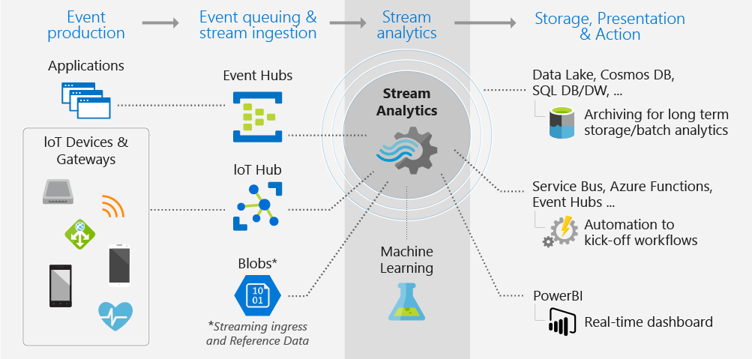
The Big Picture
https://docs.microsoft.com/en-us/azure/stream-analytics/stream-analytics-introduction

Slide 30
Azure Stream Analytics Query Language
Standard clauses
SELECT, FROM, WHERE, GROUP BY, etc.
Built-in functions
COUNT, SUM, MIN, MAX, AVG, etc.
Time management
https://docs.microsoft.com/en-us/stream-analytics-query/stream-analytics-query-language-reference

Slide 31
Practice: Analytics
Azure Stream Analytics

Slide 32

Summary
Multiple RDBMS offerings including MySQL, MariaDB and PostgreSQL
Azure SQL includes:
SQL databases
SQL managed instances
SQL virtual machines
Azure Cosmos DB is a multi-model NoSQL database
Azure Stream Analytics is a real-time analytics and complex event-processing engine

Slide 34












SoftUni Diamond Partners

Slide 35




SoftUni Organizational Partners

Slide 36

License
This course (slides, examples, demos, videos, homework, etc.) is licensed under the "Creative Commons Attribution-NonCommercial-ShareAlike 4.0 International" license

Slide 37





Trainings @ Software University (SoftUni)
Software University – High-Quality Education, Profession and Job for Software Developers
softuni.bg
Software University Foundation
http://softuni.foundation
Software University @ Facebook
facebook.com/SoftwareUniversity
Software University Forums
forum.softuni.bg

