Slide 1
React Web Applications Master Class
Advanced React
SoftUni Team
Technical Trainers
Software University
http://softuni.bg

Slide 2
Table of Contents
Core Concepts (React Basics Throwback)
React Patterns And Practices
React Context
Thinking in React

Slide 3



Learn to Search in Internet
The course assignments require to search in Internet
This is an important part of the learning process
Some exercises intentionally have no hints
Learn to find solutions!
Software development includes everyday searching and learning
No excuses, just learn to study!
Developers learn new technologies, tools, languages every day!

Slide 4
Link To All Demos

Slide 5
Core Concepts

Slide 6
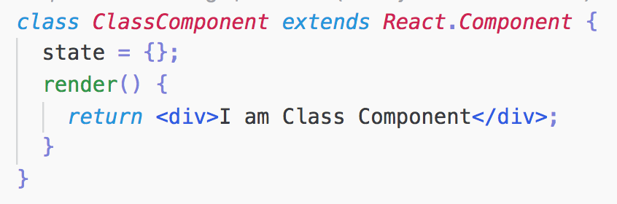
Component
Main building blocks
Reusability
Isolation
Syntax
Class extending React.Component or React.PureComponent
Stateless components - Function Components

Slide 7
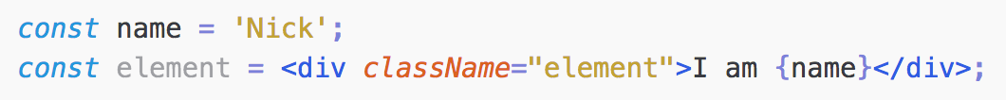
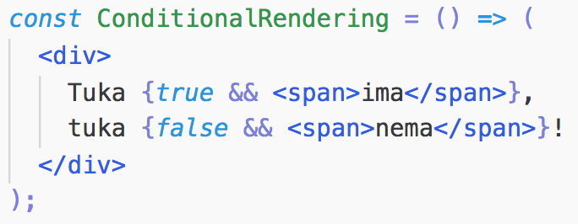
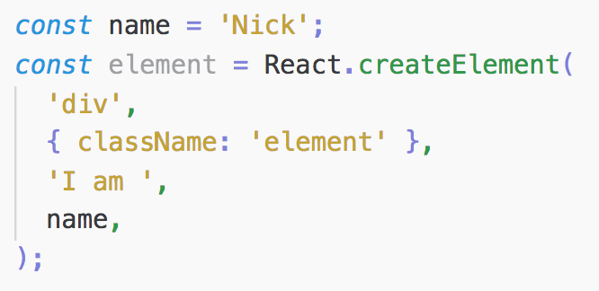
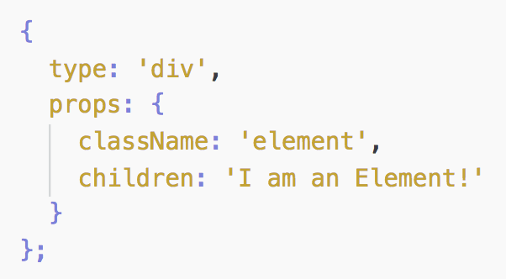

JSX and Elements
JSX (JavaScript XML)
inspired by XHP (XML literals in VB)
combines markup with logic (JavaScript Expressions)
produces React elements
Elements
smallest building blocks
describe what is seen on the screen
plain objects

Slide 8
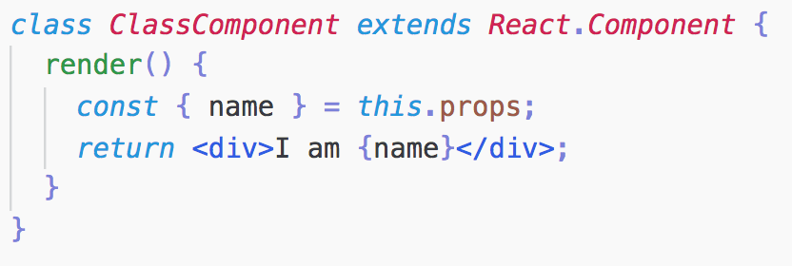
Component Props
External Data (inputs) the component depends on
Pass down from parent to child
Immutable
Accessed
from a single field this.props for class components
as single argument object for function components

Slide 9
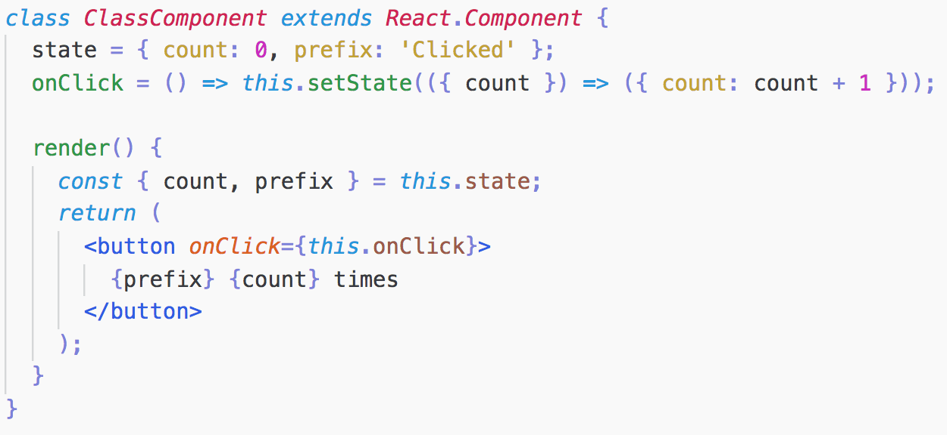




Component State
Internal state of the component
Immutable
Should be always mutated via this.setState(...)
State updates are merged
After indefinite amount of time

Slide 10
Component Re-render Causes
Props Change
State Change
Context Change*

Slide 11

React Patterns and Practices

Slide 12
Composition vs Inheritance

Slide 13
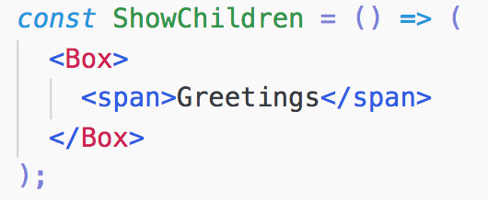
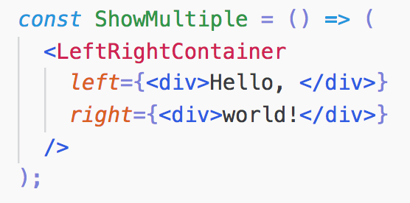
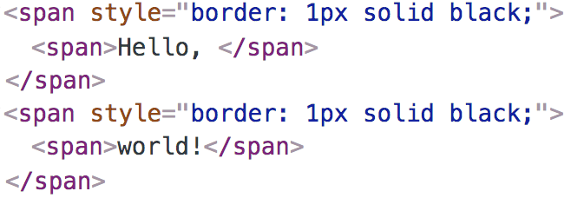
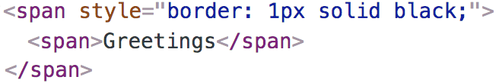
Generic Components
Using props to show unknown elements
using children prop
using multiple props

Slide 14
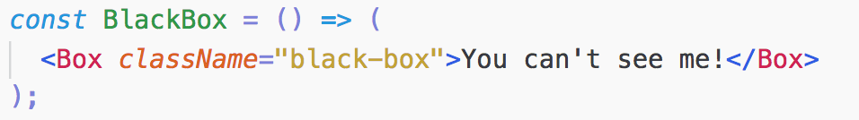
Special Components
Special cases of more generic components

Slide 15
Composition vs Inheritance
React is build with composition model in mind
Enough Flexibility
You don’t need inheritance apart from extending React.Component or React.PureComponent

Slide 16
Presentational and Container Components

Slide 17
Presentational Components
How things look
Usually renders host components
No external dependencies
Lack of knowledge about data mutations and loading
Pure functions*
No state (except of UI state)

Slide 18
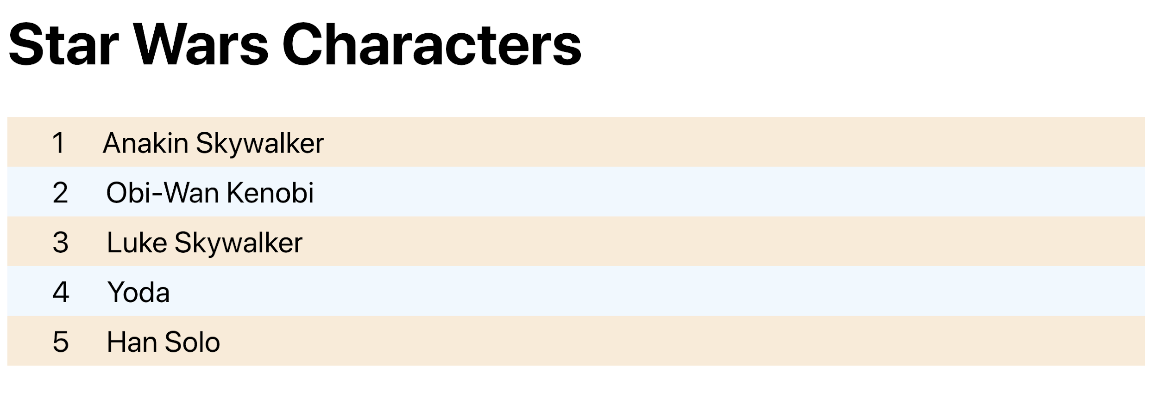
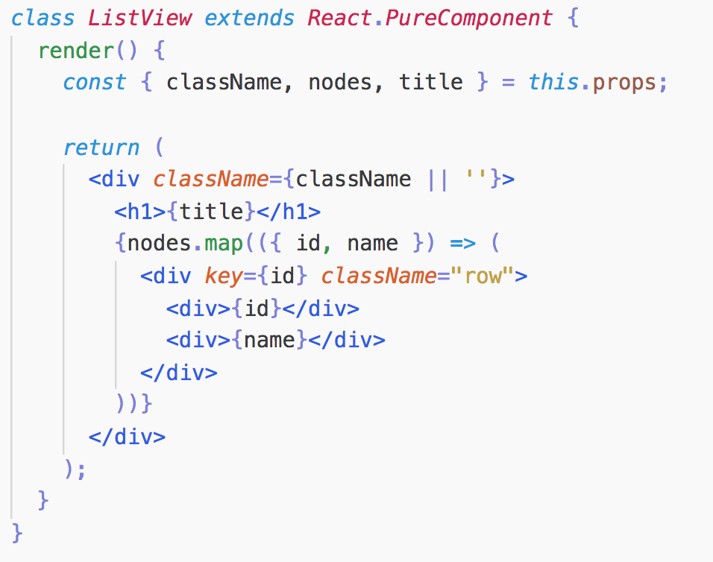
Presentational Components
No State
Pure Function
Renders DOM elements

Slide 19
Container Components
How things work
Usually no host components
Linked to external providers (redux-connect, apollo-graphql, etc.)
Serves as data and behavior providers
Usually stateful

Slide 20
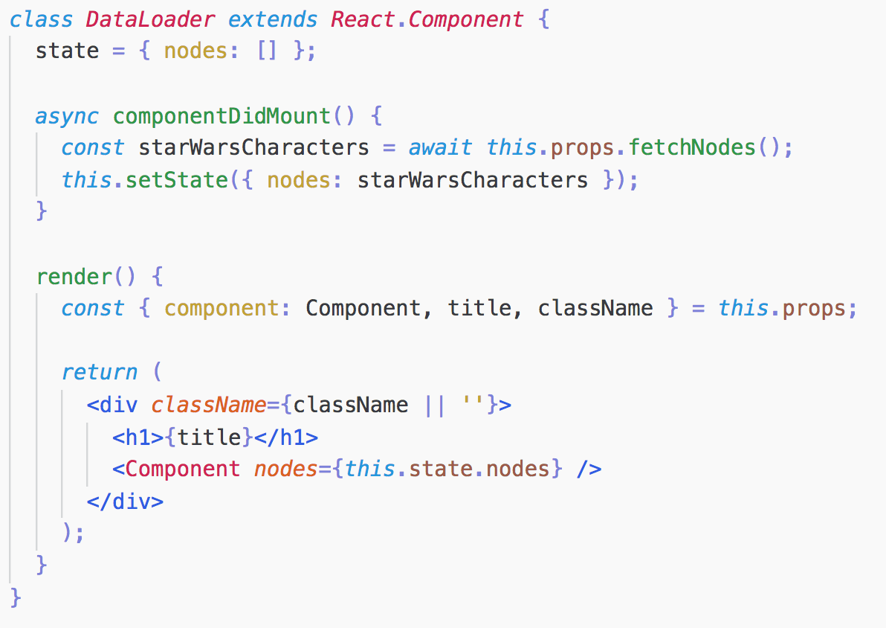
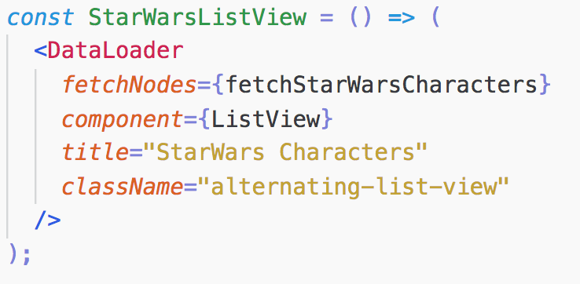
Container Components
What is it?
Inversion of Control
Stateful
Serves as Data Provider

Slide 21
But Why?
Separation of concerns
Better Reusability
Enforces Good Practices
Makes Styling Easier

Slide 22
Controlled vs Uncontrolled Form Components

Slide 23
Refs and the DOM

Slide 24
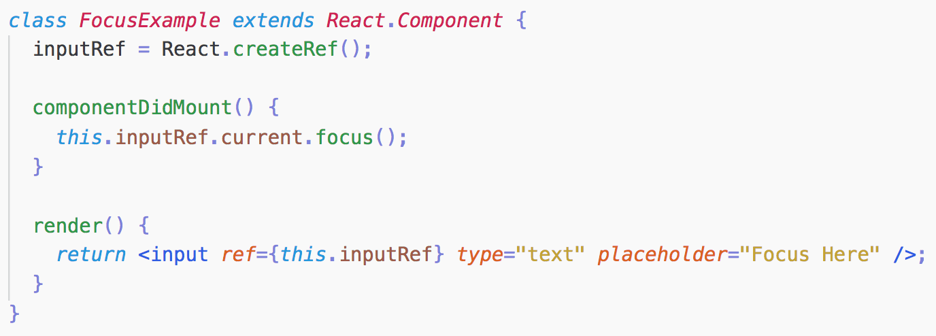
What are Refs?
Imperatively control child’s behavior
Child can be either DOM element or React Component
Used for accessing child component instance throughout the components lifecycle
Function Components cannot be refed

Slide 25
How to use Refs?
React.createRef - creates ref instance
Pass the ref instance to an element ref attribute in render
Control the rendered element via the ref instance reference
Depending on the child type ref instance receives different object as current property (e.g. this.myRef.current):
HTML element- the instance of the underlying DOM element
React Component - the instance of the mounted component

Slide 26
DEMO

Slide 27
Controlled vs Uncontrolled Form Components

Slide 28
DEMO

Slide 29
Form Components
Keep internal state
Uncontrolled
data is pulled from the components using ref
Defaults to HTML Form elements behavior
input, textarea, select

Slide 30
Controlled Components
React state (redux) becomes single source of truth
Data is pushed to components using a prop (value/checked)
React component controls the behavior of the rendered form onUserInput*
Input components whose value is controlled by React are called controlled components

Slide 31
Controlled Form
DEMO

Slide 32
Controlled vs Uncontrolled
Controlled
It’s a more “React Way”
Data (state) and UI (inputs) are always in sync
More control over the data
Uncontrolled
Quick and Easy
Less Boilerplate Code
Integration with non-React libs

Slide 33
Lifting State Up

Slide 34
Lifting State Up
DEMO

Slide 35
Lifting State Up
Each changeable data should have single source of truth
Prefer top-down data flow instead of syncing state between interdependent components
Initially, place the state as close as possible to the component in interest
Lift the state up to the closest common ancestor for components requiring the same data
Anything derivable/reducible from props or state, shouldn’t be stored in the state.

Slide 36
Higher-Order Components

Slide 37
DEMO

Slide 38
The Problems
Abstract Same Pattern Logics to be reused by Components
Encapsulate Behaviors

Slide 39
Higher-Order Components (HOCs)
Inspired by higher-order functions
Takes component as an argument and returns new component
Composes the input component by wrapping it in a container component
Doesn’t modify the input component

Slide 40
Higher-Order Components
DEMO

Slide 41
HOCs Conventions
Pass the unrelated props through to the input component
Wrap the Display Name for Easy Debugging
Maximize Composability

Slide 42
HOCs Conventions
DEMO

Slide 43
HOCs Caveats
Don’t compose within the render method
Static members should be hoisted
Refs aren’t passed through
Name collisions
Indirections
React Hooks

Slide 44
Render Props

Slide 45
Render Props
DEMO

Slide 46
Render Props
Render Prop refers to a technique for sharing code between React components using a prop whose value is a function¹
Encapsulates Behavior
Better Reusability
Mind when using with PureComponent

Slide 47
React Context

Slide 48
DEMO

Slide 49
The Problem?
Same data necessary to different components at different nesting levels of the tree
Passing data all the way from top to bottom
Some intermediate components don’t care about the data
Redundancy

Slide 50
Inversion of Control as a Solution
DEMO

Slide 51
Inversion of Control Caveats
Higher-level components become more complicated
Might cause lower-level component to be more flexible than wanted
Having multiple children needing same props

Slide 52
React Context
Context provides a way to pass data through the component tree without having to pass props down manually at every level*

Slide 53
React Context
Broadcast data and changes to all interested components down the tree.
Common examples:
Accessing current locale
Getting a theme styles
Caching data

Slide 54
React Context API

Slide 55
React.createContext(defaultValue)
Creates context object containing Provider and Consumer component
Consumers get value from the closest context Provider
Default value used only when no ascendent Provider

Slide 56
Context.Provider
Context object’s Component
Allowing consumers to subscribe to data changes
value prop for the data down to consumers
Nest provider to override value
Provider’s value change always forces re-render
Diffing same as Object.is

Slide 57
Class.contextType
Let’s you consume the nearest context object value of the context type
Accessed via this.context within the component
Can be accessed within every lifecycle method
Can subscribe only to a single context

Slide 58
Context.Consumer
Context object’s Component
Let’s you subscribe to a context
Uses render props to pass value

Slide 59
React Context
DEMO

Slide 60
Caveats
Complicates components reuse
Indirection
Unintentional re-renders of the consumers

Slide 61

Summary - React.Context
React Context allows subscribing to changing data across many component levels, but mind when using it because it complicates components composition and indirection.
…
…
…

Slide 62
Thinking in React

Slide 63
Thinking in React
DEMO

Slide 65






СофтУни диамантени партньори

Slide 66






СофтУни диамантени партньори

Slide 67





Trainings @ Software University (SoftUni)
Software University – High-Quality Education, Profession and Job for Software Developers
softuni.bg
Software University Foundation
http://softuni.foundation/
Software University @ Facebook
facebook.com/SoftwareUniversity
Software University Forums
forum.softuni.bg

