Slide 1


Routing and Patterns
Browser Routing Design Patterns in JS
SoftUni Team
Technical Trainers
Software University
http://softuni.bg

Slide 2
Table of Content
Routing Concepts
Navigation and History
Sammy.js Overview

Slide 3
Have a Question?
sli.do
#JSCORE

Slide 4
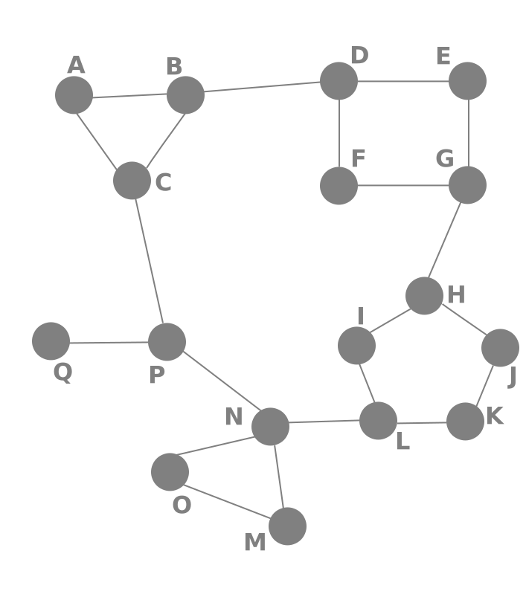
Routing Concepts
Navigation for Single Page Apps

Slide 5
SPA Applications
A single-page application (SPA) is a website that re-renders its content in response to navigation actions (e.g. clicking a link) without reloading of the page.
Single-page applications can use state from an external source (i.e. the URL location) or track state internally
Internal state SPAs are limited because there is only one “entry”
With location-based SPAs, the location is always updating as you navigate
To have location-based SPA we need a special object “Router”

Slide 6
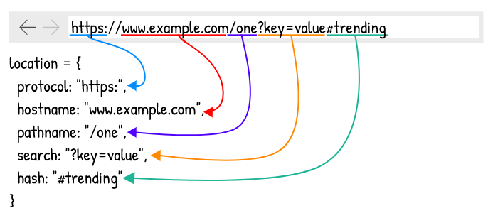
Location

Slide 7

What is Routing?
Standard Navigation
Navigation using Routing
Link
HTML
Router
Link
Link
Link
Routing allows navigation, without reloading the page

Slide 8
How Routers Work
A Router loads the appropriate content when the location changes
E.g. when the user manually enters an address
Conversely, a change in content is reflected in the address bar
E.g. when the user clicks on a link
Benefits:
Load all scripts only once
Maintain state across multiple pages
Browser history can be used
Build User Interfaces that react quickly

Slide 9
How Routers Work
Hash-based routing
Using the #hash part of the URL to simulate different content
The routing is possible because changes in the hash don’t trigger page reload
var url = null;
var getCurrent = function () {
return window.location.hash;
};
var listen = function () {
var current = getCurrent();
if (current !== url) {
console.log(‘URL changed to’ + current);
url = current;
}
setTimeout(listen, 200);
};
Listen();

Slide 10
How Routers work
History API - The DOM window object provides access to the browser's history through the history object. It exposes useful methods and properties that let you move back and forth through the user's history, as well as manipulate the contents of the history stack
HTML5 introduced the history.pushState() and history.replaceState() methods, which allow you to add and modify history entries, respectively
These methods work in conjunction with the window.onpopstate event

Slide 11
The pushState() method
pushState() takes three parameters: a state object, a title (which is currently ignored), and (optionally) a URL
State a JavaScript object which is associated with the new history entry
Title - browsers currently ignore this parameter
Passing the empty string here should be safe against future changes to the method
URL - The new history entry's URL is given by this parameter.
The browser won't attempt to load this URL after a call to pushState() but it might attempt to load the URL later, for instance after the user restarts the browser.
It must be of the same origin as the current URL.

Slide 12
The replaceState() method
history.replaceState() operates exactly like history.pushState() except that replaceState() modifies the current history entry instead of creating a new one
It is particularly useful when you want to update the state object or URL of the current history entry in response to some user action
var stateObj = { facNum: "56789123" };
history.pushState(stateObj, "", "student.html");
history.replaceState(stateObj, "", "newStudent.html");

Slide 13
The popstate event
A popstate event is dispatched to the window every time the active history entry changes
If the history entry being activated was created by a call to pushState or affected by a call to replaceState, the popstate event's state property contains a copy of the history entry’s state object
You can read the state of the current history entry without waiting for a popstate event using the history.state property

Slide 14

Live Demo

Slide 15

Routing with Sammy.js
Overview and Examples

Slide 16
Sammy.js Overview
Sammy is a lightweight routing library
Modular design with plugins and adapters
Requires with jQuery
Many additional features
const app = Sammy('#main', function() {
this.get('#/index.html', () => {
this.swap('Index');
})
});

Slide 17
Installation
Download Sammy using WebStorm's terminal
Or download from sammyjs.org
Browser builds will be located in:
Sammy requires jQuery to work!
npm install --save sammy
node_modules/sammy/lib/
Note: It's best if your project has a package.json file

Slide 18
Application Initialization
Create a Sammy instance to initialize your application
You may have multiple apps running
Each selector can only hold one app
If you refer to it again, it extends the functionality
Invoke library
Element selector
const app = Sammy('#main', function () {
// Define routes and other logic here
});
$(() => app.run()); // Activate

Slide 19
Creating Routes
The main building block of Sammy is the route
Defined by method and address (URI)
Place this block inside a Sammy initializer:
A note on using this: it holds a reference to the router object, but may not work correctly in an arrow function
Route Method
Route address
this.route('get', '#/about', function() {
this.swap('<h2>Contact Page</h2>');
});

Slide 20
Route Aliases
Each method has an alias for shorter code
this.get('#/catalog', loadBooks)
this.post('#/login', userLogin)
this.put('#/catalog/:bookId', updateBook)
this.del('#/catalog/:bookId', deleteBook)

Slide 21
URL Parameters
Parameters allow for dynamic routes
E.g. products in a catalog will load the same page
You can get the whole path using this.path
Parameter name
Receive context
this.get('#/catalog/:productId', (context) => {
console.log(context.params.productId);
});
Access passed in value

Slide 22
Hello Sammy
index.html
<!DOCTYPE html>
<head>
<meta charset="UTF-8">
<title>Hello Sammy</title>
<!-- Include jQuery and Sammy distributions -->
</head>
<body>
<header>
<h1>Hello Sammy</h1>
<a href="#/index.html">Home</a>
<a href="#/about">About</a>
<a href="#/contact">Contact</a>
</header>
<div id="main"></div>
</body>
</html>

Slide 23
Hello Sammy (2)
app.js
const app = Sammy('#main', function () {
this.get('#/index.html', () => {
this.swap('<h2>Home Page</h2>');
});
this.get('#/about', () => {
this.swap('<h2>About Page</h2>');
});
this.get('#/contact', () => {
this.swap('<h2>Contact Page</h2>');
});
});
$(() => {
app.run();
});

Slide 24
Handling Forms
Forms inside the main element are automatically handled
Route address
Route method
<form action="#/login" method="post">
User: <input name="user" type="text">
Pass: <input name="pass" type="password">
<input type="submit" value="Login">
</form>
this.post('#/login', (context) => {
console.log(context.params.user);
console.log(context.params.pass);
});
Names of inputs

Slide 25
Integrating Handlebars
Download and include the Handlebars source in your HTML
Include sammy.handlebars.js (found under lib/plugins)
Load the plugin inside a Sammy initializer:
Create a RenderContext with render, load or partial
this.use('Handlebars', 'hbs');
Template file extension

Slide 26
Using Handlebars
greeting.hbs
<h1>{{title}}</h1>
<p>Hello, {{name}}!</p>
app.js
const app = Sammy('#main', function () {
this.use('Handlebars', 'hbs');
this.get('#/hello/:name', function() {
this.title = 'Hello!'
this.name = this.params.name;
this.partial('greeting.hbs');
});
});
$(() => app.run());
Load and swap in the template

Slide 27
Using Handlebars (2)
Load a list of partial templates (inside a route definition):
The callback will be executed once all partials are loaded
Templates are cached – there's no need to manually cache them
this.loadPartials({
firstPartial: 'path-to/first.hbs',
secondPartial: 'path-to/second.hbs',
thirdPartial: 'path-to/third.hbs'
}).then(function(context) => {
console.log(context.partials);
this.partial('pageTemplate.hbs');
});

Slide 28
Additional Features
Redirect
Custom events
Useful plugins (found under lib/plugins):
Storage and Session
OAuth2
this.redirect('#/other/route');
this.redirect('#', 'other', 'route');
// Register event handler
this.bind('event-name', eventHandlerFunction);
// Raise event
this.trigger('event-name', data);

Slide 29

Routing with Sammy.js
Overview and Examples

Slide 30
What are Design Patterns
Design Patterns are general approaches to solving commonly occurring problems
They provide:
tested, proven programming paradigms
guidelines to organizing our code
a common vocabulary between developers
Using a pattern may increase complexity – misuse often creates more problems than it solves

Slide 31
Splitting Your Code
Splitting your code aims to separate concerns (only change the parts that need to be changed)
Sample code organization
Main script
Requester (Remote API)
Authenticator
Router
View Controllers

Slide 32
Live Exercise

Slide 33

Summary
Browser Routing allows SPAs to use history
Sammy.js is a simple routing library
Modular code is more maintainable
…
…
…
const app = Sammy('#main', function () {
this.get('index.html', () => {
this.swap('<h1>Index Page</h1>');
})
});

Slide 34
https://softuni.bg/trainings/2082/js-applications-november-2018

Slide 35













SoftUni Diamond Partners

Slide 36





SoftUni Organizational Partners

Slide 37




Trainings @ Software University (SoftUni)
Software University – High-Quality Education and Employment Opportunities
softuni.bg
Software University Foundation
http://softuni.foundation/
Software University @ Facebook
facebook.com/SoftwareUniversity
Software University Forums
forum.softuni.bg

Slide 38

License
This course (slides, examples, demos, videos, homework, etc.) is licensed under the "Creative Commons Attribution-NonCommercial-ShareAlike 4.0 International" license

