Slide 1

JavaScript Applications
Course Overview
Applications
SoftUni Team
Technical Trainers
Software University
http://softuni.bg

Slide 2
Table of Content
Introduction
Training & Team
Course Objectives
Course Organization

Slide 3
Have a Question?
sli.do
#JSCORE

Slide 4













SoftUni Diamond Partners

Slide 5





SoftUni Organizational Partners

Slide 6

Applications
JS Applications Intro

Slide 7
What are we going to learn?
In this course we are going to learn:
HTTP, REST Services, Postman
AJAX and jQuery AJAX
Asynchronous programming and promises
Creating single-page app with jQuery, AJAX, REST and Firebase
Templating: creating UI with Handlebars
Routing with Sammy.js
JS tools and libraries

Slide 8

Trainers and Team

Slide 9


Stamo Petkov
Head Of Department at Information Services Plc.
Worked with various technologies
.NET and C#, BASIC, Pascal, Object Pascal, PHP
More than 15 years of experience
Experienced Lecturer
C# Basics and ASP.NET MVC @ Softuni

Slide 10
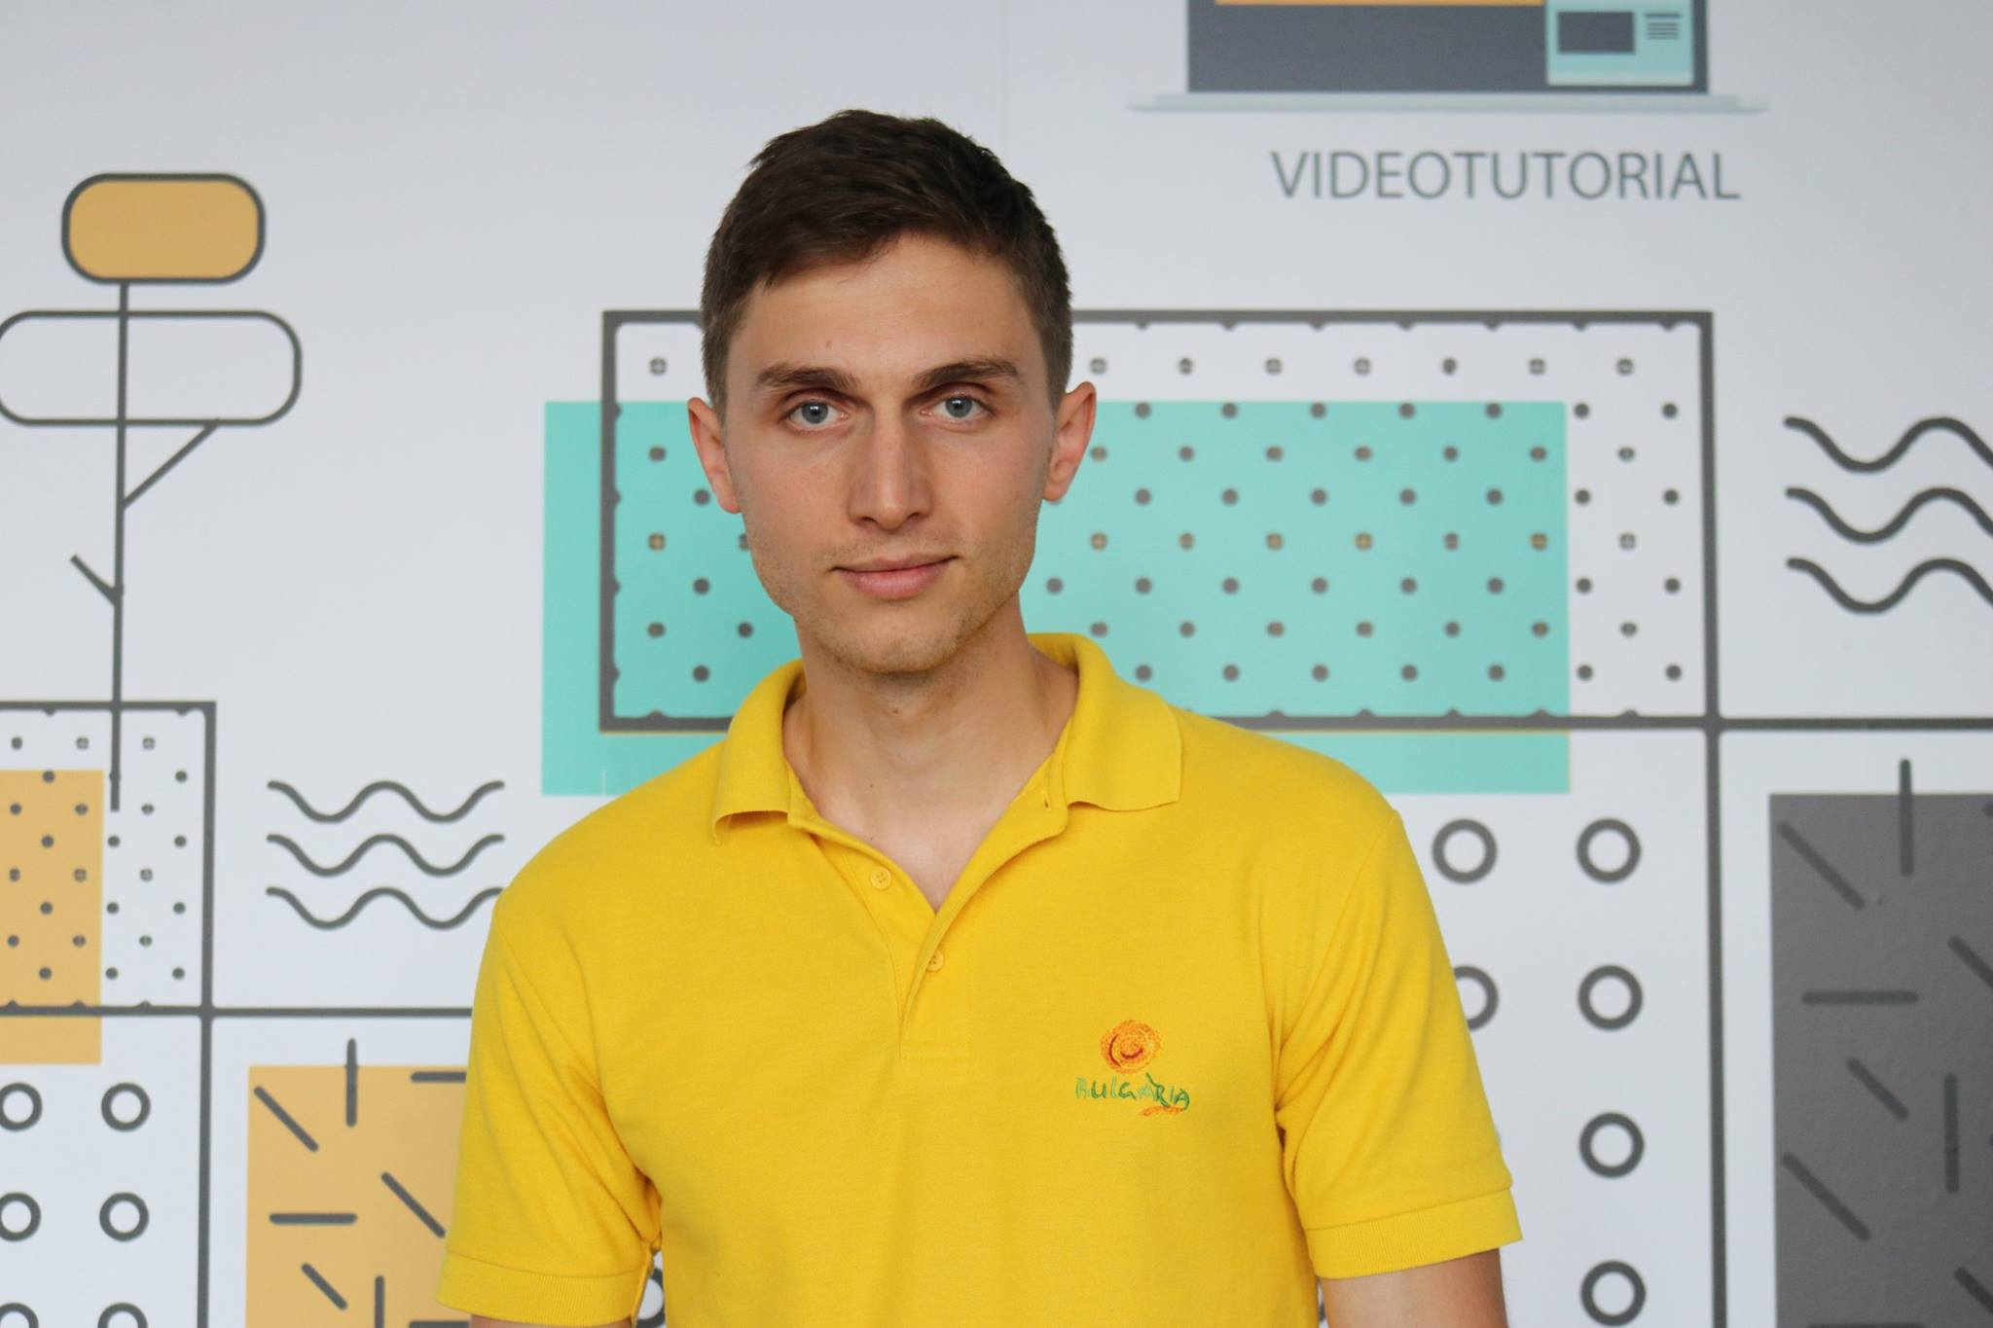
Ivaylo Dimitrov
4+ years experience in the IT (HTML, CSS, JavaScript, C#, SQL, Windows Server)
Excellent Software University student
Technical Trainer in Software University

Slide 11

Behind the Scenes
The team working on the materials:
Mladen Raykov
Bilyana Borislavova
Maya Boyadzhieva
Hristomir Asenov
Atanaska Kiricheva
Tanya Staneva

Slide 12

Course Objectives
Course Details and Schedule

Slide 13


Targets of the course
The JavaScript Applications course provides
Technologies for creating Single Page Apps (SPA)
Consuming RESTful Services (REST) with AJAX
Creating UI templates
Common JS programming patterns and routing

Slide 14
Exam
Link to last JS-Applications exam: https://judge.softuni.bg/Contests/Practice/Index/1169#0
Structure: SPA (Single Page Application) for 6 hours
Implement CRUD operations + login / register / logout
Use AJAX and REST + cloud-based back-end (Kinvey)
Optionally:
Use templates for rendering
Use MVC architecture + routing

Slide 15

Course Organization

Slide 16


Structure of the course
Lectures:
Twice a week (4 hours each)
Learn new material
Exercises:
Twice a week (4 hours each)
Practice learned material
Ask questions if any

Slide 17
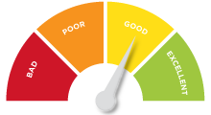

Evaluation Criteria
Mandatory:
Final exam – 90%
Exercises & homework – 10%
Bonuses:
Presence in class – 5% bonus
Forum activity – bonus up to 5%

Slide 18
https://softuni.bg/trainings/2082/js-applications-november-2018

Slide 19




Trainings @ Software University (SoftUni)
Software University – High-Quality Education and Employment Opportunities
softuni.bg
Software University Foundation
http://softuni.foundation/
Software University @ Facebook
facebook.com/SoftwareUniversity
Software University Forums
forum.softuni.bg

Slide 20

License
This course (slides, examples, demos, videos, homework, etc.) is licensed under the "Creative Commons Attribution-NonCommercial-ShareAlike 4.0 International" license

