Slide 1

JavaScript Advanced
Course Overview
Advanced
SoftUni Team
Technical Trainers
Software University
http://softuni.bg

Slide 2
Table of Content
Introduction
Training & Team
Course Objectives
Course Organization

Slide 3
Have a Question?
sli.do
#JSCORE

Slide 4













SoftUni Diamond Partners

Slide 5





SoftUni Organizational Partners

Slide 6

Advanced
JS Advanced Intro

Slide 7
What are we going to learn?
In this course we are going to learn:
DOM and BOM, Manipulating the DOM Tree
jQuery: Simplified DOM and Events
Advanced Functions: IIFE, this, call, apply, bind
Object Composition and Revealing Modules
Unit Testing with Mocha and Sinon
Classes and Members
Class Inheritance and Prototype Chain
Modules, Babel Transpiler, CommonJS

Slide 8

Trainers and Team

Slide 9



Pavel Kolev
Co-Founder and Lead Developer in Rebellious Software
Principal Software Engineer in Telerik
10 years experience in programming
Passionate about JavaScript

Slide 10
Rebellious Software
Online Collectible Card Game
Developed by Rebellious Software
The Rules of Battle Have Changed. Gain Control. Dare to Win.
Available soon on Steam and Mobile.

Slide 11
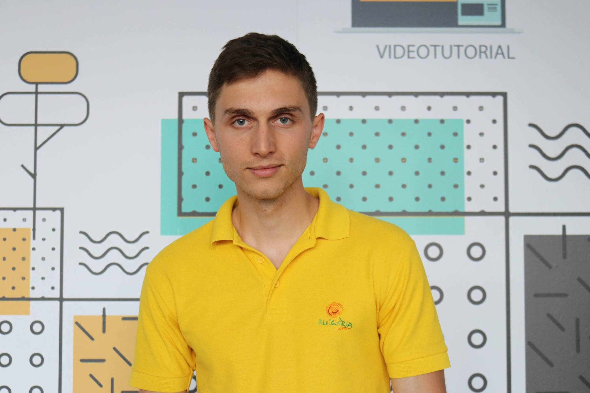
Ivaylo Dimitrov
4+ years experience in the IT (HTML, CSS, JavaScript, C#, SQL, Windows Server)
Excellent Software University student
Technical Trainer in Software University

Slide 12

Behind the Scenes
The team working on the materials:
Mladen Raykov
Bilyana Borislavova
Maya Boyadzhieva
Hristomir Asenov
Atanaska Kiricheva
Tanya Staneva

Slide 13

Course Objectives
Course Details and Schedule

Slide 14
Targets of the course
Advanced coding skills for the JS language
Extends the JS Fundamentals course
Covers DOM, advanced functions, IIFE, object composition, unit testing, classes and inheritance, modules, transpilers, exceptions, generators, iterators

Slide 15
Exam
Link to last JS-Advanced exam: https://judge.softuni.bg/Contests/1158/JS-Advanced-Retake-Exam-30-August-2018
Structure: 4 problems for 6 hours
Problem One – Dom manipulations
Problem Two – Unit testing
Problem Three – Classes
Problem Four – Advanced jQuery/DOM

Slide 16

Course Organization

Slide 17


Structure of the course
Lectures:
Twice a week (4 hours each)
Learn new material
Exercises:
Twice a week (4 hours each)
Practice learned material
Ask questions if any

Slide 18


Evaluation Criteria
Mandatory:
Final exam – 85%
Exercises & homework – 15%
Bonuses:
Presence in class – 5% bonus
Forum activity – bonus up to 5%

Slide 19
https://softuni.bg/trainings/2081/js-advanced-october-2018

Slide 20




Trainings @ Software University (SoftUni)
Software University – High-Quality Education and Employment Opportunities
softuni.bg
Software University Foundation
http://softuni.foundation/
Software University @ Facebook
facebook.com/SoftwareUniversity
Software University Forums
forum.softuni.bg

Slide 21

License
This course (slides, examples, demos, videos, homework, etc.) is licensed under the "Creative Commons Attribution-NonCommercial-ShareAlike 4.0 International" license

