Slide 1
Reduce Stress with
10 Minutes of Chair Yoga
Louise Mahoney, MS

Slide 2
What is Stress & How Does it Affect You?
Stress is your body’s response to any kind of demand both good and bad
Can alter your state of health, your mood and emotions
Can affect cognitive function - Impairs
  Concentration
  Attention
  Decision making ability
  Creativity

Slide 3
What Can You Do?
Understand how stress works
Identify stressors in your life
Engage in healthy stress management techniques such as:
  Diaphragmatic Breathing
  Paced Respiration
  Progressive relaxation
  Exercise and stretching
  Yoga
  Meditation
  Visualization
  Laughter

Slide 4
Stress Response Controlled by the Autonomic Nervous System
Controls the body’s reaction to stress by through a balance between its 2 branches:
  Sympathetic
    responsible for the "fight-or-flight response"
  Parasympathetic
    responsible for the "relaxation response"

Slide 5
The Vagus Nerve
The 10th cranial nerve – derived from the word “vagabond” – “to wander” – extends from the medulla through the diaphragm to the abdomen.
Main nerve of the parasympathetic nervous system and responsible for:
  slowing respiration
  reducing heart rate
  lowering blood pressure
  stimulating digestive activity

Slide 6
Yoga Breathing
Using the diaphragm as you breath can stimulate the vagus nerve and help reduce stress
A large component of every yoga class is controlled breathing
One very effective breathing technique is Ujjayi breathing

Slide 7
10 Minute Chair Yoga
The following 7 yoga poses/exercises can be done anytime and anywhere to reduce stress and re-energize yourself during the day
Begin the practice with slow breathing through the nose – try the Ujayii breathing (next slide) and continue on to refresh and renew…….

Slide 8
Ujjayi Breathing
A balancing and calming breath which increases oxygenation and builds internal body heat
Inhalation and exhalation are both done through the nose. Sound is created by narrowing the airway as air passes in and out – as it would narrow with a whisper. Try whispering as you breath in and out.
The length and speed of the breath is controlled by the diaphragm
You will feel a faint rubbing/vibration in the throat
The inhalation and exhalation are equal in duration and are controlled in a manner that causes no distress

Slide 9
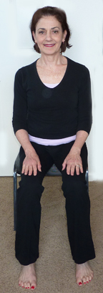
Chair Yoga
Begin by sitting on the edge of a chair with your feet placed squarely on the floor about hip distance apart, toes facing straight forward.
Place your palms flat on your thighs, and feel length in your spine—head balanced over heart, heart balanced over hips.
Inhale and exhale evenly for five counts each.
Repeat inhale/exhale 2 times.

Slide 10
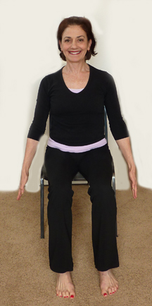
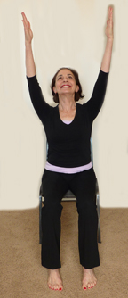
Seated Mountain Pose
Place both arms down by your side and as you inhale slowly for 4 counts reach arms out and up with palms facing up while lifting arms overhead
Exhale as you move arms down with palms facing towards the floor as you exhale for 4 counts.
Repeat 4 times

Slide 11
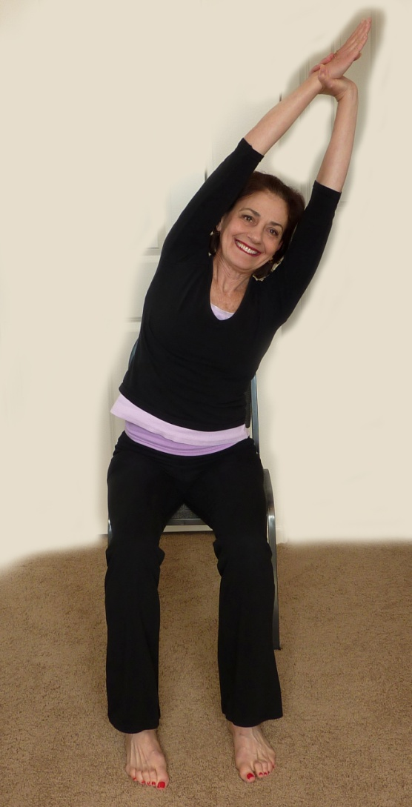
Seated Side Stretch
Inhale and lift your arms overhead, taking hold of your left wrist with your right hand.
As you exhale, bend to the right. Stay there for two breaths.
As you inhale, come back up to vertical and change wrists.
Exhale, and bend to the left. Stay there for two breaths.
Inhale back up to a tall spine.
Exhale, release your arms down to your side

Slide 12
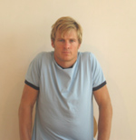
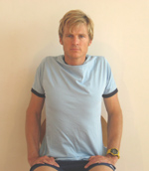
Shoulder Rolls and Stretch
Circle your shoulders by slowly rolling them up, back and down
On the fourth roll, interlace your fingers behind your back with your arms as straight as you are able to make them
If you don’t have room behind you, reach back and hold onto the outside edges of the back of your chair and stretch your shoulders and chest

Slide 13
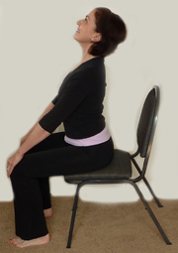
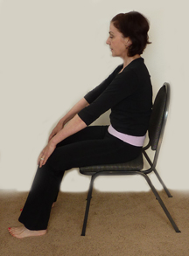
Seated Cat/Cow
Place hands on your knees. As you inhale, lift your chest, and arch the back
As you exhale, tuck your pelvis and pull your navel in toward the spine, round your spine back toward the back of the chair – keep your head in line with your spine – don’t drop the head.
As you move, inhale and exhale deeply and feel the broadness of the back of the body
Repeat 3 more times

Slide 14
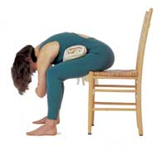
Seated Forward Bend
Move your feet out slightly wider than hip distance and
Engage your abdominal muscles as you begin to fold your upper body over your legs, letting your upper body fall through your thighs. You may be able to reach the floor with your palms flat
Otherwise, try to hold onto your ankles or shins - the goal is to let your head drop lower than your hips and relax the head and neck
You may grab onto your elbows or let your arms drop to the floor
Engage your abdominal muscles and slowly roll up and find length in your spine.

Slide 15
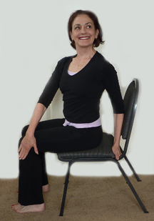
Seated Spinal Twist
Inhale. As you exhale, twist your upper body to the right, starting from the base of the spine. You can place your left hand on the outside of your right thigh and your right hand on the back of your chair.
As you look over your right shoulder, move your eyes to the upper right corner of your eyes and then the lower right corner. Repeat 2 X
Close your eyes as you untwist back to center
Repeat to the other side

Slide 16
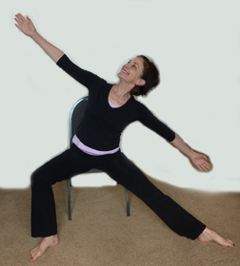
Seated Triangle Pose
Sit on the edge of your chair, keep the left leg bent and extend your right leg straight to the side, keeping both feet on the floor. Extend arms out to the side
Inhale deeply, lift your torso tall and as you exhale reach your torso up and out to the right side. When you cannot go any farther, allow the arms and body to windmill towards the floor – keep the arms outstretched
Take 2 deep breaths. On your next inhalation, reach your torso and arms out and up and come back to seated
Repeat to the left side

Slide 17
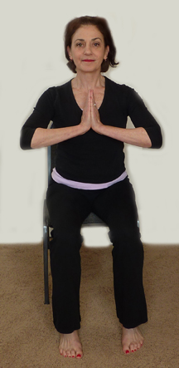
Namaste!
Bring your knees back to center, hip distance, sit up tall
Take 2 deep cleansing breaths as you raise your arms up overhead and back down
On the third breath, bring the palms of your hands together, with the thumbs touching your chest
Close your eyes and breath normally for a few seconds and you have completed your chair yoga break!

Slide 18

How to refer a Veteran to yoga in Palo Alto
Complete the WRIISC Yoga consult in CPRS
More information @ www.warrelatedillness.va.gov/paloalto

Slide 19
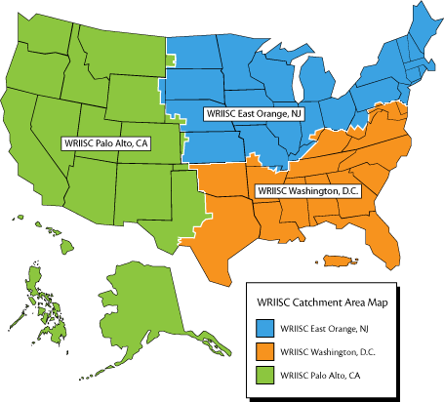
Contact Us
WRIISC Washington, DC
wriisc.dc@va.gov
1-800-722-8340
WRIISC East Orange, NJ
wriisc.nj@va.gov
1-800-248-8005
WRIISC Palo Alto, CA
wriisc.pa@va.gov
1-800-482-3297

