Slide 1
Sample and data overview
Samples
Ambient air and smoke samples containing microbes
Acquired using a drone with a pump to pull a certain volume of air onto a filter
Filters are stained and mounted to a slide for counting bacteria and fungi under a microscope
For this study, we have 8 smoke samples and 3 ambient samples
The ambient samples were taken before there was any smoke in the air
Cell data
40 random fields of view (FOVs) across the slide are counted
40 rows of counts per sample (11 samples * 40 = 440 rows)
Counts have FOVs with zeros and are generally right skewed
Staining process introduces varying amounts of contamination (extra microbes)
Lab blanks are stained to quantify this for respective batches of samples
Environmental data
For each sample, there is associated environmental data
Particulate matter, temperature, humidity, h20 mixing ratio (amount of water in air)

Slide 2
What initial models should address
Firstly, do smoke samples have significantly different numbers of cells than ambient
Smoke has a lot of variation between samples (e.g. some samples are very smokey, while others are not)
Can any of the environmental data help explain differences between the sample types (Ambient vs. Smoke)
Assuming a significant difference between ambient and smoke, use the model to determine an ambient value to subtract from the smoke values for “background correction” rather than using mean or median of ambient

Slide 3
Model Structure
Implemented a Tweedie distribution (family=tweedie(link="log")) to accommodate the continuous non-negative response variable with exact zeros
The Tweedie distribution seemed appropriate for lab-blank corrected counts that are no longer integers
Estimated dispersion parameter of 1.02 indicates a distribution closer to Poisson than Gamma
Utilized a generalized linear mixed model with the following components: Fixed effects: Sample Type, water mixing ratio, and their interaction
Random effect structure: (1|LB_Batch:Sample) to account for nested sampling design
This addresses non-independence of observations from 40 fields of view per sample
Implemented a zero-inflation model with Sample Type as predictor
Formula: ziformula = ~SampleType
This accommodates excess zeros beyond what the Tweedie distribution would predict
Log volume offset to standardize for different sample volumes
This converts the model to effectively predict concentration rather than absolute counts

Slide 4
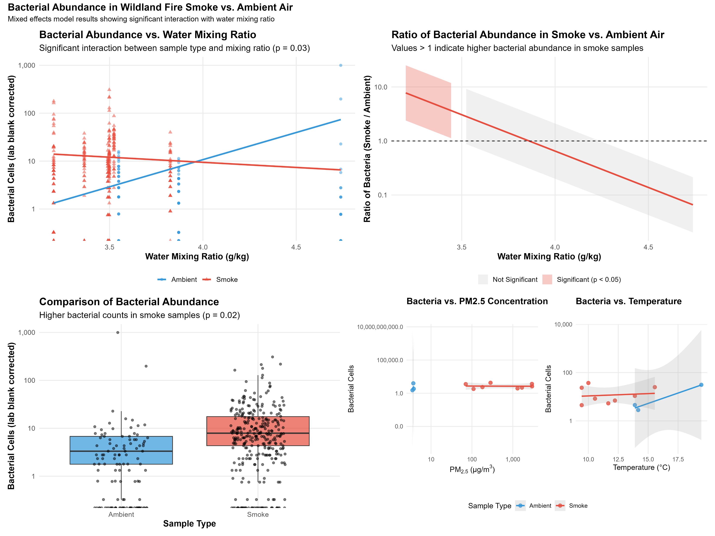

Slide 5
Results
AIC = 2941.4 and BIC = 2978.2
Log-likelihood = -1461.7
Random effect variance (0.3834) with standard deviation of 0.6192
Substantial sample-to-sample variability beyond fixed effects
Smoke: At very low mixing ratios, smoke samples have approximately 160,000 times higher bacterial counts than ambient samples!
In ambient air, each unit increase in water mixing ratio is associated with approximately 13.6 times higher bacterial counts
The effect of water mixing ratio is substantially different between smoke and ambient samples.
In smoke, the effect of increasing mixing ratio is much weaker and potentially even negative, about a 40% decrease in bacteria per unit increase in mixing ratio.
Smoke samples have significantly lower probability of excess zeros than ambient samples. This suggests more consistent presence of bacteria in smoke, with a reduction in the probability of zeros by approximately 73%

Slide 6
Results continued
At lower mixing ratios (3.20-3.36 g/kg), smoke samples have significantly higher bacterial counts than ambient samples (7.8x and 4.7x higher, respectively, p<0.05).
At moderate mixing ratios (3.50 g/kg), the difference becomes marginally significant (3.1x higher, p=0.06).
At higher mixing ratios (3.83-4.74 g/kg), the difference disappears or potentially reverses (ratios of 1.1x and 0.07x, p>0.05).
The bacterial enhancement in smoke is most pronounced in drier conditions and diminishes as humidity increases.

