Slide 1
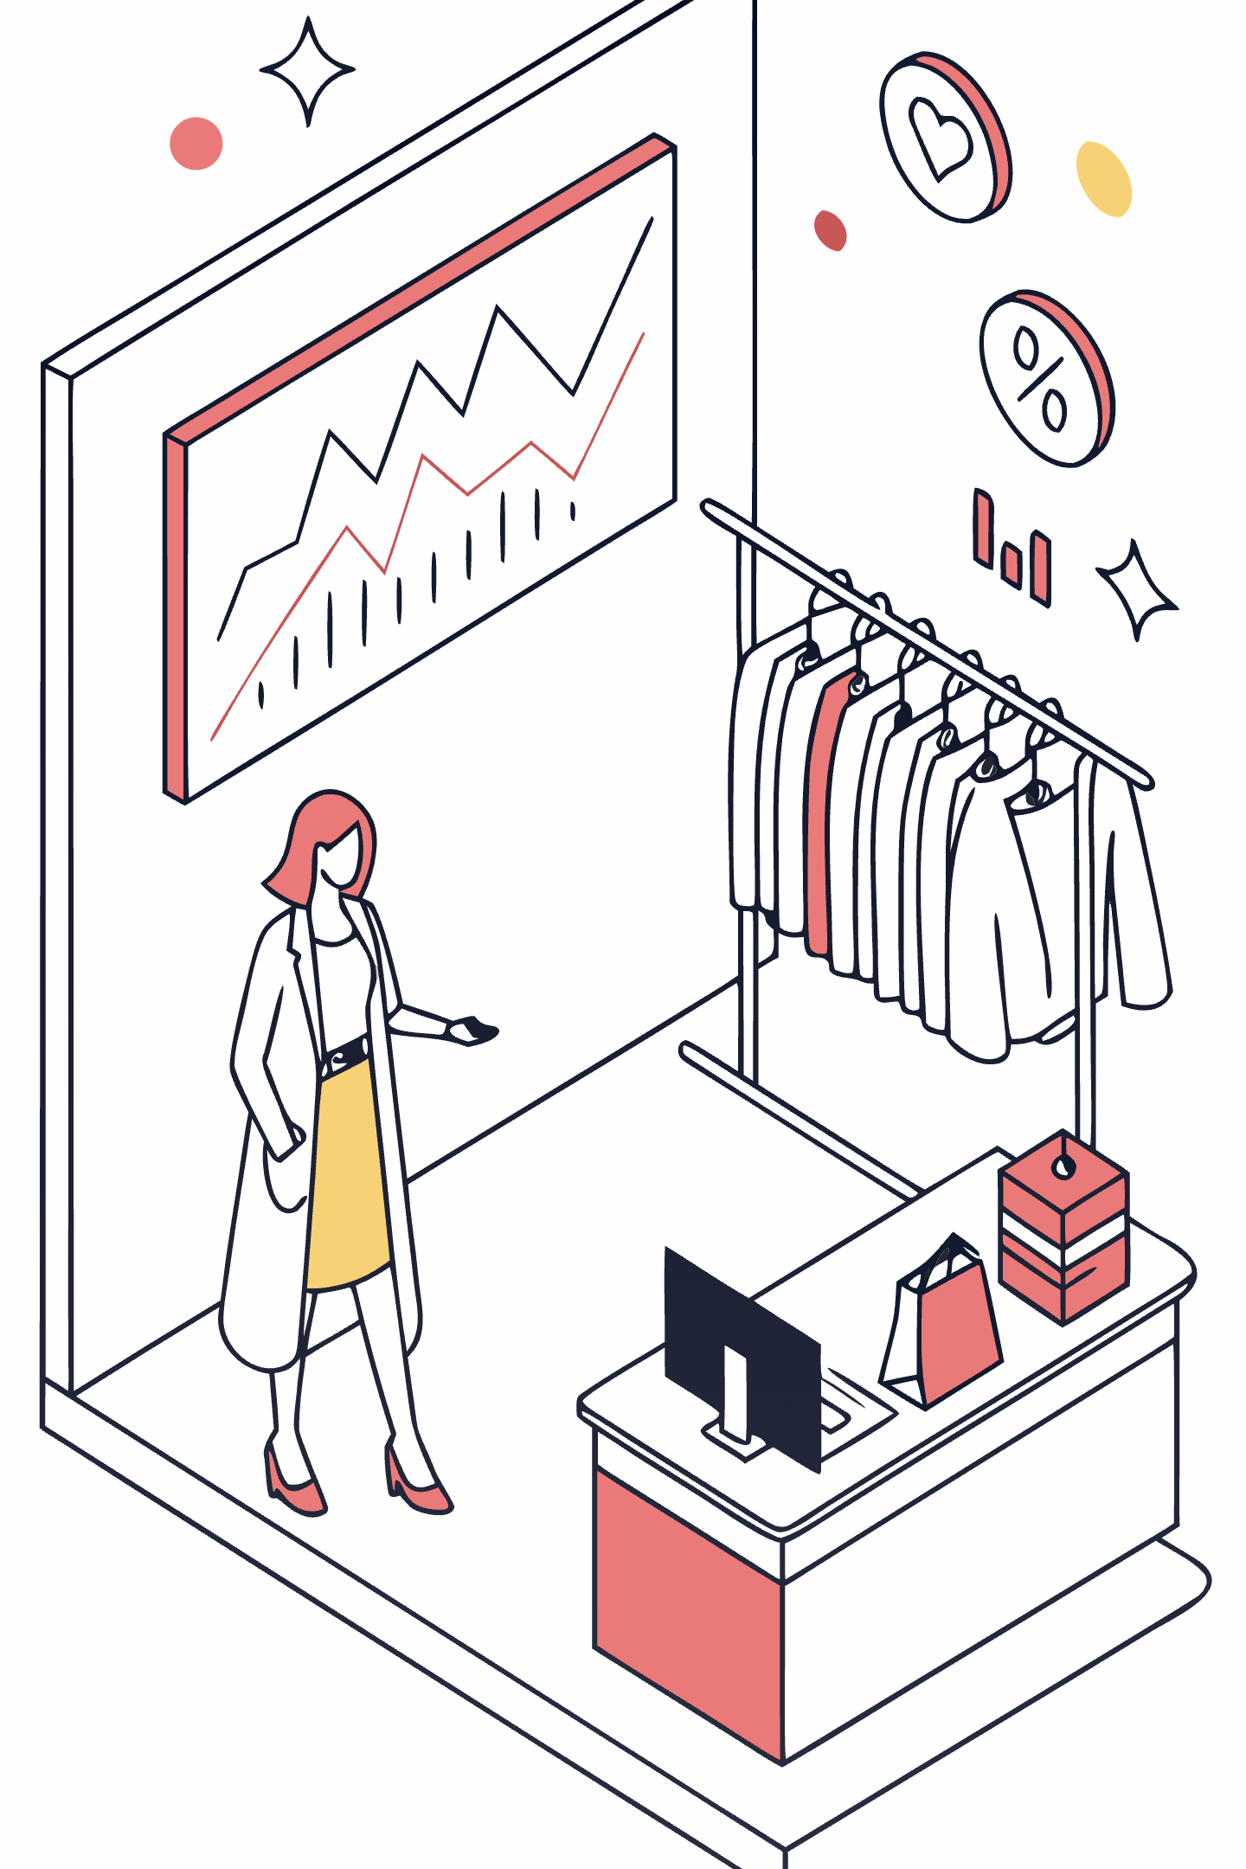
Why Women's Clothing is More Expensive
A Comprehensive Analysis of Economic Factors, Market Dynamics, and Pricing Strategies

Slide 2
Executive Summary
Women's clothing consistently commands higher prices than men's apparel across nearly all categories. This pricing disparity stems from a complex interplay of economic principles, market forces, and strategic business decisions rather than simple discrimination.
Economic Drivers
Market Dynamics
Marketing Impact
Higher willingness to pay, complex designs, and varied materials increase production costs and justify premium pricing
Seasonality, luxury positioning, and rapid trend cycles create opportunities for strategic price differentiation
Targeted campaigns emphasizing exclusivity, fashion innovation, and brand prestige support higher price points
This analysis examines the multifaceted reasons behind women's fashion pricing, drawing on economic research, industry data, and market trends to provide a comprehensive understanding of this persistent phenomenon.

Slide 3

Demand Elasticity and Consumer Willingness to Pay
Women's clothing markets demonstrate significantly higher variance in willingness to pay compared to men's apparel. This economic principle allows retailers to implement sophisticated pricing strategies that capture consumer surplus more effectively.
Firms capitalize on this variance by setting higher initial prices and dynamically adjusting based on real-time sales data and inventory levels. The result is a pricing structure that reflects not just production costs, but the perceived value consumers place on style, design complexity, and quality.
Research shows women prioritize fashion innovation, seasonal trends, and aesthetic diversity—factors that command premium pricing in competitive markets.

Slide 4
The Value of Differentiation and Design Complexity
Women's fashion features substantially more complex designs, varied styles, and diverse material selections compared to men's clothing. This complexity directly impacts production costs and retail pricing strategies.
Design Intricacy
Material Diversity
Style Variation
Multiple cuts, silhouettes, and construction techniques require specialized labor and longer production times
From silk and chiffon to technical fabrics, women's clothing utilizes a broader range of materials with varying cost structures
Seasonal collections feature hundreds of unique styles, each requiring separate design, production, and inventory management
Marketing campaigns amplify these differences by emphasizing luxury, exclusivity, and trend leadership. Branding strategies position women's fashion as investment pieces rather than utilitarian purchases, fundamentally increasing perceived value and justifying premium price points.

Slide 5
Consumer Perceptions and the Fairness Question
The Pink Tax Debate
42%
67%
Gender-based pricing—often called the "pink tax"—generates significant consumer criticism and affects purchasing behavior. Studies show women increasingly recognize pricing disparities and view them as unfair, impacting brand loyalty and purchase decisions.
Consumers Aware
Perceive Unfairness
Percentage of women who recognize gender-based pricing in apparel
Women who view pricing disparities as unjustified
However, firms must balance consumer willingness to pay against perceptions of fairness. Some retailers have begun addressing these concerns through transparent pricing, while others continue traditional strategies, betting that fashion value outweighs fairness concerns.
28%
Changed Behavior
Shoppers who've switched brands due to pricing concerns
The tension between economic optimization and consumer fairness remains a defining challenge for the women's fashion industry in 2025.

Slide 6




Marketing Costs and Societal Pressures
Marketing Investment
Women's fashion brands allocate significantly higher budgets to advertising, social media campaigns, and influencer partnerships compared to men's brands
Societal Expectations
Cultural norms create pressure for women to maintain diverse wardrobes and follow seasonal trends, driving demand for premium products
Regulatory Environment
Current frameworks permit gender-based pricing, allowing market forces rather than regulations to determine price structures
These interconnected factors create a self-reinforcing cycle where higher marketing costs justify premium pricing, which funds additional marketing investments, perpetuating the price differential between women's and men's fashion.

Slide 7

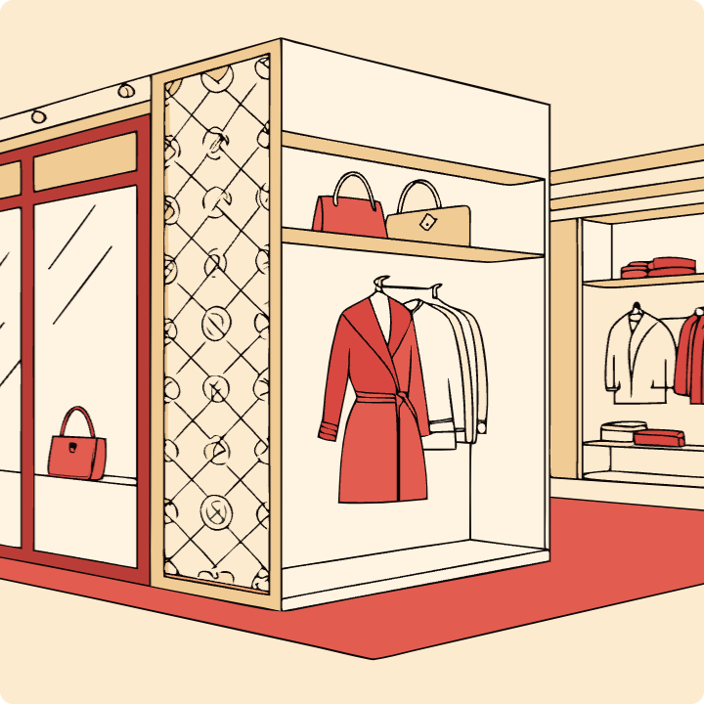

Fashion Industry Trends Shaping 2025 Pricing
The women's fashion market in 2025 faces unprecedented complexity driven by economic volatility, technological disruption, and shifting consumer expectations. These forces fundamentally reshape pricing strategies and market positioning.
AI Integration
Luxury Positioning
Economic Impact
Artificial intelligence drives personalization, inventory optimization, and dynamic pricing algorithms
US market investments in premium segments increase, pushing average price points higher
Tariff changes and economic volatility create pricing pressure and supply chain challenges
According to McKinsey's State of Fashion 2025 report, these trends converge to create an environment where premium positioning becomes increasingly important for brand differentiation and margin protection.

Slide 8
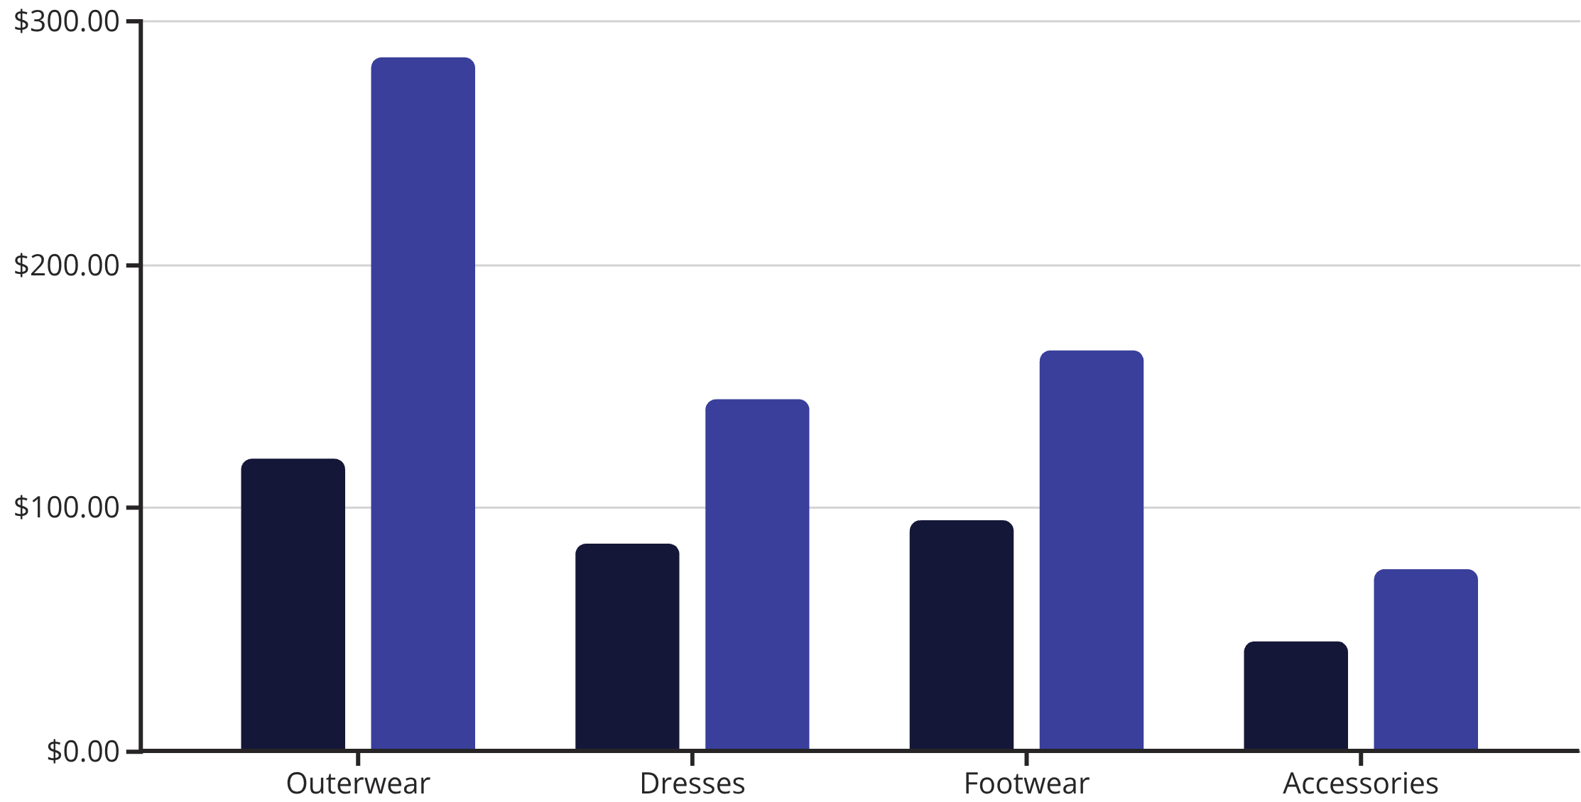
Seasonal Pricing Dynamics in Women's Fashion
Seasonality represents one of the most significant drivers of price variation in women's clothing. The stark differences between winter and summer collections reflect material costs, design complexity, and consumer demand patterns.
Summer Price
Winter Price
Winter apparel commands approximately 50% higher prices than summer items, driven by heavier materials like wool and synthetic insulation versus lightweight cotton and silk. The holiday shopping season generates up to 60% of annual online sales, creating additional pricing leverage for retailers during peak winter months.

Slide 9

Strategic Pricing Models in Women's Fashion
Retailers employ three primary wholesale pricing strategies, each designed to maximize margins while responding to different market segments and competitive pressures. The choice of strategy significantly impacts final consumer prices and brand positioning.
01
Cost-Plus Pricing
In 2025, value-based pricing dominates the luxury segment, where perceived exclusivity justifies substantial premiums. Meanwhile, fast fashion brands rely on cost-plus models to maintain aggressive pricing while preserving margins on high-volume sales.
Standard markup on production costs, common in mid-market segments
02
Value-Based Pricing
Premium positioning focused on perceived luxury and exclusivity
03
Competitor-Based Pricing
Market matching strategies that respond to rival pricing moves

Slide 10

Marketing Innovation Driving Premium Positioning
Contemporary marketing strategies in women's fashion leverage cutting-edge technology and social platforms to create compelling narratives that justify premium pricing. These innovations fundamentally reshape how brands connect with consumers and establish value propositions.
AI-Driven Personalization
Creator-Led Storytelling
Social Commerce Integration
Machine learning algorithms analyze individual preferences, purchase history, and browsing behavior to deliver tailored product recommendations and dynamic pricing that maximizes conversion rates
Influencer partnerships and user-generated content create authentic brand narratives that resonate with target audiences, building emotional connections that transcend price sensitivity
Direct purchasing through Instagram, TikTok, and Pinterest reduces friction in the customer journey while enabling brands to capture impulse purchases at full price points
These marketing investments significantly increase operational costs but generate returns through higher average transaction values and reduced price sensitivity among engaged consumers.

Slide 11
Gender Comparison: Men's vs. Women's Fashion Economics
The stark contrast between men's and women's fashion markets illuminates why pricing disparities persist. Men's fashion operates under fundamentally different economic principles that limit both variety and pricing complexity.
Lower Average Spending
Men allocate significantly less of their discretionary income to clothing purchases, creating downward pressure on retail prices and limiting premium positioning opportunities
Reduced Style Variation
Men's collections feature fewer silhouettes, colors, and seasonal changes, resulting in lower design costs and more efficient production processes
Practical Focus
Consumer preferences emphasize durability and functionality over fashion innovation, driving competition on price rather than design differentiation
Muted Seasonal Impact
Men's fashion experiences less pronounced price spikes between seasons, with winter and summer items showing only 20-30% variation compared to 50% for women

Slide 12

Key Insights and Market Implications
Understanding the pricing dynamics in women's fashion requires recognizing the complex interplay between economic forces, consumer behavior, and strategic business decisions. These insights shape industry practices and inform future policy discussions.
1
Market-Driven, Not Discriminatory
The "pink tax" emerges primarily from market dynamics—higher willingness to pay, design complexity, and differentiated consumer preferences—rather than arbitrary discrimination
2
Design Complexity Increases Costs
Greater variety in styles, materials, and construction techniques directly impacts production expenses, justifying higher baseline prices for women's apparel
3
Marketing Justifies Premiums
Strategic branding and positioning campaigns create perceived value that supports luxury pricing, with marketing investments representing significant operational costs
4
Seasonality Amplifies Variation
Winter collections command 50% price premiums over summer items due to material costs and holiday shopping dynamics
5
Awareness Without Action
While consumer awareness of pricing disparities grows, industry practices remain largely unchanged as fashion value continues to outweigh fairness concerns for most shoppers
Sources: Economic Forces, U.S. Government Accountability Office, McKinsey State of Fashion 2025, BlackCurve Pricing Research, Seth Society, JOOR Market Analysis, Bureau of Labor Statistics, University of Mannheim Consumer Research

