Slide 1
A-Alpha Bio Homework
Mark Thompson
Submitted in partial fulfillment for Data Scientist application
Assignment:
Design and train one or more regressor models to fit experimental binding affinities between Pembrolizumab single-chain variable fragments (scFv) variants and PD-1 cell-surface receptor. The scFv fragments are amino acid sequences of 246 residues with double point mutations.
This is a sequence-to-affinity regression problem. Without any 3D structural information, the model should fit the 1D sequence data to the experimental affinities.
The trained model is then used to predict binding affinities on a hold-out set of scFv fragments.

Slide 2
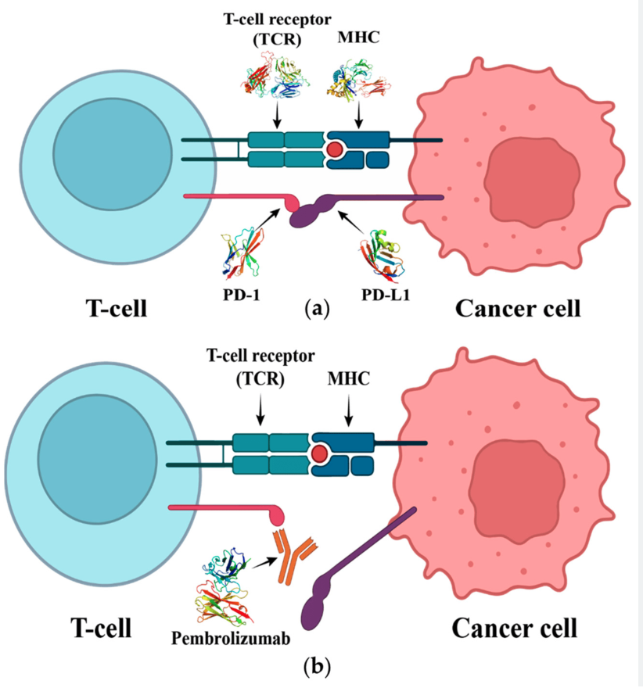
Background on the dataset
Pembrolizumab: A humanized monoclonal (Ig) G4 antibody directed against human cell surface receptor PD-1 (programmed death-1 or programmed cell death-1). Pembrolizumab targets and blocks a protein called PD-1 on the surface of T cells. Blocking PD-1 triggers the T cells to find and kill cancer cells.
It is sold under the brand name Keytruda, is a cancer immunotherapy that treats melanoma, lung cancer, head and neck cancer, Hodgkin lymphoma, stomach cancer, cervical cancer, and certain types of breast cancer.
Figure 1. (a) The interaction of T cell receptor (TCR) with the major histocompatibility complex (MHC). It initiates T cell activation, and the interaction of PD-1 with PD-L1 will lead to the inhibition of T cell. (b) Pembrolizumab blocks the connection between PD-1 and PD-L1, thus preventing T cell inhibition and restoring its activity.
scFv fragments:
https://en.wikipedia.org/wiki/Single-chain_variable_fragment
https://www.cancer.gov/publications/dictionaries/cancer-drug/def/pembrolizumab
https://www.mdpi.com/1422-0067/24/13/10684

Slide 3
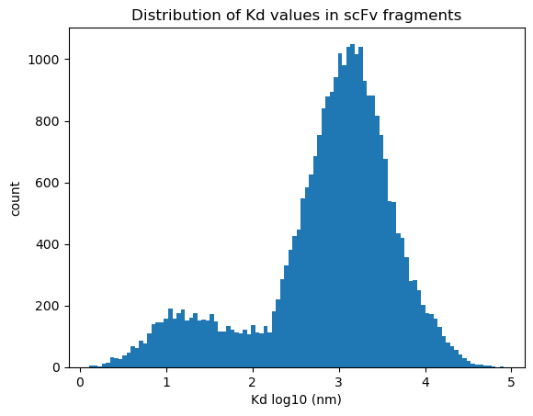
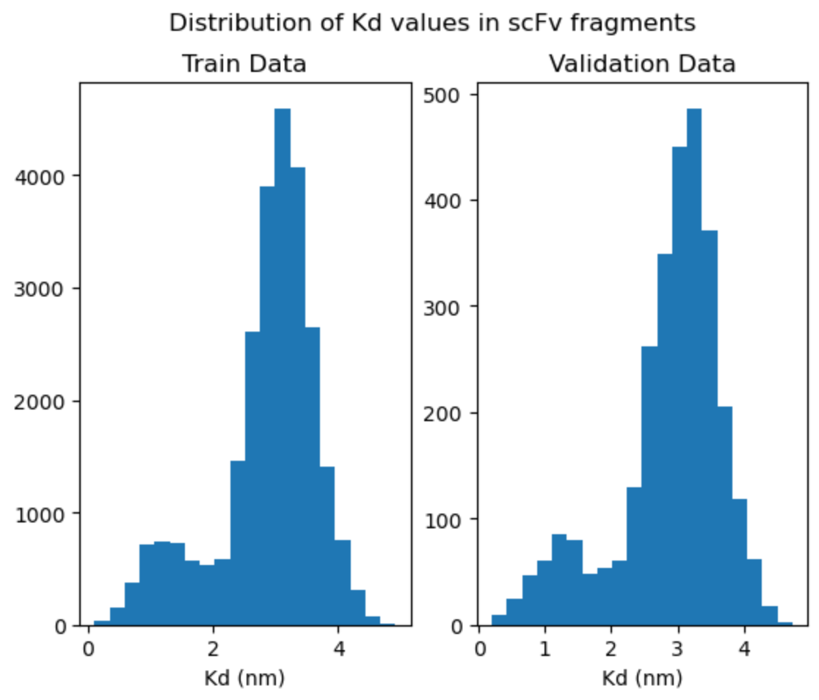
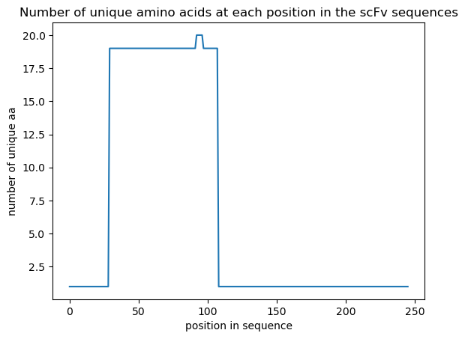
Data set analysis – part 1
alphaseq_data_train.csv
29199 unique aa sequences
For duplicate entries use the mean of their Kd values
remove all entries with NANs for Kd
all sequences are same length: 246 residues
plot distribution of Kd values
interesting bimodal distribution
diff between the two peaks is ~0.25 kcal/mol ΔG
plot the variability at each residue position in the sequence over all sequences
79 residue region (position 29 to 108) has all the mutations
this is likely a CDR region
bimodal-like distribution is similar to that reported in the Nature paper

Slide 4
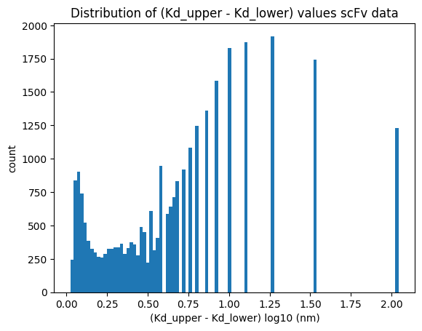
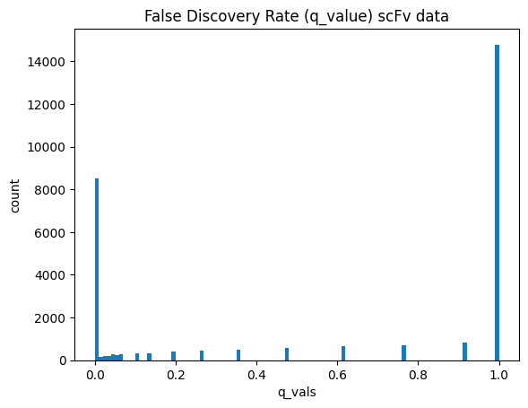
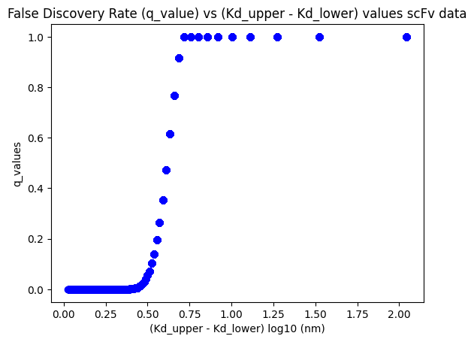
Data set analysis – part 2
ΔKd
q_values
ΔKd vs q_value
Not surprising that larger ΔKd correlate with larger q_values
Data in this region should be considered for removal

Slide 5
Training Datasets : three versions
Clean-1
remove NANs, duplicates, and use mean Kd for duplicates
keep all rows (29199 rows)
80/10/10 split train (23359 rows), val (2920 rows), test (2920)
Clean-4
remove NANs, duplicates, and use mean Kd for duplicates
keep only rows with q_values < 0.50 (12320 rows)
80/10/10 split: train(9856), val (1232), test(1232)
Clean-3b
remove NANs, duplicates, and use mean Kd for duplicates
keep only rows with q_value < 0.05 (9302 rows)
85 / 7.5 / 7.5 split: train(7862), val (694), test(694)

Slide 6
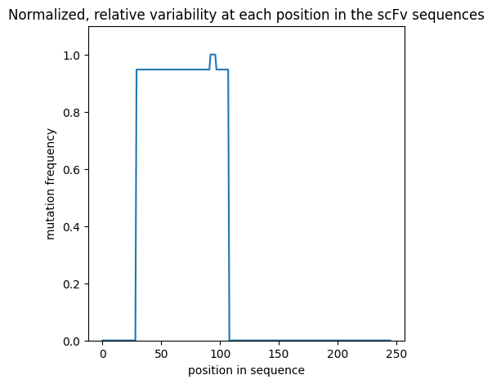
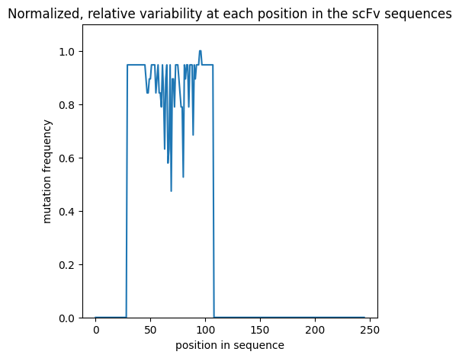
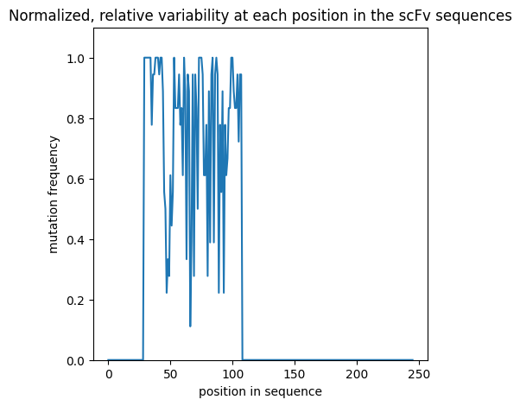
Training Datasets
Relative variability of sequence data by position
Clean-1 dataset
Clean-4 dataset
Clean-3 dataset

Slide 7
Data set analysis – Sequence Length Distributions
Sequence Length | Number of sequences
 | Holdout Set | Training Set (clean-1)
245 | 301 | 0
246 | 24112 | 29199
247 | 5658 | 0
Train the models using a block_length = 247 to accommodate the longest length in the holdout set
(Exception : Visual Transformer model; clips the last 5 residues in training set to better fit the 2D image format)
Pad the end of sequences shorter than 247 with ‘PAD’ token where necessary

Slide 8
Training Datasets
Clean-3b dataset is small with increased risk of overfitting
Regularization/augmentation techniques at sequence level
replace aa residue(s) with MASK token (like a dropout); (note this is not MLM as done in BERT)
randomly choose Kd values over range [Kd_lower_bound, Kd_upper_bound]
I did not have time to try this
flip the aa-sequence back-to-front
this probably breaks the transformer position embedding (is fine for MLP though)
roll the aa-sequence either direction a random number of residues
this probably breaks the transformer position embedding (is fine for MLP though)
And of course, use the use standard dropout in the model for weights, embeddings, etc
Checkpoints saved based on best val loss
Early stopping where noted

Slide 9
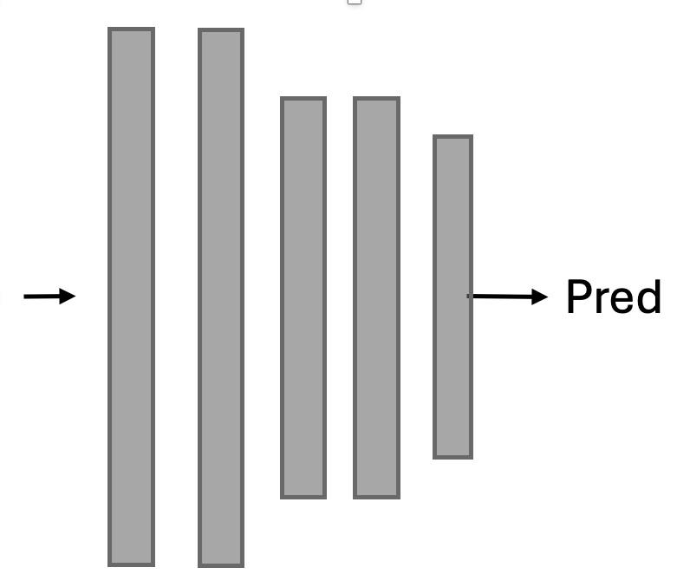
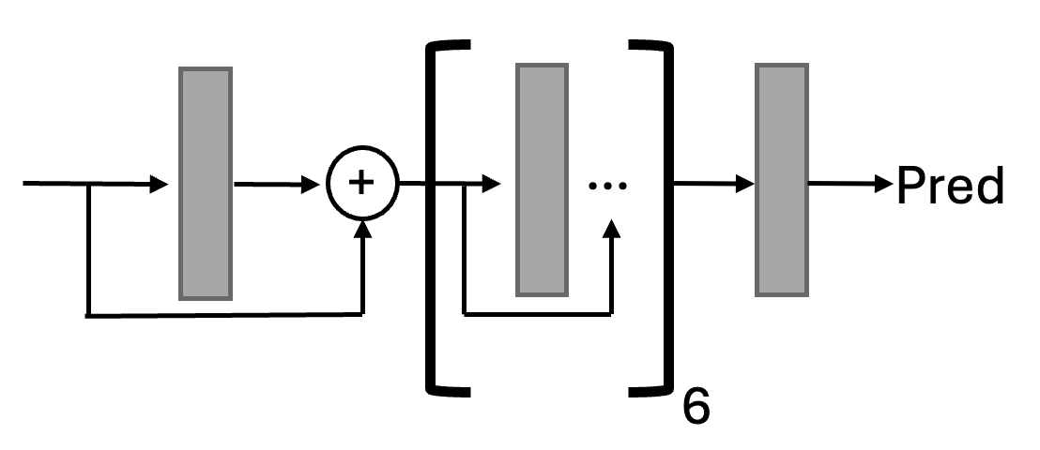
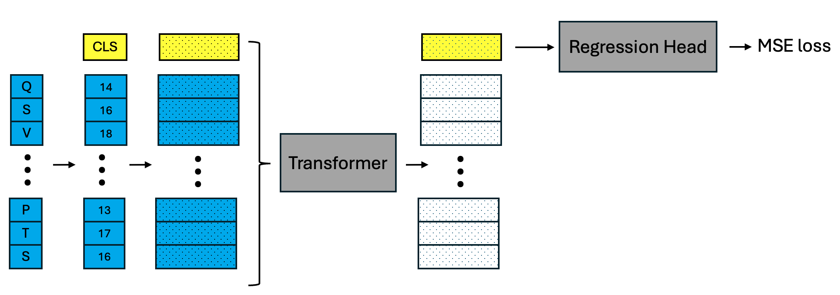
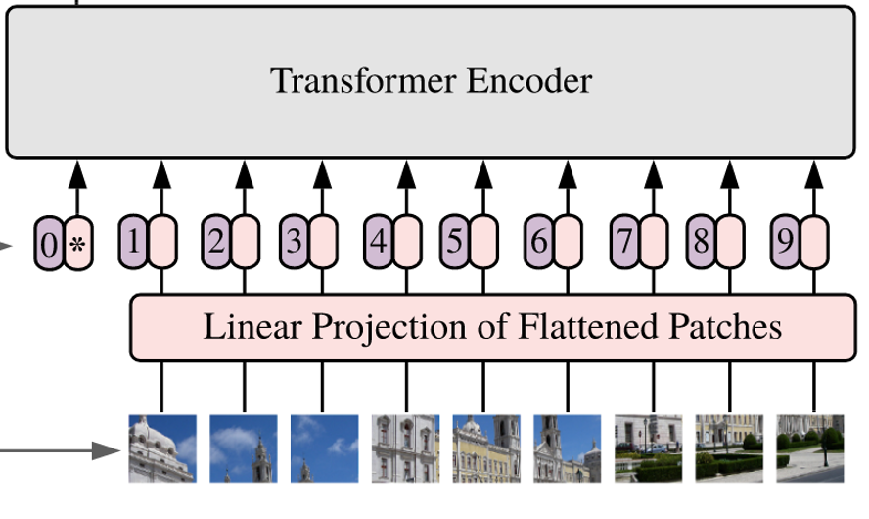
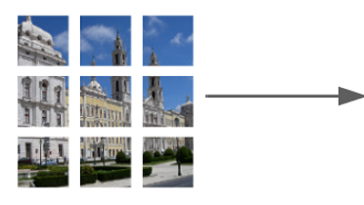
Model architectures examined in this study
MLP
Residual MLP (as a regression head)
Regression Head
MSE loss
Vision Transformer
with residual-MLP regression head
Transformer
with residual-MLP regression head

Slide 10
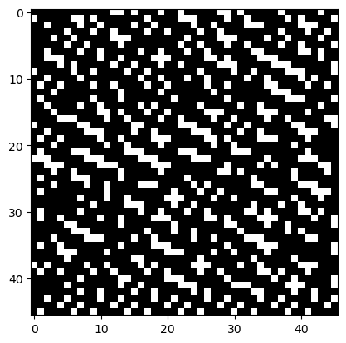
Vision Transformer: 1-channel image
aa sequence: ['CLS', 'Q', 'V', 'Q', 'L', 'V', ‘Q]
(use block_size = 242 (drop the last 4 residues)
encoded: [ 0, 14, 18, 14, 10, 18, 14]
binary: [00000000000011010001001000…] (using 8-bits per token)
reshape: (1,44,44)

Slide 11
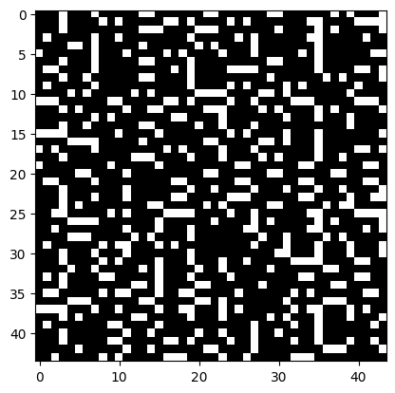
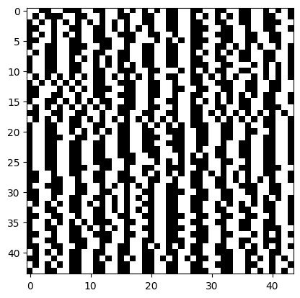
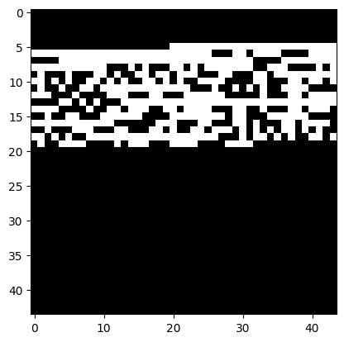
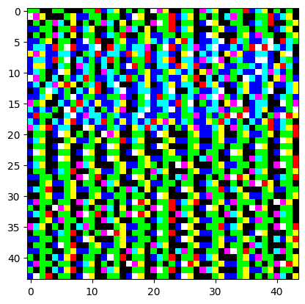
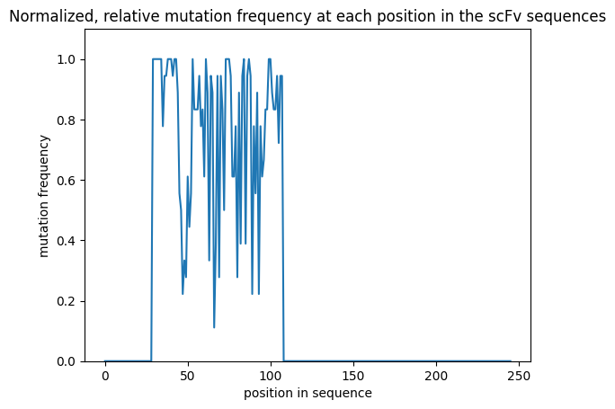
Vision Transformer: 3-channel image
channel 1
encoded residues
channel 2
aa groups
polar
non-polar
neg chg
pos chg
channel 3
mutation freq*
* relative variability by position over the entire dataset

Slide 12
Settings for models and training
Simple MLP
Vision Transformer (VIT)
Transformer
8 layers
input/output size : 247
dropout : 0.25
vocab size: 24
regularize sequences
flip prob: 0.2
mask prob: 0.1
block size: 242
img size: (1,42,42)
emb_dim: 256
patch_dim: 4
heads: 8
head size: 64
layers: 6
vocab size: 24
dropout
emb: 0.15
tform: 0.15
mlp: 0.3
regularize sequences
flip prob: 0.0
mask prob: 0.05
block size: 247
emb_dim: 256
heads: 8
head size: 64
layers: 6
vocab size: 24
dropouts
emb: 0.15
tform: 0.15
mlp: 0.3
regularize sequences
flip prob: 0.0
mask prob: 0.05
Misc:
VIT & TForm models: due to resource constraints, I could not explore larger attention heads (emb, heads, layers)
AdamW and exponential learning rate decay in all cases
Initial learning rate 0.001
Loss: MSE
VIT blocksize: I cut off the last 4 aa residues to better accommodate the dimensions needed for the VIT image patches

Slide 13
Results: Dataset Clean-3b
metrics calculated on the test set
Model | Train loss | Val loss | Epochs | Test set |  |  |  |  | Comment
 |  |  |  | MAE | MSE | MAPE ¹ | PPE10 ² | PPE20 ³
MLP | 0.37 | 0.41 | 3787 | 0.52 | 0.39 | 0.33 | 21 | 42
VIT | 0.14 | 0.17 | 500 | 0.29 | 0.16 | 0.17 | 48 | 70 | 1-channel
VIT | 0.10 | 0.13 | 500 | 0.27 | 0.16 | 0.16 | 50 | 74 | 3-channel
*Transformer | 0.02 | 0.12 | 183 | 0.28 | 0.15 | 0.17 | 49 | 71
* best performing model based on MSE
MAPE : mean absolute percentage error : mean(abs(actual-pred)/actual). Lower is better
PPE10 : percentage of time prediction is within 10% of ground truth. Higher is better
PPE20 : percentage of time prediction is within 20% of ground truth. Higher is better

Slide 14
Results: Transformer trained/tested on different datasets
model trained on each dataset
metrics calculated on that dataset’s test subset
Dataset | q_value cutoff ¹ | data set size | Train loss | Val loss | Epochs ² | Test set |  |  |  |  | Comment
 |  |  |  |  |  | MAE | MSE | MAPE | PPE10 | PPE20
Clean-3b | 0.05 | 9302 | 0.02 | 0.12 | 183 | 0.28 | 0.15 | 0.17 | 49 | 71
* Clean-4 | 0.5 | 12320 | 0.05 | 0.11 | 316 | 0.26 | 0.13 | 0.15 | 54 | 80
Clean-1 | 1.0 | 29199 | 0.16 | 0.13 | 86 | 0.30 | 0.15 | 0.12 | 54 | 85 | shows some overfitting
* best performing dataset (based on val loss and test set MSE value)
only data with q_value less than this value included in dataset
epochs value is from the best val loss checkpoint. Typically, the training jobs was set to run either 500 or 1000 epochs
It’s noted in the Table-Transformer literature that the transformer architecture can be surprisingly robust to “dirty” data

Slide 15
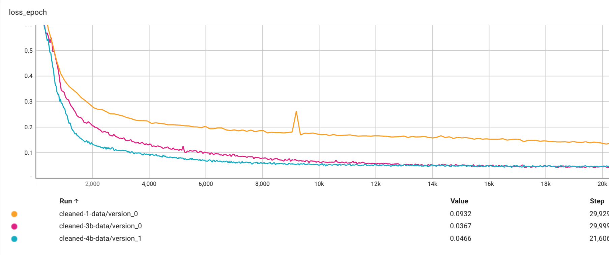
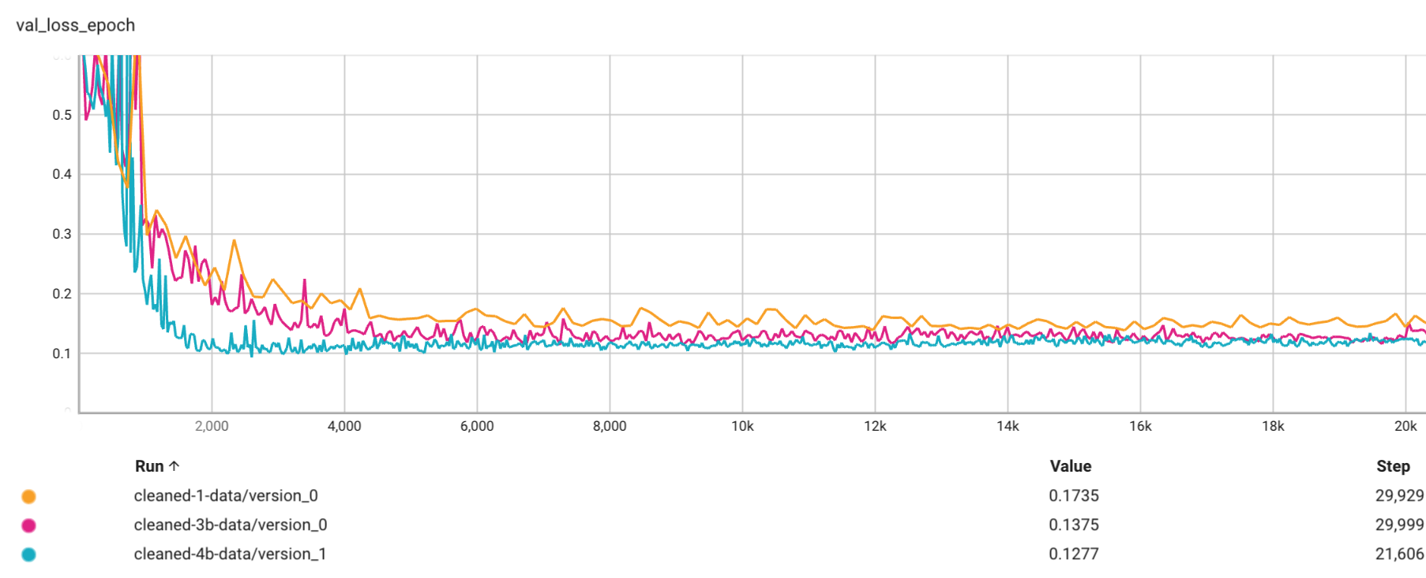
Loss Curves
Training
Transformer model
Clean-1, Clean-4, and Clean-3b datasets
Show the first 20K batches
Validation

Slide 16
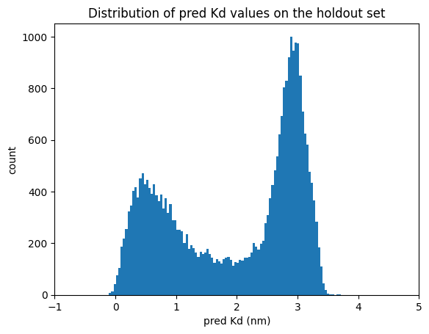
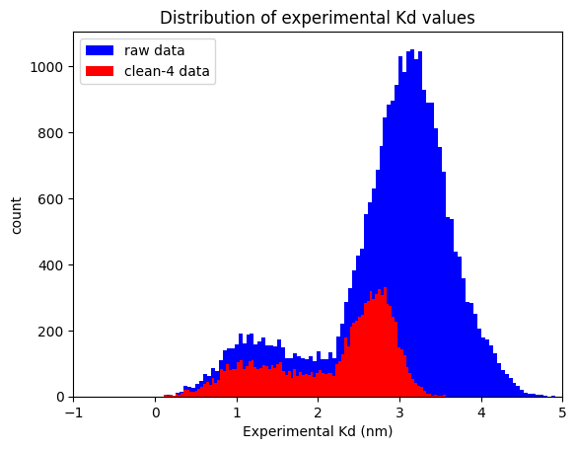
Transformer model holdout set predictions
trained on clean-4 dataset
Holdout set
Comparing Kd distributions holdout-preds vs. raw training and clean-4 data:
holdout preds resemble overall shape of clean-4 data (less so the raw data)
most of the high-q_value data that was culled is in the higher-end of the Kd range
the low-Kd part of the holdout distribution skews more strongly towards 0, relative to experimental results

Slide 17
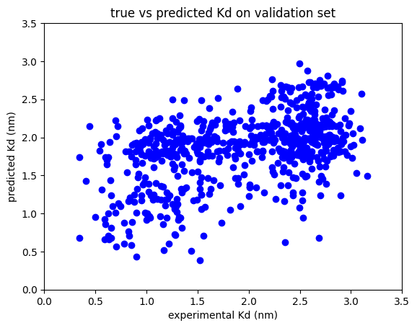
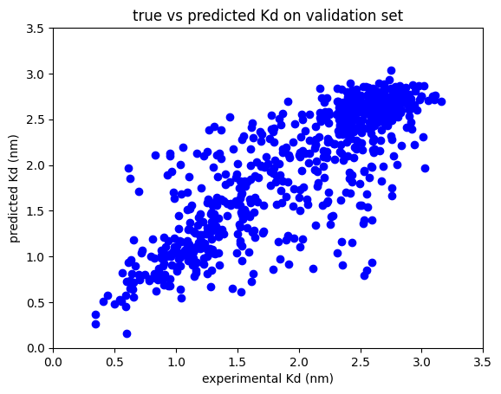
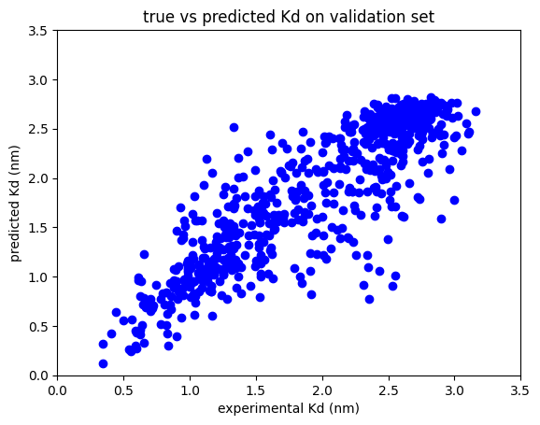
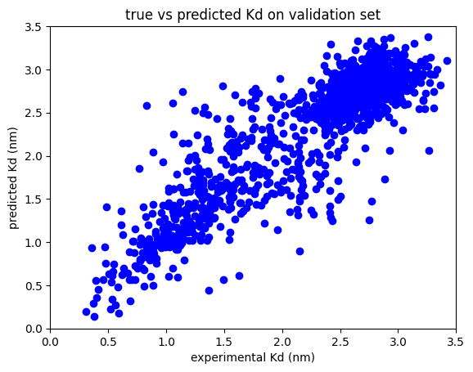
Plots experiment vs predicted on test set :
MLP
VIT 1-channel
VIT 3-channel
Transformer
Clean-3b dataset
Clean-3b dataset
Clean-3b dataset
Clean-4 dataset
clustering about the x=y line is tighter for models that performed better

Slide 18
Conclusions
MLP models do not explicitly treat relationships between different elements in a sequence. For sequence-to-affinity regression problem, MLP performed the poorest
Transformer-based models explicitly treat these interactions via the self-attention mechanism and this proves advantageous in this study
also, these converge faster than the MLP models I tried.
Vision transformer on this data proved surprisingly effective
3-channel approach did slightly better than 1-channel.
CAVEAT: In hindsight, I could simply have encoded/embed the same data from channels 2,3 into the linear Transformer model as well; which is probably more straightforward. (So, using VIT probably not as clever as I originally thought)
May 9: See addendum (next couple slides)

Slide 19
Addendum (submitted May 9)
I have incorporated two additional embeddings into the transformer model:
aa-groups (polar, nonpolar, neg chg, pos chg, none)
sequence position variability over the dataset
This newer model version is ”tform_mlp_v2”

Slide 20
Results: compare Transformer versions
Model | Train loss | Val loss | Epochs | Test set |  |  |  |  | Comment
 |  |  |  | MAE | MSE | MAPE ² | PPE10 ³ | PPE20 ⁴
Transformer v1 | 0.09 | 0.10 | 135 | 0.24 | 0.11 | 0.13 | 57 | 80 | clean-4 dataset
Transformer v2 ¹ | 0.05 | 0.10 | 312 | 0.24 | 0.11 | 0.13 | 57 | 82 | clean-4b dataset
Essentially no change in performance metrics between the two versions
Amino acid group and sequence position variability features added to the embeddings
MAPE : mean absolute percentage error : mean(abs(actual-pred)/actual). Lower is better
PPE10 : percentage of time prediction is within 10% of ground truth. Higher is better
PPE20 : percentage of time prediction is within 20% of ground truth. Higher is better

Slide 21
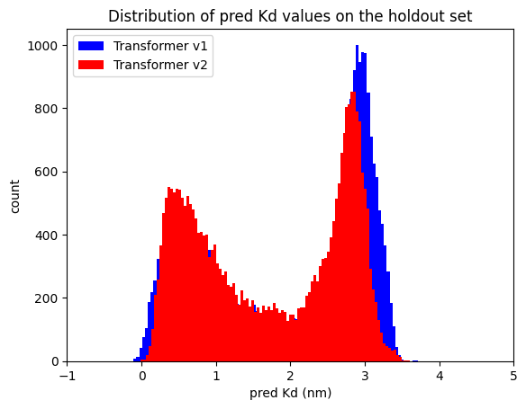
Results: compare Transformer versions
Transformer v2 shows small change in distribution of predicted Kd values

Slide 22
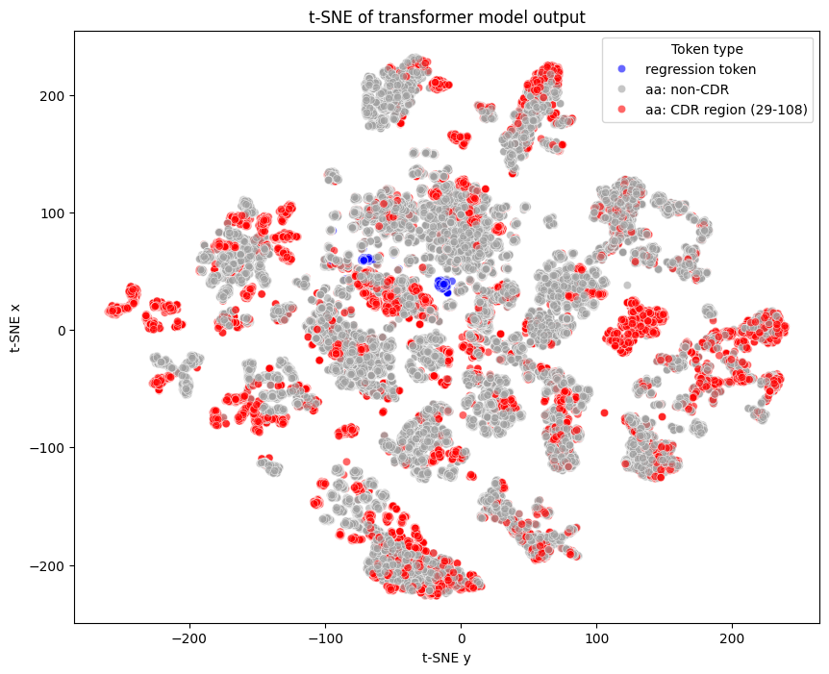
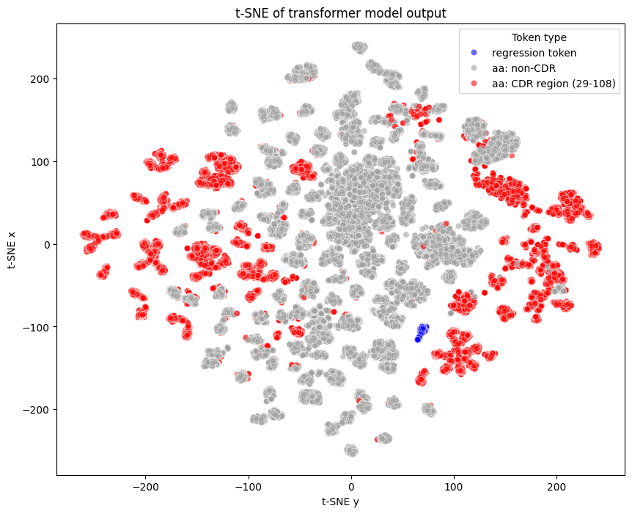
Dimensionality Reduction using t-SNE
The t-SNE algorithm reduces each embedding to a 2D point in the t-SNE plot.
Semantically similar classes are close with each other and should form clusters in the embedding space.
Transformer V2 shows increased clustering of the CDR residues (red) and separation from non-CDR (gray) (aka conserved) residues.
The regression token (blue) mostly clusters with itself (as expected)
Transformer v1
Transformer v2
both used a batch of 160 sequences

Slide 23
Addendum conclusions & notes
The performance metrics are virtually identical between Transformer versions v1 & v2
Inference results are moderately changed in v2
The position variability embedding is almost certainly the reason that the v2 model clusters the CDR from non-CDR residues under dimensionality reduction
I have begun to examine the output of the final attention block tensor (softmax((Q*K^{T})/sqrt(d)) to see how the attention values compare to tSNE results (data not included). This is pretty easy using forward hooks in pytorch
Updated results added to folder “Addendum_May9”
Addendum_May9 folder contains:
scFv_dataset_v2.py
tform_mlp_v2.py
test_tform_mlp_v2.py (trivial change from the v1 file)
inference_tform_mlp_v2.py (trivial change from the v1 file)
tform_mlp_params.yaml
preds_tform_mlp_1715280172.2843447.csv
The code base has been refactored since my initial submission.
I am happy to resubmit the complete new codebase (including the above _v2 changes in their proper places) if requested

Slide 24
Appendix 1: BERT
This was too ambitious to complete for this assignment
Below, I outline some of the preliminary work I did

Slide 25
BERT Stuff: Relevant literature, code, and data
Note: I did most of the BERT coding/testing in the 2 weeks before my call with Adrian (i.e. before getting the homework problem)
BERT : https://aclanthology.org/N19-1423.pdf
ProteinBERT : https://doi.org/10.1093/bioinformatics/btac020
Code partially taken from:
Barney Hill : https://github.com/barneyhill/minBERT
Andrej Karpathy: https://github.com/karpathy/minGPT
my Table Transformer code (from real-estate automated valuation model development)
A-Alpha Bio:
Nature Comm: http://biorxiv.org/lookup/doi/10.1101/2022.10.07.502662
Nature: https://www.nature.com/articles/s41597-022-01779-4
scFv Datasets: https://github.com/mit-ll/AlphaSeq_Antibody_Dataset.git
Observed Antibody Space :
https://doi.org/10.4049/jimmunol.1800708
https://opig.stats.ox.ac.uk/webapps/oas/
My Github repo for this homework’s code: https://github.com/planaria158/BERT.git

Slide 26
BERT pre-train dataset: OAS (Observed Antibody Space) database
Pretrain (masked language model) with:
Human, SARS-COV-2, light chain, unpaired
175 datafiles
Plan
focus on just sequence_alignment_aa column (not germline)
eliminate duplicates
ignore the separate v, d, and j (they are already in the light chain)
ignore fwr1, fwr2, fwr3, fwr4 regions (on the heavy chain?)
ignore CDR sequences (they are already contained in the longer light-chain sequences)
Result of data extraction
total rows 20306305, num unique, len(seqs): 18061315
range in length from min_len: 43 , max_len: 132
https://opig.stats.ox.ac.uk/webapps/oas/

Slide 27
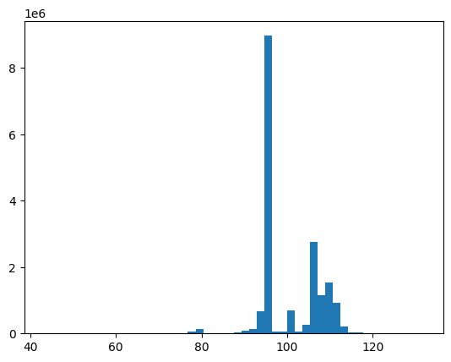
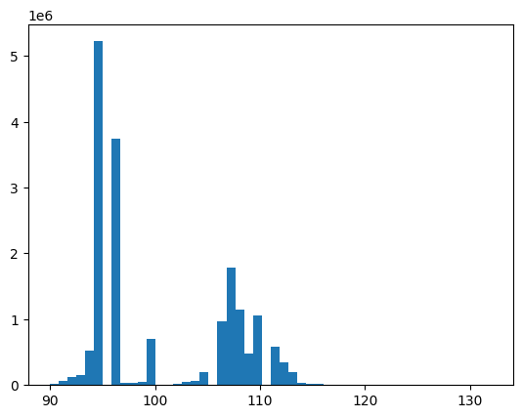
OAS dataset: distribution of peptide lengths
18061315 sequences
17599987 sequences
remove all seqs < 90 length
sequence length
sequence length
Final dataset:
17599987 unique sequences between 90 – 132 length
train: 14079989
test: 3519998

Slide 28
BERT
pre-train in masked-language mode, OAS light-chain dataset
CLS
0
0
0
Q
14
14 ?
0
S
Mask
16 ?
16
V
18
Transformer
18 ?
0
…
…
…
…
Linear
…
…
CE loss
P
Mask
13 ?
13
T
17
17 ?
0
S
16
16 ?
0
Contexts
Logits
Mask
CLS + aa residues
Encodings (masked)
Embeddings
(separate mask created during encoding
and also passed into transformer)

Slide 29
BERT
fine-tune on scFv library with binding affinities. Create sequence to affinity model
CLS
0
Regression Head
(e.g. mlp)
MSE loss
Q
14
S
16
binding energy (nm)
V
18
Transformer
…
…
…
…
ignore
P
13
T
17
S
16
Encodings
Contexts
CLS + scFv aa
Embeddings
freeze some or all of the layers

Slide 30
Settings for BERT that I tried on the homework data
BERT pre-train
BERT fine-tune
block size: 248
emb_dim: 192
heads: 8
layers: 6
mask prob: 0.15
vocab size: 25
dropouts
emb: 0.1
residual: 0.1
attn: 0.1
BERT pre-train
mask prob: 0
head dropout: 0.2
base tformer layers:
all frozen
unfreeze last 1
unfreeze last 2
unfreeze last 3
Misc:
BERT pre-train: due to resource constraints, I had to use a small BERT (emb, heads, layers) and only did 10 epochs of pre-training
AdamW and exponential learning rate decay for all trainings
Initial learning rate 0.0001
Loss: Cross entropy for MLM pretraining. MSE for fine tuning

Slide 31
Results: Dataset Clean-3, BERT
Train Loss | Valid. Loss | Epochs | RMSE (valid set) | Comment
0.34 | 0.33 | 10 | na | pre-train OAS data
0.51 | 0.52 | 160 | 1.06 | fine-tune transformer frozen
0.50 | 0.52 | 335 |  | fine-tune last 1 layer tform
0.24 | 0.29 | 460 |  | fine-tune last 2 layers tform
0.05 | 0.18 | 675 | 1.06 | unfreeze last 3 layers
definitely some overfitting
I simple didn’t have the GPU resources and time to really refine the pre-training
Pre-train BERT on OAS dataset, then fine-tune on scFv train data (OAS dataset is 18061315 rows)

