Slide 1
A-Alpha Bio Homework
Mark Thompson
Submitted in partial fulfillment for Data Scientist application

Slide 2
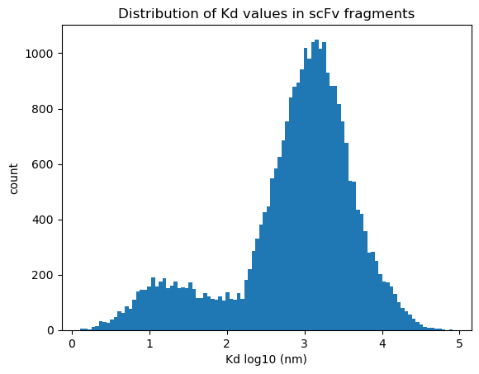
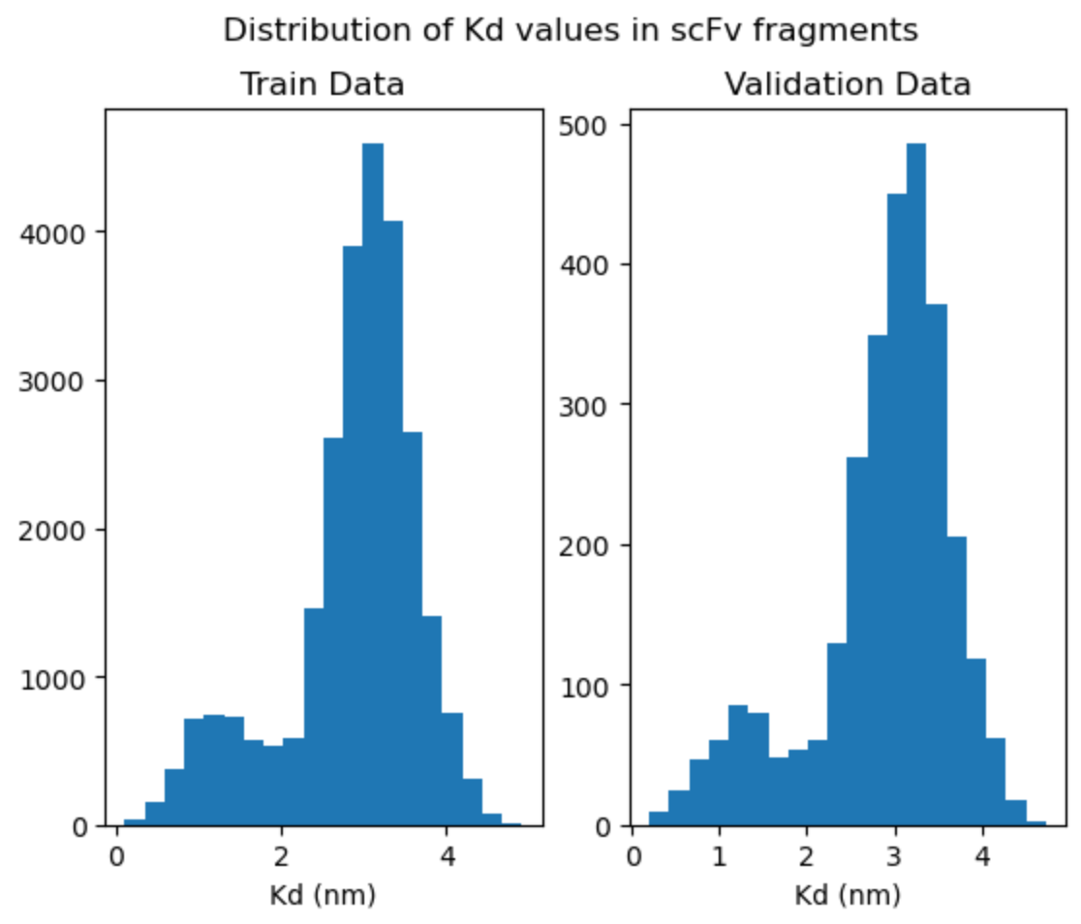
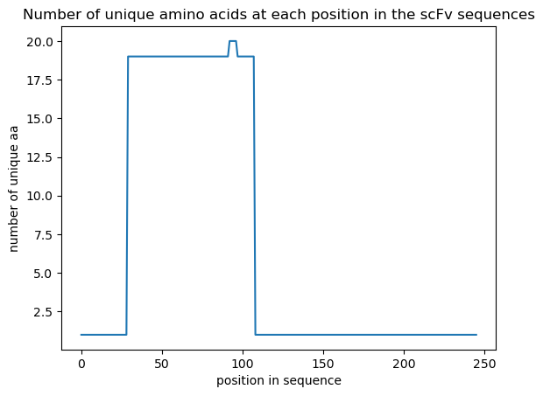
Data set analysis – part 1
alphaseq_data_train.csv
29199 unique aa sequences
For duplicate entries use the mean of their Kd values
remove all entries with NANs for Kd
all sequences are same length: 246 residues
plot distribution of Kd values
interesting bimodal distribution
diff between the two peaks is ~0.25 kcal/mol ΔG
plot the variability at each residue position in the sequence over all sequences
80 residue region (position 29 to 108) has all the mutations
this is likely a CDR region
bimodal-like distribution is similar to that reported in the Nature paper

Slide 3
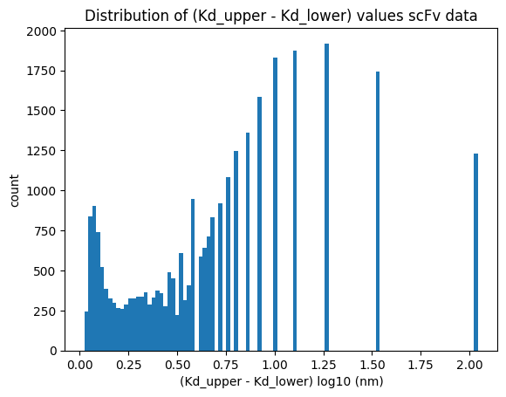
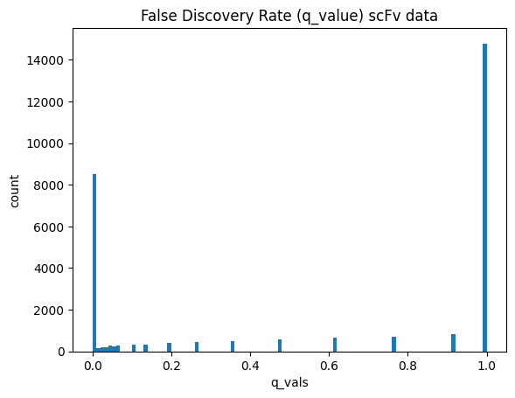
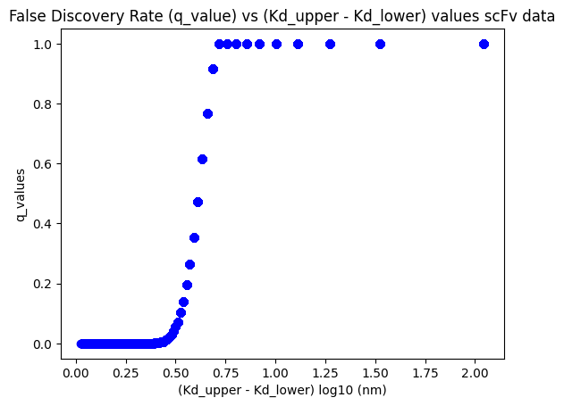
Data set analysis – part 2
ΔKd
q_values
ΔKd vs q_value
Not surprising that larger ΔKd correlate with larger q_values
Data in this region should be considered for removal

Slide 4
Training Datasets : three versions
Clean-1
remove NANs, duplicates, and use mean Kd for duplicates
keep all rows (29199 rows)
80/10/10 split train (23359 rows), val (2920 rows), test (2920)
Clean-4
remove NANs, duplicates, and use mean Kd for duplicates
keep only rows with q_values < 0.50 (12320 rows)
80/10/10 split: train(9856), val (1232), test(1232)
Clean-3b
remove NANs, duplicates, and use mean Kd for duplicates
keep only rows with q_value < 0.05 (9302 rows)
85/7.5/7.5 split: train(7862), val (694), test(694)

Slide 5
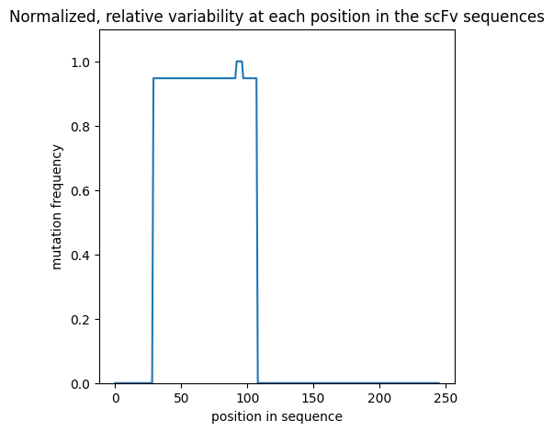
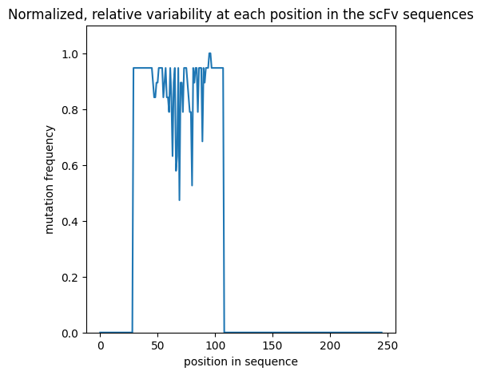
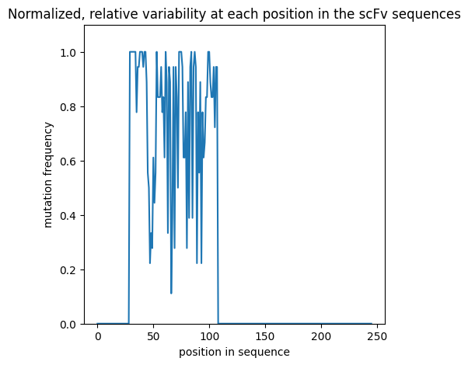
Training Datasets
Relative variability of sequence data by position
Clean-1 dataset
Clean-4 dataset
Clean-3 dataset

Slide 6
Data set analysis – Sequence Length Distributions
Sequence Length | Number of sequences
 | Holdout Set | Training Set (clean-1)
245 | 301 | 0
246 | 24112 | 29199
247 | 5658 | 0
Train the models using a block_length = 247 to accommodate the longest length in the holdout set
(Exception : Visual Transformer model; clips the last 5 residues in training set to better fit the 2D image format)
Pad the end of sequences shorter than 247 with ‘PAD’ token where necessary

Slide 7
Training Datasets
Clean-3b dataset is small with increased risk of overfitting
Regularization/augmentation techniques at sequence level
replace aa residue(s) with MASK token (like a dropout); (note this is not MLM as done in BERT)
randomly choose Kd values over range [Kd_lower_bound, Kd_upper_bound]
I did not have time to try this
flip the aa-sequence back-to-front
this probably breaks the transformer position embedding (is fine for MLP though)
roll the aa-sequence either direction a random number of residues
this probably breaks the transformer position embedding (is fine for MLP though)
And of course, use the use standard dropout in the model for weights, embeddings, etc
Checkpoints saved based on best val loss
Early stopping where noted

Slide 8
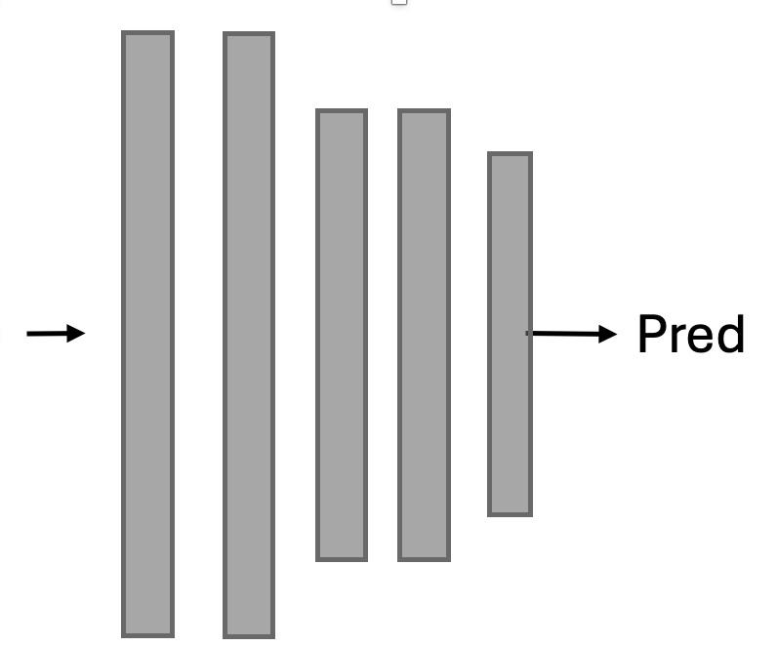
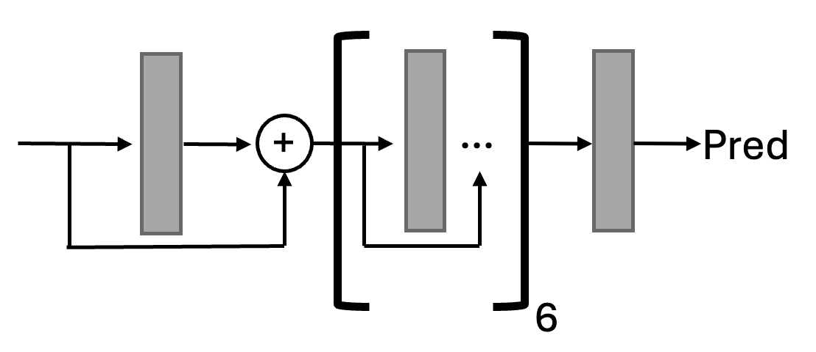
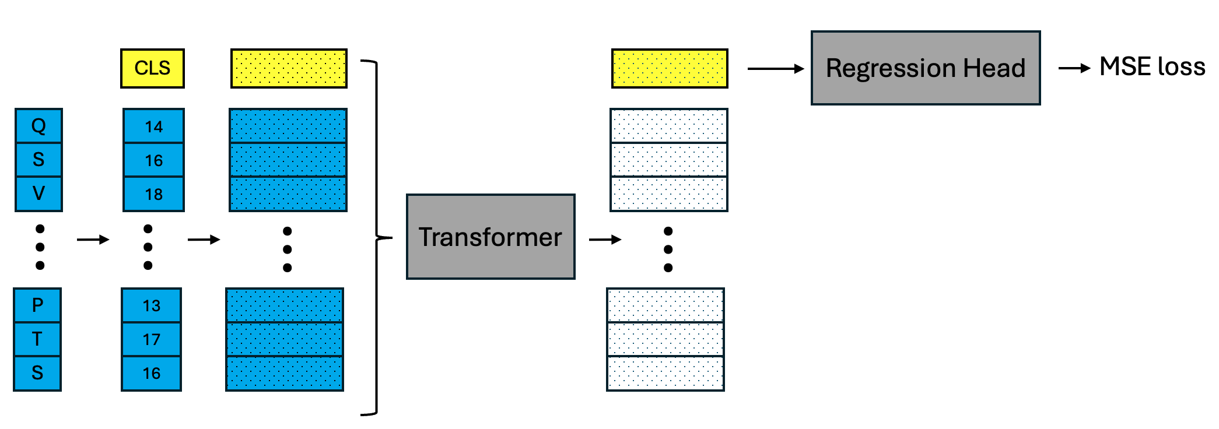
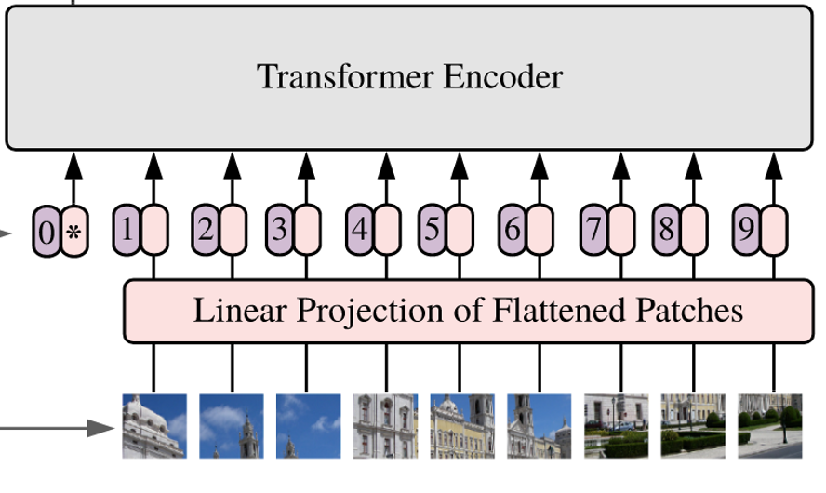
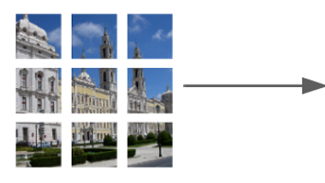
Model architectures examined in this study
MLP
Residual MLP (as a regression head)
Regression Head
MSE loss
Vision Transformer
with residual-MLP regression head
Transformer
with residual-MLP regression head

Slide 9
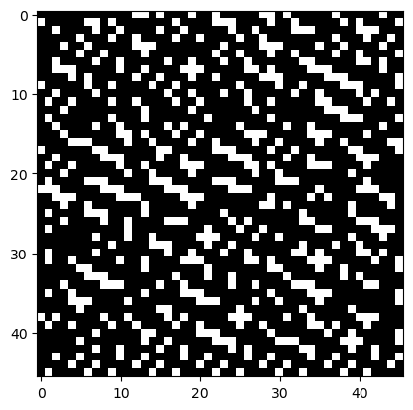
Vision Transformer: 1-channel image
aa sequence: ['CLS', 'Q', 'V', 'Q', 'L', 'V', ‘Q]
(use block_size = 241 (drop the last 5 residues)
encoded: [ 0, 14, 18, 14, 10, 18, 14]
binary: [00000000000011010001001000…] (using 8-bits per token)
reshape: (1,44,44)

Slide 10
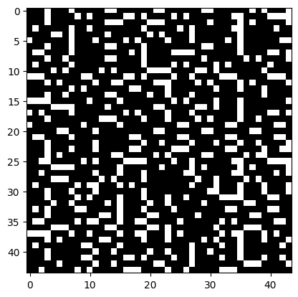
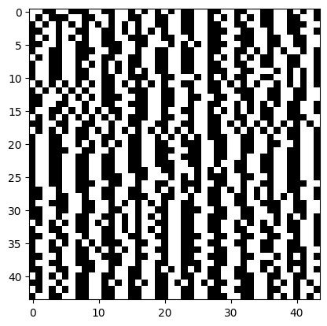
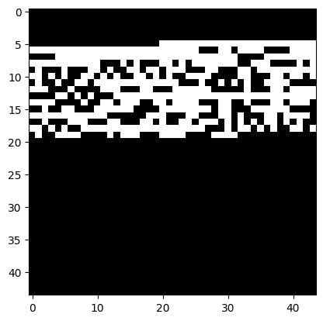
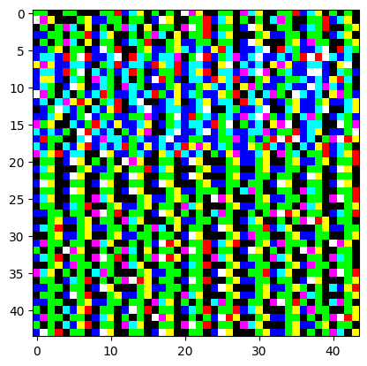
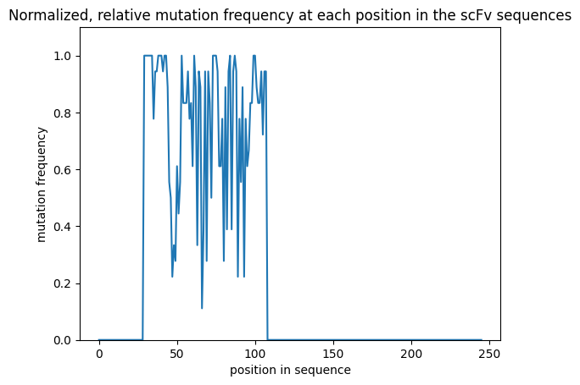
Vision Transformer: 3-channel image
channel 1
encoded residues
channel 2
aa groups
polar
non-polar
neg chg
pos chg
channel 3
mutation freq*
* relative variability by position over the entire dataset

Slide 11
Settings for models and training
Simple MLP
Vision Transformer (VIT)
Transformer
8 layers
input/output size : 247
dropout : 0.25
vocab size: 24
regularize sequences
flip prob: 0.2
mask prob: 0.1
block size: 242
img size: (1,42,42)
emb_dim: 256
patch_dim: 4
heads: 8
head size: 64
layers: 6
vocab size: 24
dropout
emb: 0.15
tform: 0.15
mlp: 0.3
regularize sequences
flip prob: 0.0
mask prob: 0.05
block size: 247
emb_dim: 256
heads: 8
head size: 64
layers: 6
vocab size: 24
dropouts
emb: 0.15
tform: 0.15
mlp: 0.3
regularize sequences
flip prob: 0.0
mask prob: 0.05
Misc:
VIT & TForm models: due to resource constraints, I could not explore larger attention heads (emb, heads, layers)
AdamW and exponential learning rate decay in all cases
Initial learning rate 0.001
Loss: MSE
VIT blocksize: I cut off the last 5 aa residues to better accommodate the dimensions needed for the VIT image patches

Slide 12
Results: Dataset Clean-3b
metrics calculated on the test set
Model | Train loss | Val loss | Epochs | Test set |  |  |  |  | Comment
 |  |  |  | MAE | MSE | MAPE ² | PPE10 ³ | PPE20 ⁴
MLP | 0.37 | 0.41 | 3787 | 0.52 | 0.39 | 0.33 | 21 | 42
VIT ¹ | 0.12 | 0.16 | 700 | 0.29 | 0.16 | 0.17 | 48 | 70 | 1-channel
VIT ¹ | 0.10 | 0.13 | 500 | 0.27 | 0.16 | 0.16 | 50 | 74 | 3-channel
*Transformer ¹ | 0.02 | 0.12 | 183 | 0.28 | 0.15 | 0.17 | 49 | 71
* best performing model
Regression head is residual-MLP. (interestingly, residual-MLP head gave better convergence properties than standard MLP)
MAPE : mean absolute percentage error : mean(abs(actual-pred)/actual). Lower is better
PPE10 : percentage of time prediction is within 10% of ground truth. Higher is better
PPE20 : percentage of time prediction is within 20% of ground truth. Higher is better

Slide 13
Results: Transformer on different cleaned datasets
model trained on each dataset
metrics calculated on that dataset’s test subset
Dataset | q_value cutoff ¹ | data set size | Train loss | Val loss | Epochs ² | Test set |  |  |  |  | Comment
 |  |  |  |  |  | MAE | MSE | MAPE | PPE10 | PPE20
Clean-3b | 0.05 | 9302 | 0.02 | 0.12 | 183 | 0.28 | 0.15 | 0.17 | 49 | 71
Clean-4 | 0.5 | 12320 | 0.05 | 0.11 | 316 | 0.26 | 0.13 | 0.15 | 54 | 79
Clean-1 | 1.0 | 29199
only data with q_value less than this value included in dataset
epochs value is from the best val loss checkpoint. Typically, the training jobs was set to run either 500 or 1000 epochs
It’s noted in the Table-Transformer literature that the transformer architecture can be surprisingly robust to “dirty” data

Slide 14
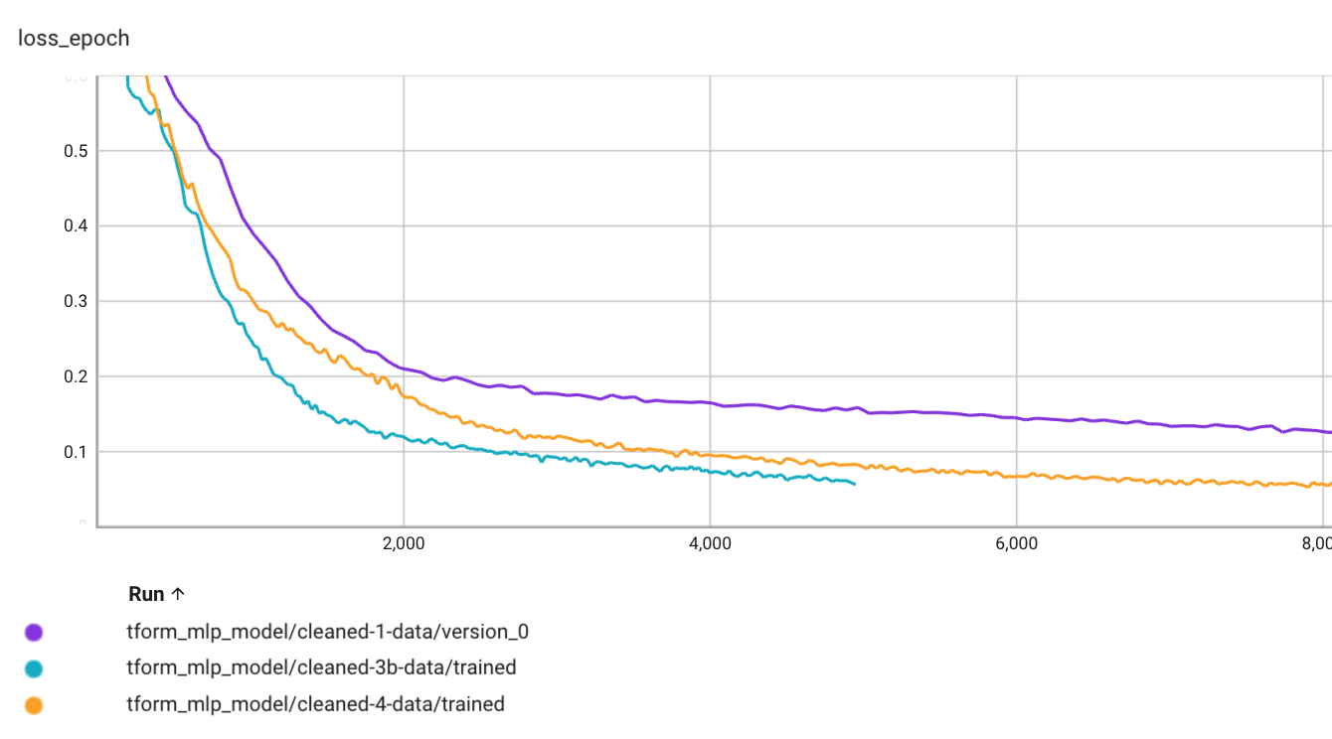
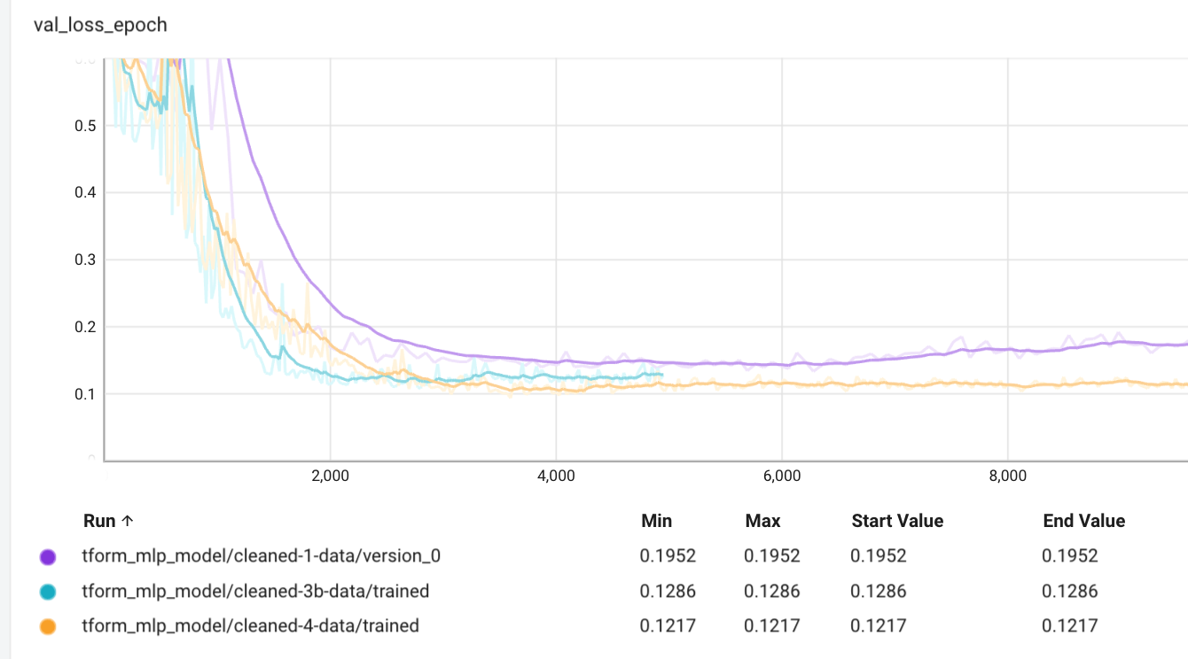
Loss Curves
Transformer model
Clean-1, Clean-4, and Clean-3b datasets
Show just the first 8K batches
Train
Smaller dataset converges faster (not surprising)
In spite of it’s larger size, clean-1 dataset shows signs of overfitting
Validation

Slide 15
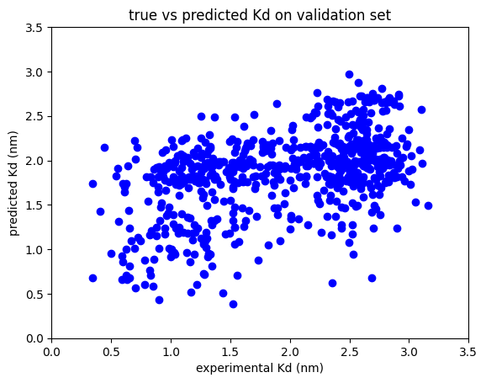
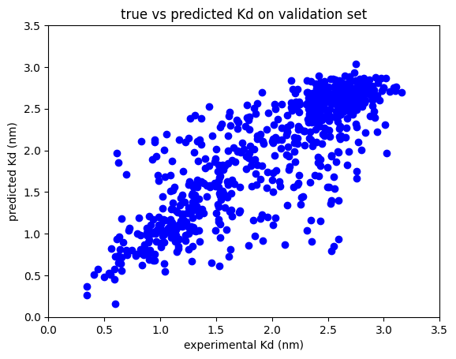
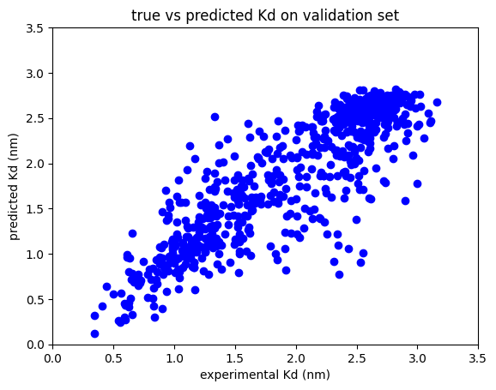
Plots experiment vs predicted on test set : Clean-3 dataset
MLP
VIT 1-channel
VIT 3-channel
Transformer
The clustering about the x=y line is tighter for models that performed better

Slide 16
Plots Kd distribution on hold-out set

Slide 17
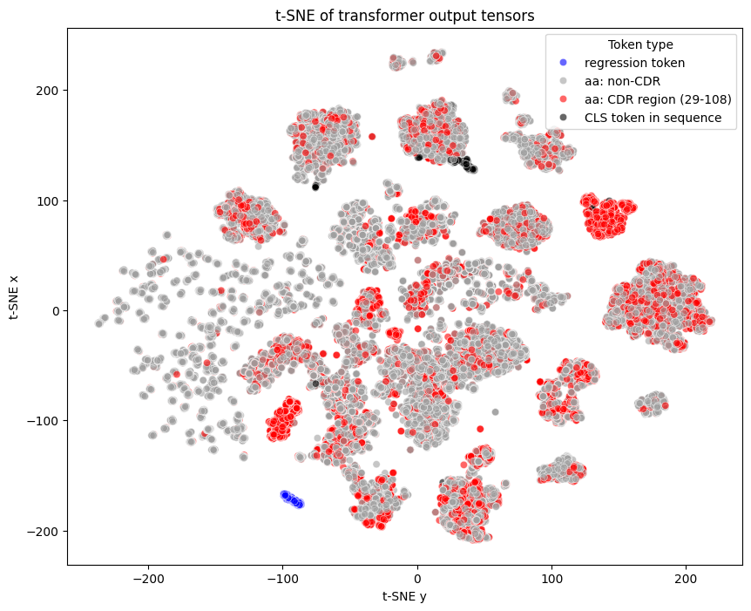
t-SNE plots : Transformer model
redo
REGR
[CLS*, aa, aa, aa, aa, …..]
sequence emitted by
dataset class
token added in the model to use for regression
regress token clusters tightly: makes sense
CLS tokens cluster in a single region
CDR aa’s still scattered, however:
there are two tight CDR-only clusters
suss this out??
Transformer-based models should learn relationships between the elements of the sequence
t-SNE plots are not usually definitive, but are merely suggestive…
* I should have left the CLS token out when constructing sequences since they are duplicated in the model by the regression token. (It was a holdover from my BERT mask-language-model dataset)

Slide 18
t-SNE plots : VIT model 1-channel

Slide 19
t-SNE plots : VIT model 3-channel

Slide 20
Conclusions
MLP models do not treat relationships between different elements in a sequence. For sequence-to-affinity regression problem, MLP, not surprisingly, performed the poorest
Transformer-based models explicitly treat these interactions via the self-attention mechanism and this proves advantageous in this study
also, these converge faster than the MLP models I tried.
Vision transformer on this data proved surprisingly effective
3-channel approach did slightly better than 1-channel.
Would be interesting to explore other encodings for these layers and other types of data to add in additional layers
In hindsight, I could simply have encoded/embed the same data as channels 2,3 into the linear Transformer model as well; which is probably more straightforward
The t-SNE plots show that clustering of features occurs which is expected from self-attention. Additional work on this would be interesting,

Slide 21
Other approaches
Train multiple models and combine their predictions into a linear-regression model
Transformer models (different objectives: MSE, MAE)
VIT 3-channel model (different objectives: MSE, MAE)
etc…
pred = (c₁ * m₁) + (c₂ * m₂) + ….
regress the coefficients c_{i}
Or, obviously, try more robust models like BERT

Slide 22
Appendix 1: BERT
This was too ambitious to complete for this assignment
Below, I outline some of the preliminary work I did

Slide 23
BERT Stuff: Relevant literature, code, and data
Note: I did most of the BERT coding/testing in the 2 weeks before my call with Adrian (i.e. before getting the homework problem)
BERT : https://aclanthology.org/N19-1423.pdf
ProteinBERT : https://doi.org/10.1093/bioinformatics/btac020
Code partially taken from:
Barney Hill : https://github.com/barneyhill/minBERT
Andrej Karpathy: https://github.com/karpathy/minGPT
my Table Transformer code (from real-estate automated valuation model development)
A-Alpha Bio:
Nature Comm: http://biorxiv.org/lookup/doi/10.1101/2022.10.07.502662
Nature: https://www.nature.com/articles/s41597-022-01779-4
scFv Datasets: https://github.com/mit-ll/AlphaSeq_Antibody_Dataset.git
Observed Antibody Space :
https://doi.org/10.4049/jimmunol.1800708
https://opig.stats.ox.ac.uk/webapps/oas/
My Github repo for this homework’s code: https://github.com/planaria158/BERT.git

Slide 24
BERT pre-train dataset: OAS (Observed Antibody Space) database
Pretrain (masked language model) with:
Human, SARS-COV-2, light chain, unpaired
175 datafiles
Plan
focus on just sequence_alignment_aa column (not germline)
eliminate duplicates
ignore the separate v, d, and j (they are already in the light chain)
ignore fwr1, fwr2, fwr3, fwr4 regions (on the heavy chain?)
ignore CDR sequences (they are already contained in the longer light-chain sequences)
Result of data extraction
total rows 20306305, num unique, len(seqs): 18061315
range in length from min_len: 43 , max_len: 132
https://opig.stats.ox.ac.uk/webapps/oas/

Slide 25
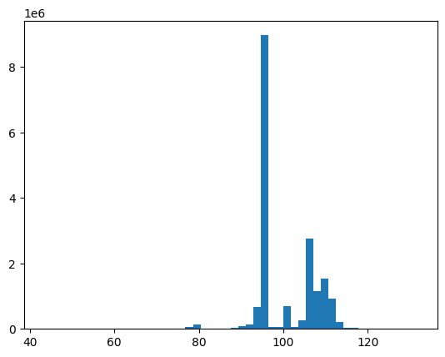
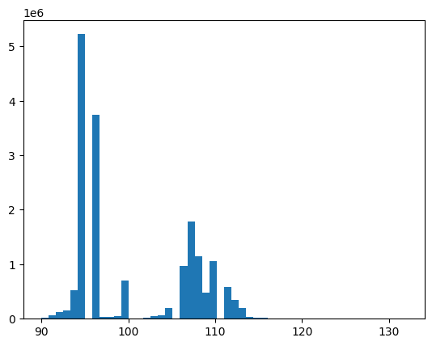
OAS dataset: distribution of peptide lengths
18061315 sequences
17599987 sequences
remove all seqs < 90 length
sequence length
sequence length
Final dataset:
17599987 unique sequences between 90 – 132 length
train: 14079989
test: 3519998

Slide 26
BERT
pre-train in masked-language mode, OAS light-chain dataset
CLS
0
0
0
Q
14
14 ?
0
S
Mask
16 ?
16
V
18
Transformer
18 ?
0
…
…
…
…
Linear
…
…
CE loss
P
Mask
13 ?
13
T
17
17 ?
0
S
16
16 ?
0
Contexts
Logits
Mask
CLS + aa residues
Encodings (masked)
Embeddings
(separate mask created during encoding
and also passed into transformer)

Slide 27
BERT
fine-tune on scFv library with binding affinities. Create sequence to affinity model
CLS
0
Regression Head
(e.g. mlp)
MSE loss
Q
14
S
16
binding energy (nm)
V
18
Transformer
…
…
…
…
ignore
P
13
T
17
S
16
Encodings
Contexts
CLS + scFv aa
Embeddings
freeze some or all of the layers

Slide 28
Settings for BERT that I tried on the homework data
BERT pre-train
BERT fine-tune
block size: 248
emb_dim: 192
heads: 8
layers: 6
mask prob: 0.15
vocab size: 25
dropouts
emb: 0.1
residual: 0.1
attn: 0.1
BERT pre-train
mask prob: 0
head dropout: 0.2
base tformer layers:
all frozen
unfreeze last 1
unfreeze last 2
unfreeze last 3
Misc:
BERT pre-train: due to resource constraints, I had to use a small BERT (emb, heads, layers) and only did 10 epochs of pre-training
AdamW and exponential learning rate decay for all trainings
Initial learning rate 0.0001
Loss: Cross entropy for MLM pretraining. MSE for fine tuning

Slide 29
Results: Dataset Clean-3, BERT
Train Loss | Valid. Loss | Epochs | RMSE (valid set) | Comment
0.34 | 0.33 | 10 | na | pre-train OAS data
0.51 | 0.52 | 160 | 1.06 | fine-tune transformer frozen
0.50 | 0.52 | 335 |  | fine-tune last 1 layer tform
0.24 | 0.29 | 460 |  | fine-tune last 2 layers tform
0.05 | 0.18 | 675 | 1.06 | unfreeze last 3 layers
definitely some overfitting
I simple didn’t have the GPU resources and time to really refine the pre-training
Pre-train BERT on OAS dataset, then fine-tune on scFv train data (OAS dataset is 18061315 rows)

Slide 31
Bit bucket

Slide 32
Results: Dataset Clean-3
redo analysis using test set
metrics calculated on the validation set
Model | Train Loss | Valid. Loss (MSE) | Epochs ⁵ | MAE | RMSE | MAPE ² | PPE10 ³ | PPE20 ⁴ | Comment
MLP | 0.36 | 0.39 | 10000 | 0.51 | 0.62 | 0.36 | 23 | 46
residual MLP | 0.22 | 0.34 | 7150 | 0.45 | 0.57 | 0.30 | 30 | 53 | no sequence regularization
VIT ¹ | 0.09 | 0.16 | 1100 | 0.28 | 0.39 | 0.17 | 46 | 72 | 1-channel
VIT ¹ | 0.05 | 0.14 | 1300 | 0.26 | 0.36 | 0.15 | 50 | 74 | 3-channel
Transformer ¹ | 0.08 | 0.14 | 3600 | 0.27 | 0.38 | 0.16 | 50 | 75
Regression head is residual-MLP. (interestingly, residual-MLP head gave better convergence properties than standard MLP)
MAPE : mean absolute percentage error : mean(abs(actual-pred)/actual). Lower is better
PPE10 : percentage of time prediction is within 10% of ground truth. Higher is better
PPE20 : percentage of time prediction is within 20% of ground truth. Higher is better
I generally stopped when training had plateaued for >100 epochs with respect to improved validation loss

Slide 33
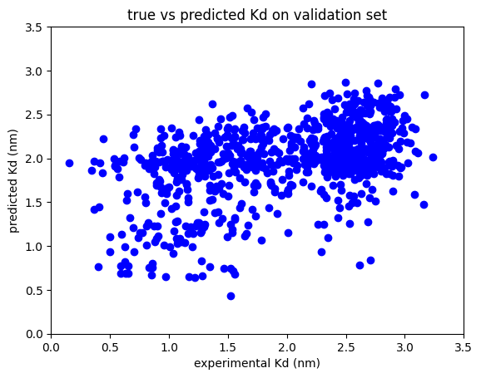
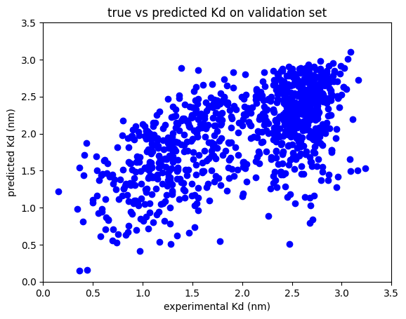
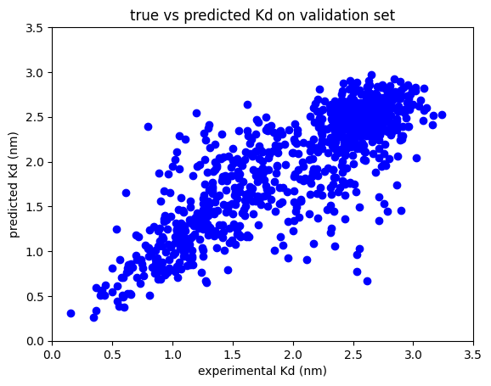
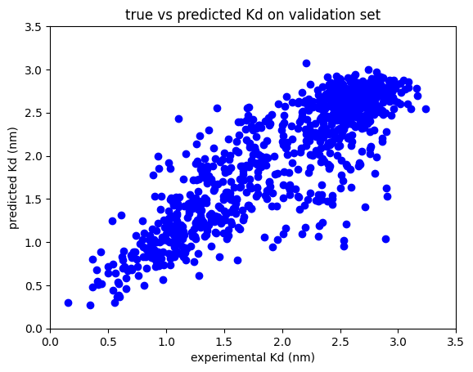
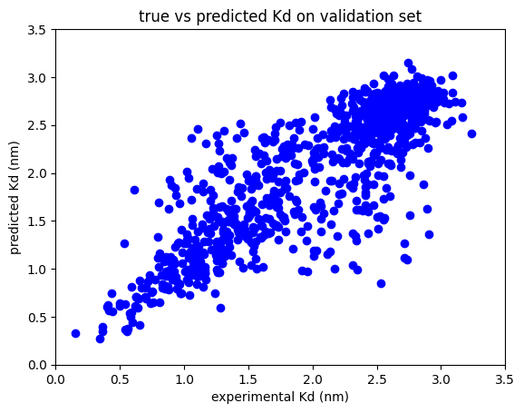
Plots experiment vs predicted on validation set
Clean-2 dataset
MLP
Residual MLP
VIT 1-channel
VIT 3-channel
Transformer

Slide 34
Ideas for model training
I tried various architectures just to get a baseline of what to focus on going forward
Vanilla MLP (5 layers)
Dense MLP (8 layers) similar to what is used at Plunk for their AVM. Remarkably effective on their table data for such a simple model.
Residual MLP (8 layers)
Vision Transformer (convert encoded sequences into binary-encoded 2D 1-channel image
Transformer + MLP
BERT : pre-trained on OAS dataset and fine tuned on scFv data

Slide 35
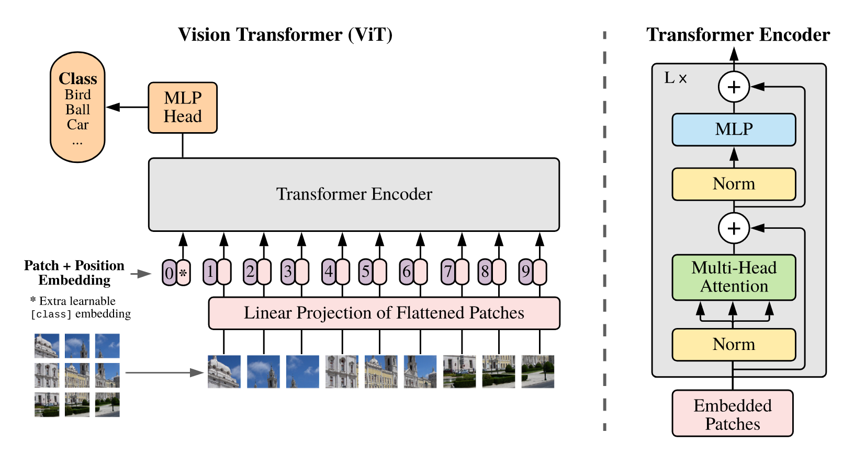
Vision Transformer
A reasonably simple model that uses self-attention which I think can be applied to this problem
Also, it can run on my Macbook M2 hardware
http://arxiv.org/abs/2010.11929

Slide 36
Pre-training on OAS data
Code: pytorch with a pytorch-lightning (harness to manage the training, test loop)
Hardware: two GeForce RTX 2080 Ti with 11GB memory each.
Settings:
emb dim: 512
layers: 12
heads: 16
dropouts: 0.1
vocab size: 23 (20 aa, CLS, X, and MASK tokens)
block size: 91 (CLS token + 90 aa)
mask prob: 0.15
AdamW, learn rate 10⁻⁴, decay gamma: 0.9985
batch size: 120 (it’s what would fit on my compute resources)
gpus: 2
max epochs: 10

Slide 37
Results: Dataset Clean-1
Model | Train Loss | Valid. Loss | Epochs | RMSE (valid set) | Comment
MLP | 0.23 | 0.31 | 10K | 1.08
dense MLP | 0.20 | 0.29 | 10K | 1.06
residual MLP | 0.24 | 0.30 | 10K | 1.05
VIT | 0.28 | 0.34 | 1250 | 1.02
BERT (naive) ¹ | 0.03 | 0.27 | 1000 |  | strong overfitting
BERT ² | 0.34 | 0.33 | 10 | na | pre-train
 |  |  |  |  | fine-tune
Train the fine-tune BERT model from scratch (no pre-training) on scFV train data
Pre-train BERT on OAS dataset, then fine-tune on scFv train data
OAS dataset is 18061315 rows.

Slide 38
Results: Dataset Clean-3
Model | Train Loss | Valid. Loss | Epochs | RMSE (valid set) | Comment
residual MLP | 0.21 | 0.33 | 8360 | 0.92
VIT (1-channel) | 0.14 | 0.21 | 1925 | 0.97 | early stop to avoid overfit
VIT (1-channel) |  |  |  |  | 2x2 img patches
VIT (3-channel)
TFormMLP
BERT ¹ | 0.34 | 0.33 | 10 | na | pre-train
 | 0.51 | 0.52 | 160 | 1.06 | fine-tune transformer frozen
 | 0.50 | 0.52 | 335 |  | fine-tune last 1 layer tform unfrozen maybe overfitting…
 | 0.24 | 0.29 | 460 |  | fine-tune last 2 layers tform unfrozen maybe overfitting…
 | 0.05 | 0.18 | 675 | 1.06 | unfreeze last 3 layers
Pre-train BERT on OAS dataset, then fine-tune on scFv train data (OAS dataset is 18061315 rows)

Slide 39
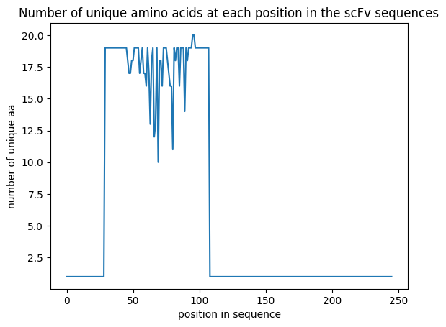
Regularization
Overfitting will be an issue with datasets this small (especially the Clean-2 dataset)
Regularization, data augmentation, and misc training ideas:
Rather than regress to a single Kd value, randomly choose Kd from the range Kd_lower -> Kd_upper. Do this every batch
Make random point mutations in the non-CDR regions of the sequence with low frequency
Clip just the CDR extended by +/- 5-10 residues from the entire sequence and train on just that
Different objectives: MSE and MAE in separate training runs
Where possible, pre-train model on much-larger relevant dataset, then fine-tune on these smaller sets
Early stopping
Is there anyway to recover the data that was culled by q_value? (prob not)

Slide 40
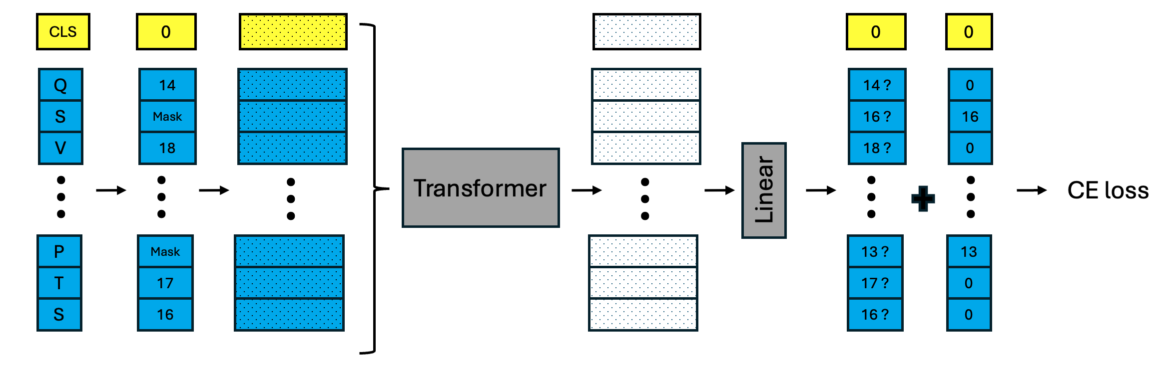
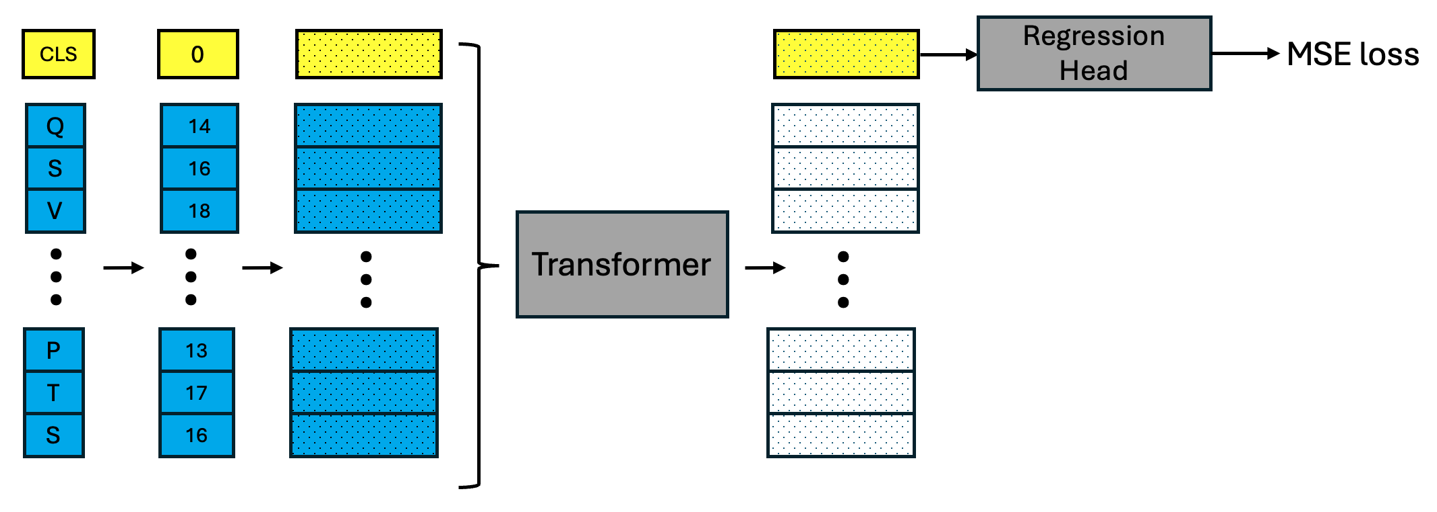
BERT
BERT pre-train, MLM
Dataset: OAS light chain sequences
BERT fine tune
Dataset: A-Alpha Bio homework data

Slide 41
BERT
fine-tune on scFv library with binding energies. Create sequence to affinity model
CLS
Regression Head
MSE loss
Q
14
S
16
V
18
Transformer
…
…
…
…
P
13
T
17
S
16
freeze some or all of the layers
Encodings
CLS + scFv aa
Embeddings

Slide 42
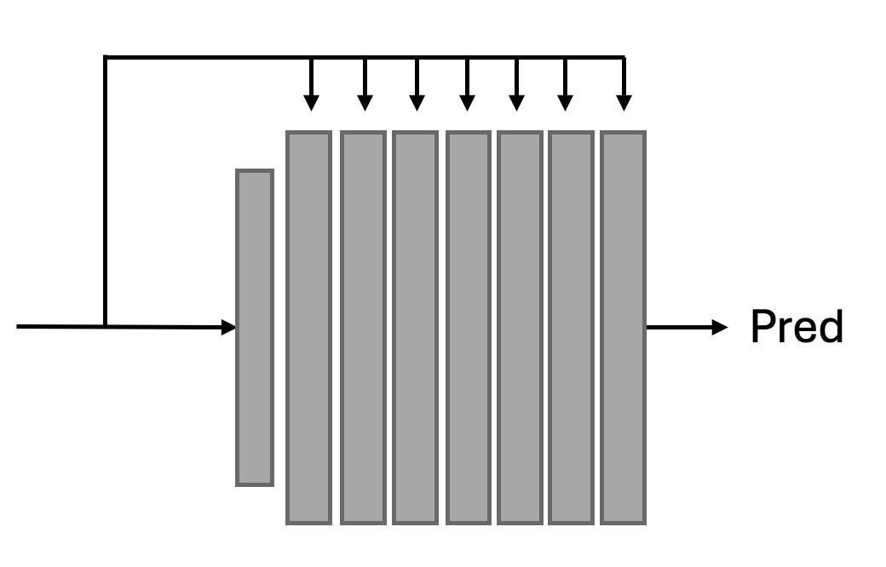
+
…
Pred
Pred
6
Dense MLP

Slide 43
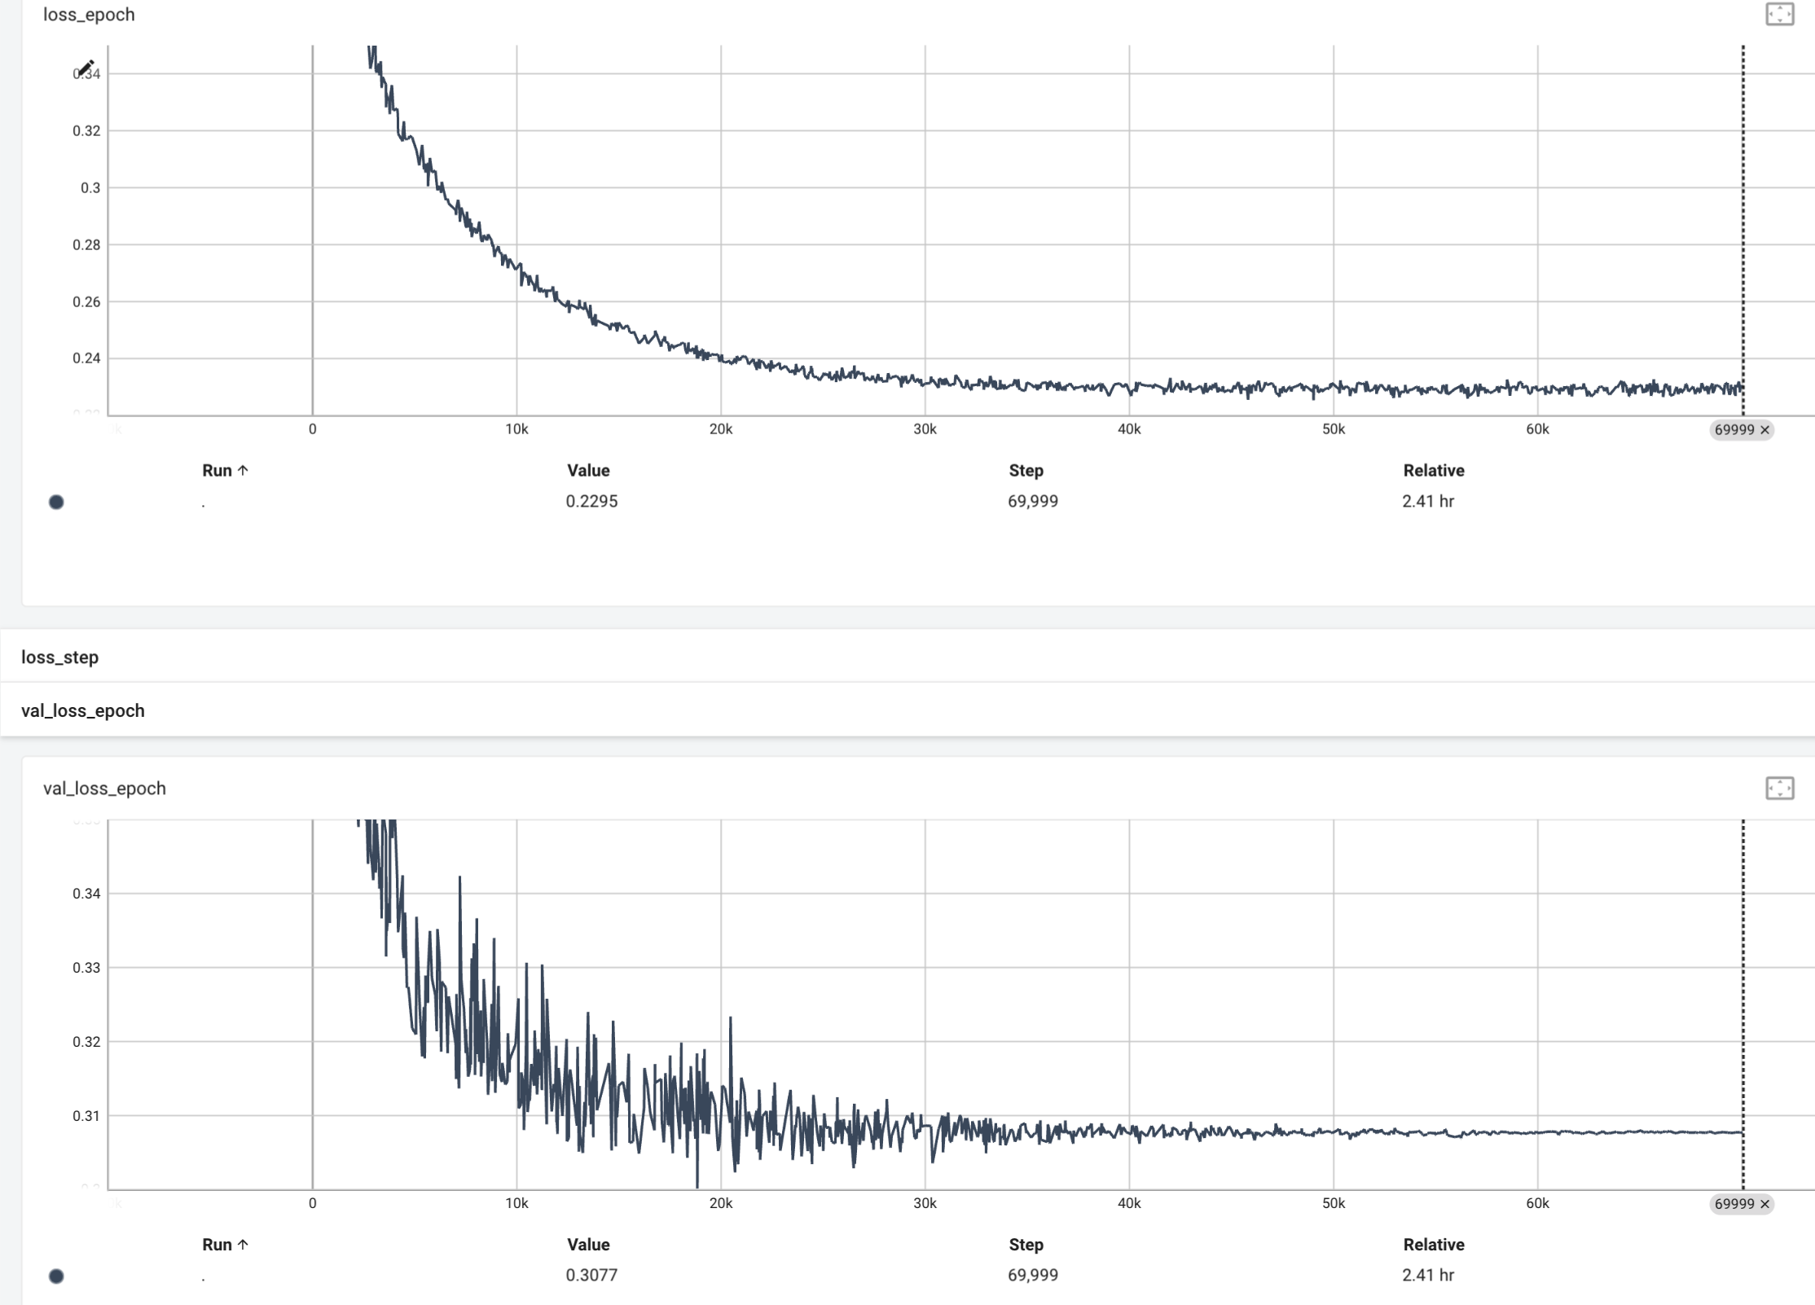
Simple MLP
4-layer MLP
(from TabTransformer and FTTransformer papers)
Pred
final loss:
train: 0.23
val: 0.31
10,000 epochs

Slide 44
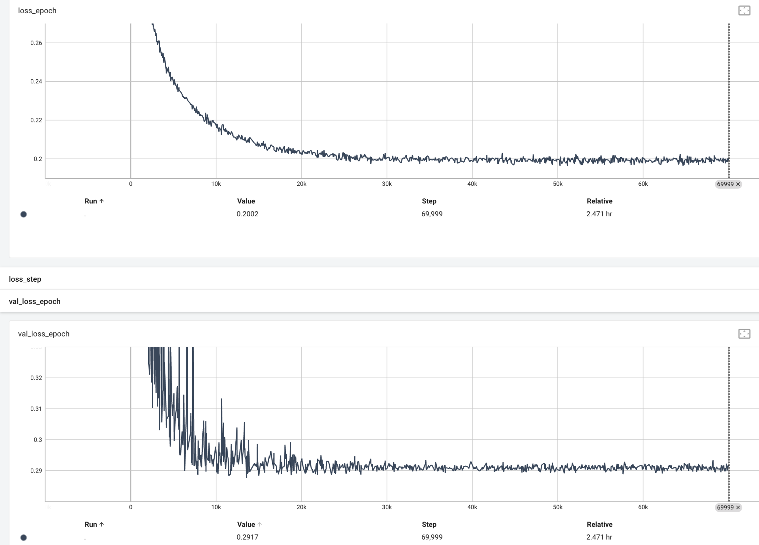
Dense MLP
8-layer densely-connected
Pred
final loss:
train: 0.20
val: 0.29
10,000 epochs

Slide 45
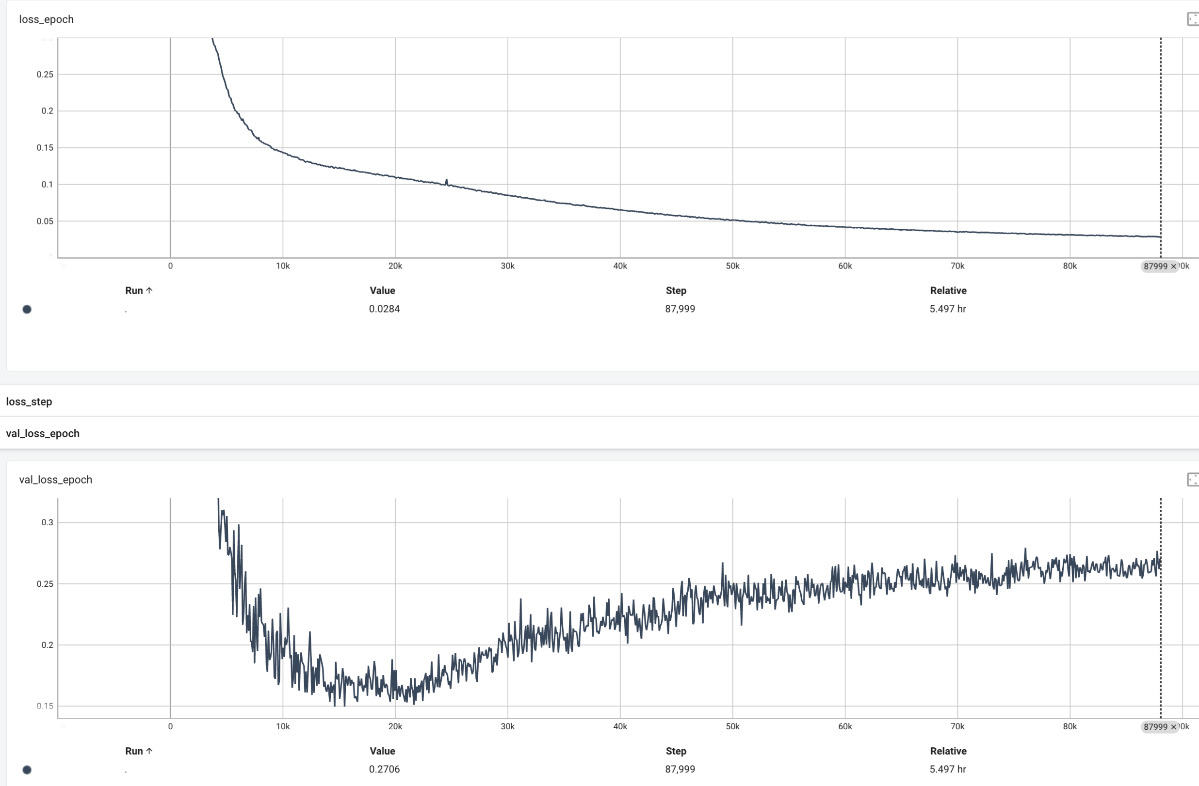
BERT
CLS
0
Regression Head
MSE loss
Start with un-pre-trained fine-tune model and train from scratch
I am not expecting a satisfactory result
Q
14
S
16
V
18
Transformer
…
…
…
…
P
13
T
17
S
16
1000 epochs
final loss:
train: 0.03
val: 0.27
Classic signs of overfitting
Dropouts used:
embd : 0.1
resididual : 0.2
attn : 0.2
regress_head : 0.2

Slide 46
Issue(s) I have not resolved to my satisfaction yet
Position embedding:
Use absolute position determined from each specific aa sequence?
Or, the absolute position in the entire human light chain?
makes more sense but not sure how I can get this information or if it changes for different antibody types (ie. IgG, IgA, etc)
There is no absolute light chain length for human IgG abs. A few different chains have slightly different lengths. Absolute alignment with reference light chains is probably not practical.
I’ll pre-train using option #1

Slide 47
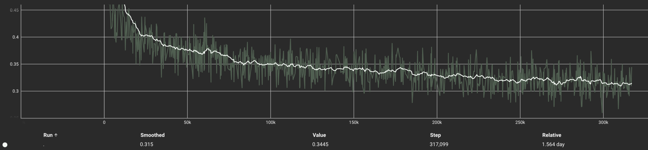
Pre-training: loss
Training loss: after 5 epochs
Stopped after 5 epochs
final losses
train: 0.32
val: 0.31

Slide 48
Fine Tuning dataset
antibody_dataset_1 : the scFv antibody sequence/binding affinity data in the AlphaSeq experimental assay data
Total rows: 1109000
Number of unique: 104972 (there are between 8-20 instances of each sequence)
Number of rows where pred_Affinity is not NAN : 340100
NANs are most likely non-binders (perhaps give them affinity 0?)
number of unique sequences in this subset: 87211
for each of these unique sequences, there are multiple binding affinity values
for example,
seq 1: num affinity values = 6 , values: {0.87, 0.91, 0.96, 3.92, 4.92, 5.72}
-RTlog10(5.72) = -4.88 kcal/mol binding free energy
-RTlog10(0.87) = -5.36 kcal/mol
for reference kT = 0.6 kcal/mol so this difference is on the order of kT
Final data set:
87211 sequences
affinity will be the mean of each sequence’s multiple affinities
43 Kd values are negative (?!?!) : remove these.
Final row count = 87168
Train/test split 90/10: 78451/8717 rows, respectively
https://www.nature.com/articles/s41597-022-01779-4
"Of the 119,600 designs, 104,972 were successfully built into the AlphaSeq library and target binding was subsequently measured with 71,384 designs”

Slide 49
Fine tune results
In progress
issue? block-size = 90 during pre-training. How to adapt for fine-tune data of longer length?
See this link: https://discuss.huggingface.co/t/fine-tuning-bert-with-sequences-longer-than-512-tokens/12652
I’ve choosen to use PAD tokens.
Set block_size = 256 (long enough for the scFv data set)
Redo pre-training on OAS data set with this new block size
Redo the fine-tuning
ProteinBERT paper : https://doi.org/10.1093/bioinformatics/btac020
2.2 Sequence and annotation encoding
Protein sequences were encoded as sequences of integer tokens. We used 26 unique tokens representing the 20 standard amino acids, selenocysteine (U), an undefined amino-acid (X), another amino acid (OTHER) and 3 additional tokens (START, END and PAD). For each sequence, START and END tokens were added before the first amino acid and after the last amino acid, respectively. The PAD token was added to pad sequences shorter than the sequence length chosen for the minibatch.
…..
An important feature of ProteinBERT is sequence length flexibility. To avoid the risk of overfitting the model to a specific constant length, we periodically (every 15 min of training) switched the encoding length of protein sequences, using lengths of 128, 512 or 1024 tokens.

Slide 50
Results: Dataset Clean-2
Model | Train Loss | Valid. Loss | Epochs | RMSE (valid set) | Comment
residual MLP
VIT | 0.26 | 0.32 | 860 | 0.94
BERT ¹ |  |  |  |  | pre-train
 |  |  |  |  | fine-tune
Pre-train BERT on OAS dataset, then fine-tune on scFv train data

