Slide 1
A-Alpha Bio Homework
Mark Thompson
Submitted in partial fulfillment for Data Scientist application

Slide 2
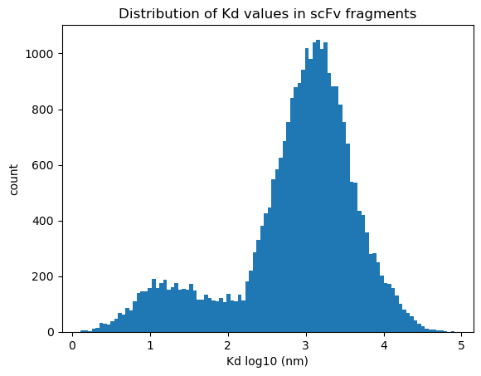
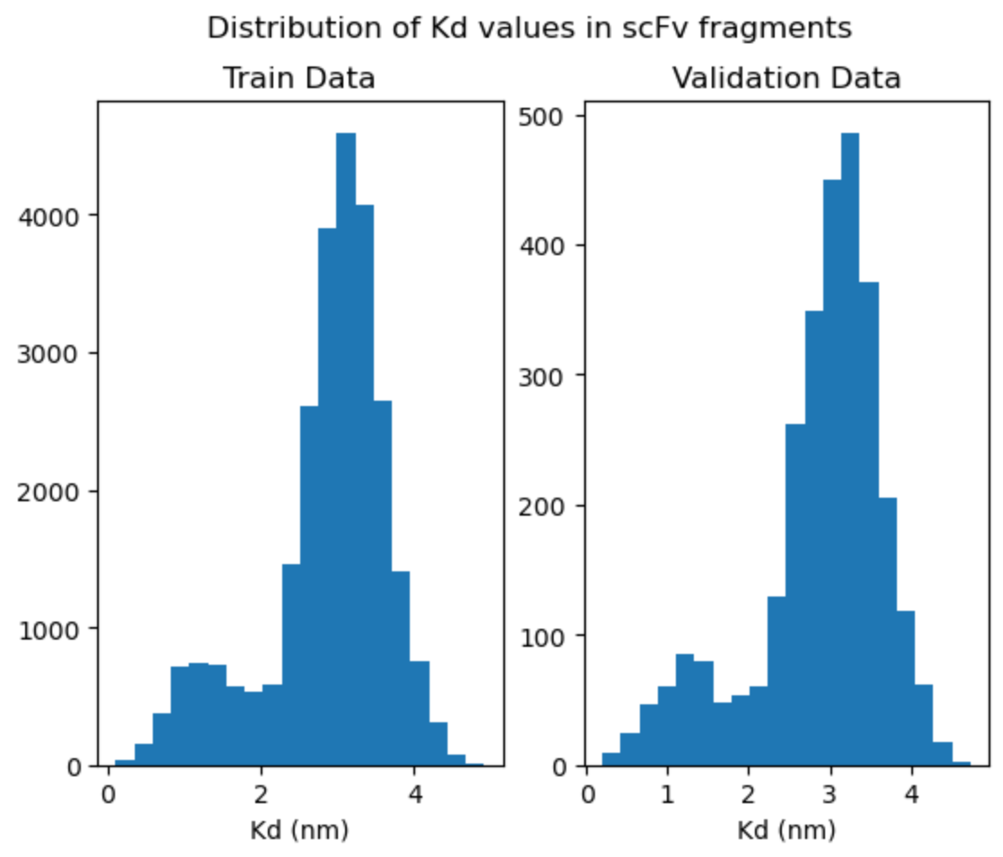
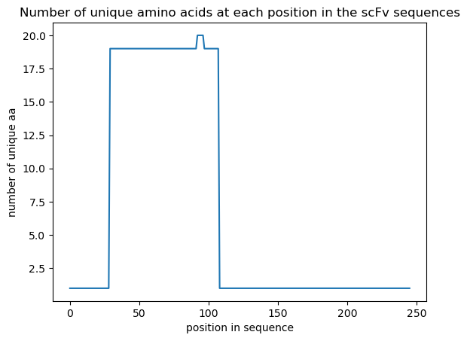
Data set analysis – part 1
alphaseq_data_train.csv
29199 unique aa sequences
For duplicate entries use the mean of their Kd values
remove all entries with NANs for Kd
all sequences are same length: 246 residues
plot distribution of Kd values
interesting bimodal distribution
diff between the two peaks is ~0.25 kcal/mol ΔG
plot the variability at each residue position in the sequence over all sequences
80 residue region (position 29 to 108) has all the mutations
this is likely a CDR region
bimodal-like distribution is similar to that reported in the Nature paper

Slide 3
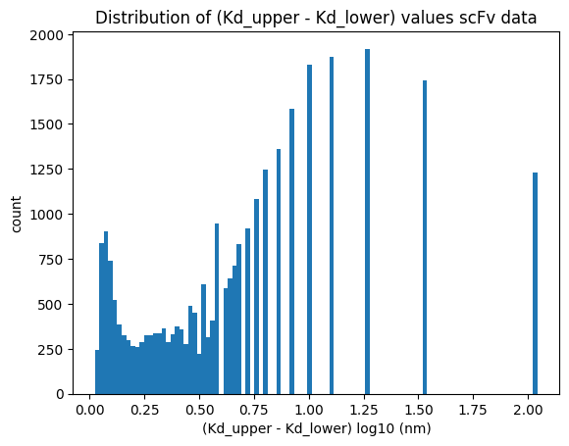
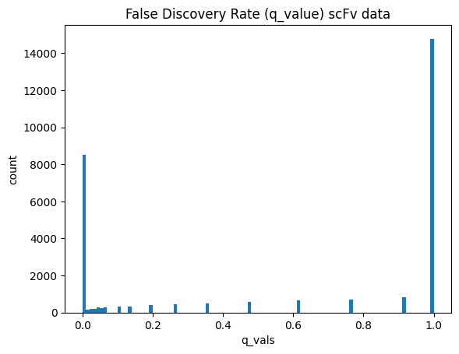
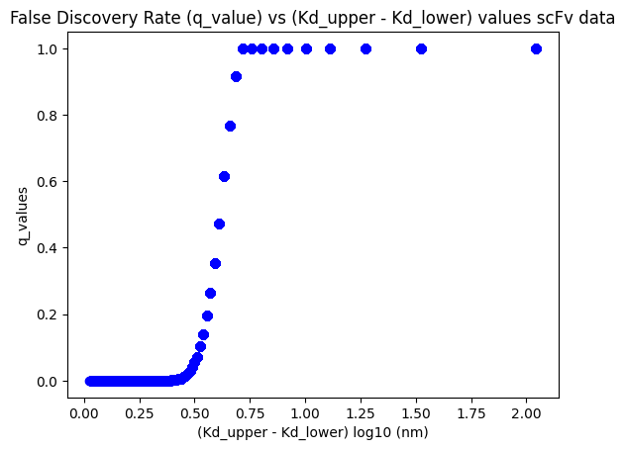
Data set analysis – part 2
ΔKd
q_values
ΔKd vs q_value
Not surprising that larger ΔKd correlate with larger q_values
Data in this region should be considered for removal

Slide 4
Training Datasets : three versions
Clean-1
remove NANs, duplicates, and use mean Kd for duplicates
keep all rows (29199 rows)
80/10/10 split train (23359 rows), val (2920 rows), test (2920)
Clean-4
remove NANs, duplicates, and use mean Kd for duplicates
keep only rows with q_values < 0.50 (12320 rows)
80/10/10 split: train(9856), val (1232), test(1232)
Clean-3b
remove NANs, duplicates, and use mean Kd for duplicates
keep only rows with q_value < 0.05 (9302 rows)
85/7.5/7.5 split: train(7862), val (694), test(694)

Slide 5
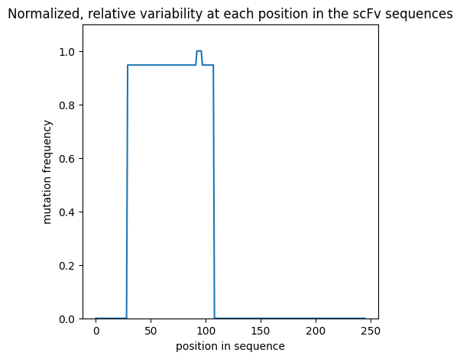
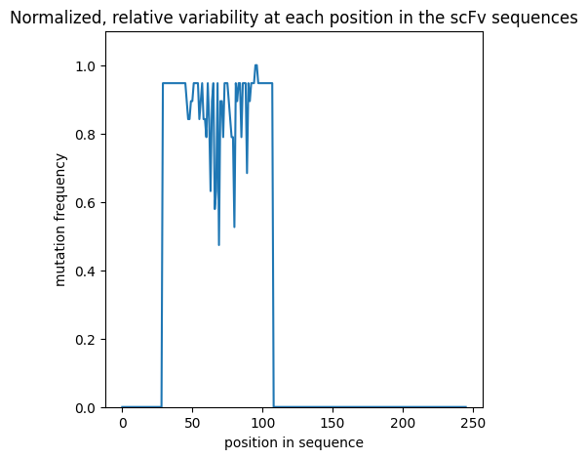
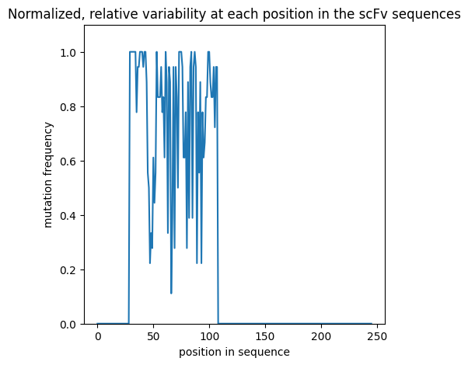
Training Datasets
Relative variability of sequence data by position
Clean-1 dataset
Clean-4 dataset
Clean-3 dataset

Slide 6
Data set analysis – Sequence Length Distributions
Sequence Length | Number of sequences
 | Holdout Set | Training Set (clean-1)
245 | 301 | 0
246 | 24112 | 29199
247 | 5658 | 0
Train the models using a block_length = 247 to accommodate the longest length in the holdout set
(Exception : Visual Transformer model; clips the last 5 residues in training set to better fit the 2D image format)
Pad the end of sequences shorter than 247 with ‘PAD’ token where necessary

Slide 7
Training Datasets
Clean-3b dataset is small with increased risk of overfitting
Regularization/augmentation techniques at sequence level
replace aa residue(s) with MASK token (like a dropout); (note this is not MLM as done in BERT)
randomly choose Kd values over range [Kd_lower_bound, Kd_upper_bound]
I did not have time to try this
flip the aa-sequence back-to-front
this probably breaks the transformer position embedding (is fine for MLP though)
roll the aa-sequence either direction a random number of residues
this probably breaks the transformer position embedding (is fine for MLP though)
And of course, use the use standard dropout in the model for weights, embeddings, etc
Checkpoints saved based on best val loss
Early stopping where noted

Slide 8
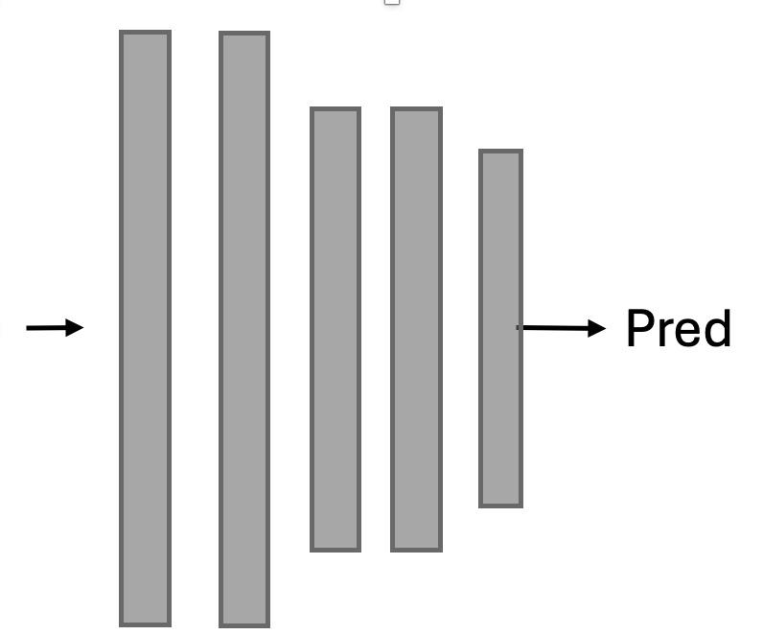
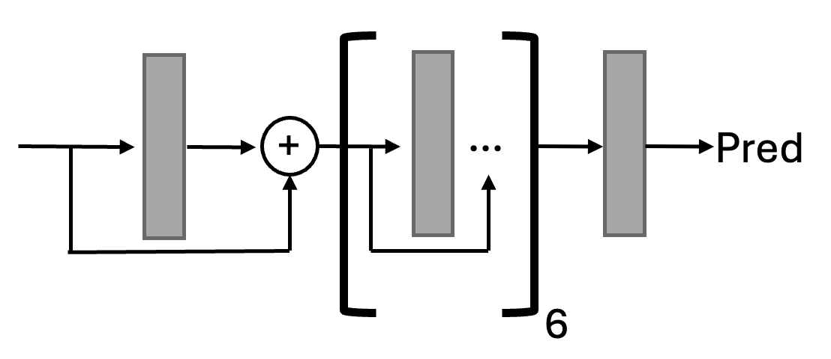
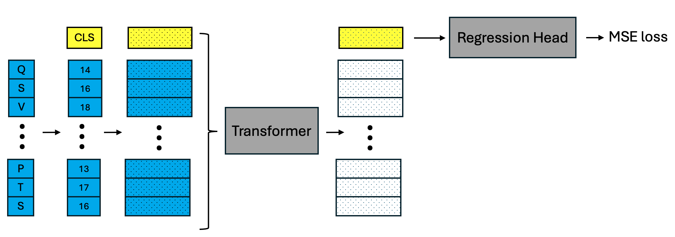
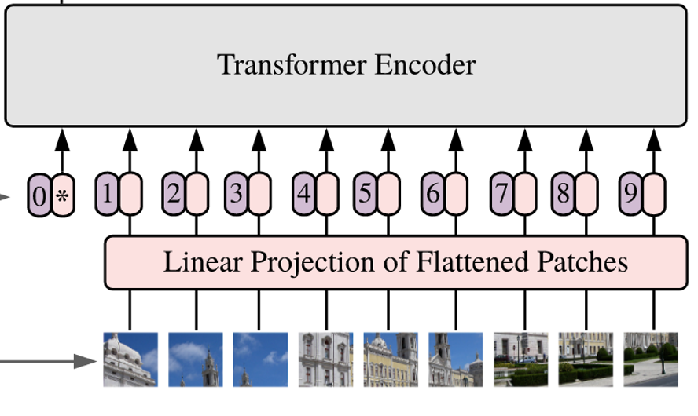
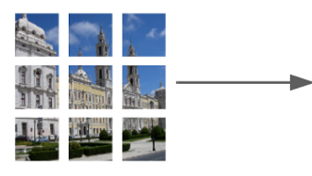
Model architectures examined in this study
MLP
Residual MLP (as a regression head)
Regression Head
MSE loss
Vision Transformer
with residual-MLP regression head
Transformer
with residual-MLP regression head

Slide 9
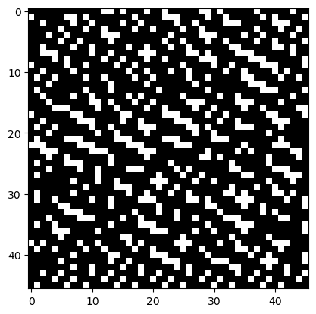
Vision Transformer: 1-channel image
aa sequence: ['CLS', 'Q', 'V', 'Q', 'L', 'V', ‘Q]
(use block_size = 241 (drop the last 5 residues)
encoded: [ 0, 14, 18, 14, 10, 18, 14]
binary: [00000000000011010001001000…] (using 8-bits per token)
reshape: (1,44,44)

Slide 10
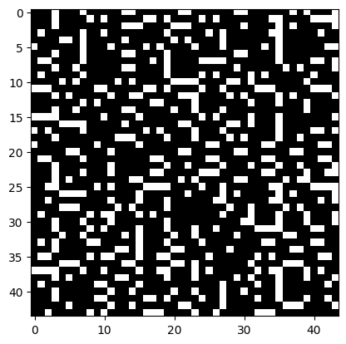
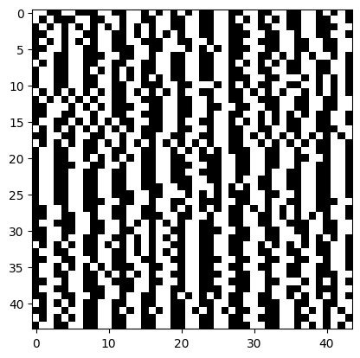
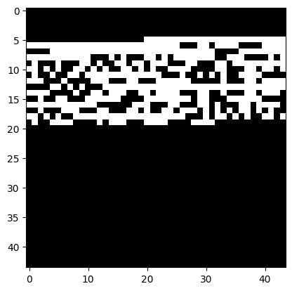
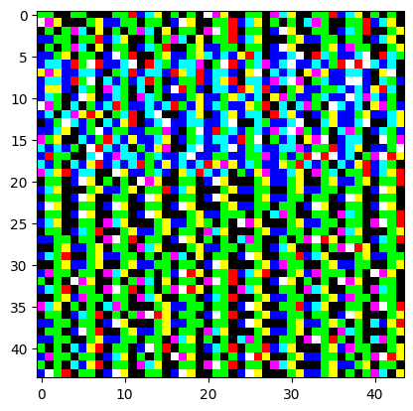
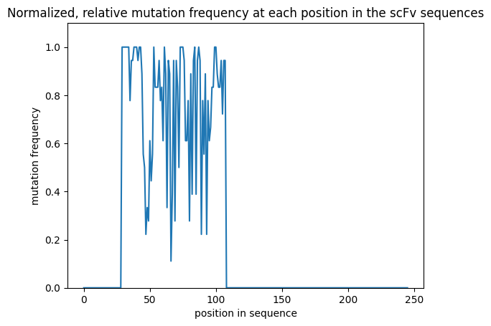
Vision Transformer: 3-channel image
channel 1
encoded residues
channel 2
aa groups
polar
non-polar
neg chg
pos chg
channel 3
mutation freq*
* relative variability by position over the entire dataset

Slide 11
Settings for models and training
Simple MLP
Vision Transformer (VIT)
Transformer
8 layers
input/output size : 247
dropout : 0.25
vocab size: 24
regularize sequences
flip prob: 0.2
mask prob: 0.1
block size: 242
img size: (1,42,42)
emb_dim: 256
patch_dim: 4
heads: 8
head size: 64
layers: 6
vocab size: 24
dropout
emb: 0.15
tform: 0.15
mlp: 0.3
regularize sequences
flip prob: 0.0
mask prob: 0.05
block size: 247
emb_dim: 256
heads: 8
head size: 64
layers: 6
vocab size: 24
dropouts
emb: 0.15
tform: 0.15
mlp: 0.3
regularize sequences
flip prob: 0.0
mask prob: 0.05
Misc:
VIT & TForm models: due to resource constraints, I could not explore larger attention heads (emb, heads, layers)
AdamW and exponential learning rate decay in all cases
Initial learning rate 0.001
Loss: MSE
VIT blocksize: I cut off the last 5 aa residues to better accommodate the dimensions needed for the VIT image patches

Slide 12
Results: Dataset Clean-3b
metrics calculated on the test set
Model | Train loss | Val loss | Epochs | Test set |  |  |  |  | Comment
 |  |  |  | MAE | MSE | MAPE ² | PPE10 ³ | PPE20 ⁴
MLP | 0.37 | 0.41 | 3787 | 0.52 | 0.39 | 0.33 | 21 | 42
VIT ¹ | 0.14 | 0.17 | 500 | 0.29 | 0.16 | 0.17 | 48 | 70 | 1-channel
VIT ¹ | 0.10 | 0.13 | 500 | 0.27 | 0.16 | 0.16 | 50 | 74 | 3-channel
*Transformer ¹ | 0.02 | 0.12 | 183 | 0.28 | 0.15 | 0.17 | 49 | 71
* best performing model
Regression head is residual-MLP. (interestingly, residual-MLP head gave better convergence properties than standard MLP)
MAPE : mean absolute percentage error : mean(abs(actual-pred)/actual). Lower is better
PPE10 : percentage of time prediction is within 10% of ground truth. Higher is better
PPE20 : percentage of time prediction is within 20% of ground truth. Higher is better

Slide 13
Results: Transformer on different cleaned datasets
model trained on each dataset
metrics calculated on that dataset’s test subset
Dataset | q_value cutoff ¹ | data set size | Train loss | Val loss | Epochs ² | Test set |  |  |  |  | Comment
 |  |  |  |  |  | MAE | MSE | MAPE | PPE10 | PPE20
Clean-3b | 0.05 | 9302 | 0.02 | 0.12 | 183 | 0.28 | 0.15 | 0.17 | 49 | 71
* Clean-4 | 0.5 | 12320 | 0.05 | 0.11 | 316 | 0.26 | 0.13 | 0.15 | 54 | 80
Clean-1 | 1.0 | 29199 | 0.16 | 0.13 | 86 | 0.30 | 0.15 | 0.12 | 54 | 85 | shows some overfitting
* best performing dataset (based on val loss and test set MSE value)
only data with q_value less than this value included in dataset
epochs value is from the best val loss checkpoint. Typically, the training jobs was set to run either 500 or 1000 epochs
It’s noted in the Table-Transformer literature that the transformer architecture can be surprisingly robust to “dirty” data

Slide 14
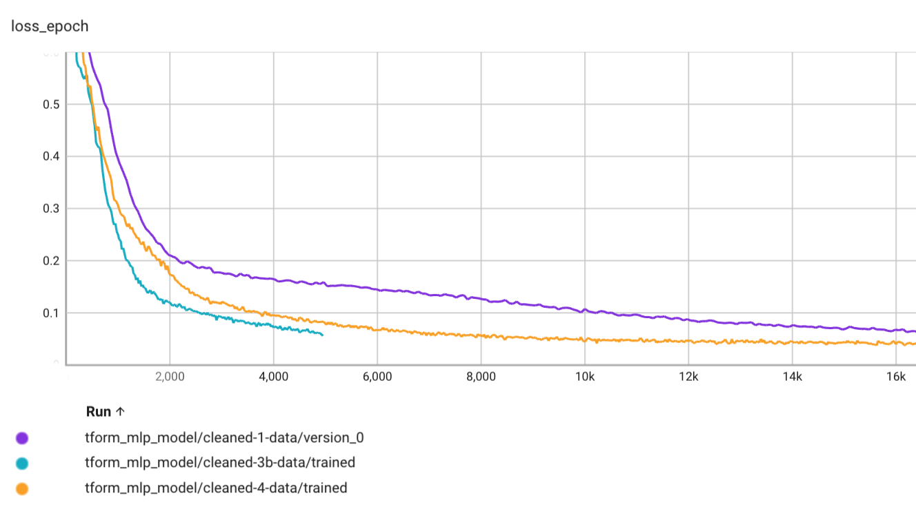
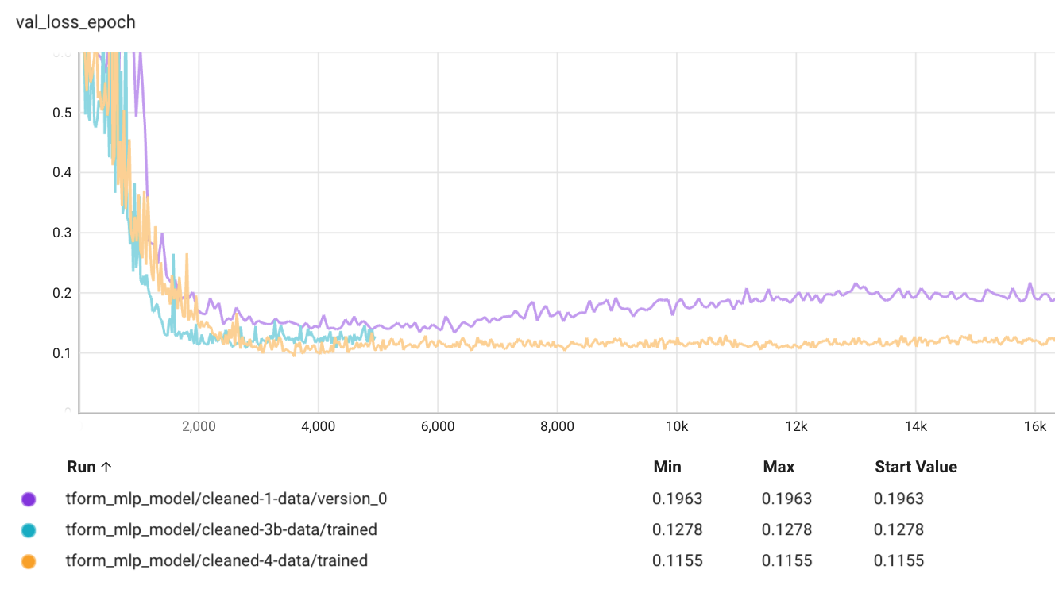
Loss Curves
Train
Transformer model
Clean-1, Clean-4, and Clean-3b datasets
Show the first 16K batches
Training converges faster for smaller datasets (not surprising)
In spite of it’s larger size, clean-1 dataset shows small signs of overfitting
Validation

Slide 15
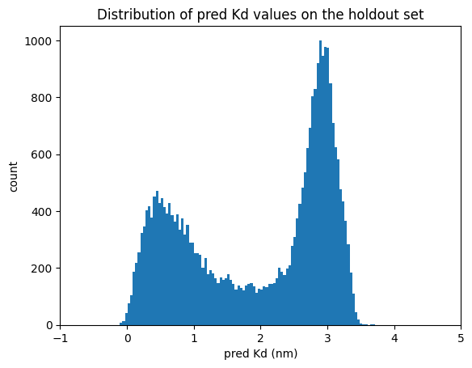
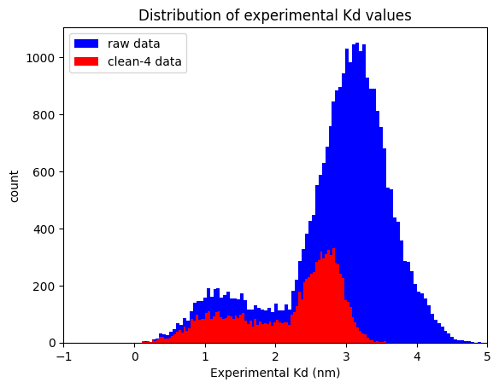
Transformer model holdout set predictions
trained on clean-4 dataset
Holdout set
Comparing Kd distributions holdout-preds vs. raw training and clean-4 data:
holdout preds resemble overall shape of clean-4 data (less so the raw data)
most of the high q_value data that was culled is in the higher-end of the Kd range
the low-Kd part of the holdout distribution skews more strongly towards 0, relative to experimental results

Slide 16
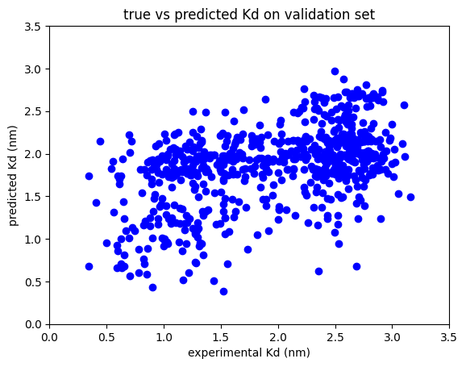
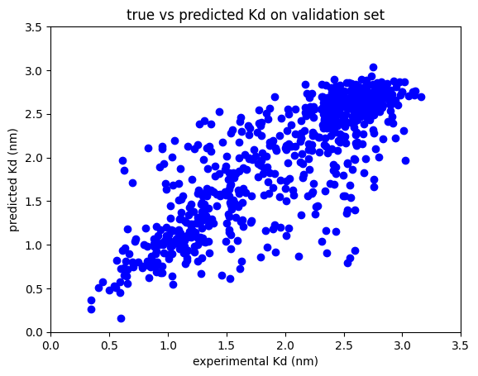
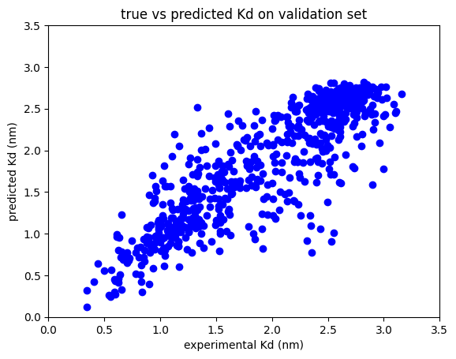
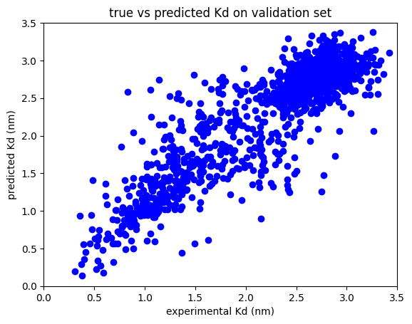
Plots experiment vs predicted on test set :
MLP
VIT 1-channel
VIT 3-channel
Transformer
Clean-3b dataset
Clean-3b dataset
Clean-3b dataset
Clean-4 dataset
clustering about the x=y line is tighter for models that performed better

Slide 17
Conclusions
MLP models do not explicitly treat relationships between different elements in a sequence. For sequence-to-affinity regression problem, MLP, not surprisingly, performed the poorest
Transformer-based models explicitly treat these interactions via the self-attention mechanism and this proves advantageous in this study
also, these converge faster than the MLP models I tried.
Vision transformer on this data proved surprisingly effective
3-channel approach did slightly better than 1-channel.
CAVEAT: In hindsight, I could simply have encoded/embed the same data from channels 2,3 into the linear Transformer model as well; which is probably more straightforward. (So, using VIT probably not as clever as I originally thought)
In some sense, VIT maybe was quite incorrect: the sequences passed into the transformer are shorter (due to patch embedding), and the image format forces patches to have spatial relationships that have nothing to do with the original aa sequence. Deserves more thought

Slide 18
Appendix 1: BERT
This was too ambitious to complete for this assignment
Below, I outline some of the preliminary work I did

Slide 19
BERT Stuff: Relevant literature, code, and data
Note: I did most of the BERT coding/testing in the 2 weeks before my call with Adrian (i.e. before getting the homework problem)
BERT : https://aclanthology.org/N19-1423.pdf
ProteinBERT : https://doi.org/10.1093/bioinformatics/btac020
Code partially taken from:
Barney Hill : https://github.com/barneyhill/minBERT
Andrej Karpathy: https://github.com/karpathy/minGPT
my Table Transformer code (from real-estate automated valuation model development)
A-Alpha Bio:
Nature Comm: http://biorxiv.org/lookup/doi/10.1101/2022.10.07.502662
Nature: https://www.nature.com/articles/s41597-022-01779-4
scFv Datasets: https://github.com/mit-ll/AlphaSeq_Antibody_Dataset.git
Observed Antibody Space :
https://doi.org/10.4049/jimmunol.1800708
https://opig.stats.ox.ac.uk/webapps/oas/
My Github repo for this homework’s code: https://github.com/planaria158/BERT.git

Slide 20
BERT pre-train dataset: OAS (Observed Antibody Space) database
Pretrain (masked language model) with:
Human, SARS-COV-2, light chain, unpaired
175 datafiles
Plan
focus on just sequence_alignment_aa column (not germline)
eliminate duplicates
ignore the separate v, d, and j (they are already in the light chain)
ignore fwr1, fwr2, fwr3, fwr4 regions (on the heavy chain?)
ignore CDR sequences (they are already contained in the longer light-chain sequences)
Result of data extraction
total rows 20306305, num unique, len(seqs): 18061315
range in length from min_len: 43 , max_len: 132
https://opig.stats.ox.ac.uk/webapps/oas/

Slide 21
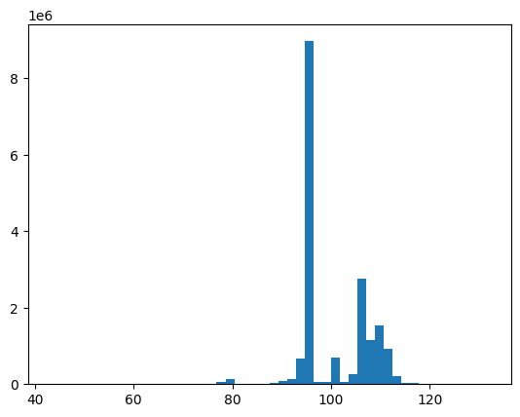
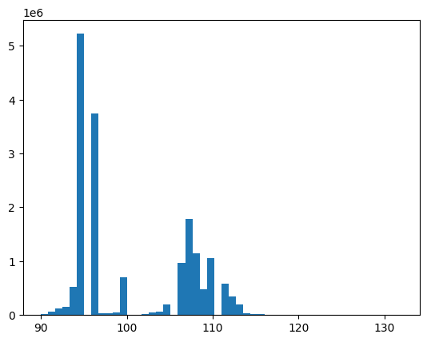
OAS dataset: distribution of peptide lengths
18061315 sequences
17599987 sequences
remove all seqs < 90 length
sequence length
sequence length
Final dataset:
17599987 unique sequences between 90 – 132 length
train: 14079989
test: 3519998

Slide 22
BERT
pre-train in masked-language mode, OAS light-chain dataset
CLS
0
0
0
Q
14
14 ?
0
S
Mask
16 ?
16
V
18
Transformer
18 ?
0
…
…
…
…
Linear
…
…
CE loss
P
Mask
13 ?
13
T
17
17 ?
0
S
16
16 ?
0
Contexts
Logits
Mask
CLS + aa residues
Encodings (masked)
Embeddings
(separate mask created during encoding
and also passed into transformer)

Slide 23
BERT
fine-tune on scFv library with binding affinities. Create sequence to affinity model
CLS
0
Regression Head
(e.g. mlp)
MSE loss
Q
14
S
16
binding energy (nm)
V
18
Transformer
…
…
…
…
ignore
P
13
T
17
S
16
Encodings
Contexts
CLS + scFv aa
Embeddings
freeze some or all of the layers

Slide 24
Settings for BERT that I tried on the homework data
BERT pre-train
BERT fine-tune
block size: 248
emb_dim: 192
heads: 8
layers: 6
mask prob: 0.15
vocab size: 25
dropouts
emb: 0.1
residual: 0.1
attn: 0.1
BERT pre-train
mask prob: 0
head dropout: 0.2
base tformer layers:
all frozen
unfreeze last 1
unfreeze last 2
unfreeze last 3
Misc:
BERT pre-train: due to resource constraints, I had to use a small BERT (emb, heads, layers) and only did 10 epochs of pre-training
AdamW and exponential learning rate decay for all trainings
Initial learning rate 0.0001
Loss: Cross entropy for MLM pretraining. MSE for fine tuning

Slide 25
Results: Dataset Clean-3, BERT
Train Loss | Valid. Loss | Epochs | RMSE (valid set) | Comment
0.34 | 0.33 | 10 | na | pre-train OAS data
0.51 | 0.52 | 160 | 1.06 | fine-tune transformer frozen
0.50 | 0.52 | 335 |  | fine-tune last 1 layer tform
0.24 | 0.29 | 460 |  | fine-tune last 2 layers tform
0.05 | 0.18 | 675 | 1.06 | unfreeze last 3 layers
definitely some overfitting
I simple didn’t have the GPU resources and time to really refine the pre-training
Pre-train BERT on OAS dataset, then fine-tune on scFv train data (OAS dataset is 18061315 rows)

