Slide 1
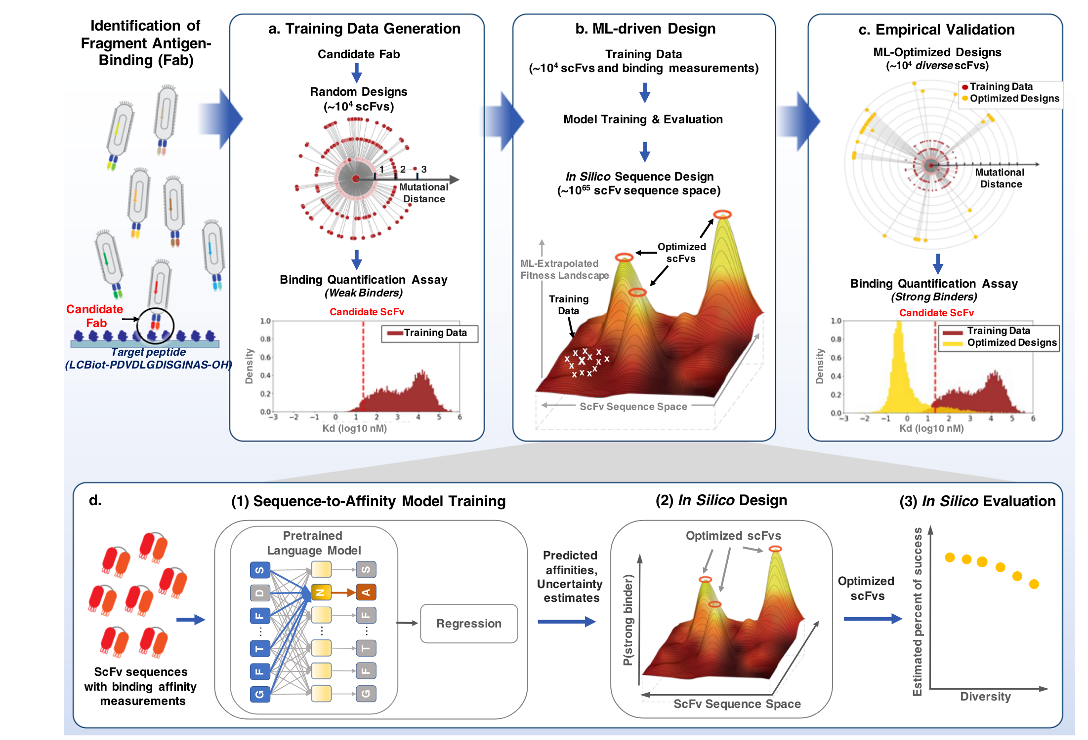
BERT for Biology Stuff
Mark Thompson
Purpose
Enhance my understanding of BERT (and LLMs) for drug design
Familiarize myself with how model is structured and works
Reproduce parts of the a-AlphaBio study
(NOT the actual results, but simplified overall process)
just this part
https://www.nature.com/articles/s41597-022-01779-4

Slide 2
Relevant literature, code, and data
BERT : https://aclanthology.org/N19-1423.pdf
ProteinBERT : https://doi.org/10.1093/bioinformatics/btac020
Code taken from:
Barney Hill : https://github.com/barneyhill/minBERT
Andrej Karpathy: https://github.com/karpathy/minGPT
my Table Transformer code (from real-estate automated valuation model development)
a-Alpha-Bio:
Nature Comm: http://biorxiv.org/lookup/doi/10.1101/2022.10.07.502662
Nature: https://www.nature.com/articles/s41597-022-01779-4
scFv Datasets: https://github.com/mit-ll/AlphaSeq_Antibody_Dataset.git
Observed Antibody Space :
https://doi.org/10.4049/jimmunol.1800708
https://opig.stats.ox.ac.uk/webapps/oas/
My Github repo for this homework’s code: https://github.com/planaria158/BERT.git

Slide 3
BERT
pre-train in masked-language mode, OAS light-chain dataset
CLS
0
0
0
Q
14
14 ?
0
S
Mask
16 ?
16
V
18
Transformer
18 ?
0
…
…
…
…
Linear
…
…
CE loss
P
Mask
13 ?
13
T
17
17 ?
0
S
16
16 ?
0
Contexts
Logits
Mask
CLS + aa residues
Encodings (masked)
Embeddings
(separate mask created during encoding
and also passed into transformer)

Slide 4
Training Data: OAS (Observed Antibody Space) database
Pretrain (masked language model) with:
Human, SARS-COV-2, light chain, unpaired
175 datafiles
Plan
focus on just sequence_alignment_aa column (not germline)
eliminate duplicates
ignore the separate v, d, and j (they are already in the light chain)
ignore fwr1, fwr2, fwr3, fwr4 regions (on the heavy chain?)
ignore cdr sequences (they are already contained in the longer light-chain sequences)
Result of data extraction
total rows 20306305, num unique, len(seqs): 18061315
range in length from min_len: 43 , max_len: 132
https://opig.stats.ox.ac.uk/webapps/oas/

Slide 5
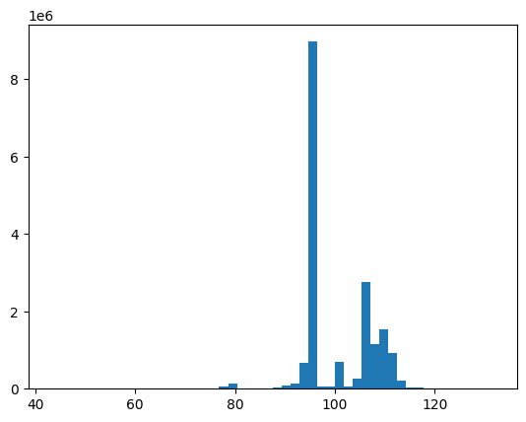
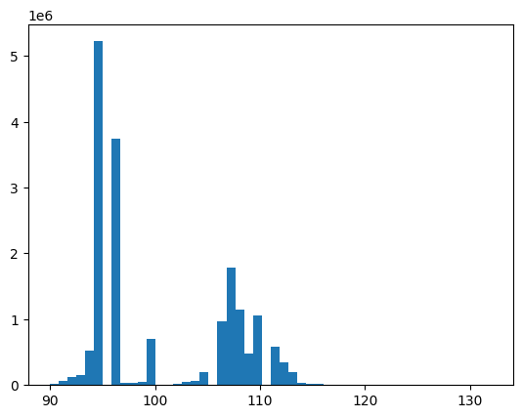
Training Data: distribution of peptide lengths
18061315 sequences
17599987 sequences
remove all seqs < 90 length
sequence length
sequence length
Final dataset:
17,599,987 unique sequences between 90 – 132 length
train: 14,079,989
test: 3,519,998

Slide 6
Issue(s) I have not resolved to my satisfaction yet
Position embedding:
Use absolute position determined from each specific aa sequence?
Or, the absolute position in the entire human light chain?
makes more sense but not sure how I can get this information or if it changes for different antibody types (ie. IgG, IgA, etc)
There is no absolute light chain length for human IgG abs. A few different chains have slightly different lengths. Absolute alignment with reference light chains is probably not practical.
I’ll pre-train using option #1

Slide 7
Pre-training on OAS data
Code: pytorch with a pytorch-lightning harness to manage the training, test loop
Hardware: two GeForce RTX 2080 Ti with 11GB memory each.
Settings:
emb dim: 512
layers: 12
heads: 16
dropouts: 0.1
vocab size: 23 (20 aa, CLS, X, and MASK tokens)
block size: 91 (CLS token + 90 aa)
mask prob: 0.15
AdamW, learn rate 10⁻⁴, decay gamma: 0.9985
batch size: 120 (it’s what would fit on my compute resources)
gpus: 2
max epochs: 10

Slide 8
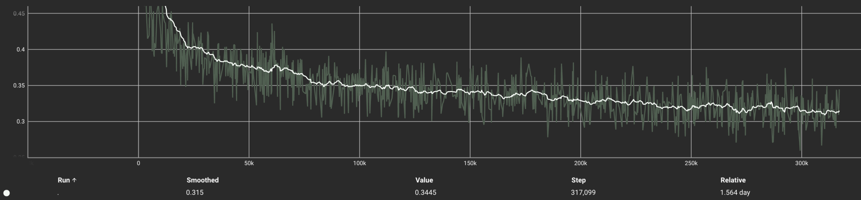
Pre-training: loss
Training loss: after 5 epochs
Stopped after 5 epochs
final losses
train: 0.32
val: 0.31

Slide 9
BERT
fine-tune on scFv library with binding energies. Create sequence to affinity model
CLS
0
Regression Head
(e.g. mlp)
MSE loss
Q
14
S
16
binding energy (nm)
V
18
Transformer
…
…
…
…
ignore
P
13
T
17
S
16
Encodings
Contexts
CLS + scFv aa
Embeddings
freeze weights

Slide 10
Fine Tuning dataset
antibody_dataset_1 : the scFv antibody sequence/binding affinity data in the AlphaSeq experimental assay data
Total rows: 1109000
Number of unique: 104972 (there are between 8-20 instances of each sequence)
Number of rows where pred_Affinity is not NAN : 340100
NANs are most likely non-binders (perhaps give them affinity 0?)
number of unique sequences in this subset: 87211
for each of these unique sequences, there are multiple binding affinity values
for example,
seq 1: num affinity values = 6 , values: {0.87, 0.91, 0.96, 3.92, 4.92, 5.72}
-RTlog10(5.72) = -4.88 kcal/mol binding free energy
-RTlog10(0.87) = -5.36 kcal/mol
for reference kT = 0.6 kcal/mol so this difference is on the order of kT
Final data set:
87211 sequences
affinity will be the mean of each sequence’s multiple affinities
43 Kd values are negative (?!?!) : remove these.
Final row count = 87168
Train/test split 90/10: 78451/8717 rows, respectively
https://www.nature.com/articles/s41597-022-01779-4
"Of the 119,600 designs, 104,972 were successfully built into the AlphaSeq library and target binding was subsequently measured with 71,384 designs”

Slide 11
Fine tune results
issue? block-size = 90 during pre-training. How to adapt for fine-tune data of longer length?
In progress

Slide 12
t-SNE plots…
In progress

