Slide 1
BERT stuff with antibodies
Mark Thompson
April, 2024

Slide 2
OAS (Observed Antibody Space) database
Pretrain (masked language model) with:
Human, SARS-COV-2, light chain, unpaired
175 datafiles
Plan
focus on just sequence_alignment_aa column (not germline)
eliminate duplicates
ignore the separate v, d, and j (they are already in the light chain)
ignore fwr1, fwr2, fwr3, fwr4 regions (on the heavy chain?)
ignore cdr sequences (they are already contained in the longer light-chain sequences)
Result of data extraction
total rows 20306305, num unique, len(seqs): 18061315
range in length from min_len: 43 , max_len: 132
https://opig.stats.ox.ac.uk/webapps/oas/

Slide 3
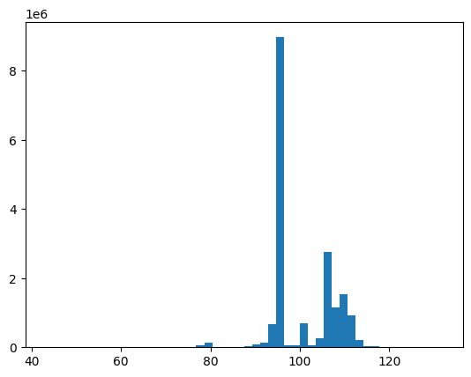
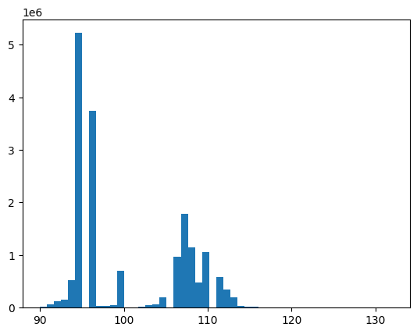
18061315 sequences
17599987 sequences
sequence length
sequence length
remove all seqs < 90 length
Final dataset:
17,599,987 unique sequences between 90 – 132 length
train: 14,079,989
test: 3,519,998

Slide 4
Position embedding:
Use absolute position in the specific aa sequence?
Or, the absolute position in the entire human light chain?
makes more sense but not sure how I can get this information or if it changes for different antibody types (ie. IgG, IgA, etc
There is no absolute light chain length for human IgG abs. A few different chains have slightly different lengths. Absolute alignment with reference light chains is probably not practical.

