Slide 1
Starbucks API Presentation
Zhu Yunhao

Slide 2






1. Technical Report Highlights (Architecture)
Framework & Tech Stack
Live Cloud Deployment
Data Processing
Developed robust Python scripts to clean and parse inherently unstructured Kaggle datasets, safely mapping complex nutritional metrics into the underlying SQLite database.
The system utilizes a 3-tier architecture built on Django and Django REST Framework (DRF). This ensures rapid development, robust Object-Relational Mapping (ORM), and efficient JSON serialization.
Successfully migrated from local development to a live production environment hosted on PythonAnywhere.

Slide 3
1. Technical Report Highlights (API Design)
RESTful Integrity: The API strictly adheres to REST principles, utilizing predictable resource-oriented URLs and returning semantically accurate HTTP status codes (200, 201, 400, 404).
Create & Read: Implemented robust POST methods with strict payload validation against serializers, alongside comprehensive GET methods for collection arrays and individual items.
Advanced Update Logic: Programmatically differentiated between full resource replacement (PUT mandates all fields) and partial modification (PATCH allows selective updates).
Delete: Securely removes designated resources via the DELETE method.

Slide 4
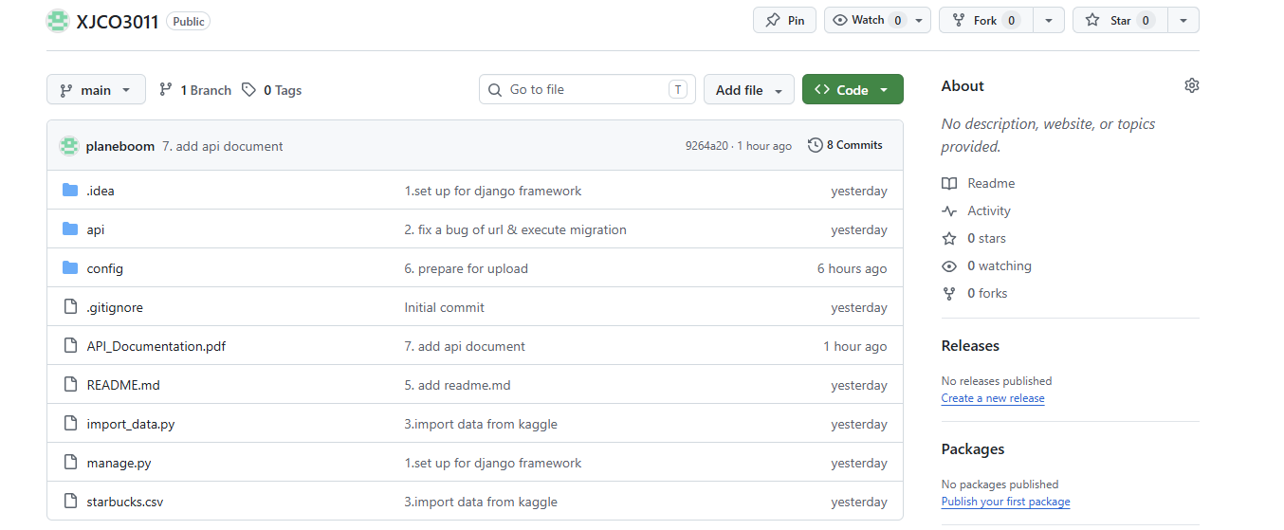
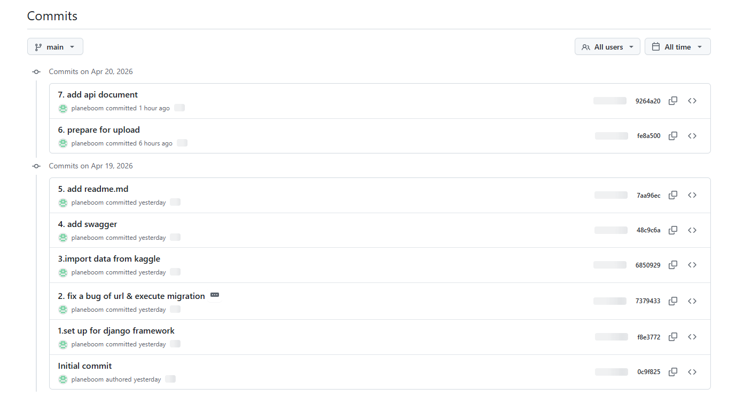
2. Version Control & Commit History
Git & GitHub Practices
Version control was integral to maintaining code integrity and tracking project milestones throughout the development lifecycle.
•
Continuous Integration: The project is fully hosted on GitHub, ensuring codebase security and accessibility.
•
Frequent Commits: Code was pushed regularly to reflect iterative development phases rather than a single monolithic upload.

Slide 5

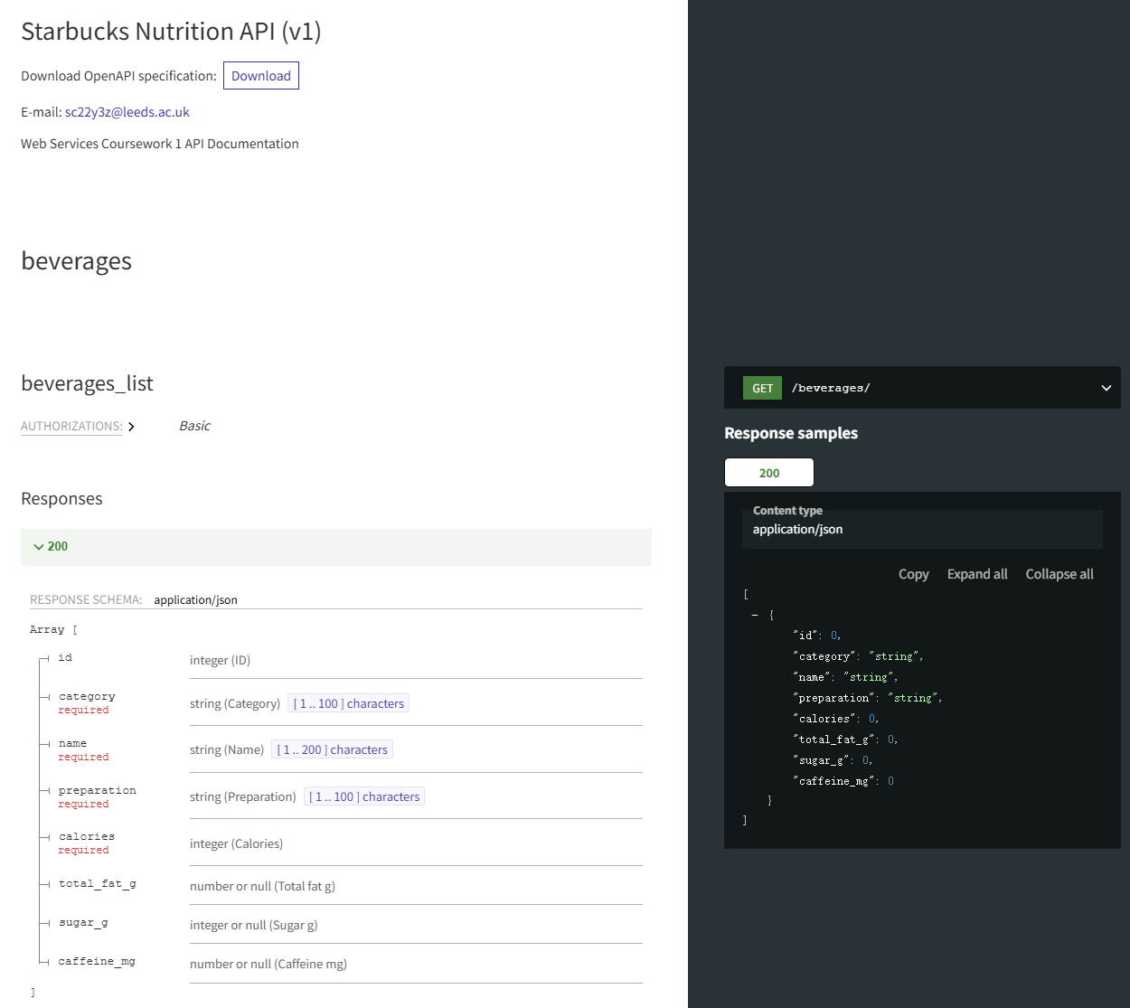
3. API Documentation Overview
Comprehensive API specifications were generated to provide clear endpoint definitions, payload requirements, and request/response examples.
•
Systematic Testing via Postman: Engineered a complete test suite to rigorously validate all CRUD endpoints. This simulated the full client-server lifecycle, ensuring that every request (from creation to deletion) returns accurate data and correct HTTP status codes.
•
Interactive ReDoc & Swagger UI: The API features dynamically generated, interactive documentation. While ReDoc serves as the primary clean, organized interface for data models, Swagger UI is also provided to allow developers to explore and test endpoints directly via the cloud URL.

Slide 6
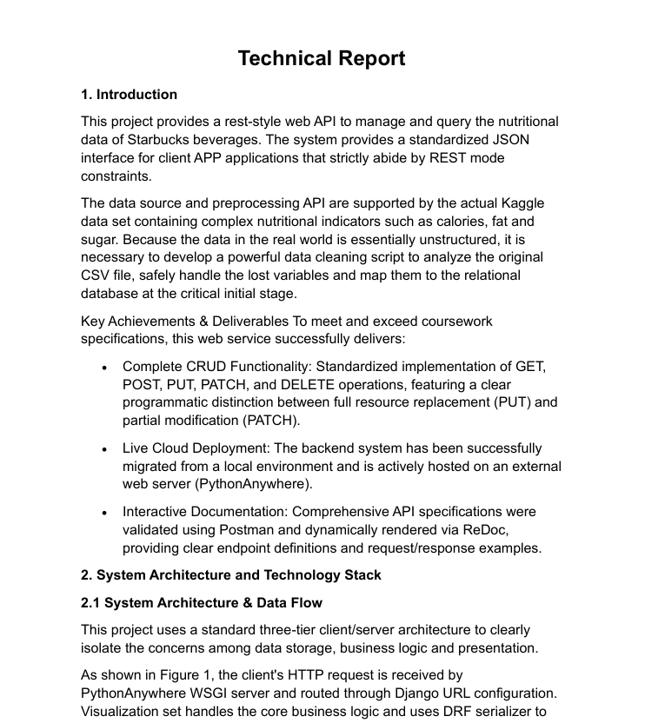
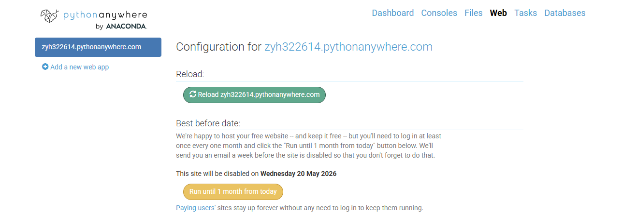
4. All Deliverables Overview
Final Submission Checklist
All required project components have been successfully completed, verified, and packaged for final evaluation:
Code Repository: Complete Django source code hosted on GitHub, including the data import scripts and SQLite database. https://github.com/planeboom/XJCO3011
API Docs: Interactive documentation running live on the cloud, plus the static API_Documentation.pdf.
Technical Report: The 5-page PDF report detailing architecture, design choices, and deployment strategies.
Live Deployment: Fully functional API hosted on PythonAnywhere.

Slide 7


Generative AI Usage Declaration
Assisted Tasks
Original Work
•
Initial Research: Surveyed Kaggle for suitable datasets.
•
Architecture & APIs: Independent selection of the DRF framework and design of all RESTful endpoint logic.
•
Scripting: Assisted with the try-except boilerplate to safely parse the irregular CSV data.
•
Deployment: Manual configuration of the PythonAnywhere server and execution of the Postman testing suites.
•
Debugging: Analyzed Django 500 error logs to resolve production static file routing issues.

Slide 8
Thank you for your listening

