Slide 1
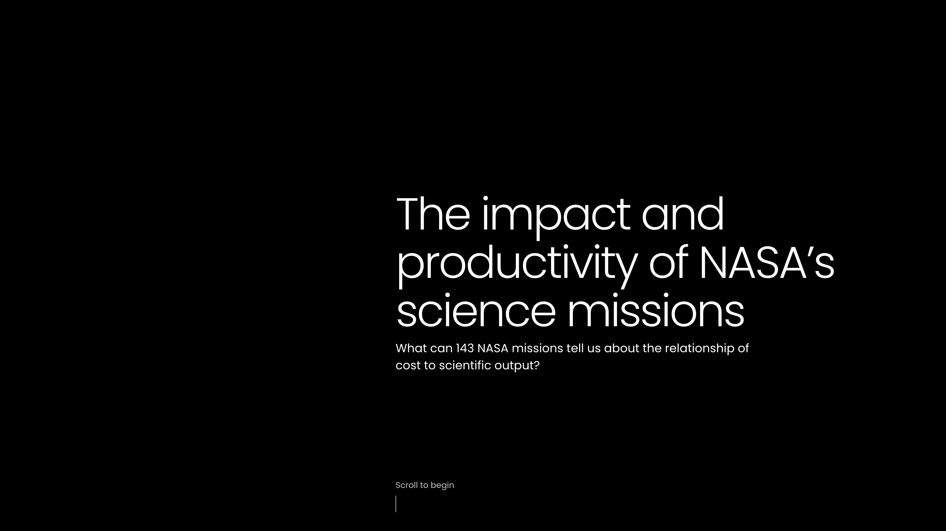

Slide 2
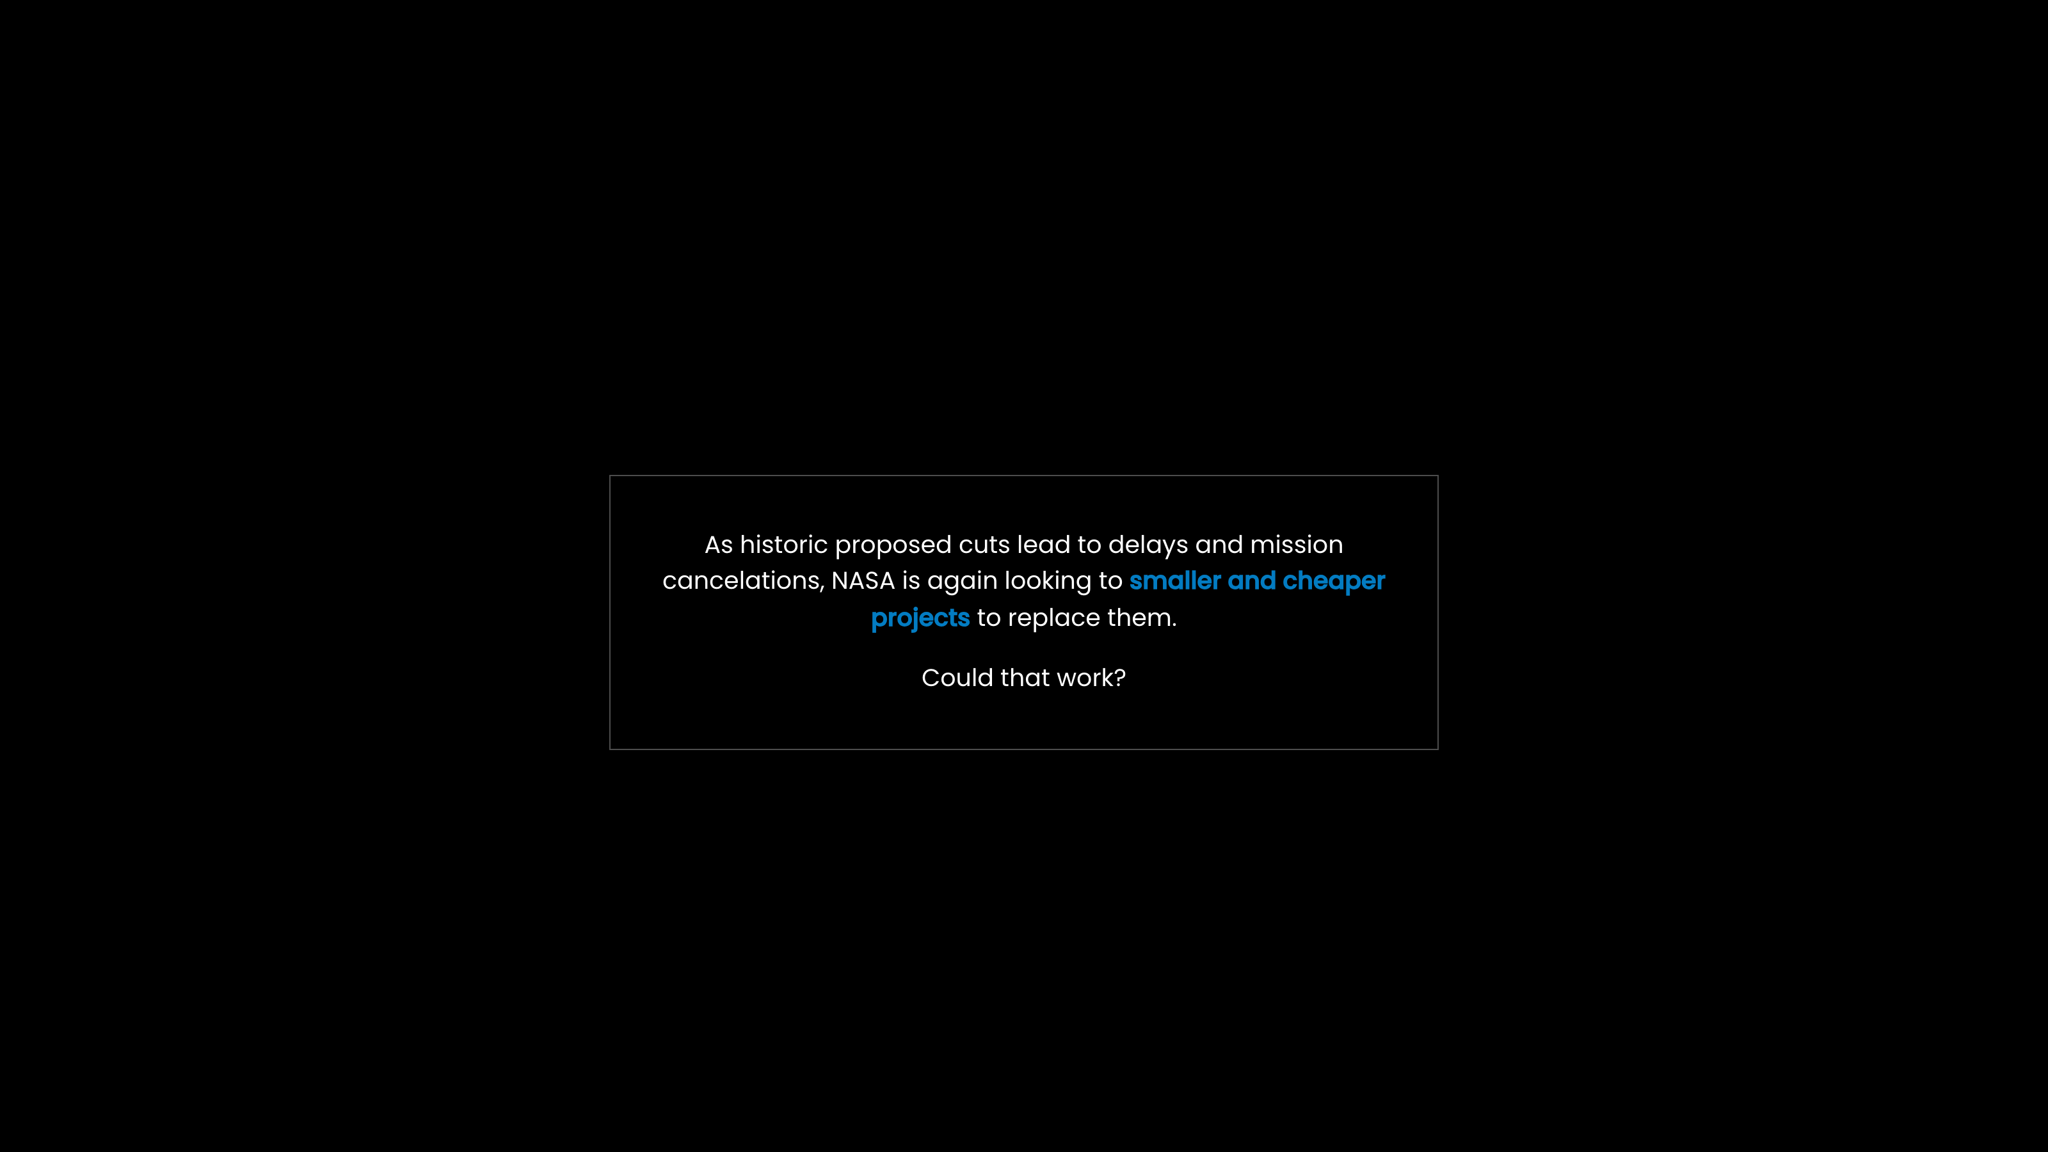
Notes:
As historic proposed cuts lead to delays and mission cancelations, NASA is again looking to smaller and cheaper projects to replace them.
Could that work?

Slide 3
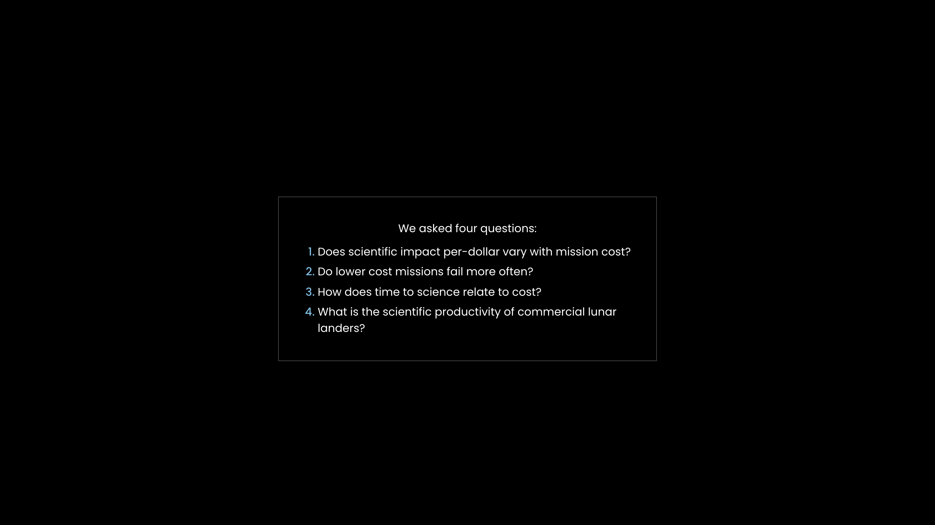
Notes:
We asked four questions:
Does scientific impact per-dollar vary with mission cost?
Do lower cost missions fail more often?
How does time to science relate to cost?
What is the scientific productivity of commercial lunar landers?

Slide 4
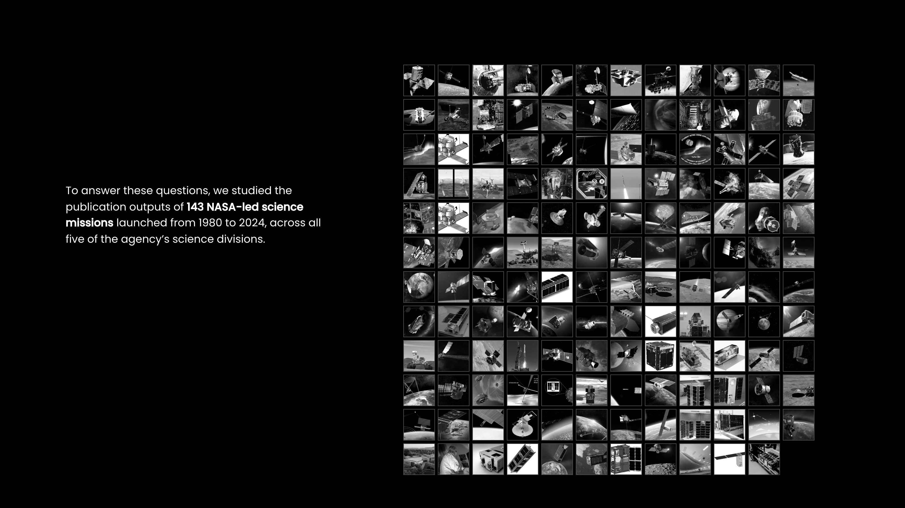
Notes:
To answer these questions, we studied the publication outputs of 143 NASA-led science missions launched from 1980 to 2024, across all five of the agency’s science divisions.

Slide 5
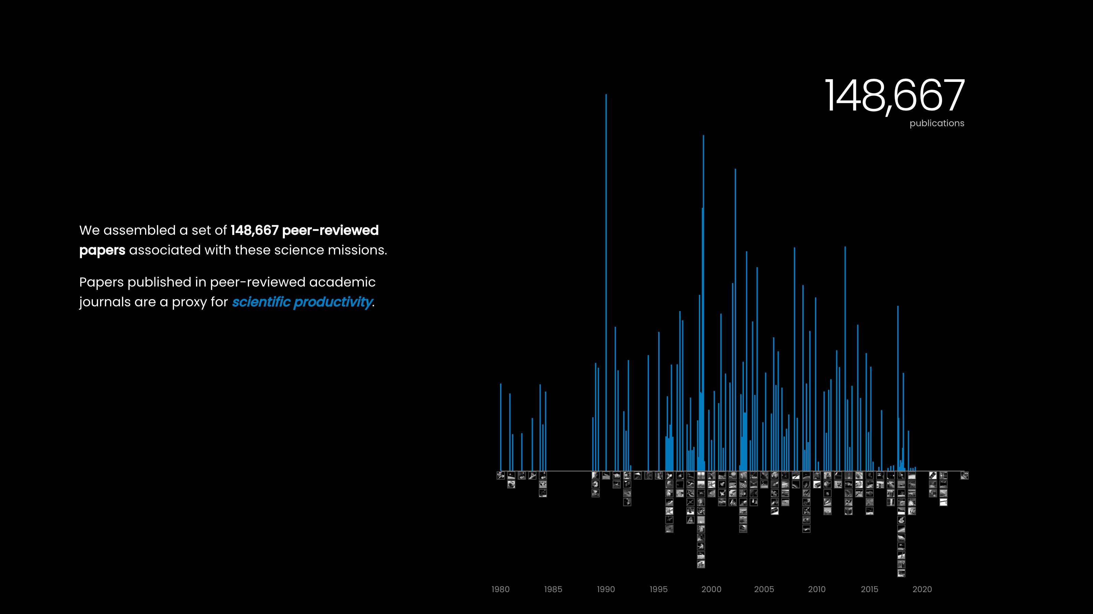
Notes:
We assembled a set of 148,667 peer-reviewed papers associated with these science missions.
Papers published in peer-reviewed academic journals are a proxy for scientific productivity.

Slide 6
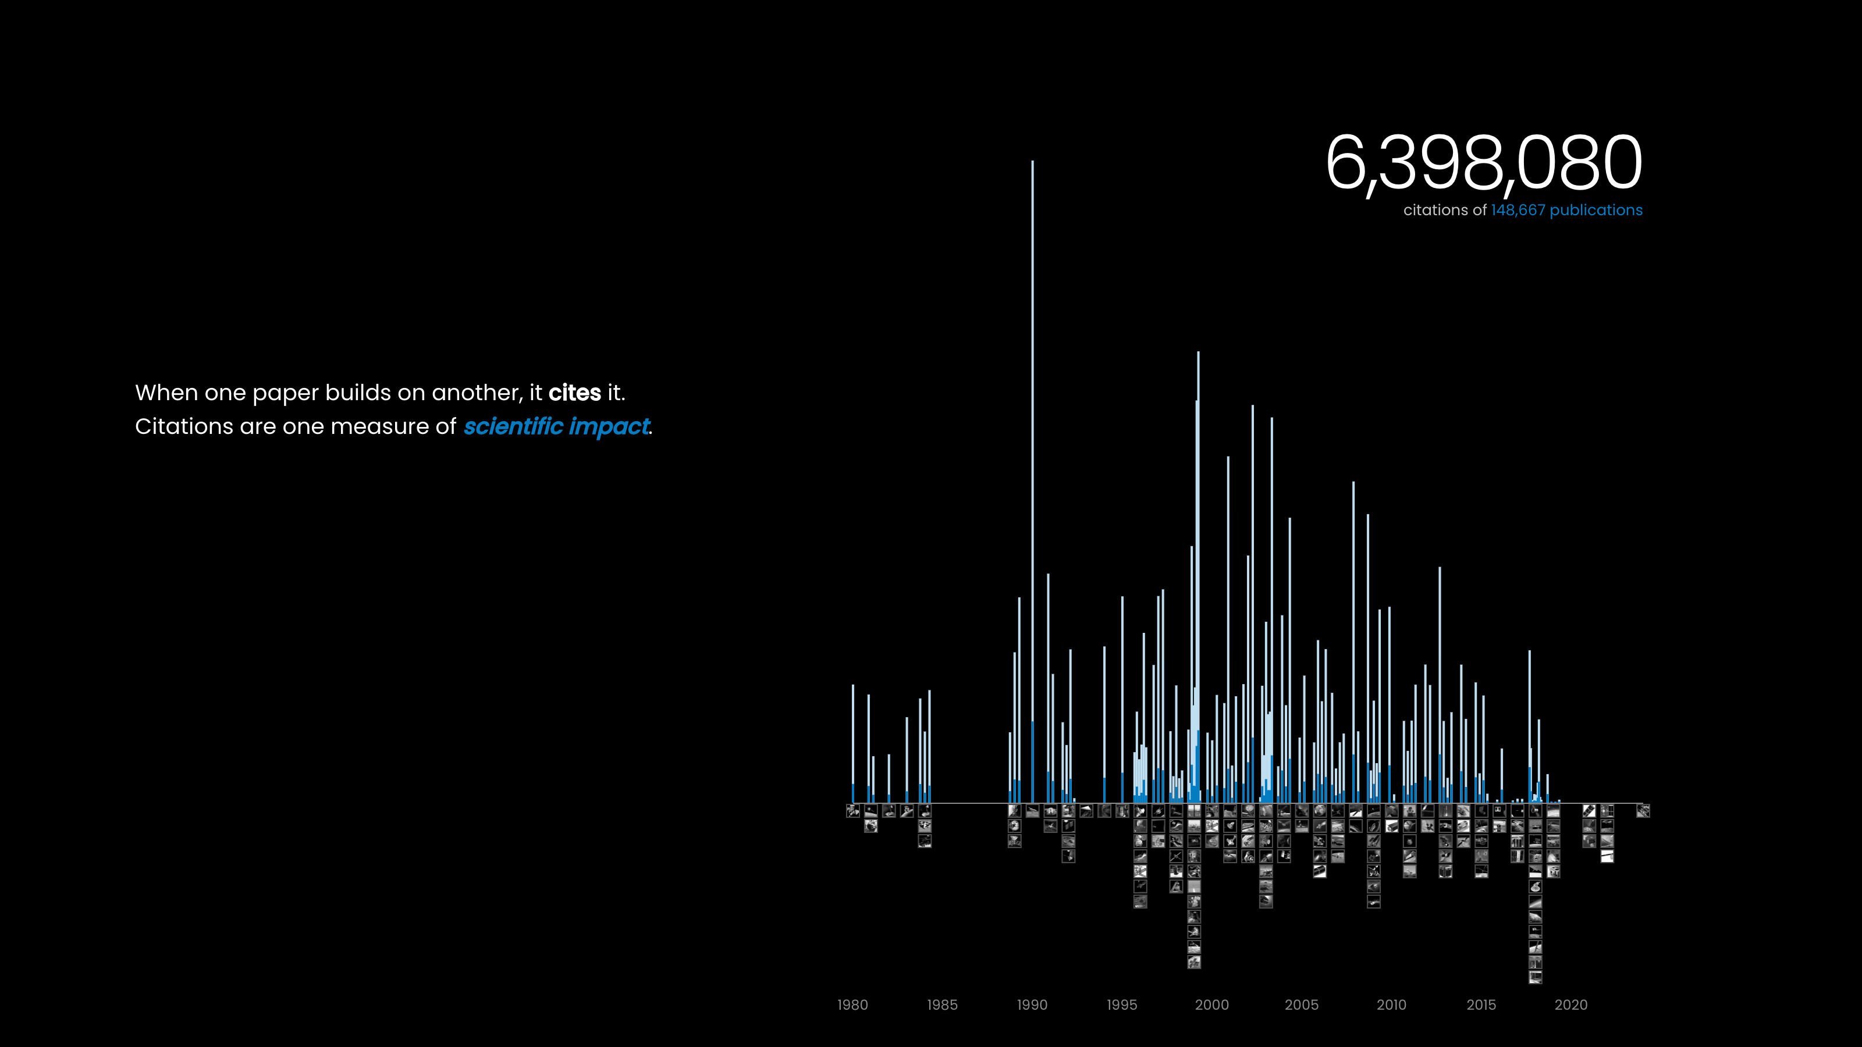
Notes:
When one paper builds on another, it cites it. Citations are one measure of scientific impact.

Slide 7
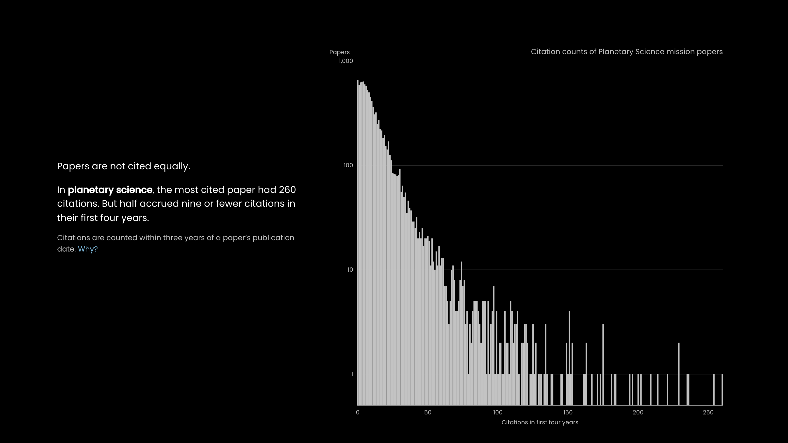
Notes:
Papers are not cited equally.
In planetary science, the most cited paper had 260 citations. But half accrued nine or fewer citations in their first four years.
Citations are counted within three years of a paper’s publication date. Why?

Slide 8
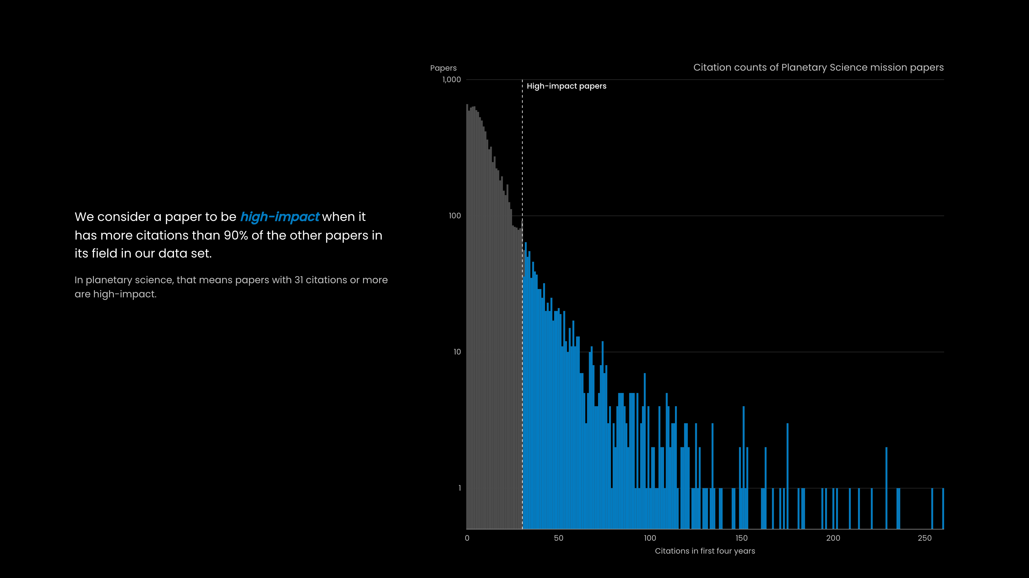
Notes:
We consider a paper to be high-impact when it has more citations than 90% of the other papers in its field in our data set.
In planetary science, that means papers with 31 citations or more are high-impact.

Slide 9
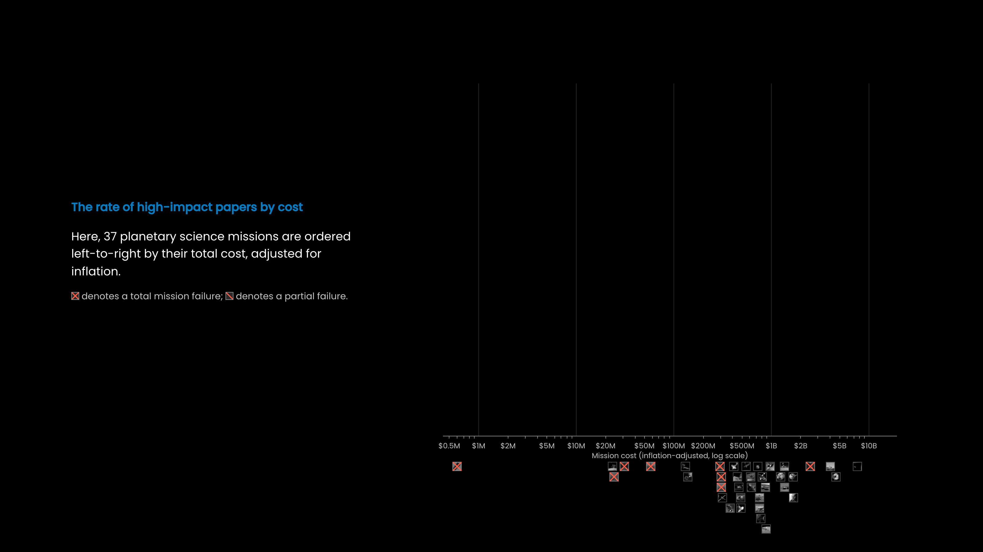
Notes:
The rate of high-impact papers by cost
Here, 37 planetary science missions are ordered left-to-right by their total cost, adjusted for inflation.
denotes a total mission failure; denotes a partial failure.

Slide 10
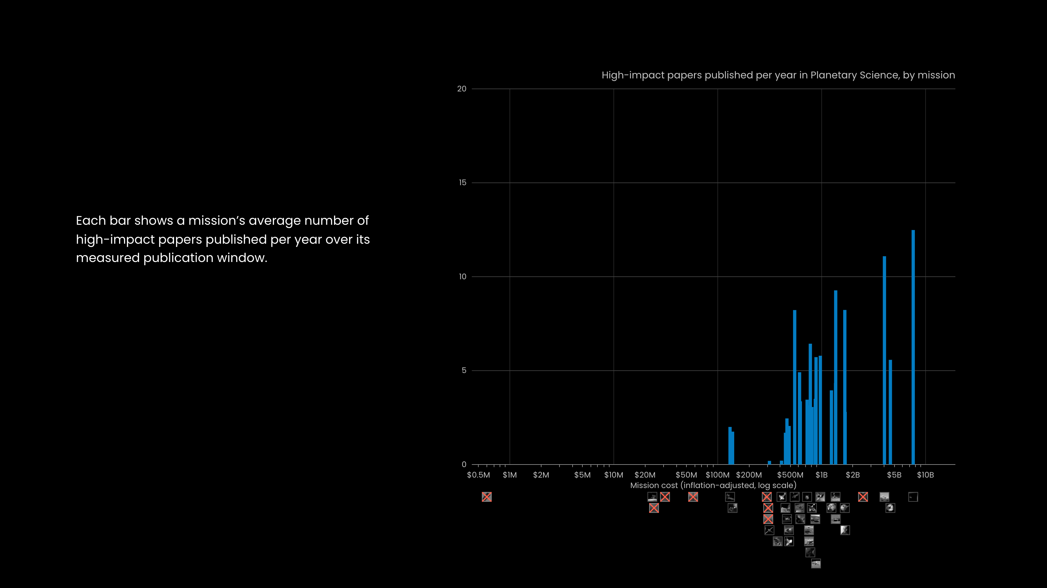
Notes:
Each bar shows a mission’s average number of high-impact papers published per year over its measured publication window.

Slide 11
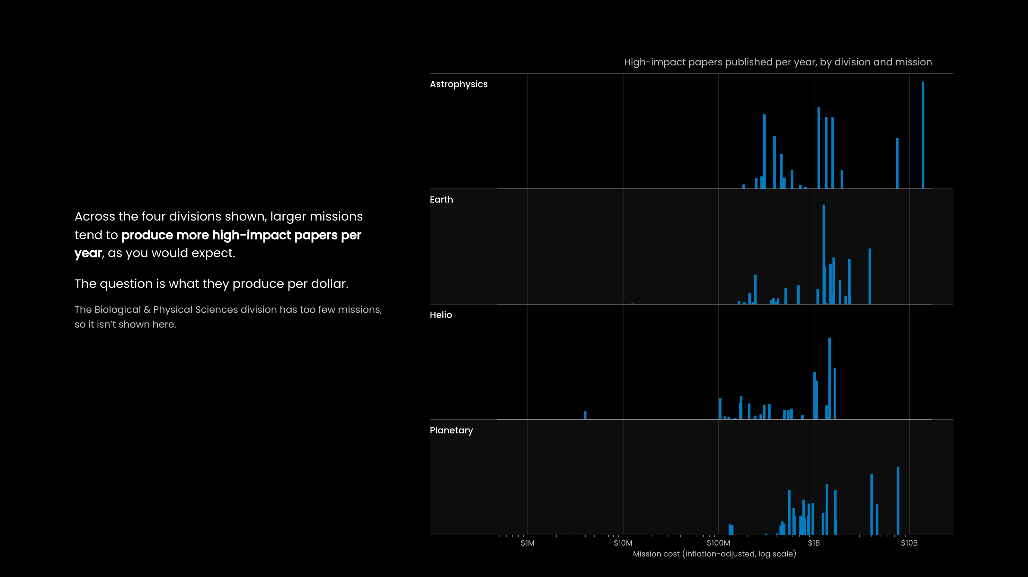
Notes:
Across the four divisions shown, larger missions tend to produce more high-impact papers per year, as you would expect.
The question is what they produce per dollar.
The Biological & Physical Sciences division has too few missions, so it isn’t shown here.

Slide 12
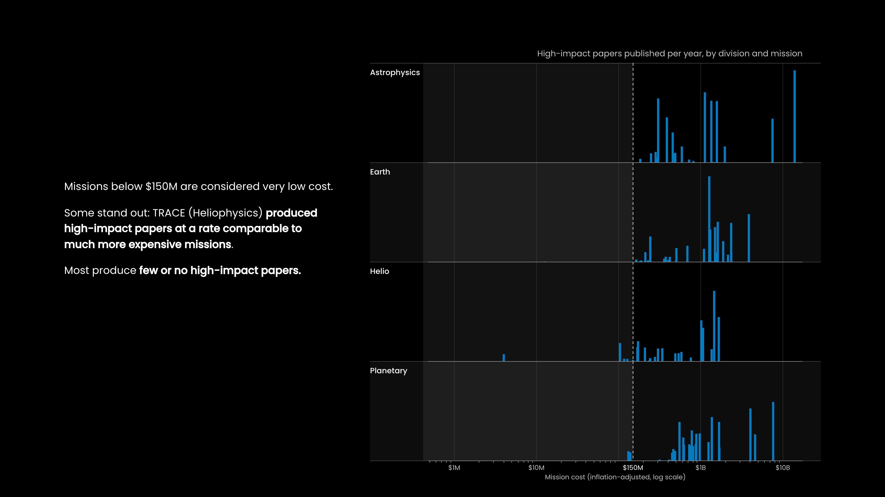
Notes:
Missions below $150M are considered very low cost.
Some stand out: TRACE (Heliophysics) produced high-impact papers at a rate comparable to much more expensive missions.
Most produce few or no high-impact papers.

Slide 13
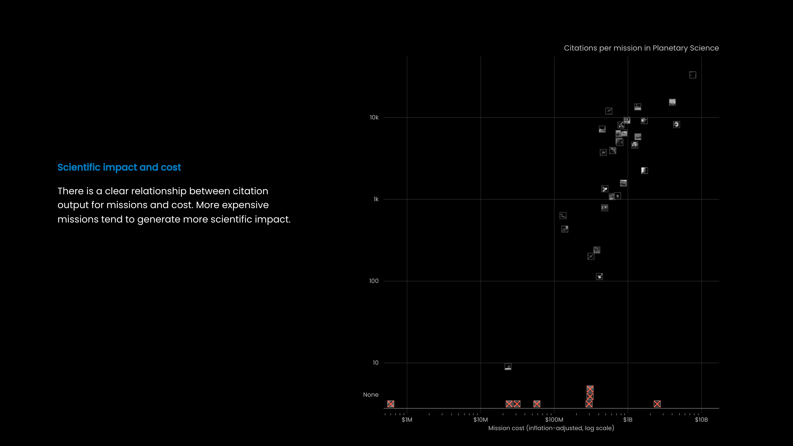
Notes:
Scientific impact and cost
There is a clear relationship between citation output for missions and cost. More expensive missions tend to generate more scientific impact.

Slide 14
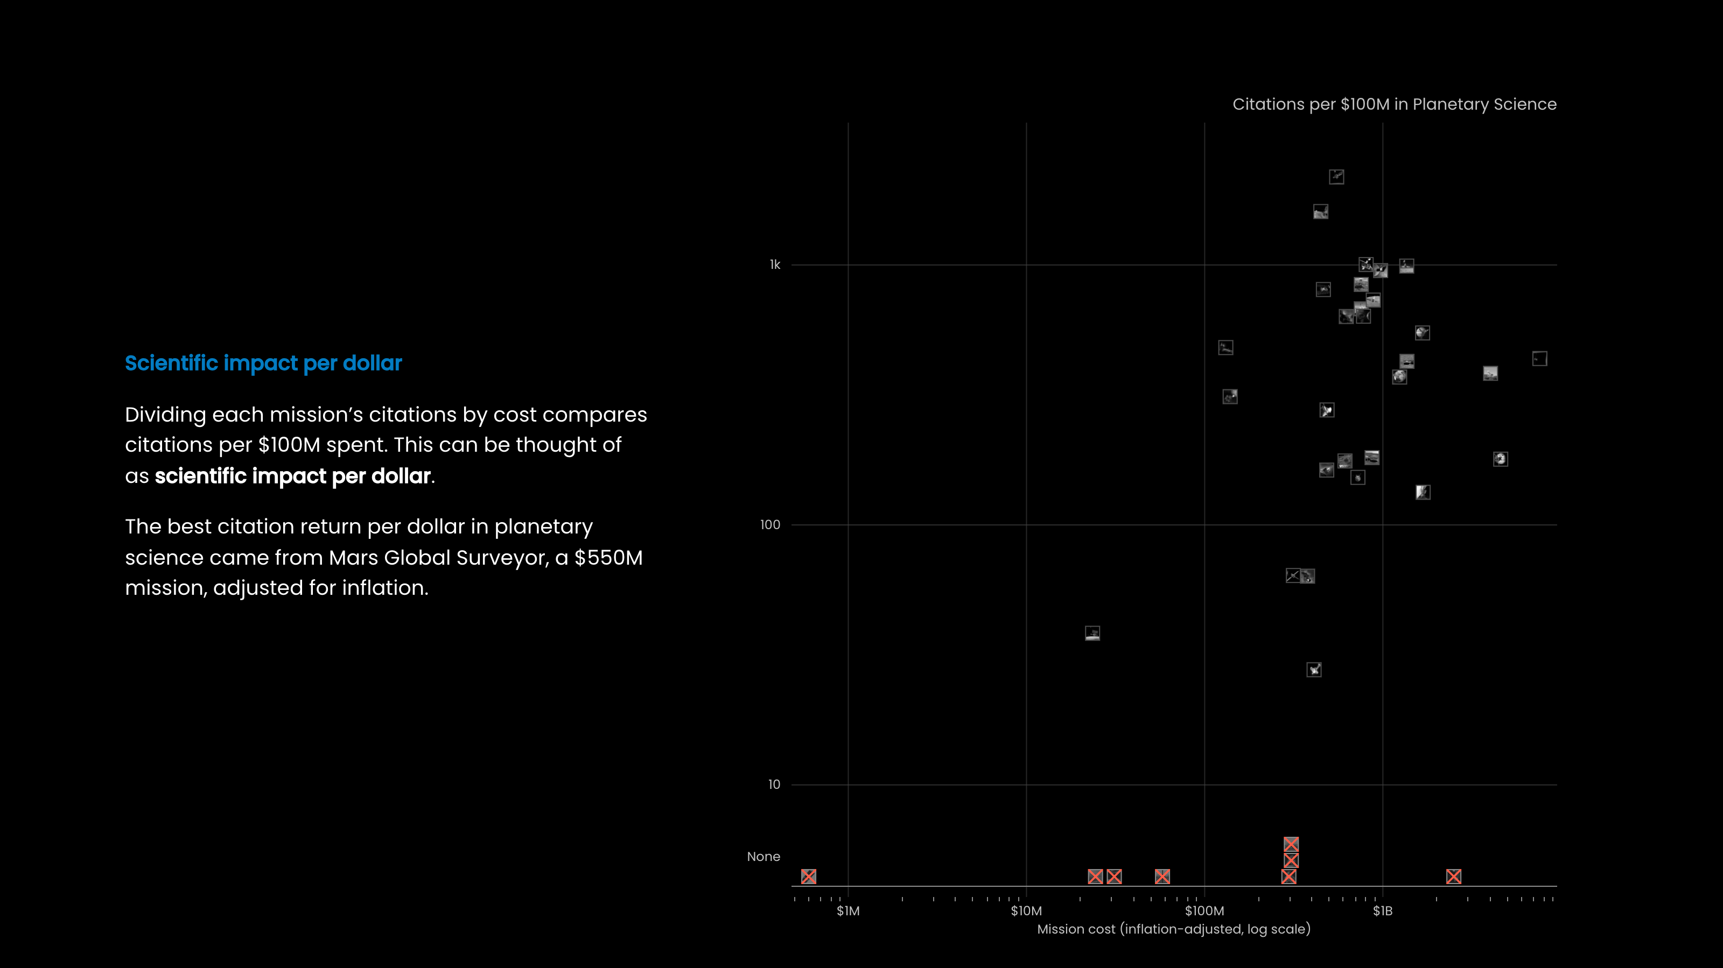
Notes:
Scientific impact per dollar
Dividing each mission’s citations by cost compares citations per $100M spent. This can be thought of as scientific impact per dollar.
The best citation return per dollar in planetary science came from Mars Global Surveyor, a $550M mission, adjusted for inflation.

Slide 15
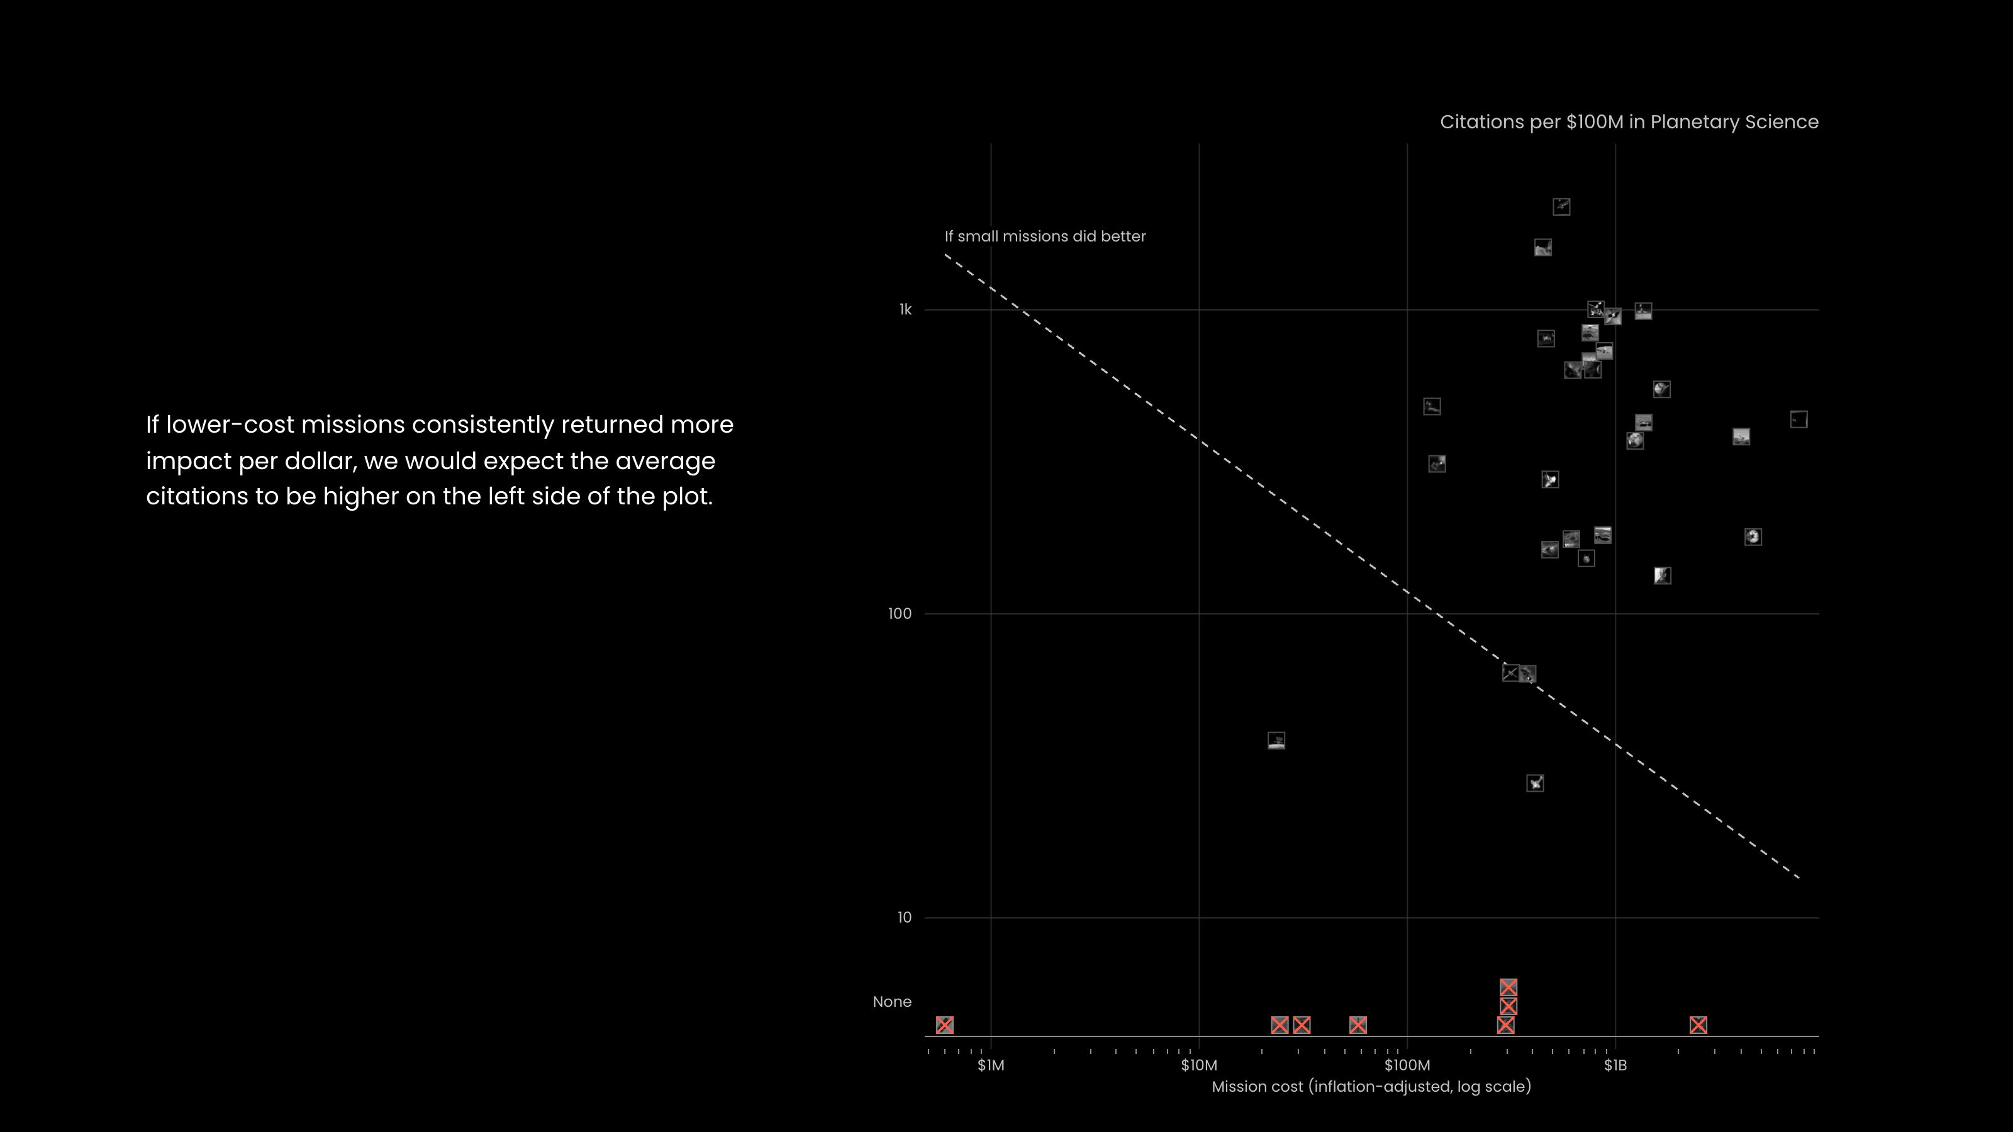
Notes:
If lower-cost missions consistently returned more impact per dollar, we would expect the average citations to be higher on the left side of the plot.

Slide 16
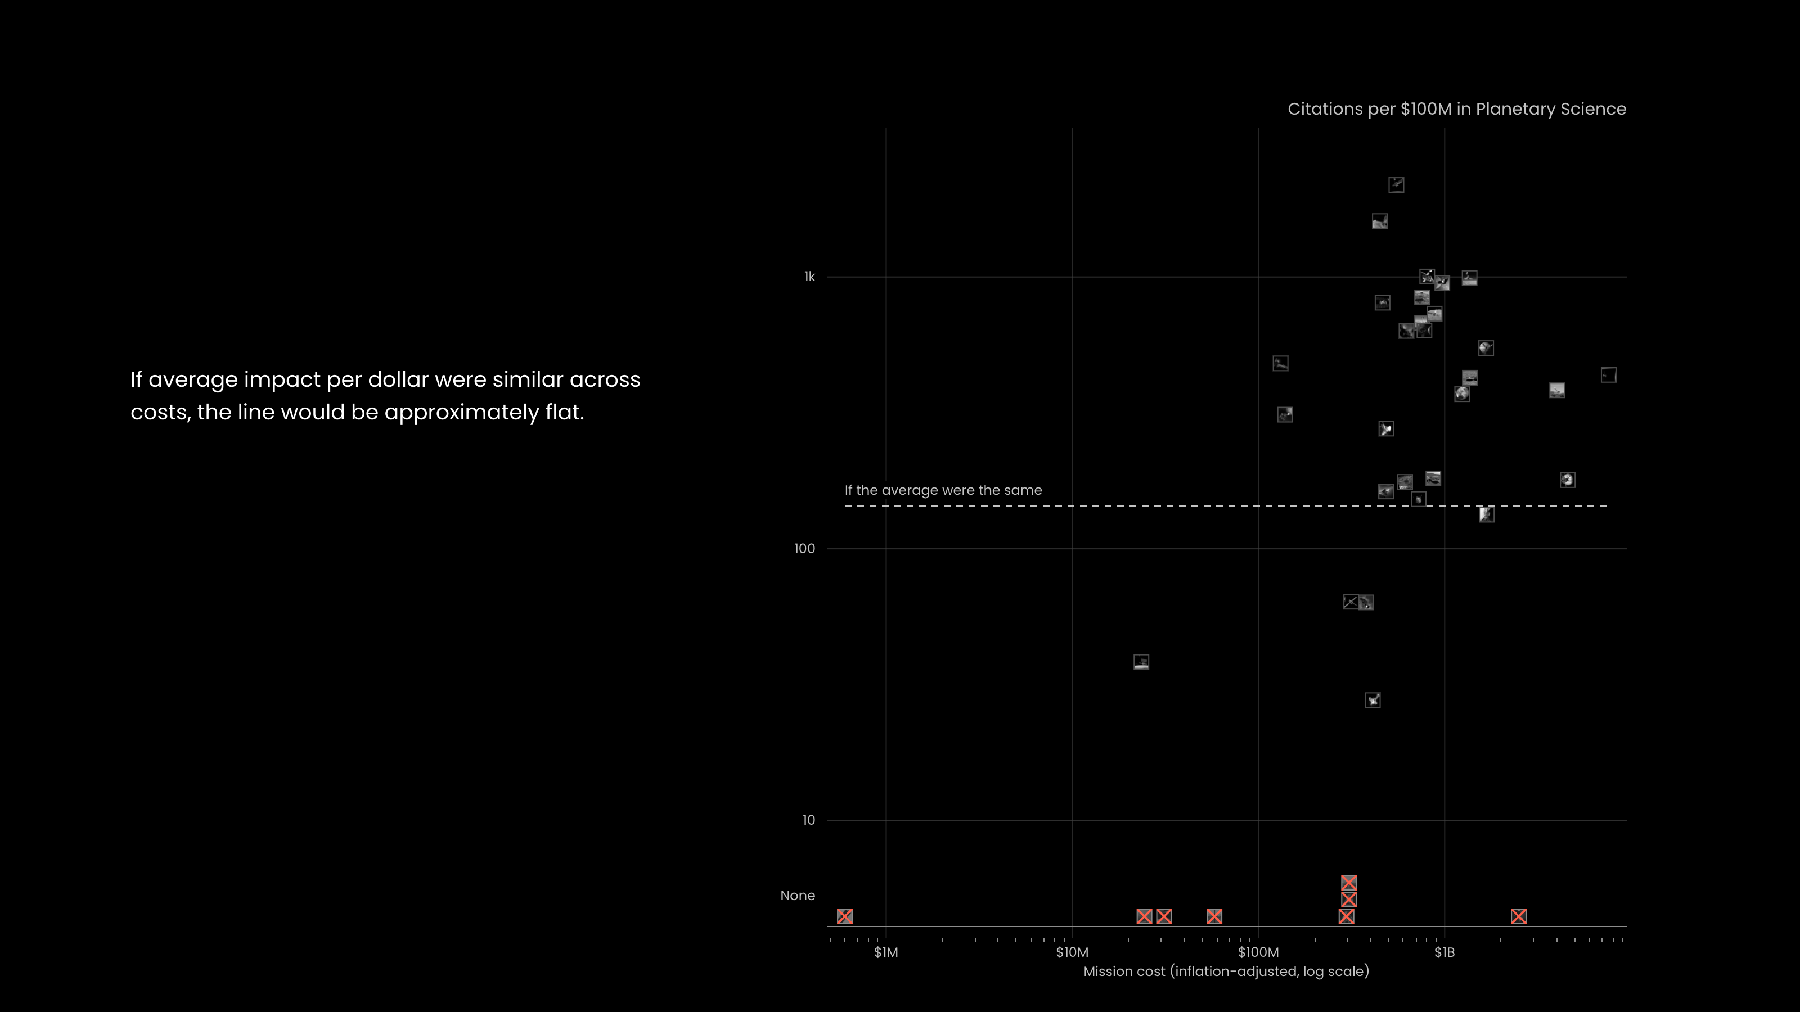
Notes:
If average impact per dollar were similar across costs, the line would be approximately flat.

Slide 17
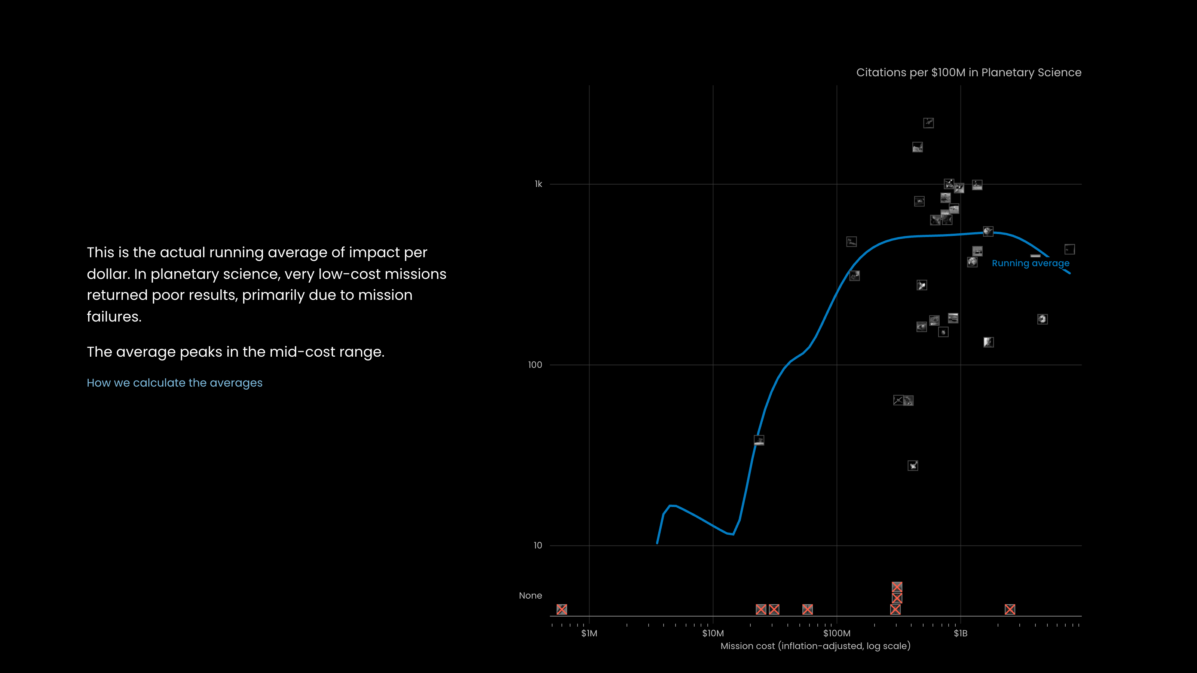
Notes:
This is the actual running average of impact per dollar. In planetary science, very low-cost missions returned poor results, primarily due to mission failures.
The average peaks in the mid-cost range.
How we calculate the averages

Slide 18
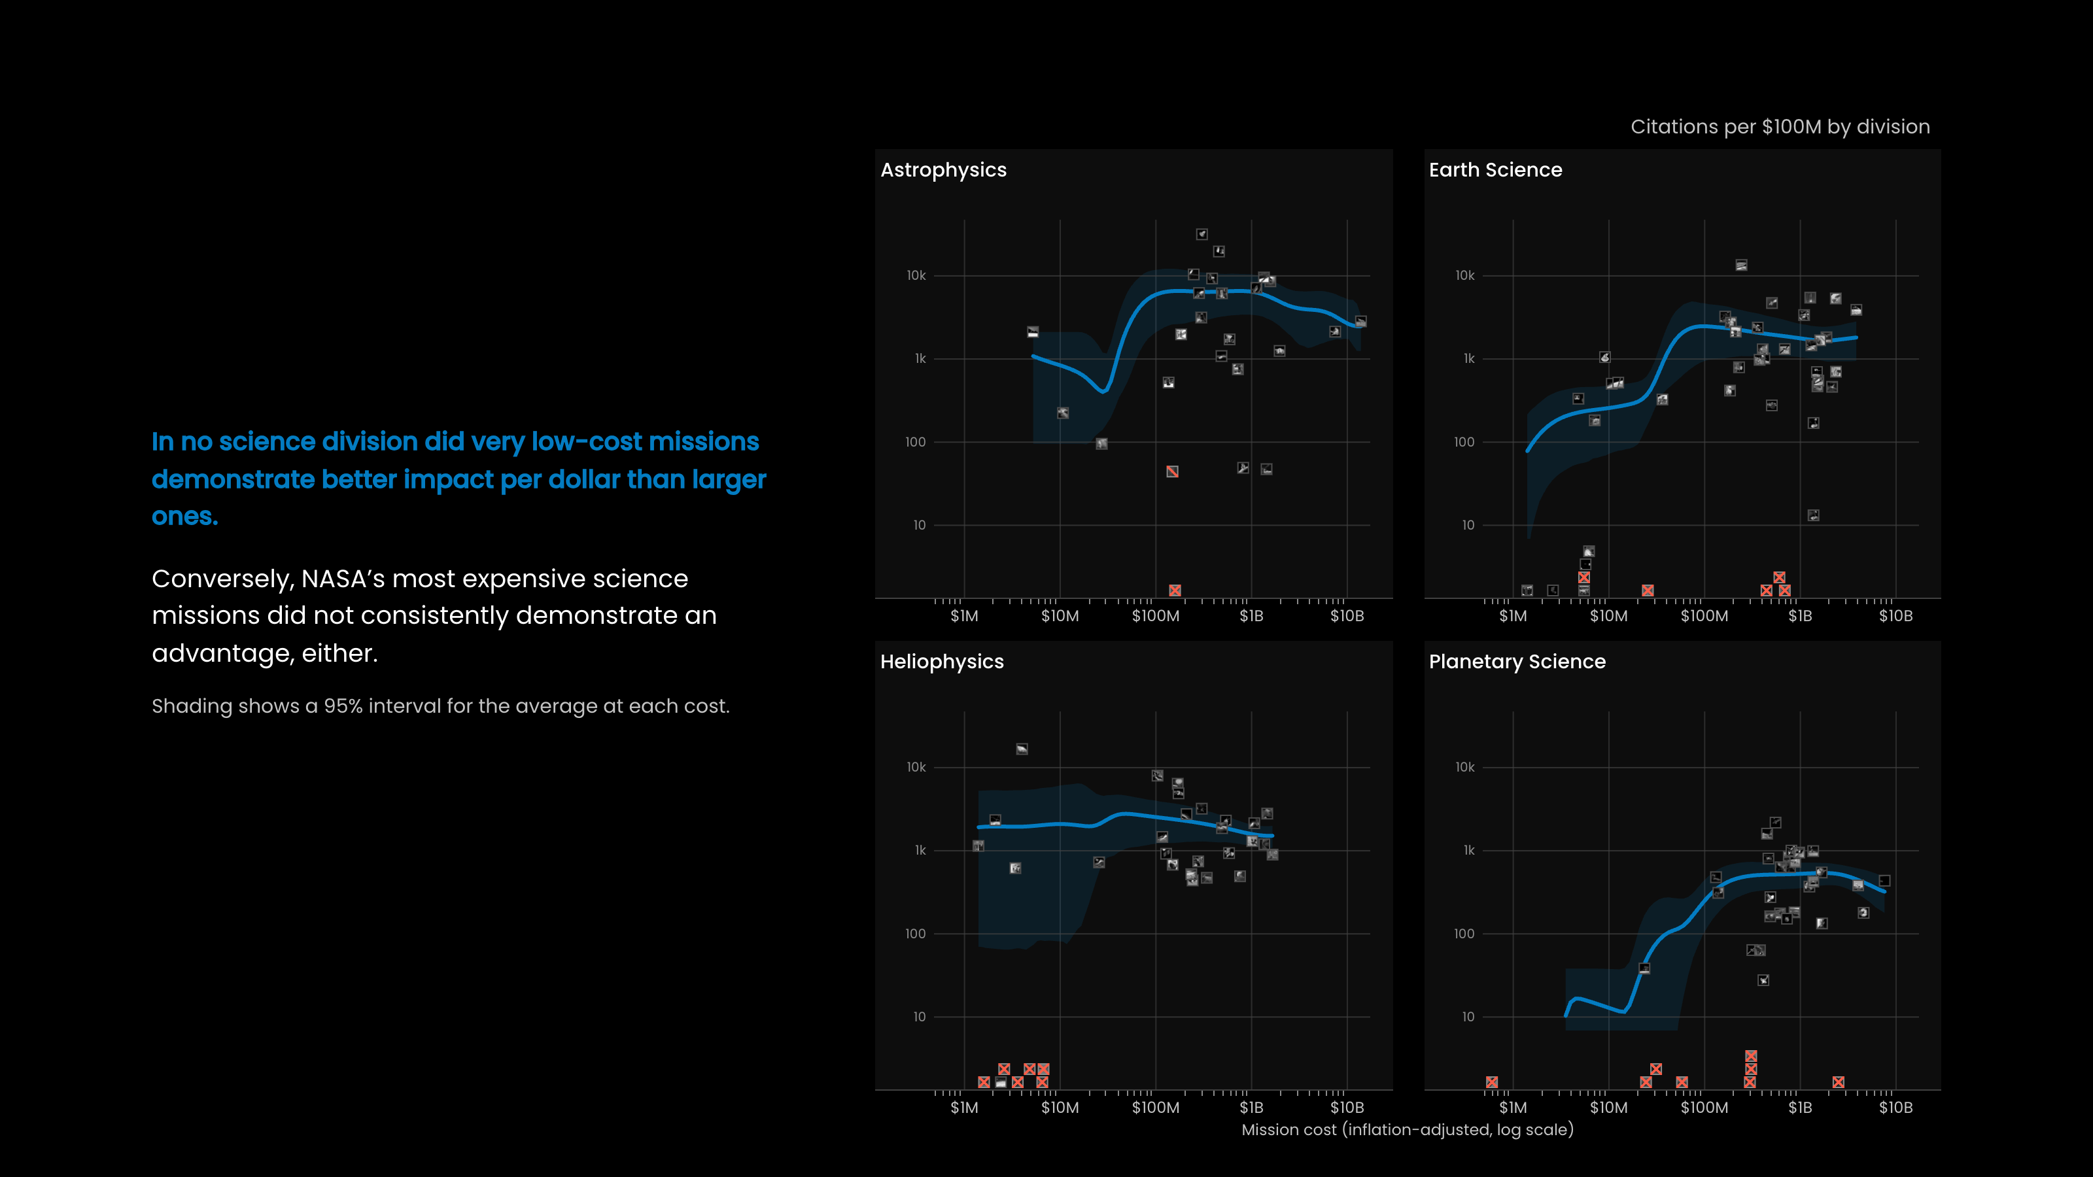
Notes:
In no science division did very low-cost missions demonstrate better impact per dollar than larger ones.
Conversely, NASA’s most expensive science missions did not consistently demonstrate an advantage, either.
Shading shows a 95% interval for the average at each cost.

Slide 19
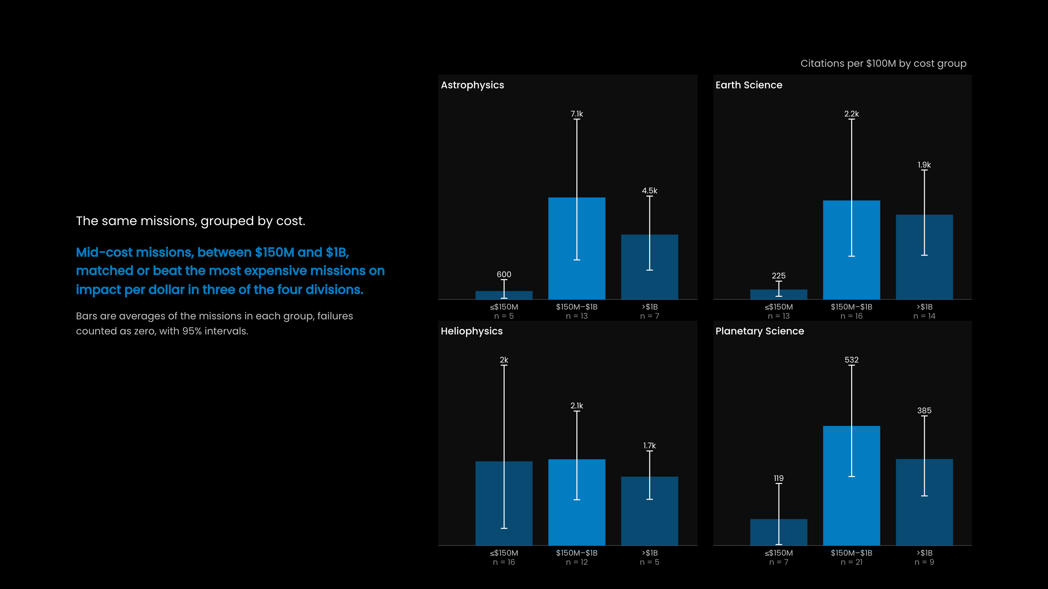
Notes:
The same missions, grouped by cost.
Mid-cost missions, between $150M and $1B, matched or beat the most expensive missions on impact per dollar in three of the four divisions.
Bars are averages of the missions in each group, failures counted as zero, with 95% intervals.

Slide 20
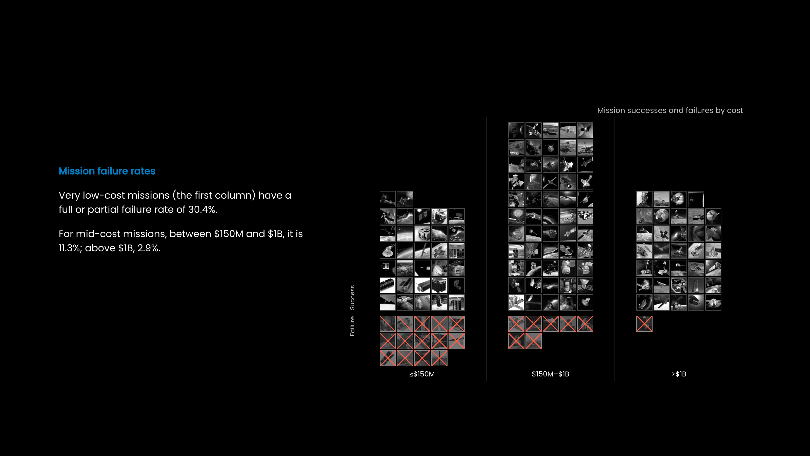
Notes:
Mission failure rates
Very low-cost missions (the first column) have a full or partial failure rate of 30.4%.
For mid-cost missions, between $150M and $1B, it is 11.3%; above $1B, 2.9%.

Slide 21
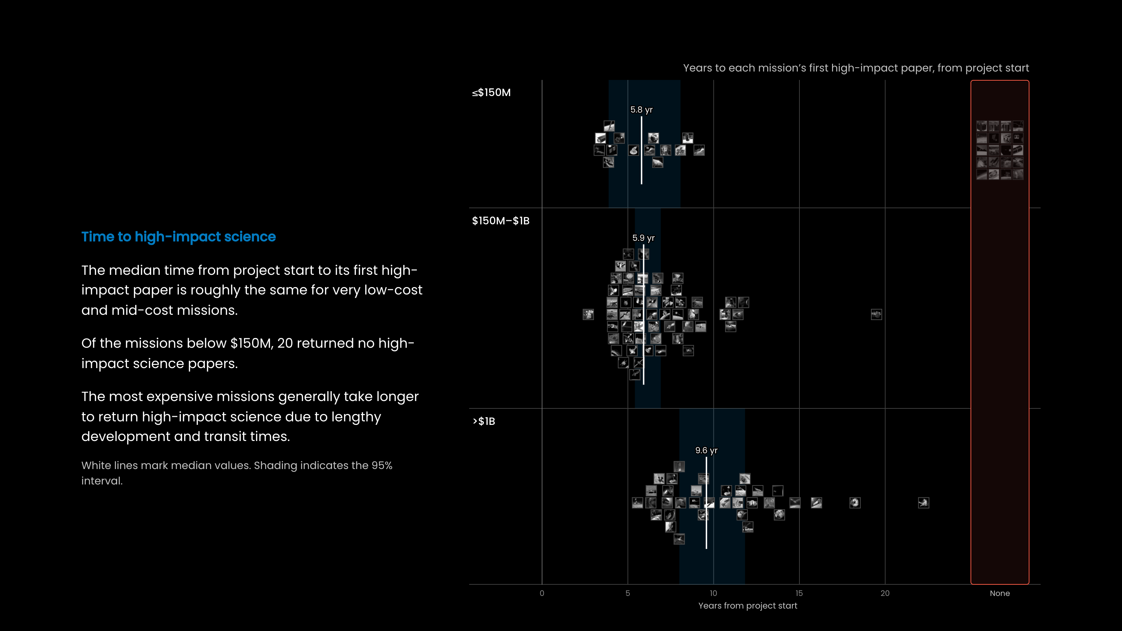
Notes:
Time to high-impact science
The median time from project start to its first high-impact paper is roughly the same for very low-cost and mid-cost missions.
Of the missions below $150M, 20 returned no high-impact science papers.
The most expensive missions generally take longer to return high-impact science due to lengthy development and transit times.
White lines mark median values. Shading indicates the 95% interval.

Slide 22
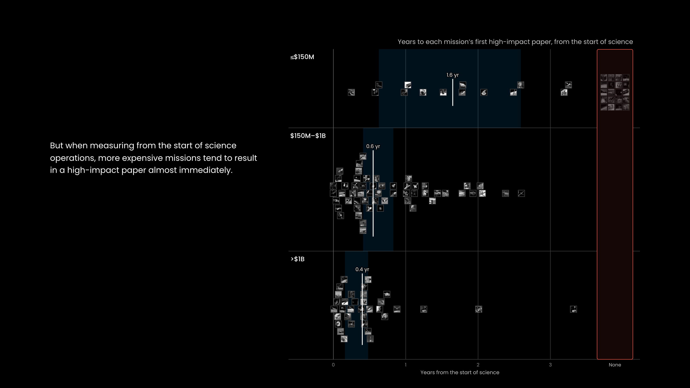
Notes:
But when measuring from the start of science operations, more expensive missions tend to result in a high-impact paper almost immediately.

Slide 23
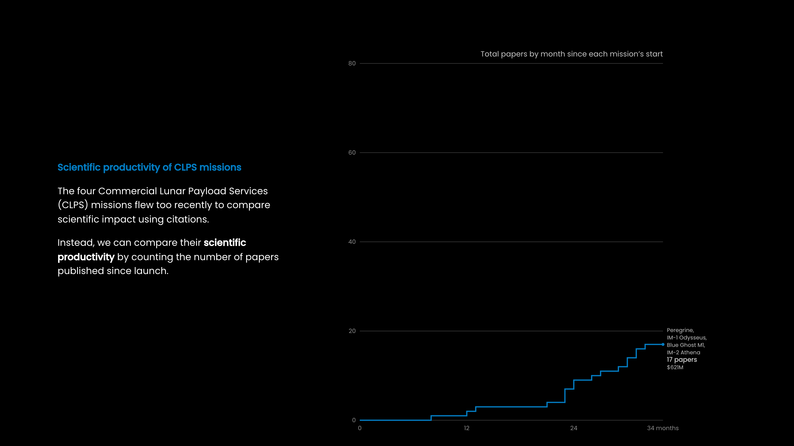
Notes:
Scientific productivity of CLPS missions
The four Commercial Lunar Payload Services (CLPS) missions flew too recently to compare scientific impact using citations.
Instead, we can compare their scientific productivity by counting the number of papers published since launch.

Slide 24
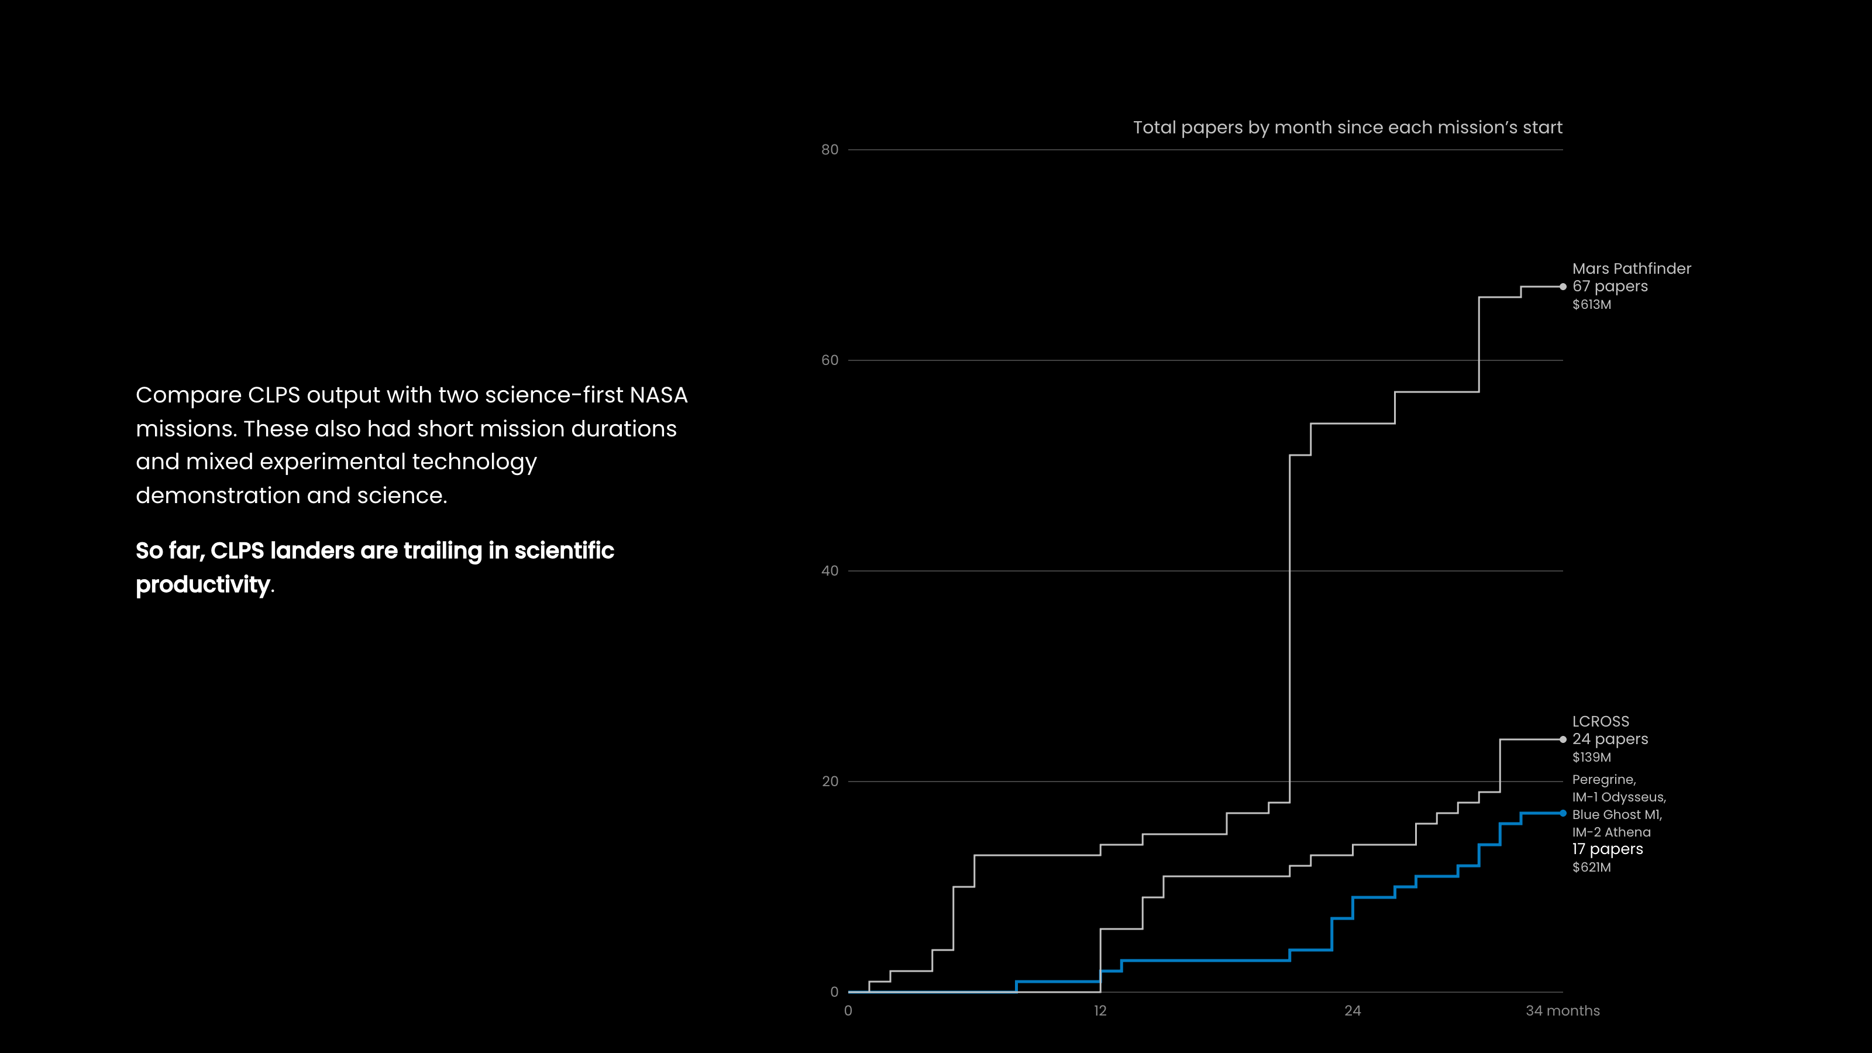
Notes:
Compare CLPS output with two science-first NASA missions. These also had short mission durations and mixed experimental technology demonstration and science.
So far, CLPS landers are trailing in scientific productivity.

Slide 25
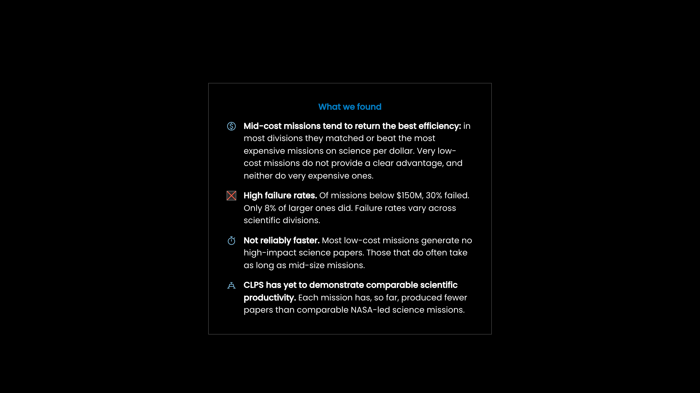
Notes:
What we found
Mid-cost missions tend to return the best efficiency: in most divisions they matched or beat the most expensive missions on science per dollar. Very low-cost missions do not provide a clear advantage, and neither do very expensive ones.
High failure rates. Of missions below $150M, 30% failed. Only 8% of larger ones did. Failure rates vary across scientific divisions.
Not reliably faster. Most low-cost missions generate no high-impact science papers. Those that do often take as long as mid-size missions.
CLPS has yet to demonstrate comparable scientific productivity. Each mission has, so far, produced fewer papers than comparable NASA-led science missions.

Slide 26
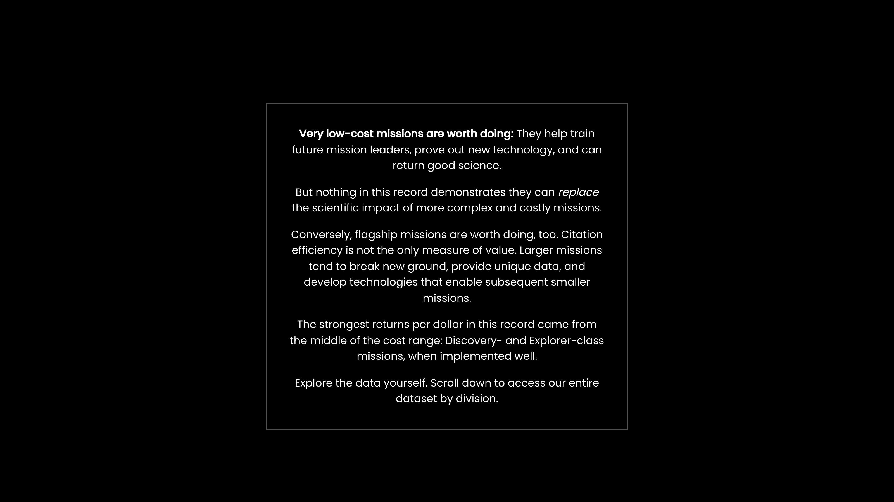
Notes:
Very low-cost missions are worth doing: They help train future mission leaders, prove out new technology, and can return good science.
But nothing in this record demonstrates they can replace the scientific impact of more complex and costly missions.
Conversely, flagship missions are worth doing, too. Citation efficiency is not the only measure of value. Larger missions tend to break new ground, provide unique data, and develop technologies that enable subsequent smaller missions.
The strongest returns per dollar in this record came from the middle of the cost range: Discovery- and Explorer-class missions, when implemented well.
Explore the data yourself. Scroll down to access our entire dataset by division.

