Slide 1


Clicks didn’t upgrade beauty.
It softened it.

Slide 2
Context
The
Breakdown
49%
Survival Mode
Half the country is just trying to make it to Friday. Luxury is a glitch.
86%
Premium Died
It’s not a recession.
It’s a vibe shift.
If it doesn't do the job, it's dead. Brand heritage means nothing if the price hurts.
Money didn't just get tight. The psychological contract broke. We stopped believing that "buying up" meant "moving up."
R108bn
Spending W/O Joy
High volume, low dopamine. We're filling baskets, not souls.

Slide 3

The Reality Check
What Died
DEAD
Consumer feedback reveals a complete rejection of the old "miracle" playbook.
❌
Transformation
Promises
😤
More Actives
= Better
💔
Aspiration
> Reality
"I'm so done with 6-week miracles. Show me maintenance, not magic. My face isn't a DIY project."
"My barrier is destroyed. I used the 20% peel and now everything stings. Never again."
"R2000 for a cream? In this economy? It better do my taxes too."
Millennial • 36
Gen Z • 24
Consumer • 28
"Brand heritage means nothing if it doesn't work. I trust the R150 pharmacy tube more."
"Before and after photos are just AI filters now. I scroll past immediately."
"Why do I need 10 steps? I just want one thing that doesn't hurt."
Millennial • 32
Gen Z • 21
Gen Z • 23
THE INSIGHT: GENTLE EFFICACY IS THE NEW POTENCY

Slide 4








The Revolt
Skin Revolted.
😓
🚫
💥
Tired of Fixing
Done with Hype
Over the Burn
Search Behavior Shift
Rejection Rate
Category Growth
"Barrier Health"
overtook "Acne Fix"
74%
3x
reject 'before/after' photos
faster growth for "Sensitive" SKUs
"My skin isn't a problem to solve. I just want it to stop hurting."
"It looks manipulative. Just show me the raw ingredients."
"If it burns, it goes in the trash. I'm done suffering for beauty."
DATA SOURCE: INNOVATR CONSUMER SENTIMENT Q1 2026

Slide 5
The Core Shift
Beauty hasn’t become basic.
It’s become supportive.
Clearer Roles
Daily Reassurance
New Performance
Fewer promises and clearer roles
Daily reassurance over dramatic results
Performance reframed as tolerance and consistency
The Shift
05

Slide 6







SHIFT EVIDENCE
What Clicks Read
🛡️
😌
✓
🛡️
Barrier Care
😌
Calm
✓
Safety
Expanded
Prioritized
Signaled
Strategic Shift
Strategic Shift
Strategic Shift
Moved "clinical" from behind the counter to the main aisle. Healing is the new daily routine.
Replaced "anti-aging" aggression with "maintenance" language. Predictability is the new premium.
Front-of-pack percentage labeling and "Derm Tested" stamps replaced celebrity endorsements.
Consumer Voice
Consumer Voice
Consumer Voice
"I don't want magic. I just want my skin to stop burning."
"I'm tired of fighting my face. I just want to make peace with it."
"I trust the percentage on the bottle more than the face on the billboard."
Shelf Space
+30%
Price Impact
-40%
Private Label
+20.5%
Barrier-repair category growth
Vs. heritage "miracle" brands
Growth outpacing branded goods

Slide 7




The Core Shift
Fear Won
Anxiety > Ambition
Safety > Status
We stopped trying to optimize ourselves. Now we just want to stabilize ourselves.
A fancy jar that burns is trash. A boring tube that works is the new flex.
Evidence: Global searches for "cortisol face" spiked 300%. Consumers are buying products specifically to lower stress markers, prioritizing hormonal balance over "hustle culture" aesthetic.
Evidence: Pharmacy brands (CeraVe, La Roche-Posay) have dethroned heritage luxury in market share. The "shelfie" has shifted from gold jars to clinical white plastic.
Calm > Confidence
Relief > Results
We traded "empowerment" for a lower heart rate. Boring is the new brave.
Forget the "10 years younger" promise. Just make the redness stop.
Evidence: Viral trends shifted from "Girlboss" faces to "Bed Rot" recovery routines. Makeup category sales dipped 8% as restorative skincare took budget priority.
Evidence: 70% of consumers now identify as having "sensitive skin." Immediate soothing claims convert 2x faster than long-term anti-wrinkle claims on shelf.

Slide 8





Cultural Shift
The Stripping
Stripped the actives.
Ingredient lists are shrinking. Consumers are rejecting 40+ line INCI lists for 3-5 proven heroes. Niacinamide, Glycerin, Ceramides. Anything else is viewed as filler, noise, or potential irritation.
Cultural
Reset.
Stripped the claims.
No more "10 years younger in 2 weeks." The new language is biological fact: "Hydrates for 24h," "Supports barrier function," "Sooths redness." Performance is now measured in stability, not miracles.
Stripped the drama.
Goodbye shouting fonts and gold foil packaging. Hello clinical minimalism, clear percentage labeling, and medical aesthetics. The shelf appeal is now defined by how calm and competent the bottle looks.

Slide 9







PROVOCATIVE POSITIONING
Wallet Reality
Market Structure
SA Woke Up
First.
49%
86%
Basics Only Income
Mass Market Share
Half the market budgets for survival, not indulgence.
Premium isn't the driver. Accessible volume rules everything.
While global beauty sold dreams, South Africa demanded real. We didn't follow the shift. We forced it.
Total Value
Early Signal
R108bn
-20%
"The numbers don't lie. The pivot to pragmatism happened here before the headlines caught up."
SA Beauty Scale
Relaxer Sales
Massive scale driven by high-frequency necessity purchases.
The first category to reject transformation for health.

Slide 10


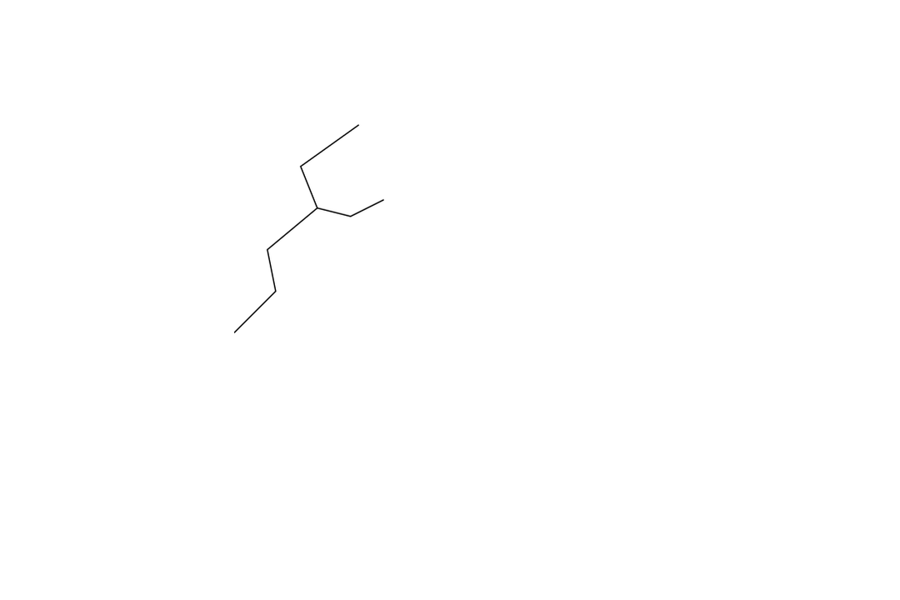
Performance Redefined
The filter came off
Frequency
Metric
Aesthetic
Instagram Saturday
Chasing Results
Curating Reels
Monday thru Friday
Trusting Routine
Owning Real
Consumers abandoned weekend "recovery" rituals for daily maintenance. The goal isn't one good photo; it's feeling stable all week.
"Does it work instantly?" replaced by "Can I use this forever?" Consistency is the new efficacy. If it disrupts the barrier, it's out.
Texture is normal. Pores are normal. Products promising to erase biology are viewed with suspicion. Support > Erase.
Outcome: Beauty stopped performing for the camera and started working for the skin.

Slide 11




Innovatr Insights
The Receipts
📈
VAL_VOL_SHARE
🔄
FREQ_INDEX
🔒
TRUST_SCORE
22%
20%
74%
RESTORATIVE
TRANSFORMATIVE
DAILY
DRAMA
PROOF
PROMISES
Restorative daily rituals drive the single biggest value volume share.
Social readiness ("camera ready") now outweighs high-glam goals.
Explicit rejection of exaggerated promises in favor of reliability.
BENCHMARK CONTEXT:
BENCHMARK CONTEXT:
Outperforms "High Glam" (12%) & "Correction" (15%).
REF: POS BASKET ANALYSIS Q4 '25
BENCHMARK CONTEXT:
Up from 52% in 2023. Top driver: Reviews.
REF: BRAND TRUST INDEX 2026
Freq: 5.4 days/week vs 1.2 for Glam.
REF: CONSUMER SAMPLE N=2,400

Slide 12


















Market Autopsy
Hype Collapsed
"Will this hurt?"
"Will I waste money?"
"Can I trust it?"
Fear of irritation.
Brand collapse.
Economic fear.
Research Stat
Market Behavior
Cultural Shift
60% of SA women identify as "sensitive." 1 in 3 returns products due to breakouts.
The 'Blind Buy' is dead. 82% read 5+ reviews before spending >R300.
Science-washing backlash. 68% feel brands "make up" benefits.
Consumer Quote
Brand Failure
Reality Check
"I don't care if it works in 2 weeks. If it burns in 2 seconds, it's trash."
High-end celebrity lines sitting stagnant while Clicks Private Label grows +20.5%.
"The logo isn't a promise anymore. It's just a sticker on a jar."
The machine broke. Safety is the only currency left.

Slide 13





CULTURAL SHIFT
The Battle Ended.
The industry moved from declaring war on skin to negotiating peace.
Messaging Evolution: Aggression to Empathy
Verbs like "fight," "destroy," and "kill" (acne/wrinkles) have vanished. Replaced by "support," "calm," and "feed." Clearasil's military language has been replaced by Starface's acceptance model.
It’s not a pivot;
it’s a ceasefire.
Claim Evolution: Defense to Tolerance
"Anti-aging" is now "Pro-aging." High percentage actives (e.g., 10% Glycolic) moved from front-of-pack glory to back-of-pack details. The new flex isn't potency; it's compatibility.
Market Signal
"We stopped trying to fix skin because consumers stopped believing it was broken. They just wanted it to be calm."
Category Repositioning: The Scrub is Dead
Physical exfoliants and harsh peels have been replaced by "Barrier Repair Balms" and "Recovery Masks." The routine shifted from stripping layers to rebuilding the biome.

Slide 14












Wins vs. Loses
The new rules of engagement
Where It Loses
Where It Wins
Complexity
Over-Hype
Calm & Clear
Everyday
"47 ingredients"
"10x younger"
5 core ingredients
Daily comfort
High Effort
Anxiety
Earned Belief
Transparency
12-step routines
Selling by flaw
Built on consistency
Full disclosure
Hidden Pricing
Value Signaling
Opaque tiers & costs
Quality over tax
Outcome
Outcome
Quiet Disengagement
Earned Loyalty
Strategic Comparison
Innovatr Beauty Insights 2026

Slide 15

Strategic Advantage
Soft Power.
Gentle isn't weak. It is strategic dominance. While aggression creates resistance, softness bypasses it to build deeper loyalty.
The CeraVe Effect
Growth Drivers
Boring packaging and "medical" cues have overtaken heritage luxury. Gen Z is trading thrill for trust—making clinical safety the ultimate flex.
"Barrier Support" claims are outpacing "Potent Actives" by 3x. Consumers are searching for recovery solutions, prioritizing health over correction.
Niche to Empire
Routine Reset
Brands like Tower 28 turned "sensitive skin"—formerly a medical niche—into a lifestyle aesthetic, proving exclusion is no longer premium.
From 10-step exfoliation to "Skin Flooding." The ritual has shifted from stripping the skin to feeding it. Rest days are now part of the regimen.

Slide 16




Strategic Mandate
The new rules
Stop selling transformation.Start selling safety.
1
🧘‍♀️
2
🛡️
3
🔄
Rule No. 1
Rule No. 2
Rule No. 3
Calm > Change
Safety > Solutions
Routine > Results
Design for calm, not change.
Signal safety, not solutions.
Build routine, not results.
No "New Formula" panic: Emphasize heritage & consistency.
Hierarchy shift: "Derm Tested" > Active percentages.
Sell the ritual: The mental reset, not just the outcome.
Tactile reassurance: Soft-touch textures, minimal sensory noise.
Visual language: Repair animations, not peeling/stripping.
Retention metric: Reward streaks over one-off trials.
Ex: Dove sells the feeling of care, not the science.
Tactics: "100% Protected" replaces "10x Younger".
Copy tweak: "Your daily peace" instead of "Instant Fix".
Strategic Action Framework
Q1 2026

Slide 17
Innovatr POV
INNOVATR
Beauty innovation isn't moving away from performance.
Performance died.
What replaced it: consistency, predictability, emotional safety.
The question isn't "Does it work?"
It's "Will it hurt me?"
POV
17

Slide 18











Executive Summary
This isn't retail. It's a reckoning.
SA
Market Signal
Private Label +20.5%
outpacing global brands.
South Africa saw it first. The rest of the beauty world is just catching up.
01
02
03
Performance Redefined
Safety is Currency
The New Mandate
The definition of "efficacy" has shifted from Transformation to Restoration. Consumers are buying peace, not promises.
Trust is the new premium. Brands that lead with Barrier Care and simplified routines are winning the loyalty war.
Stop selling "fixing." Start selling "supporting." The era of Aggressive Beauty is officially over.
Key Takeaways
It's a vibe shift, not a recession. Spending hasn't stopped; it's just smarter.
Contact Intelligence
Innovatr Intelligence | Beauty Q1 2026
/// Confidential Strategy Deck
Hannah@innovatr.co.za
Simplicity > Complexity. 5-step routines are replacing 12-step burdens.
Website
www.innovatr.co.za
SA consumers demand realness. Hype without proof is dead on arrival.

Slide 19

The detail sits
behind the data.
This deck represents directional insight, not the full diagnostic. Innovatr members have access to the complete report, including deeper data cuts, category-specific formatting, and ongoing behavioral tracking.
To access the full report:
innovatr.co.za
hannah@innovatr.co.za

