Slide 1

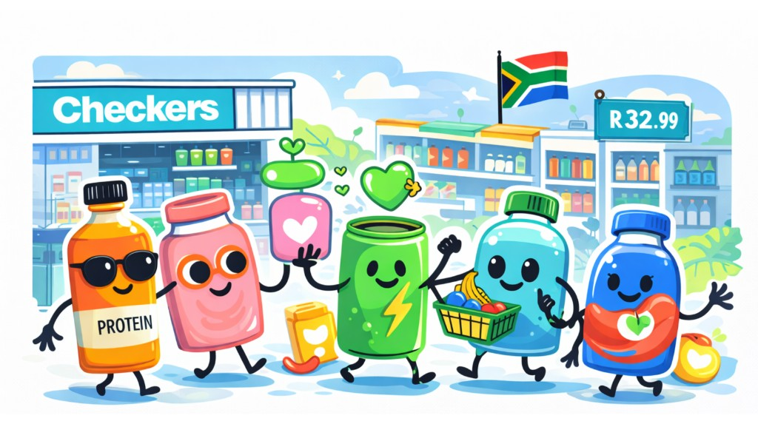
'Better for You’ Is
Background Noise
It's not a category crisis. It's a vibe shift.

Slide 2



The Quiet Crisis Nobody's
Talking About
74%
South African consumers are driven by survival, not optimization.
Skepticism is Rising: Consumers are rejecting "loud" claims and complex promises that feel risky.
of South Africans say brand trust
is non-negotiable.
Value-Conscious Market: In a constrained economy, believability is the new currency. If it sounds too good, it's ignored.
The Expectation Gap: They want the function, but resent the "new you" sales pitch.

Slide 3









From Screaming to Whispering
The strategic pivot from volume to value. In a skeptical market, quiet confidence outperforms loud claims.
The Old Model
The New Model
Loud, Aggressive
Claims
Quiet, Integrated
Function
Hero-ingredient shouting & starbursts
Function normalized & expected
"Do more / be better" performance messaging
"Daily balance" integration messaging
Function as a supporting attribute
Function as the headline differentiator
Experience-led, intuitive cues
Education-heavy packaging design

Slide 4
DEAD
What Died?
❌
Loud Health Claims
"10x energy" and aggressive promises are dismissed as noise. In a skeptical market, volume kills credibility.
Consumer feedback reveals a complete rejection of the old functional beverage playbook.
💔
Transformation Promises
"New You in 2 weeks" feels heavy and unattainable. It creates a fear of failure rather than a hope for success.
😤
Sport-Only Positioning
Consumers don't understand who it's for. If it looks like it belongs in a locker room, it doesn't make the shopping cart.

Slide 5
The Consumer Reality
Real voices from South African functional beverage consumers
😓
💸
🤔
"I'm done with promises. Just show me what's actually in it."
"R45 for a juice? It better solve my problems AND taste good."
"Is this for gym people or normal people? I can't tell."
Consumer • 28
Millennial • 34
Gen Z • 23
😤
💔
✓
"The packaging screams at me. I just want something calm."
"I tried the 'energy boost' drink. Felt nothing. Never again."
"Checkers had it on the shelf with normal juice. That's when I trusted it."
Consumer • 31
Millennial • 29
Consumer • 36

Slide 6
The Breakdown
Three data points that explain the functional beverage crisis.
74%
67%
36%
Trust Crisis
Expectation Gap
Conversion Loss
Brand trust is non-negotiable. Half the market won't try unproven claims anymore.
Consumers expect function but resist being sold to. They want benefits, not sermons.
The gap between initial interest and actual commitment. Where brands lose the sale.

Slide 7






The New Rules of Engagement
Where functional beverages win and lose in South Africa's value-conscious market.
Where It Wins
Where It Loses
Calm & Clear
Complexity
5 core ingredients, plain language, single benefit.
47 ingredients, 12-step routines, confusing science.
Everyday Use
Over-Hype
Daily comfort wins over dramatic one-off results.
"10x energy" and transformation promises feel risky.
Earned Belief
Anxiety
Trust built on consistency, not hype or celebrity.
Selling by flaw ("fix yourself") or guilt-based framing.
Transparency
Hidden Pricing
Full disclosure; quality signals over premium tax.
Opaque tiers and unclear value propositions.

Slide 8





The Collapse of Belief
Where functional claims break down in the real world. Consumers are editing health for feasibility, not rejecting it.
01
02
03
04
Habit
Skepticism
Trust Gate
Decision
Routine, autopilot consumption
"Is this actually doing anything?"
Verification or rejection
Fatigue leads to default choices

Slide 9



Function Has Been Domesticated.
Functional benefits are no longer disruptive. They're table stakes. The innovation is in making them invisible.
Expected, not
exceptional
Integrated, not
spotlighted
Proven through
use, not claims
Function is no longer a premium add-on. It is now a baseline requirement for category entry.
Wellness cues are woven into product identity rather than shouting. Drink first, function second.
Trust is built through the actual experience of the benefit over time, not aggressive promises.

Slide 10

Case Study: Checkers Xtra Savings
What Checkers Understood
(That Everyone Else Missed)
The Data Reality
With 33.7 million loyalty members, Checkers saw that overt health claims were alienating mainstream shoppers, while subtle cues drove basket penetration.
“
The Placement Strategy
Function present but understated.
They moved functional beverages out of the "Health Aisle" ghetto and integrated them into lifestyle flows—next to lunch deals, not supplements.
— The core insight driving their functional category dominance
The Result
Normalization led to habitual purchase. By treating function as a standard feature rather than a premium differentiator, they unlocked mass volume.

Slide 11







The Paradox of Less.
When volume goes down, trust goes up. Silence becomes the new signal of credibility.
Phase 02
Phase 03
Phase 01
-65%
+42%
+58%
Skepticism Reduced
Trial Increases
Repeat Strengthens
Quiet claims bypass the "too good to be true" filter. Less hype means less defensive doubt from the consumer.
Normalcy invites casual adoption. Consumers don't feel they need a "lifestyle commitment" just to try a drink.
Trust builds when the actual experience matches the expectation. Quiet promises are easier to over-deliver on.

Slide 12



Familiarity as Trojan Horse.
01
02
03
Taste must lead,
function follows
Format familiarity
builds trust
Layer function
onto normality
Drinks still need to taste good. Flavour credibility is the primary gatekeeper for trial.
Recognisable packaging signals safety, reducing the risk of a "medical" product feel.
Don't invent a new behavior. Add the benefit to an existing, trusted ritual.

Slide 13



Context Is The New Copy
Placement sends stronger signals than packaging.
Where it sits
What it says
>
Where it sits > What it says. Checkers proved this at scale.
The Signal
The Result
"I am a normal beverage choice."
Removes the friction of justification.
The Pricing Mechanic
Everyday price points reinforce accessibility, killing the "premium exclusive" vibe.

Slide 14








This Isn't About Hiding. It's About Fitting.
Refining the proposition, not removing it. Function normalized, not eliminated. Strategic restraint beats category noise.
Not This
But This
Removing benefits
Function as expected value
Don't strip away the reason to believe.
Make the benefit feel like a standard feature.
Dumbing down
Restrained benefit language
Simplicity doesn't mean lack of sophistication.
Speak plainly. Avoid hype. Let product talk.
Hiding ingredients
Proof accumulating in use
Don't obscure what makes it work.
Focus on the repeat experience, not just trial.

Slide 15



Three Questions That Kill Conversion.
Critical psychological barriers where functional beverages lose the sale. Each one represents a trust collapse point.
Is this for me?
Will it taste good?
Is it worth the switch?
Identity confusion kills trial. If branding signals "athlete only" or "medical aid," everyday consumers disqualify themselves before picking it up.
The "Flavor Tax" is real. Consumers assume function compromises flavor. If appetite appeal isn't visceral, the health benefit doesn't matter.
Inertia is powerful. Why risk money on a new habit when the old one works? The perceived payoff must dwarf the cost of changing routines.

Slide 16



The Consumer Filter
Before any functional beverage purchase, it must pass two critical tests.
Filter 01
Filter 02
The Immediacy Filter
The Reality Filter
"Will this help me get through today?"
"Can I actually keep this up?"
Consumers are solving for present-tense survival (energy, stress), not just future-tense prevention. Immediate payoff is the entry ticket.
Usability creates the belief that consistency is possible. If the routine feels too heavy, it's rejected as a "future failure" before purchase.

Slide 17




Where Innovation Loses People
Drop-off isn't apathy—it's the price of engagement being too high.
💔 Lifestyle Promises
🚫 Behavioral Demands
Transformational "New You" claims feel heavy and unattainable. Consumers fear the gap between reality and the promise.
Strict routines break the moment stress hits. High-maintenance protocols are the first thing sacrificed.
😓 Over-Education
😤 Guilt-Based Framing
If consumers have to study science lessons to understand the benefit, decision fatigue sets in instantly.
Implied failure is not a motivator in a high-pressure context. It becomes a valid reason to disengage entirely.

Slide 18

The Expectation
Paradox
67%
They want the benefit, not the sermon. Function must feel inevitable, not impressive.
of consumers expect function but resist being sold to.
"Earn your place quietly, then let the experience do the talking."

Slide 19

Behind SA's Largest Loyalty Program
Function present but understated.
Checkers Xtra Savings Strategy
33.7 Million Members
The Insight
With access to massive behavioral data, Checkers prioritized normalized placement over segregated "health" aisles.
Functional beverages perform best when positioned as everyday choices alongside standard soft drinks, not as specialist interventions.

Slide 20


Where Brands Lose The Room
The Gap Between Interest & Commitment
Avoid these critical missteps that trigger consumer skepticism.
Over-claiming
Health-First, Taste-Second
Promises that sound too good to be true trigger defense mechanisms. "Infinite energy" is dismissed as noise, not science.
Sacrificing sensory enjoyment for functional potency is fatal. Taste remains the ultimate gatekeeper for repeat purchase.
In a value-conscious SA market, the gap between aspiration and action is widening.
67% of consumers expect functional benefits but actively resist overt selling. They filter out "marketing speak" instantly.
Ingredient Overload
Complex Education
Stacking too many buzzwords creates confusion and decision paralysis. Clarity wins over complexity.
Products requiring a paragraph of explanation demand too much cognitive effort. If it's not intuitive, it fails.

Slide 21


How To Win Without Shouting
Subtle Cues & Plain Language
Replace aggressive health signaling with understated confidence. Use everyday language (e.g., "helps you focus") instead of clinical terms. Clarity builds trust.
Familiar Taste & Format
Anchor innovation in established habits. If it tastes refreshing and looks familiar but offers a functional bonus, the barrier to trial disappears.
One Clear, Restrained Benefit
Own a single, understandable use-case (e.g., "Post-gym recovery"). Single-minded propositions are easier to justify than "do-it-all" miracle drinks.
Fit Obvious Everyday Moments
Success comes from fitting into an existing routine. Target clear gaps—morning energy or afternoon slump—to become an effortless habit.

Slide 22



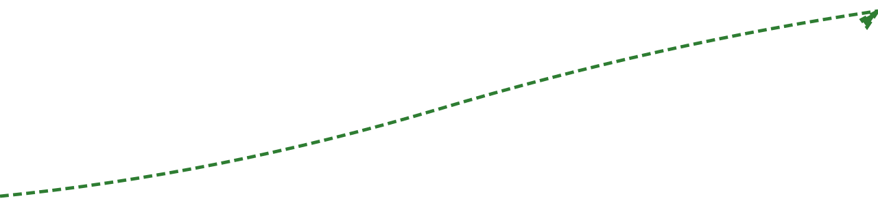

The Momentum Effect
When function is normalized, growth compounds at every stage. Each win unlocks the next.
+78%
+65%
+58%
+42%
Faster Trial
Lower Rejection
Stronger Habits
Better Scale
Low barrier to entry
Fewer skeptics
Daily routine fit
Long-term volume

Slide 23

The New Innovation Brief
Design function to feel expected, not impressive. The brief for SA functional beverages has fundamentally changed.
“Design function to feel expected, not impressive.”
Reduce Scent/Taste Signaling
Use Format Familiarity
Layer Function Behind Taste
Lower the sensory barrier. If it tastes "medicinal," it triggers skepticism. Flavor must be uncompromisingly normal.
Don't demand new rituals. Use established vehicles like juice or dairy to carry the function, reducing the friction of adoption.
Lead with the palate, verify with the label. Taste is the purchase driver; the functional effect is the retention driver.
Functional beverages in South Africa are growing up.
The brands that scale won't look like health products—they'll look familiar, reliable, and easy to live with. Believable function beats bold claims.

Slide 24
The Intelligence Advantage
Innovatr Intelligence exists to identify behavioral shifts early—across categories and launches—so brands understand what functional beverages mean to South Africans now, not what they used to mean.
Category Tracker
Launch Analysis
Confidence Scores
Real-time monitoring of shelf shifts, pricing dynamics, and competitive moves.
Deep dives into winning and failing concepts with actionable autopsies.
Quantified metrics on consumer belief vs. skepticism for new launches.
Request Intelligence Access

